Slide 1
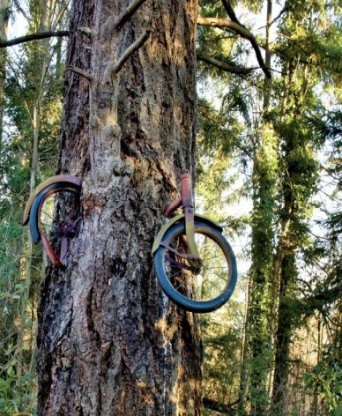
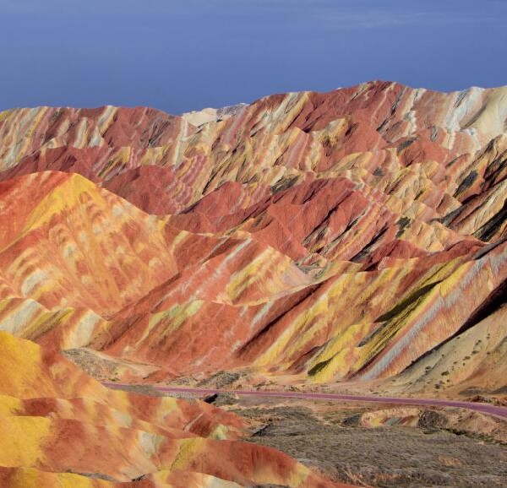
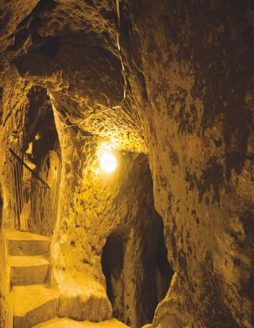
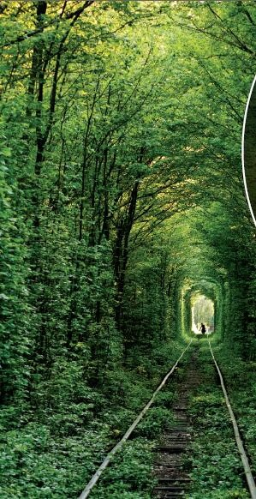
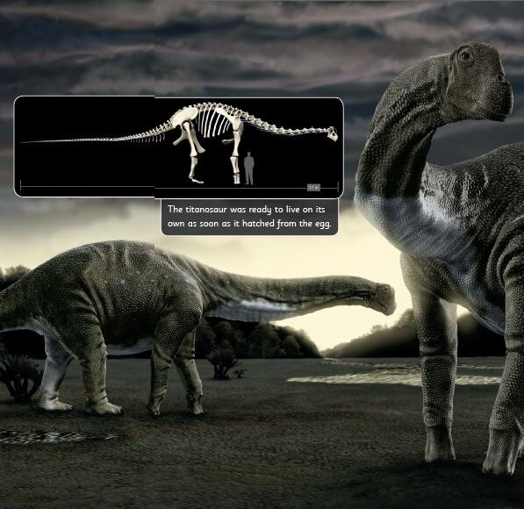
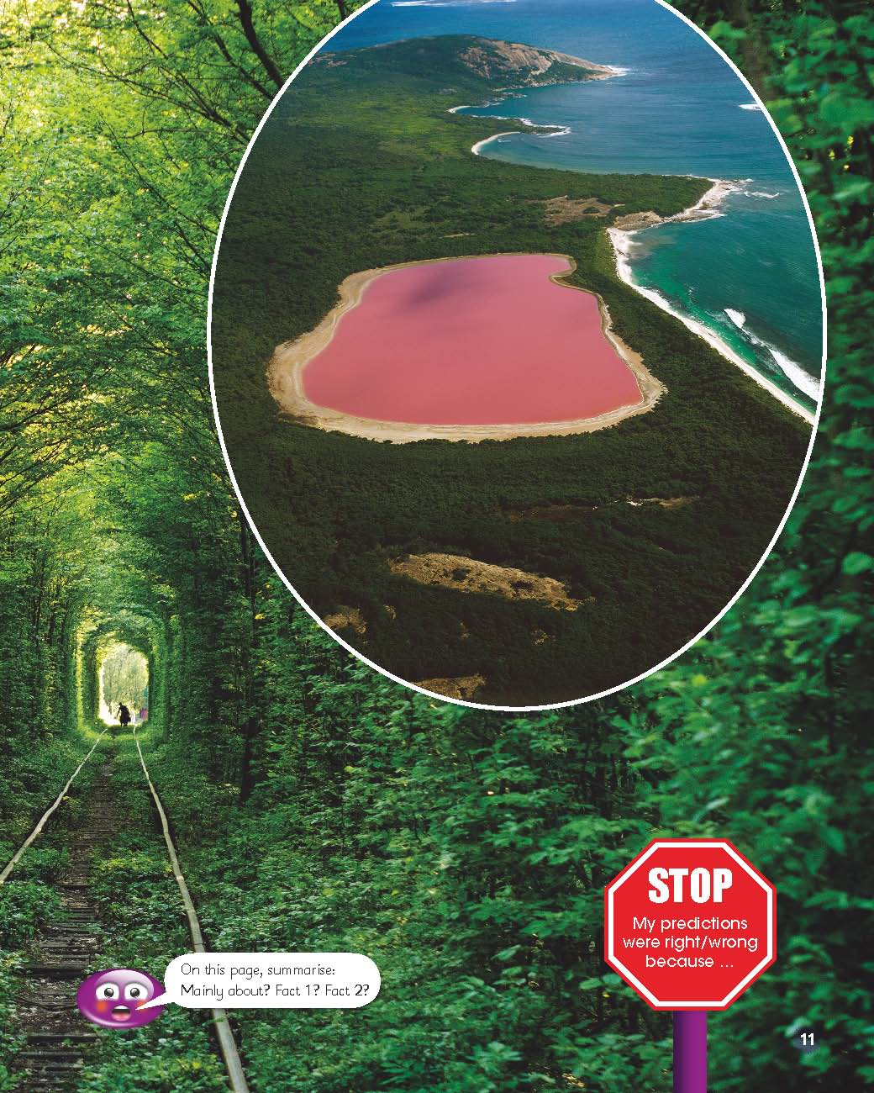
How Amazing
无奇不有
选自《多维阅读第18级》

Slide 2

Observe the cover
What can you see from the cover?
Do you think it’s amazing?

Slide 3
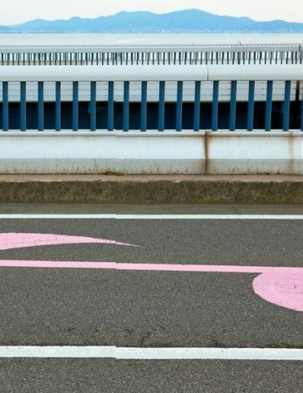



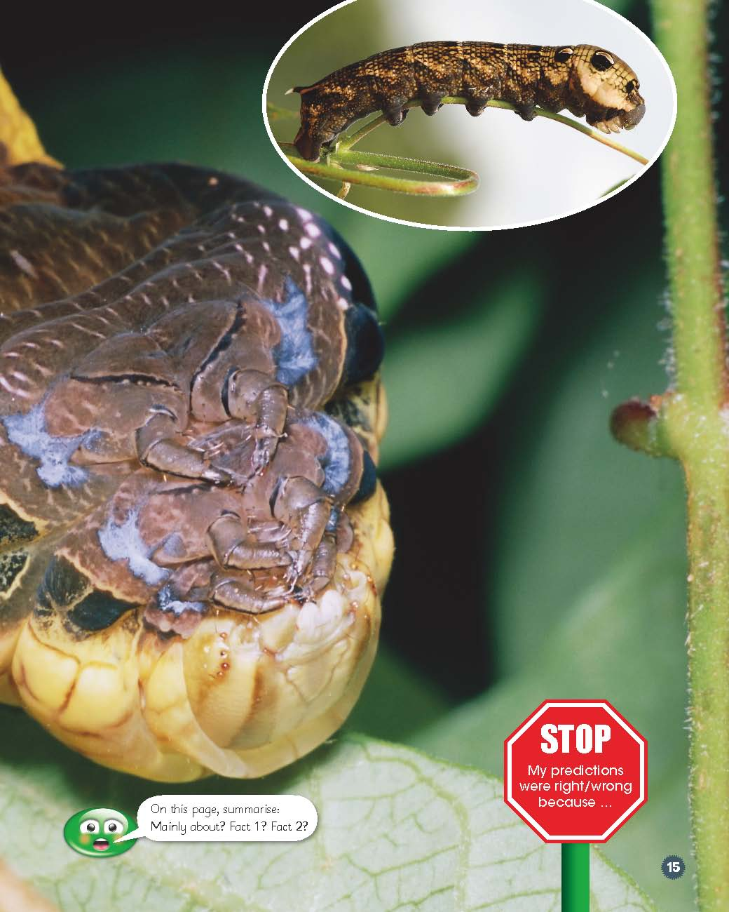
Man-made or Natural Things
Is the amazing thing man-made or
does it happen naturally?

Slide 4
Choose one and mark your ? and !
?
4Ws
Why/How
If questions
your questions about the test
!
your feelings about the text

Slide 5
Share with the Class
?
?
!
Important Questions
Interesting Questions
Your Feelings

Slide 6

Complete the IDEO-Bookmark
What is the amazing thing?
Describe the amazing thing.
Explain the reason.
What do you think of it?

Slide 7
Introduce your favorite amazing thing
What is the amazing thing?
Describe the amazing thing.
Explain the reason.
What do you think of it?

Slide 8
Think About …
Why do you think the author wrote about these things?
?
What are some other amazing things in the world that you know about?
?
Do you want to go to see these amazing things?
?

Slide 9
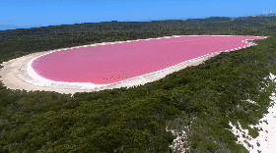
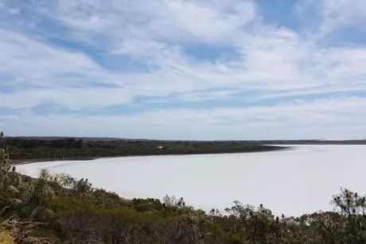
Voice Your Opinions－Pink Lake Faded
Another pink lake in Australia.
According to local conservationists, the loss of the pink color is most likely to do with the building of the new rail line and highway. The construction is responsible for cutting off the natural flow of water into the salt-lake system.

Slide 10
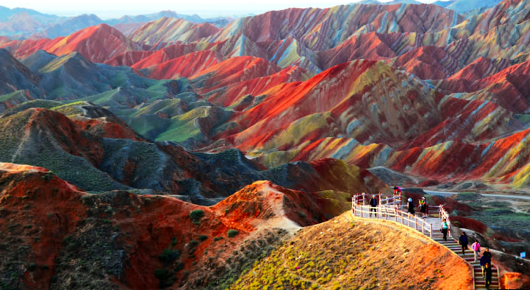
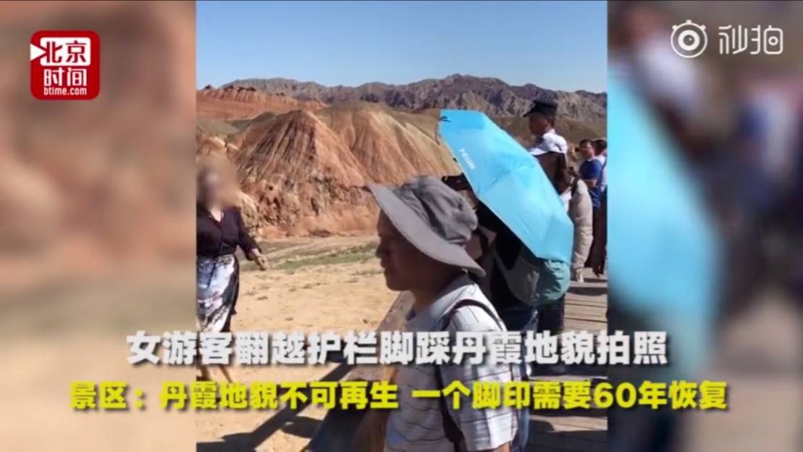
Voice Your Opinions－Footprints on rainbow mountains
Rainbow mountains have a history of more than one hundred million years. Some tourists want to get “very” close to the beautiful scenery, but they don’t know that it takes more than 60 years to recover from the footprints.

Slide 11
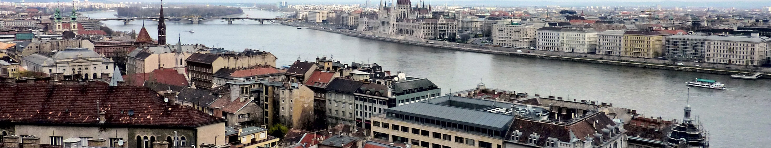
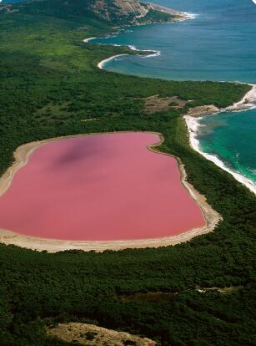
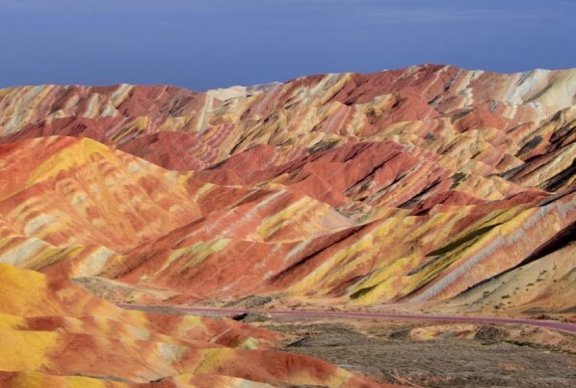
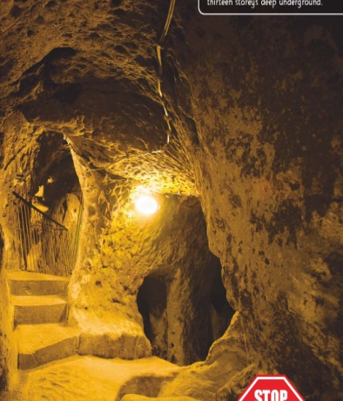

What should we do?

Slide 12
Thank you!

