Slide 1

Into Cole Cave
谁才是胆小鬼？
选自《多维阅读第12级》

Slide 2

What’s the title of this story?
What can you see from the cover?
Why does the man wear a searchlight?
What do you think the story is going to be about?
What do you want to know from the story?

Slide 3

Reading Time
Is your prediction right?
Can you find what you want to know in the book?

Slide 4
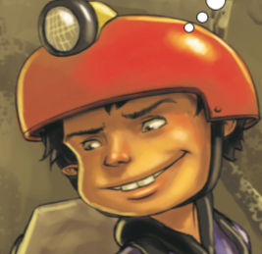
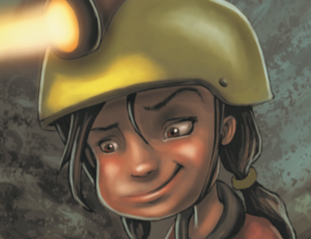
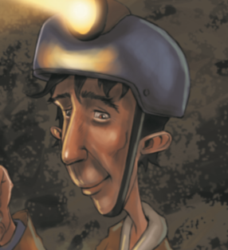
The Main Characters
Josh
Ally
Marco
Setting: At home At the entrance to the cave
On the cave floor Inside the cave

Slide 5
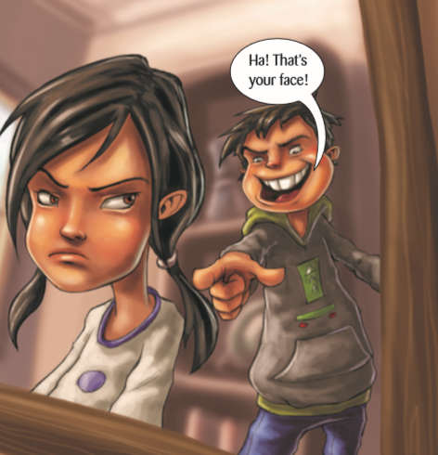
Josh was always calling his sister Ally a wimp. Ally agreed to go into the Cole Cave with Josh.
What could you say about Josh’s character?
What about Ally?
Do you think Ally’s reason for going into the cave is a good one? Why? Why not?

Slide 6




Make a list of the words that describe Cole Cave.
Notes:
四幅图片均取自百度图库

Slide 7
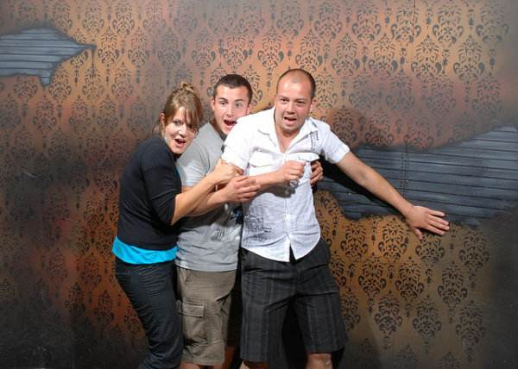
Have you ever been in a place that seemed scary?
Where was it and what made you feel scared?
Notes:
图片取自百度图库

Slide 8
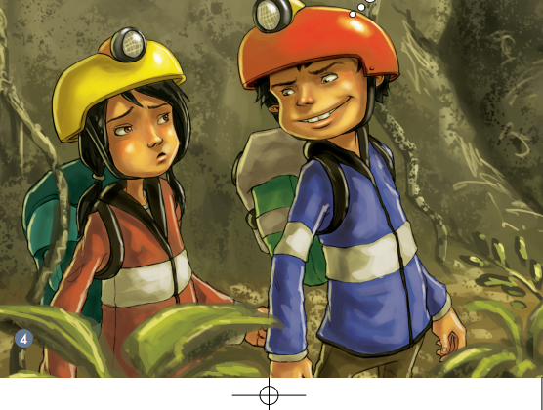
They came into the Cole Cave with the guide Marco.
How did Ally feel when she saw the cave entrance?
Why do you think Marco said “Suck your breath in”?
What were the events that led to Josh and Ally reaching the
cave entrance?

Slide 9
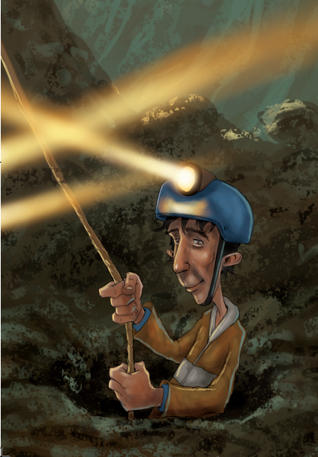
They had to use a rope to get to the cave floor. What does this tell you about the cave?
How did Ally know Marco had reached the cave floor?

Slide 10
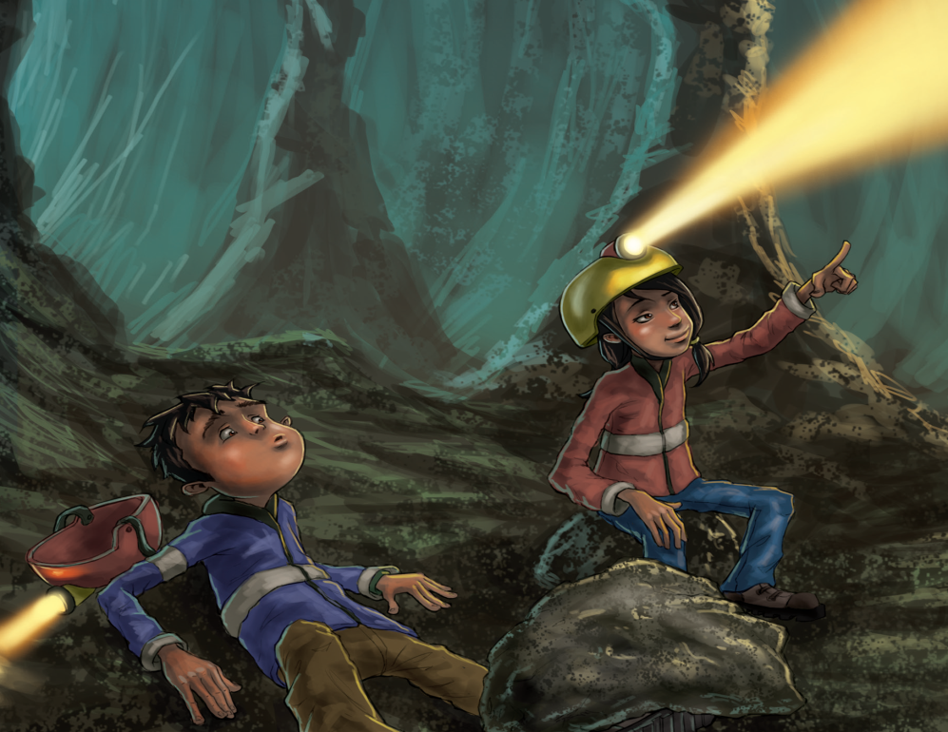
Josh crashed onto the cave floor with his foot pinned under the rock. Ally told Josh there are many vampire bats and Josh felt scared.
What was the consequence of Josh knocking off a large rock from the wall?
Why did Ally tell Josh “We are in the cave of vampire bats”?

Slide 11
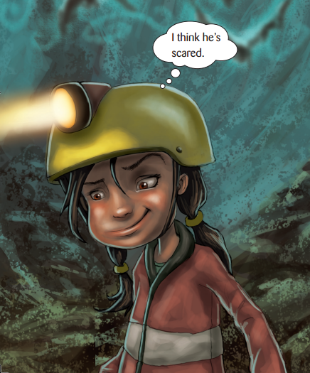
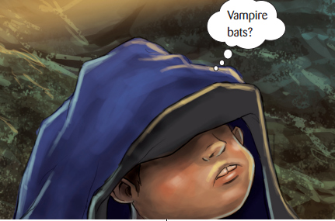
How did Josh feel now?
How did Ally feel now?

Slide 12

Ally tried to make Josh think of something else to ease his fears.
What was Josh experiencing that was the same as Ally had experienced?
Do you think this is a good thing? Why? Why not?
Why do you think Ally tried to make Josh think of something else?
What would you have done if you were Josh?

Slide 13
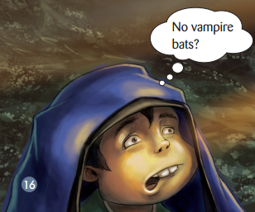

Marco told Josh the truth and Josh would never call Ally a wimp again.
Look at the expression on Ally’s face. What do you think she was thinking at that moment?
Why do you think Ally wasn’t scared in the end?

Slide 14
Story Map
Please complete the story map to show what happened in the story.
Title：
Plot:
Event 1:
Event 2:
Event 3:
Event 4:
Solution/End result:
Settings：
Main Characters：
Conflict/Problem：

Slide 15
Story Time
Let’s share the story together.
Learning tips:
Tell the story with the help of your story map.

Slide 16
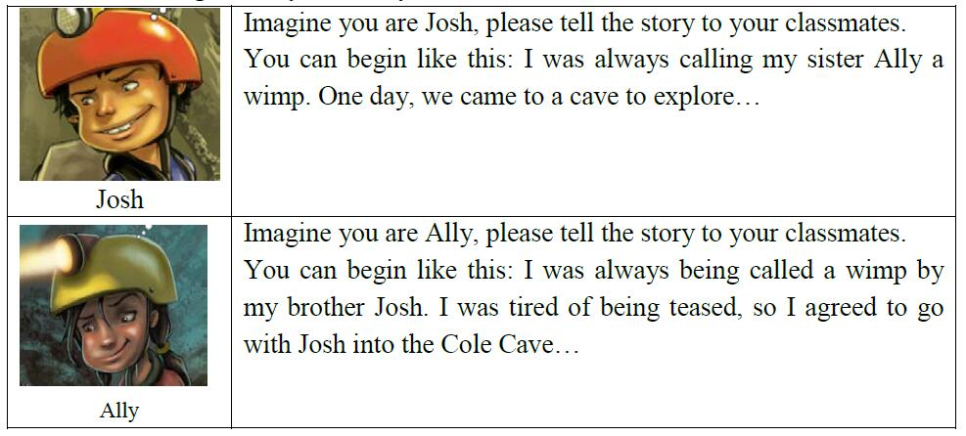
Work in Pairs
Tasks for telling the story from the perspectives of different characters.

Slide 17

Discussion
If you were Josh, how would you feel? What would you do / say?
If you were Ally, how would you feel and what you would do / say?
Imagine you were Ally. Would you choose other ways to solve the problem?

Slide 18
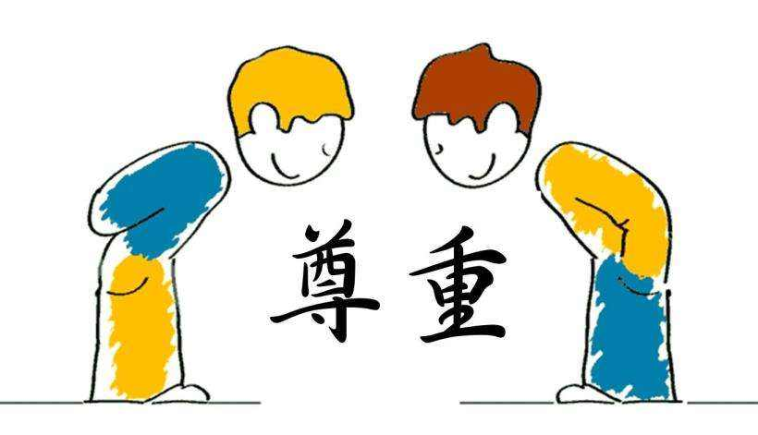
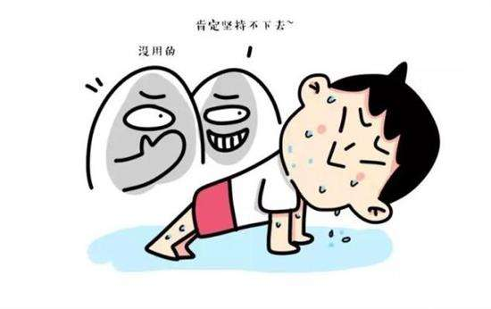

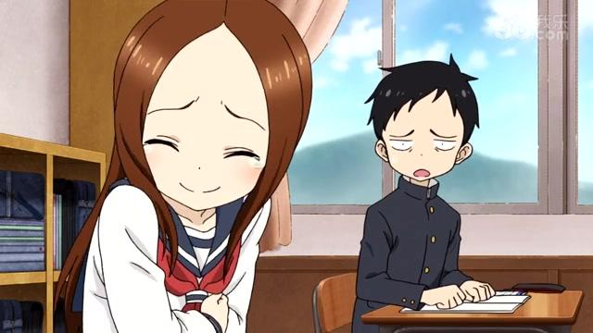
We should respect others.
Notes:
图片均取自百度图库

Slide 19

Homework
1. Tell the story “Into Cole Cave” to your parents.
2. Write a story about how you solved some problems. For example, when you were teased by someone/when you had conflict with someone.

