Slide 1

Views on the News
不同的观点
选自《多维阅读第11级》

Slide 2

What are the people doing in the picture?

Slide 3
Read the book quickly and answer the questions.
How many topics are there in this book?
What are the topics?

Slide 4

Choose one topic and read it. List the facts and reasons.
Reading Circle
Facts
Reasons

Slide 5


Word Master
The words we would like to remember!
The page of the word on.
The pronunciation of the word.
The meaning of the word.
Show us an example.
word

Slide 6
Choose one word and share with others.
Word Master
My opinions and reasons:
______________________________________________________
The words our group want to share are:
______________________________________________________
Page: ________.
Meaning: ______________________________________________________
Example: ______________________________________________________

Slide 7
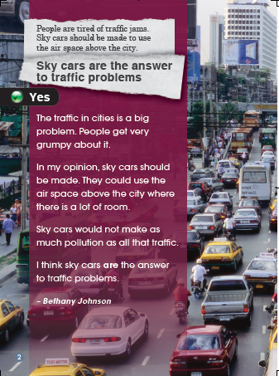
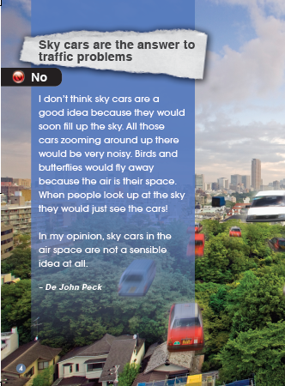
Answer these questions:
Group A
Do you think big cities have traffic problem? Why do you think that?
Do you agree with any of these reasons for sky cars? Why or why not?
What reasons did De John give for not having sky cars?

Slide 8
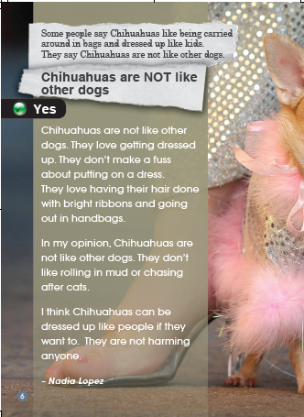
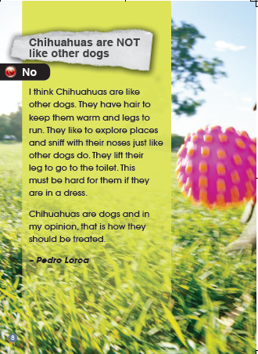
Answer these questions:
Group B
What were the reasons given for dressing Chihuahuas like people?
Do you agree with Nadia? Why or why not?
Do you think Pedro’s reasons make sense? Why or why not?

Slide 9
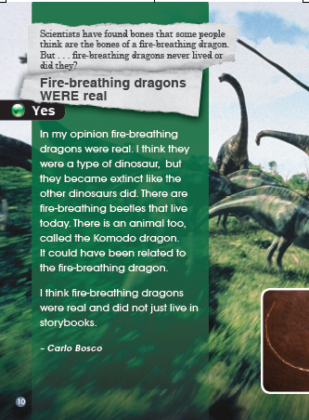
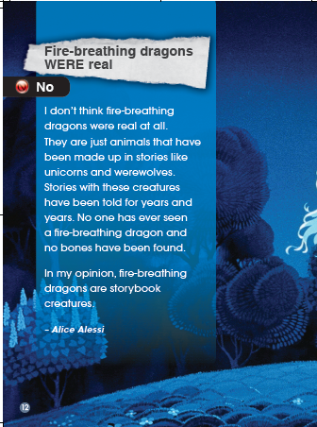
Answer these questions:
Group C
What other animals have you heard of that are extinct?
If you were to disagree with Carlo about fire-breathing dragons being real, what reasons would you give?

Slide 10
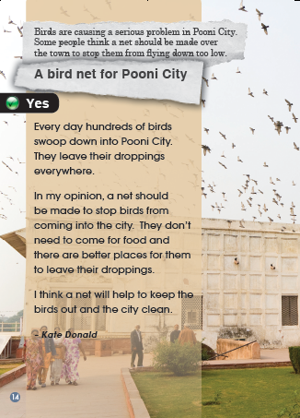
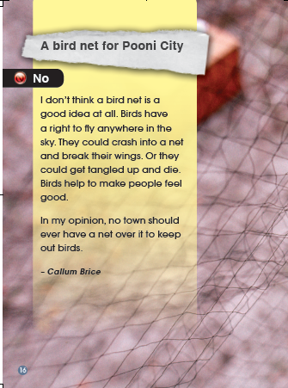
Answer these questions:
Group D
Which of these reasons do you agree or disagree with? Why?
If birds are a problem in a city, how else do you think this problem could be solved?

Slide 11
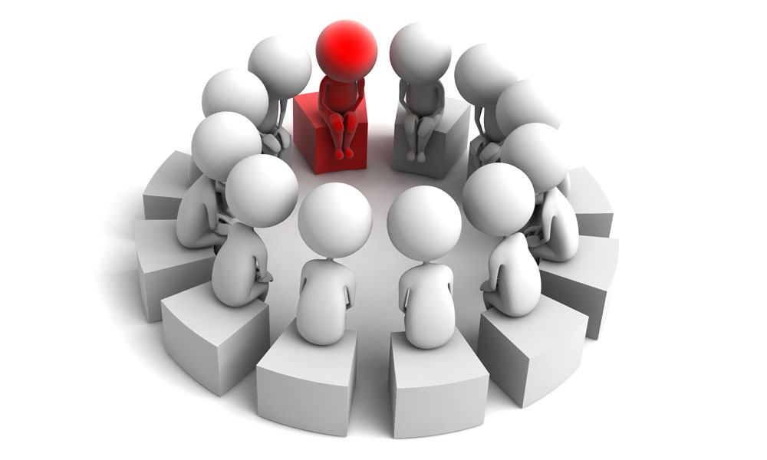
Discussion
How can we make persuasive arguments?
State what the problem is.
Give opinions.
Give reasons for the opinions.
Say what could be done

Slide 12
Please give a speech on one of the topics in this book.
Speech Time

Slide 13


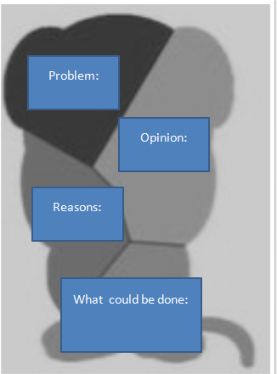
Homework
（1）课后和小组成员一起利用网络或者图书馆查询资料。看看是否还可以为今天讨论的四个话题找到其他论据。在全班汇报调查结果。
（2）与小组成员合作，围绕一个现实问题开展讨论，表明自己的观点并通过海报体现出来，并在全班进行展示。

Slide 14


