Slide 1
A Sneak Peek into Dylan’s Diary
迪伦的日记
选自《多维阅读第11级》

Slide 2

Think and Predict
1. What is the title of the book?
2. Can you guess what would happen in Dylan’s diary?

Slide 3
Fast Reading
1. Does Dylan have the same feelings about Mrs Maloney and Ally all the time?
2. How do his thoughts change?

Slide 4
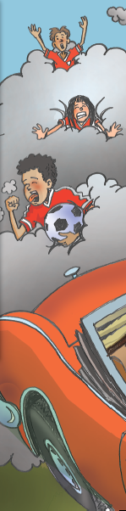
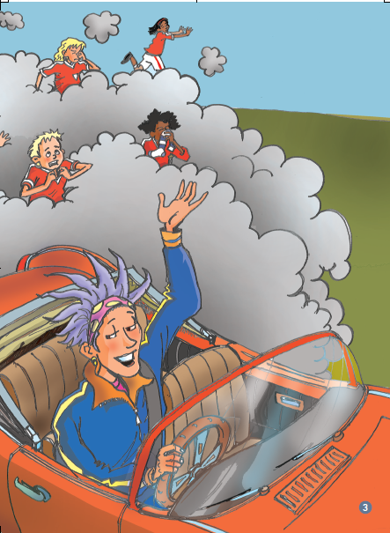
Read for Details
Monday:
1. What did Dylan think was embarrassing? Why?
2. Have you ever felt embarrassed? Why?
3. Do you think it’s good to compare Mrs Maloney’s hair to a porcupine’s quills?

Slide 5
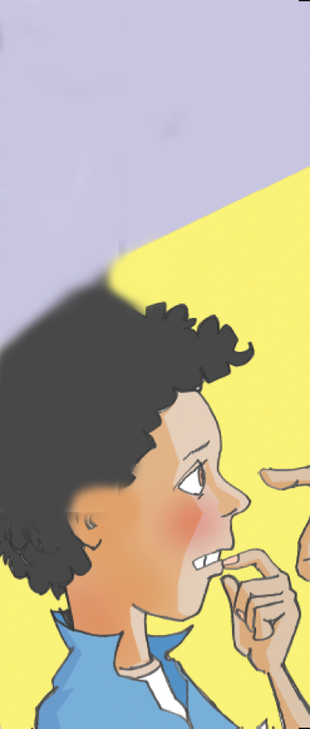
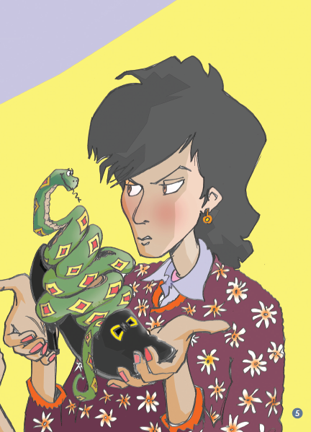
Read for Details
Tuesday:
1. Why do you think Mum said Dylan shouldn’t have a snake as a pet?
2. How did Dylan feel about this?

Slide 6
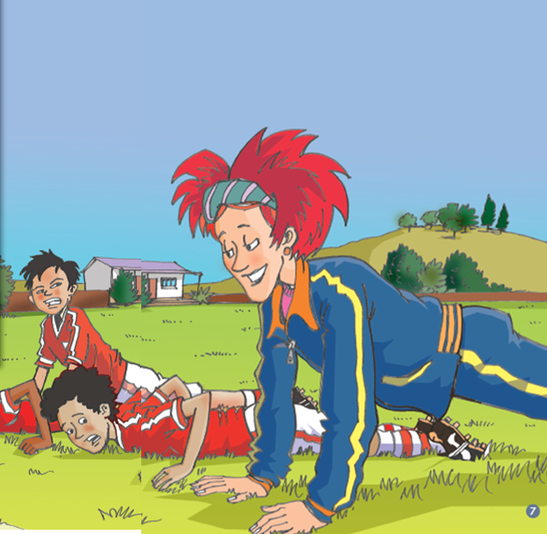
Read for Details
Wednesday:
How do you know Mrs Maloney is fit?

Slide 7
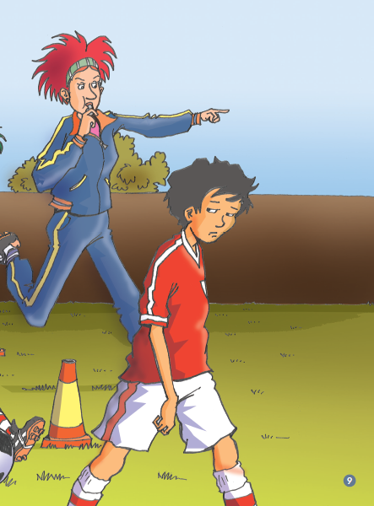
Read for Details
Thursday:
1. Do you think Toni should have been sent to the sideline? Why?
2. Why do you think Dylan thinks Ally is not responsible?
3. What are some ways you can show you are responsible at home/at school?

Slide 8
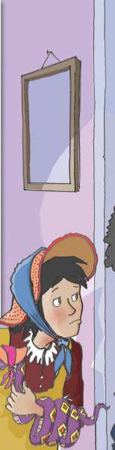
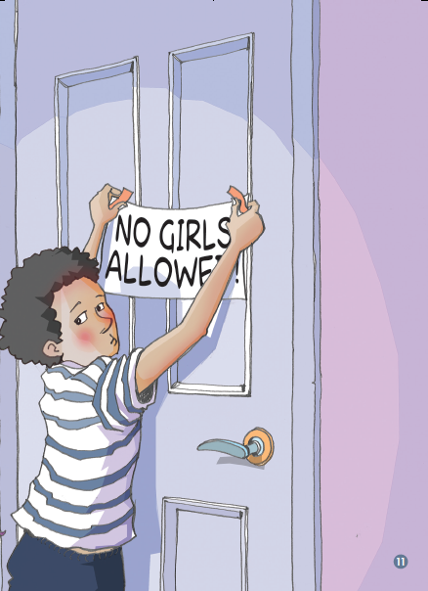
Read for Details
Friday：
1. Why do you think Mrs Maloney said “Piffle”?
2. How did Ally show Dylan she was not responsible?

Slide 9
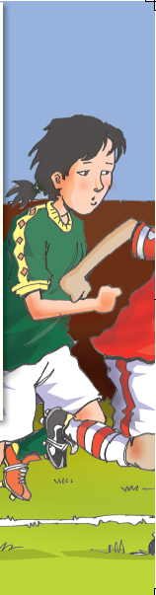
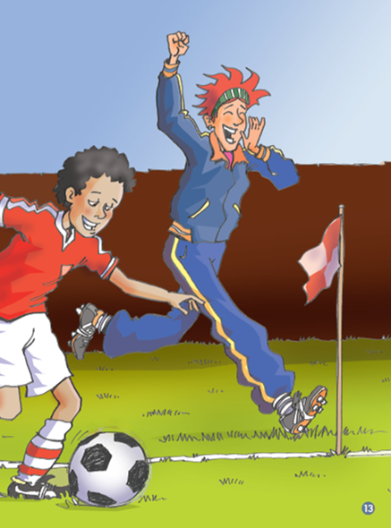
Read for Details
Saturday:
1. Why do you think Dylan wrote that Mrs Maloney was “running up and down the sideline like a red fox”?
2. Do you think Mrs Maloney is right that the Bullants won’t beat them again?

Slide 10
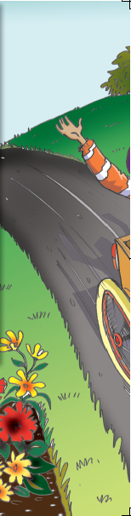
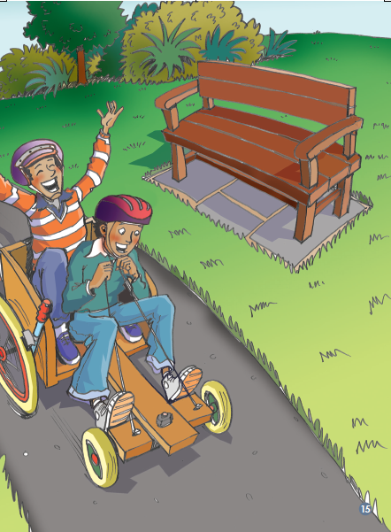
Read for Details
Sunday:
What did Dylan think was different about Mick’s dad and his?

Slide 11

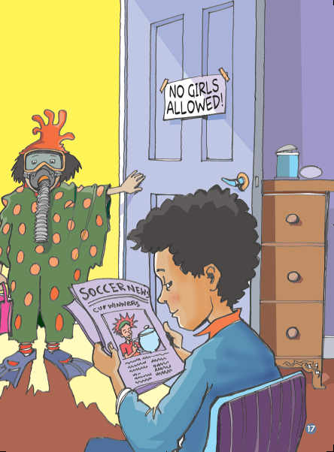
Read for Details
Monday:
1. How has Dylan changed his mind about Mrs Maloney? Why do you think he changed his mind?
2. Do you think Ally and her friends were clever? Why?

Slide 12
Complete the chart. What happened in Dylan’s week?
How did he feel?
1.Fill in the blanks
Day of the week | What happened with Mrs Maloney? How did Dylan feel about her? | What did Ally do? How did Dylan feel about her?
Monday
Tuesday
Wednesday
Thursday
Friday
Saturday
Sunday
Monday
2. Try to retell the story

Slide 13
Practice and Share
What is the most unforgettable thing in your life?
a. Think about what you did.
b. Tell your partner: what you did;
how you felt.

Slide 14
Group Discussion
1. Do you think Mrs Maloney is a good coach? Why? Why not?
2. What sort of person was Dylan / Ally / Mrs Maloney? Have you ever thought someone was not very good but changed your mind later? What made you change your mind?
3. Have you ever written a diary like Dylan? What sort of things did you write about?

Slide 15
Homework
Choose one of the tasks.
1. Read another diary after class. Please pay attention to the events in the diary and how the mood of the author changes.
2. Try to write your own diary to record your week.

