Slide 1
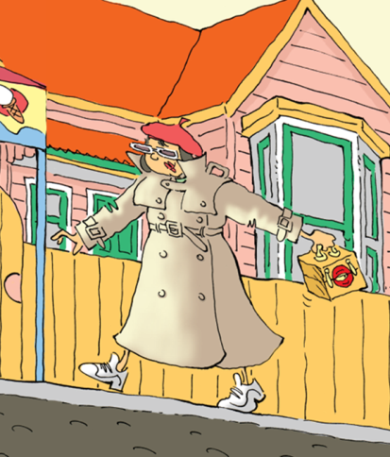
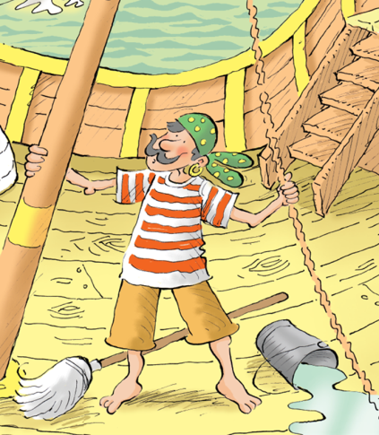
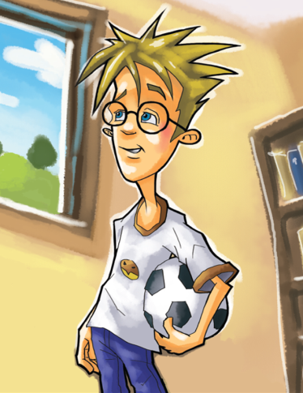
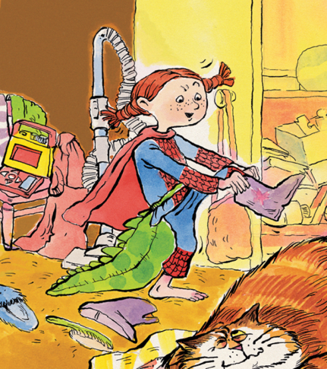
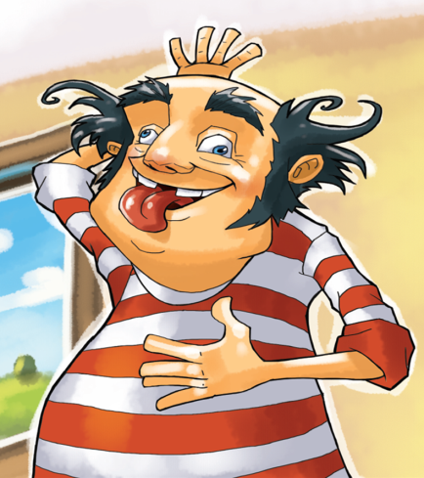
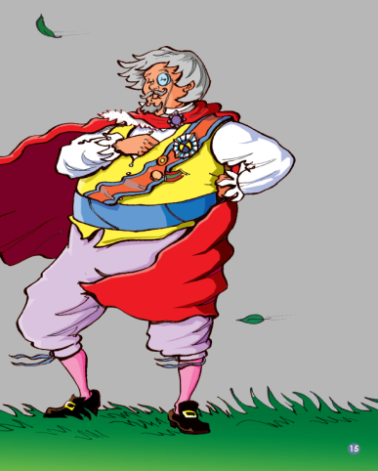
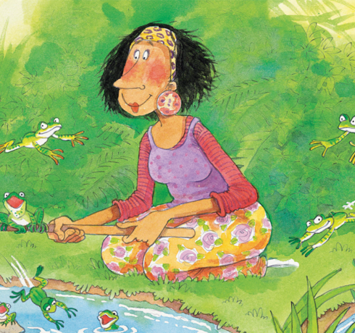
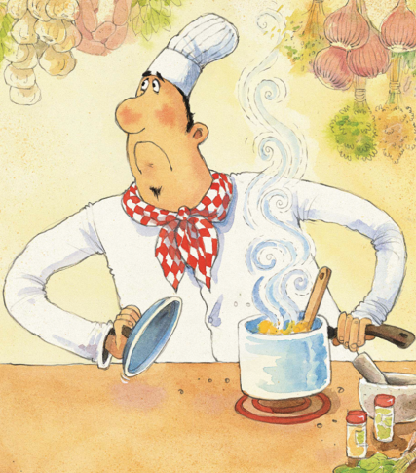
Who’s Who?
看看都是谁？
选自《多维阅读第10级》

Slide 2
What do you know from the cover?

Slide 3
Try to describe one of them.

Slide 4
Match the proper picture to the description of the people.

Slide 5
Read and Think.
1. What else do you know about Jack from the picture? How do you know that?
2. If we want to know Jack well, what else do you want to know about him?

Slide 6
Read and Think.
1. Who is the boy?
2. What does he look like?
3. What can he do well?
4. What else do you know about him?

Slide 7
Read and Think.
1. Who is the woman?
2. What does she look like?
3. How do you know what sort of person she is?

Slide 8
Jigsaw reading
Tips
four students in a group
each group, one picture
discuss and write
stick and read

Slide 9
How did the writer illustrate the people?

Slide 10
Listen and Read.

Slide 11
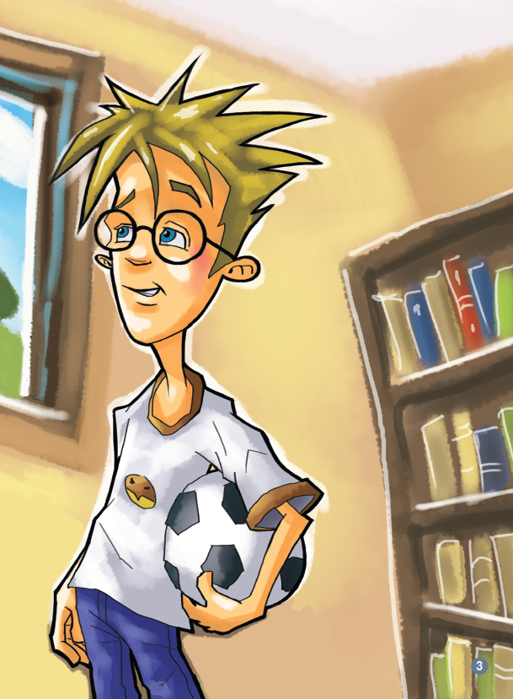

Slide 12
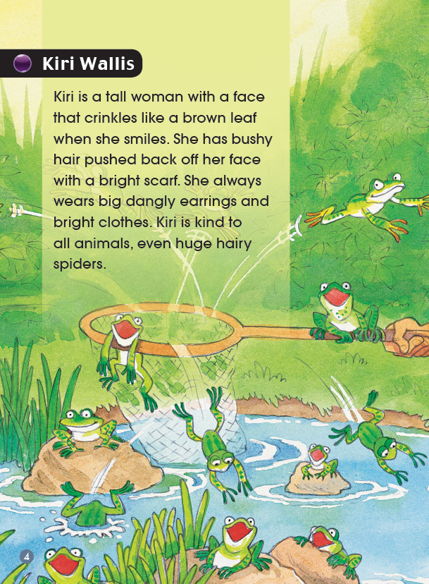
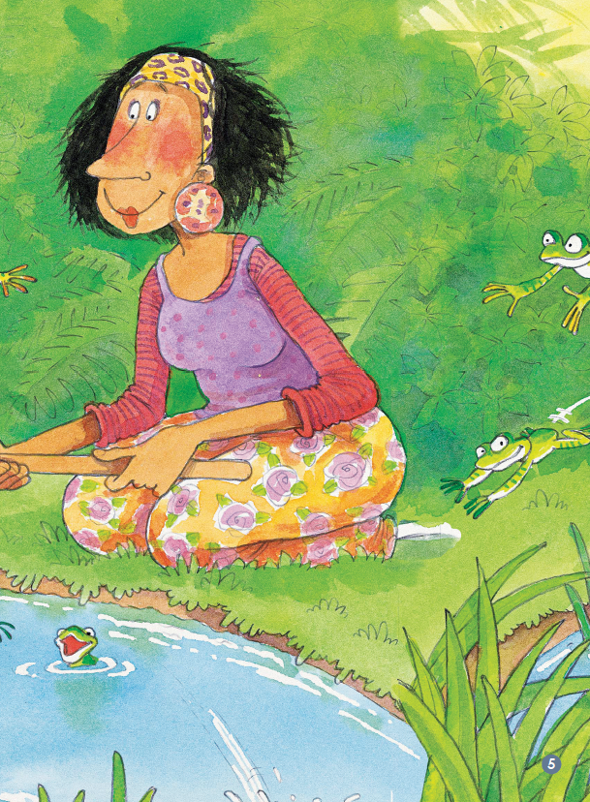

Slide 13
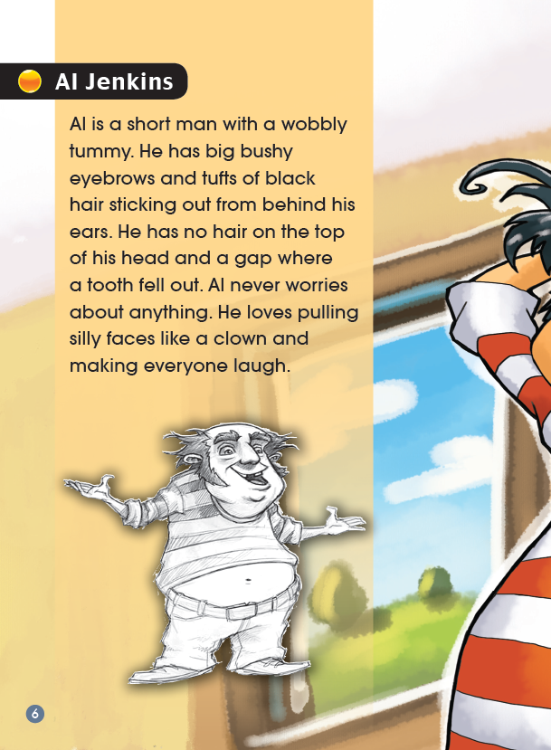
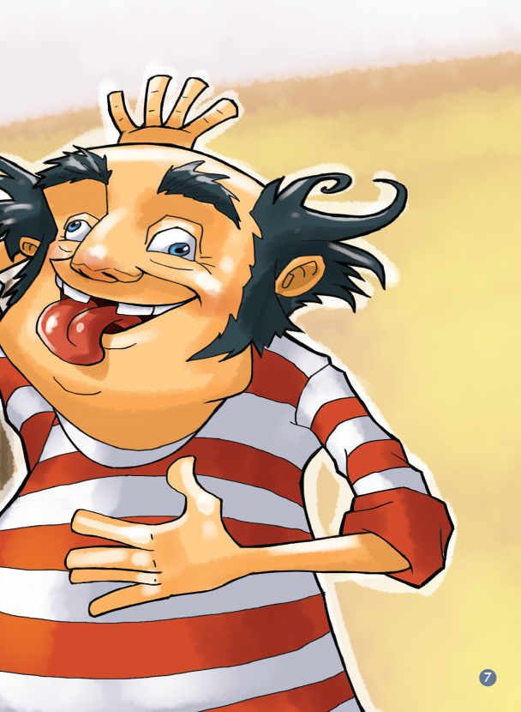

Slide 14
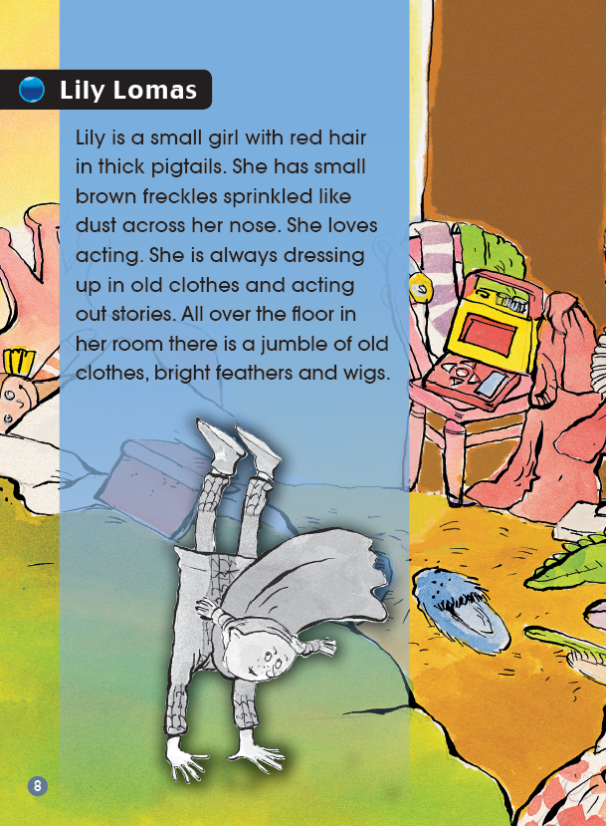
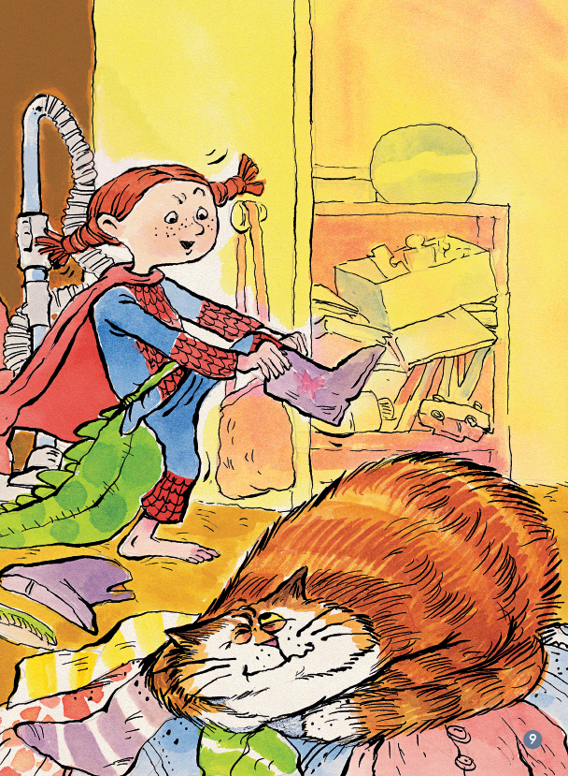

Slide 15
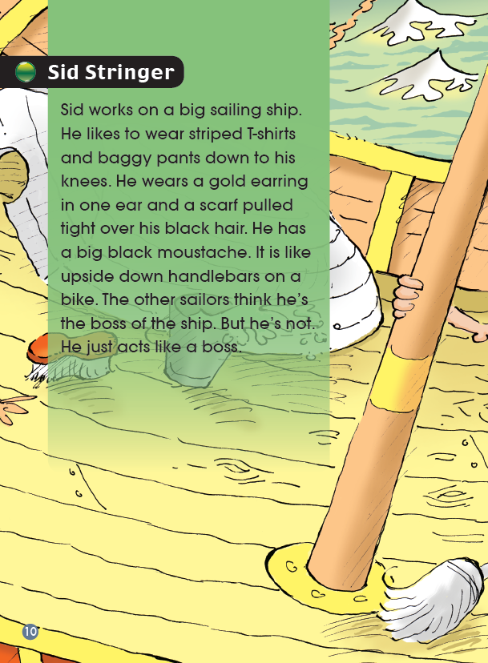
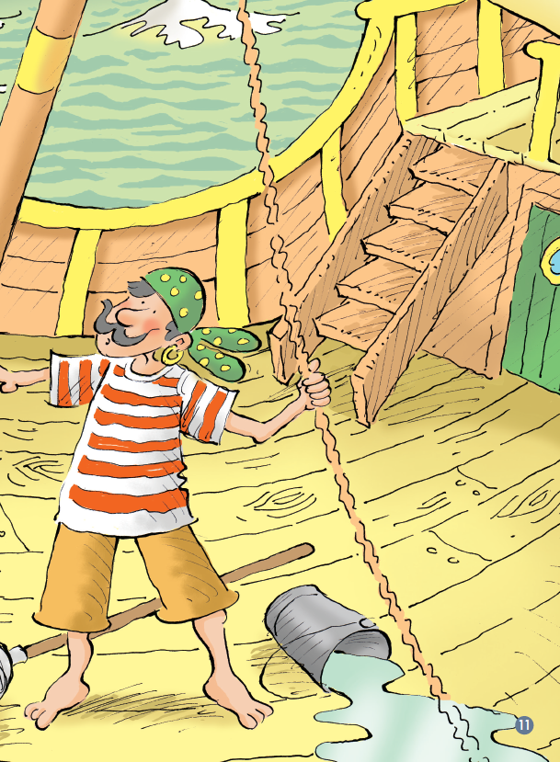

Slide 16
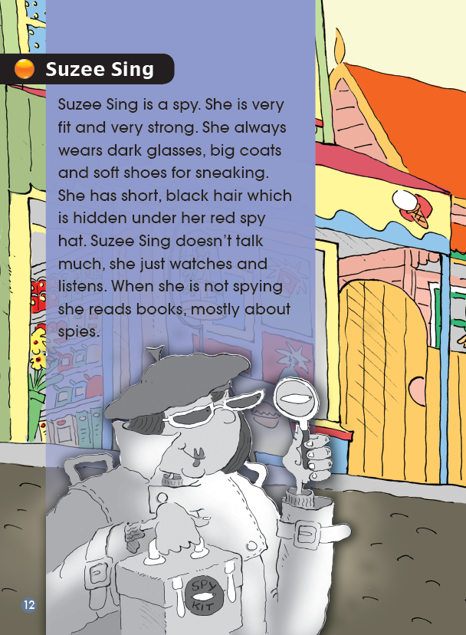
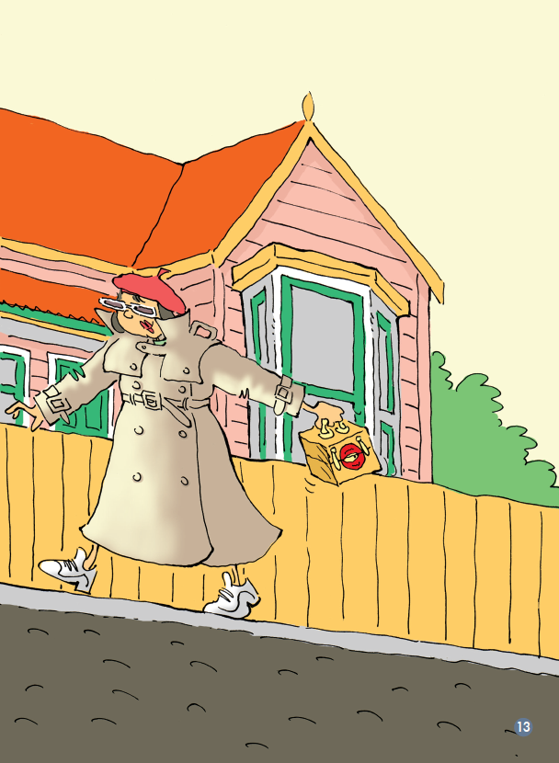

Slide 17
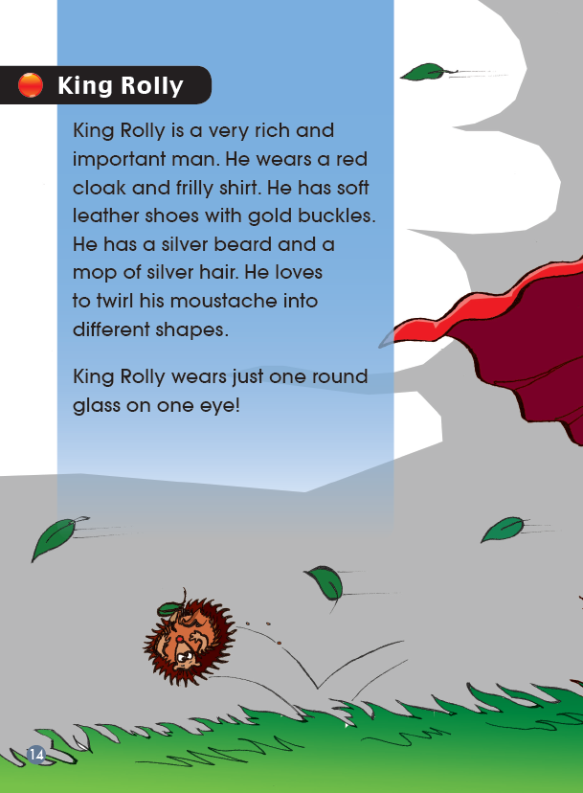

Slide 18
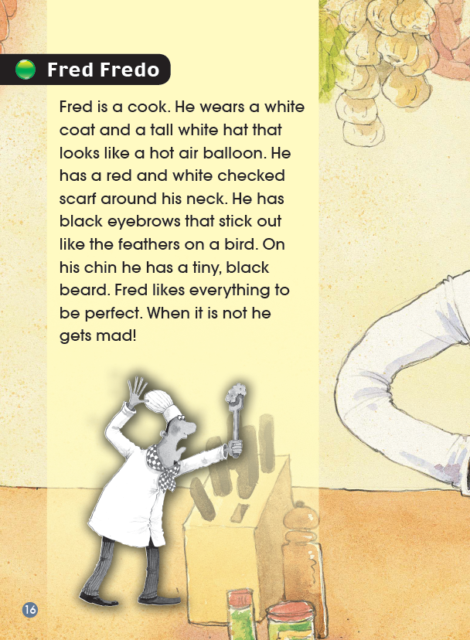
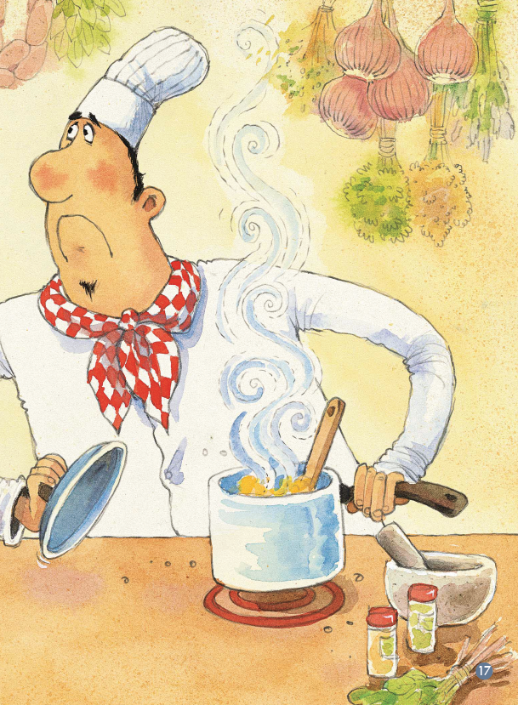

Slide 19
Read and Think.
Which person in the book impressed you a lot? Why?

Slide 20
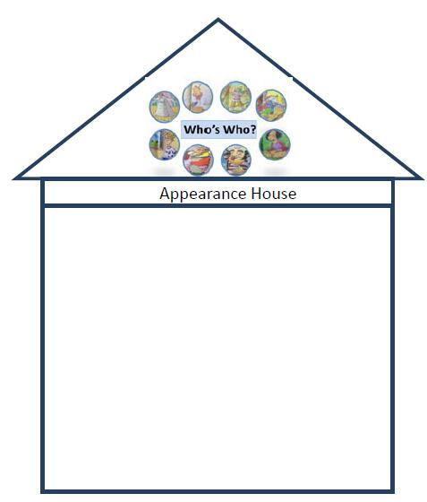
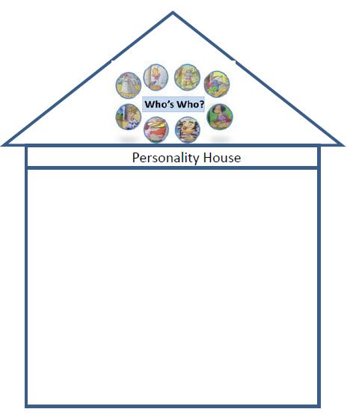
Write down the words and sentences you like in the language houses.

Slide 21
Think and Talk.
Introduce a person to us. Why do you want to talk about him/her?
2. Which is more important to people, appearance or personality? Why do you think so?

Slide 22
Homework
Introduce one of your friends, family members or a famous person to us.

