Slide 1
Abby’s Diary 阿比的日记
选自《多维阅读第10级》

Slide 2
Activity 1
Do you know what diary is?
What can you get from the cover?

Slide 3
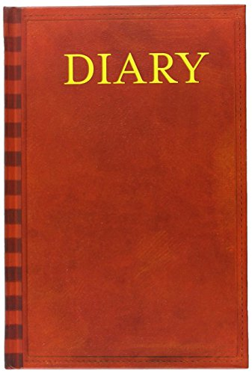
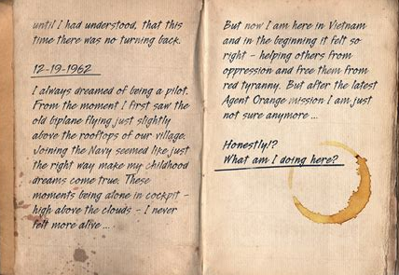
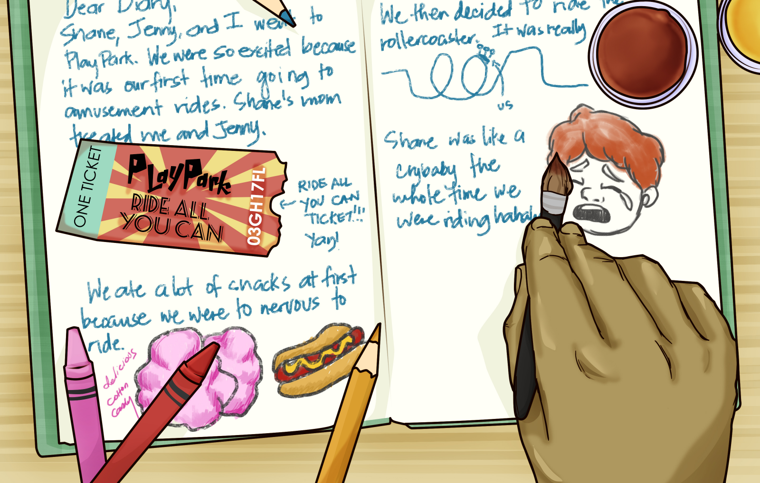
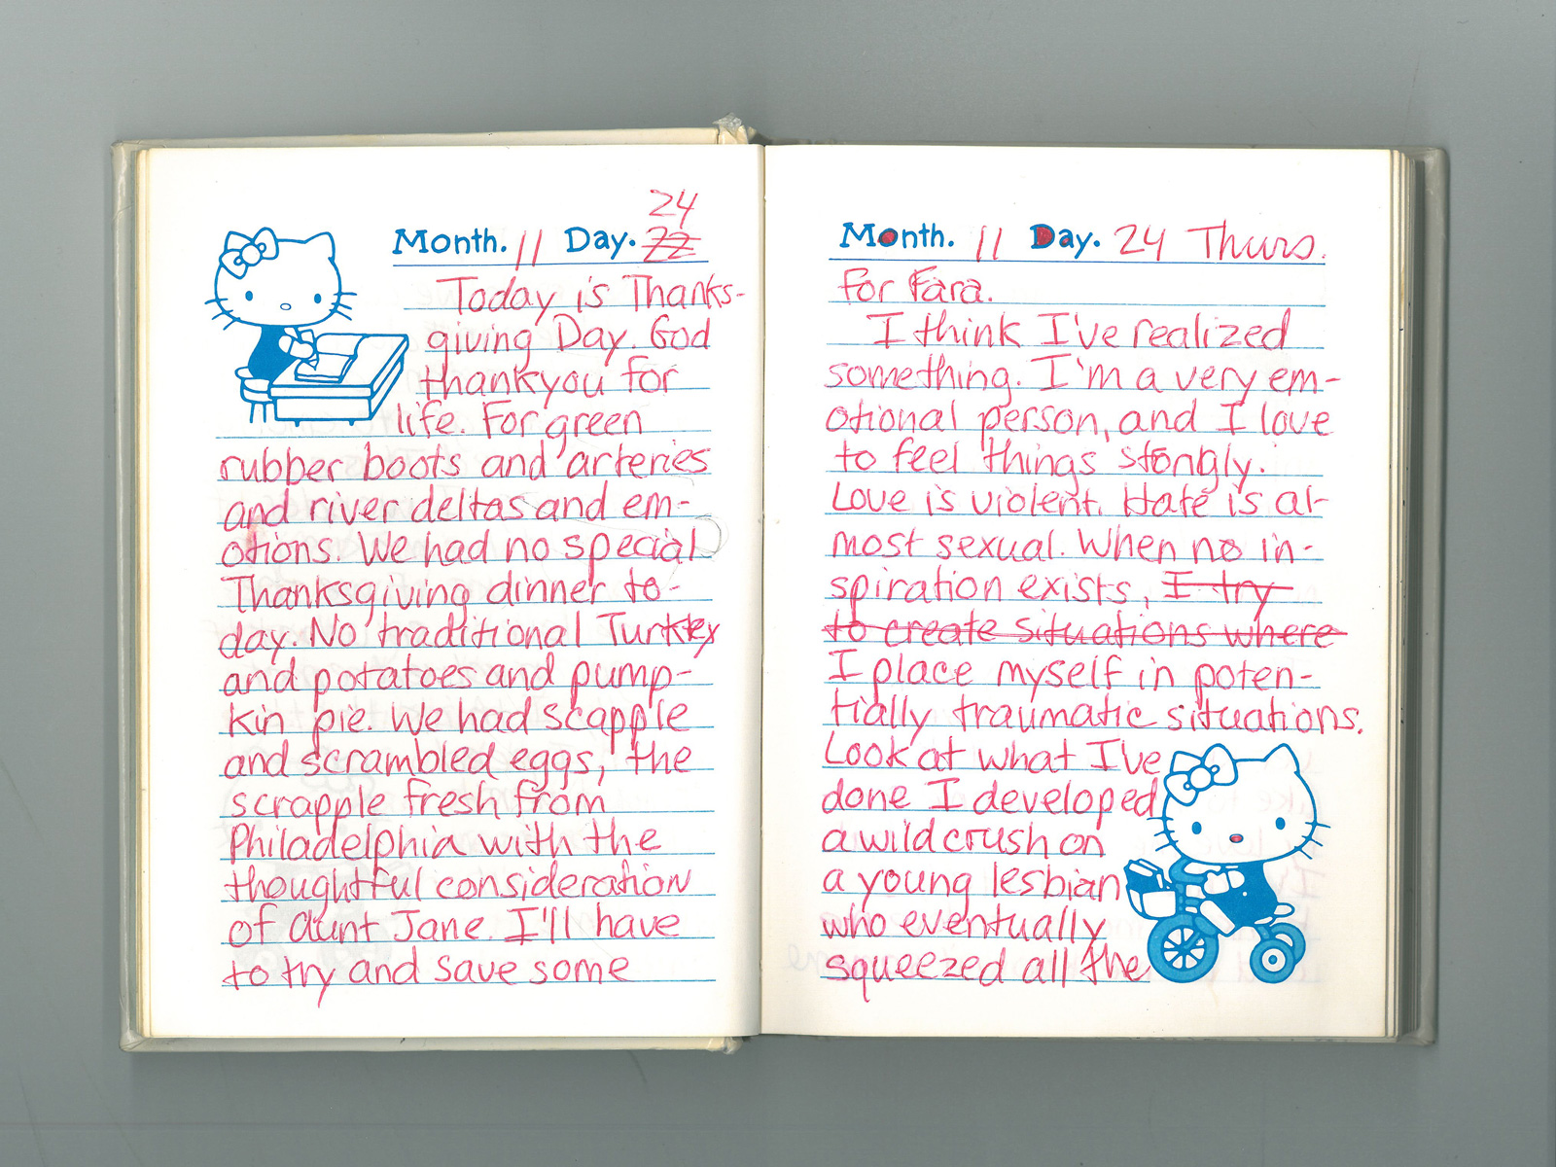

Slide 4
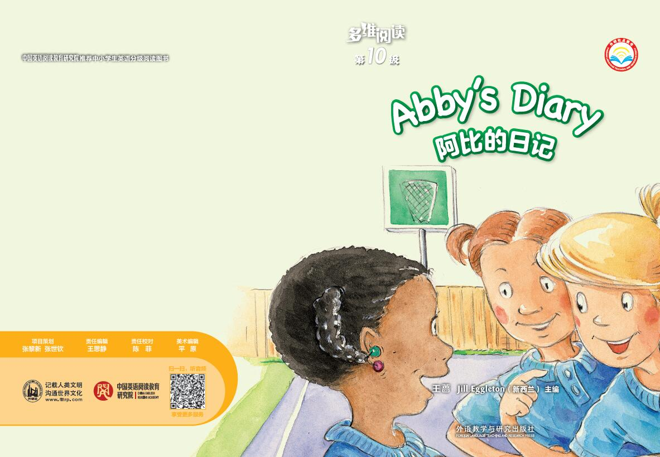
What are they talking about?
Can you guess who is Abby according to the cover?

Slide 5
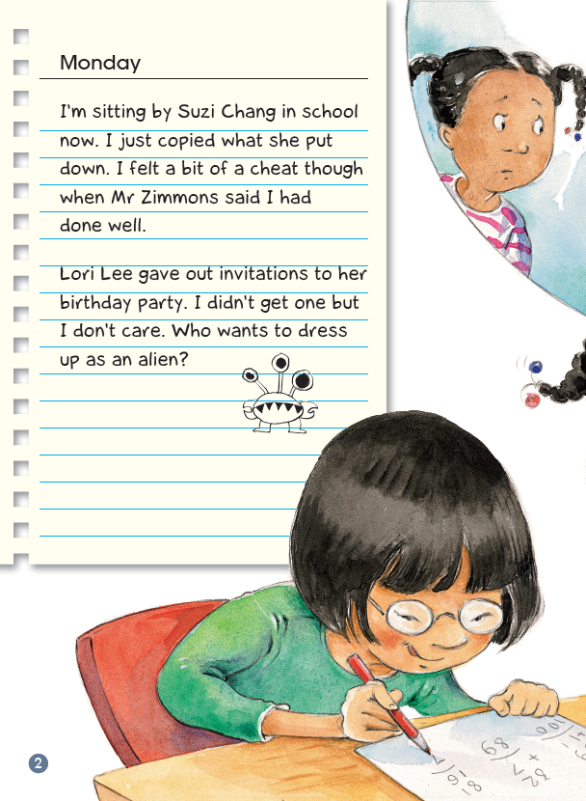
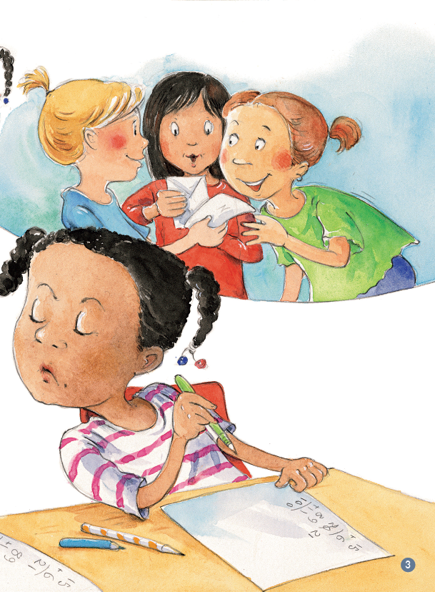
Activity 2
Read the diary of Monday
Who do you think Abby is? How do you know that ?
Who is Suzi Chang?
Who is Lori Lee?

Slide 6
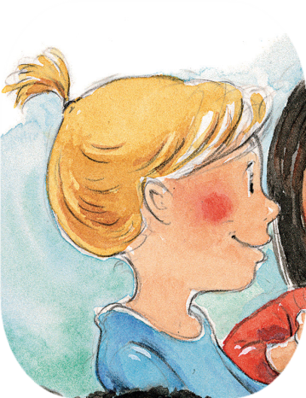
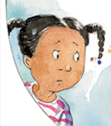
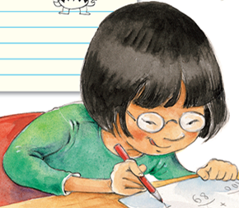
Matching Game
Abby
Suzi Chang
Lori Lee

Slide 7
• What happened to Abby?
• How do you know Abby didn’t really think it was right to copy? Find the words that tell you.
• Why do you think Lori Lee didn’t give Abby an invitation to the party?

Slide 8
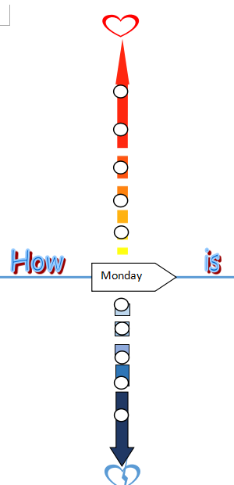
If you were Abby what would you feel on Monday?
Happy
Upset

Slide 9
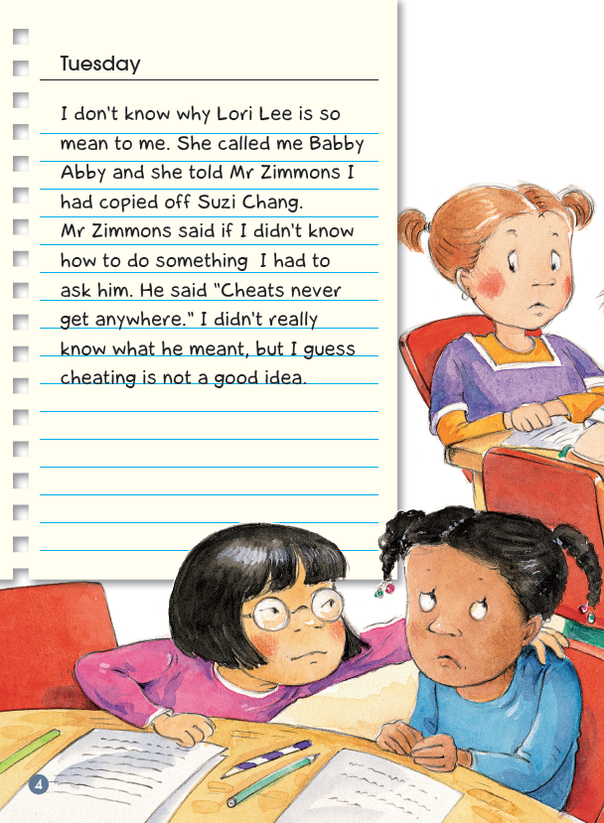
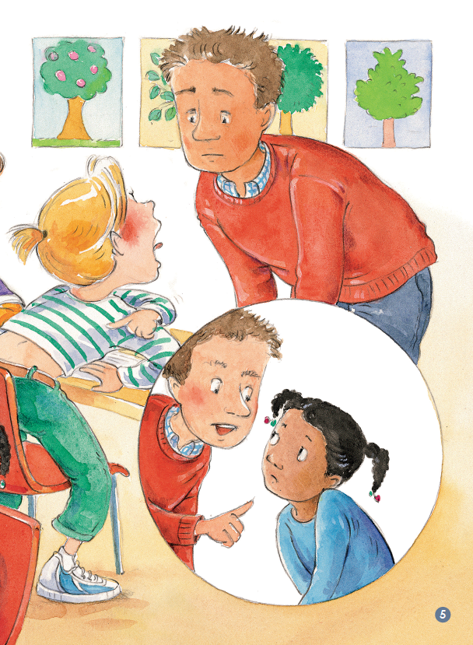
Read the diary of Tuesday
• Are there any words you didn’t know the meaning of?
• What clues can you use to work out the meaning of a word you don’t know?

Slide 10
• What were the mean things that Lori Lee did?
• What do you think Mr Zimmons meant when he said, “cheats never get anywhere”?

Slide 11
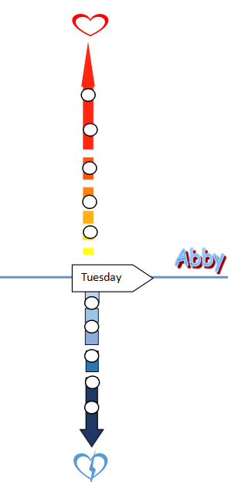
If you were Abby what would you feel on Tuesday?
Happy
Upset

Slide 12
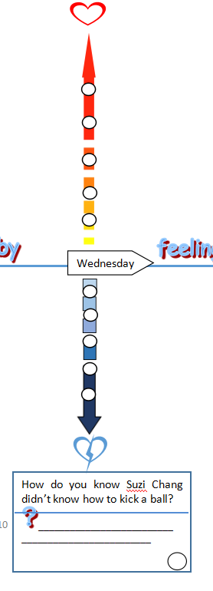
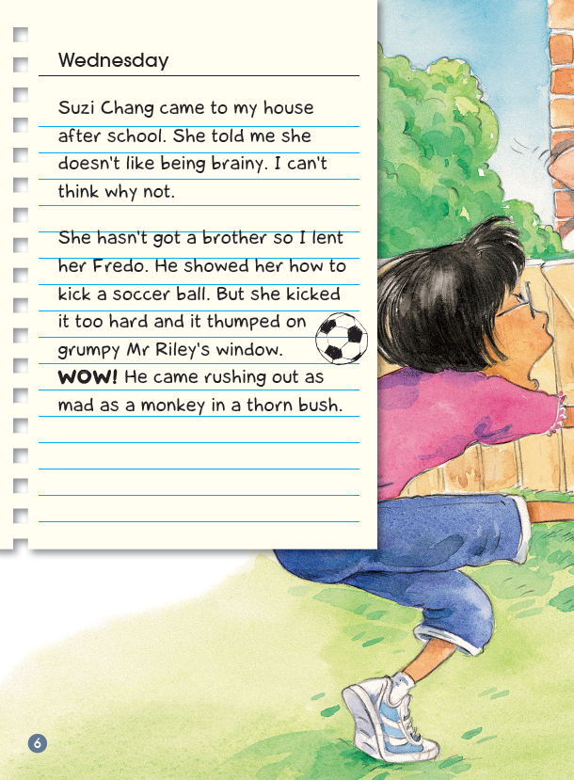
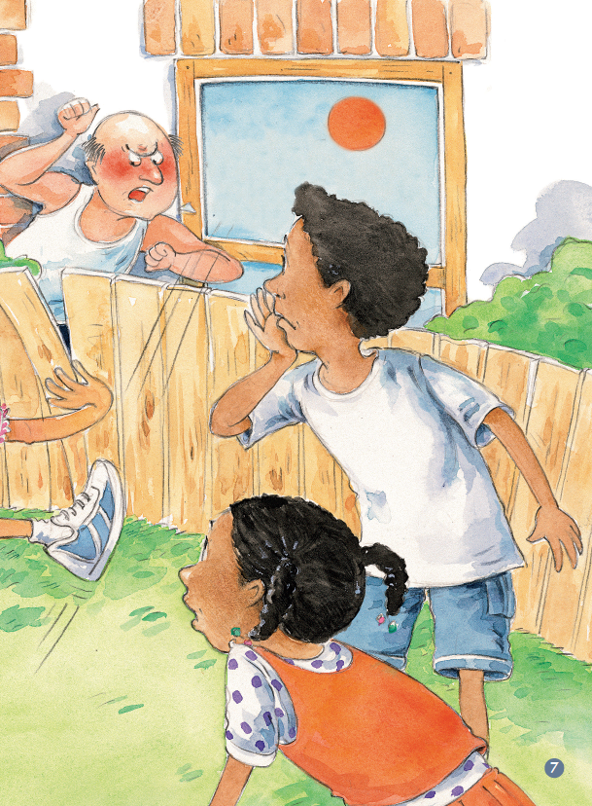
Activity 3 Jigsaw Reading
Example of task:
＋

Slide 13
How to regroup?
Sat.
Thur.
Wed.
Sat.
Thur.
Thur.
Wed.
Wed.
Sat.
Sat.
Thur.
Wed.
Thur.
Wed.
Sat.
Thur.
Wed.
Sat.
Sun.
Fri.
Sun.
Sun.
Fri.
Mon.
Fri.
Mon.
Mon.
Sun.
Sun.
Fri.
Fri.
Sun.
Fri.
Mon.
Mon.
Mon.

Slide 14
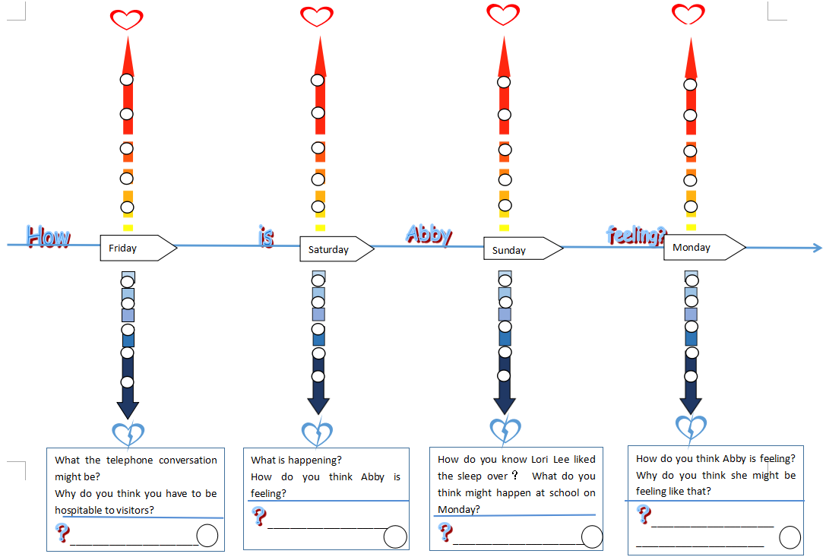
Back to the original group, share the diary you read, and finish the task below.

Slide 15
Activity 4
Read the diaries of 8 days, try to retell the event which plays an important role.

Slide 16
Check the meaning of the words or phrases you don’t know.
参考词汇：
as mad as a monkey
looks like a crinkled autumn leaf
shrieked like trapped bats
knots in her noodle
Mum knows a thing or two

Slide 17
Activity 5
Readers Theater
Act out a part of the diary you like the best

Slide 18
What sort of a person is Abby/Lori Lee/Suzi Chang?
Who do you like the best or have the deepest impression of in Abby’s diary? Why?
Have there been anyone that didn’t like you for some reasons? How did you know? How did you feel? What did you do?
Have you ever kept a diary like Abby?

Slide 19
Activity 6 Discussion Time
1. 观察Abby校园生活的心情波动曲线图，你有什么想法?
2. 如果在校园生活中，我们与同学间出现了友情危机时，将如何化解?

Slide 20
Activity 7
Mind Map
Do Partner Prattle
a trip
what you did
how you felt
a holiday
what you did
how you felt
yesterday
what you did
how you felt
a weekend
what you did
how you felt

Slide 21
Homework
Try to write a diary

