Slide 1
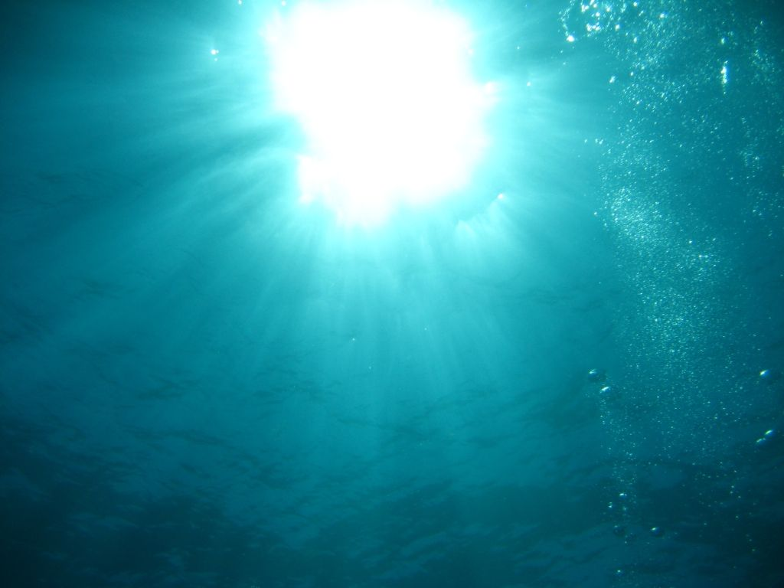
A Battle in the Deep Sea
深海大战
选自《多维阅读第9级》

Slide 2
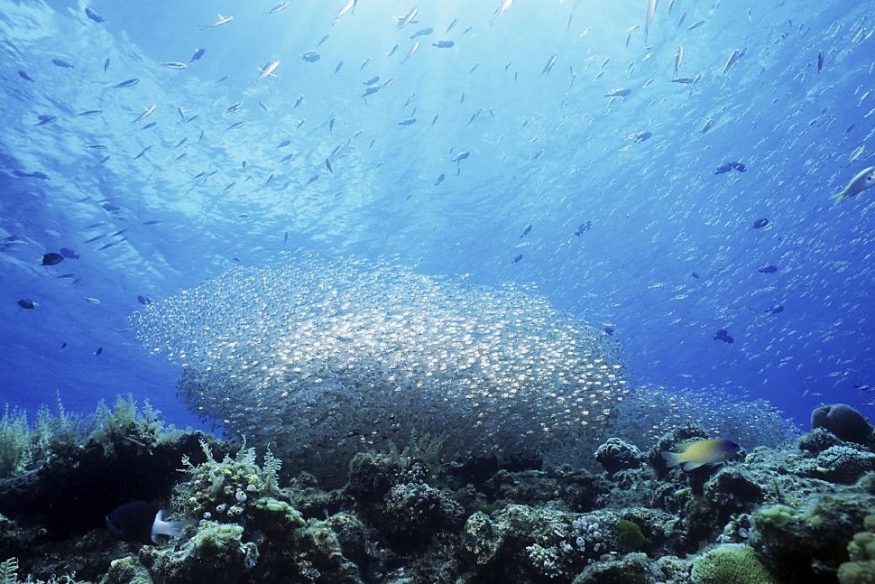
1. Where is it?
2. What do you know about it?

Slide 3

What can you see from the cover?

Slide 4
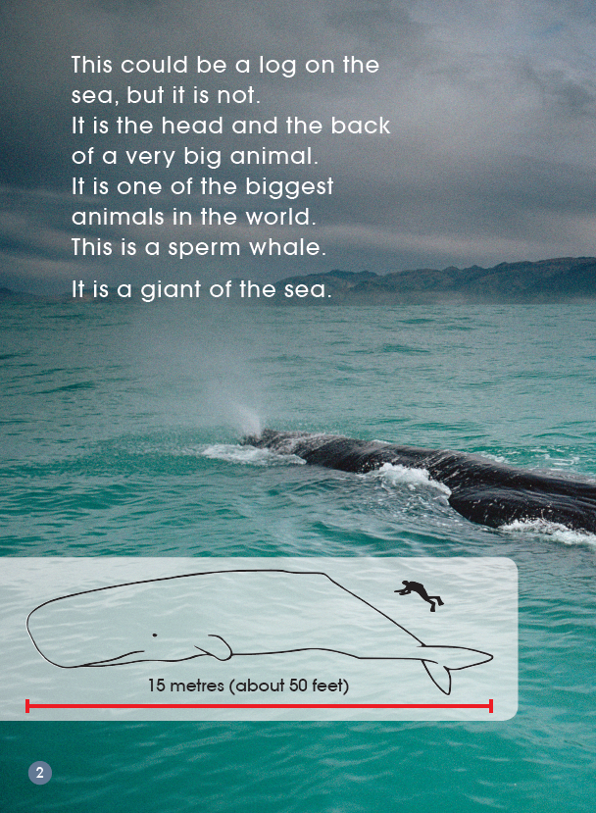
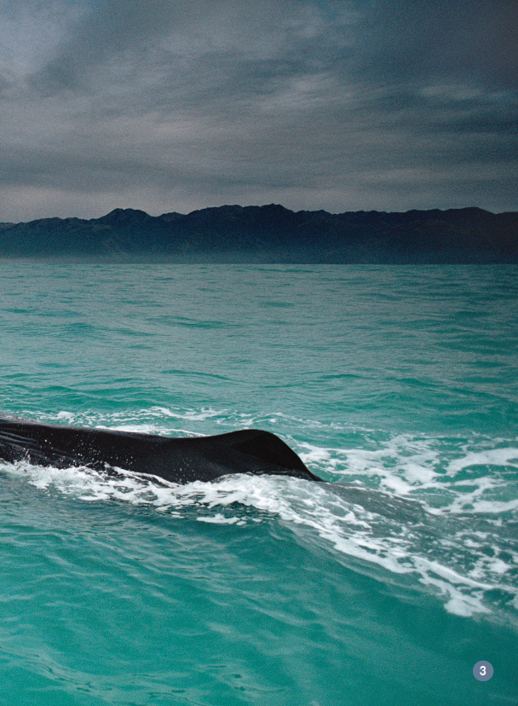
What do you think this is a photograph of? What could it be?

Slide 5
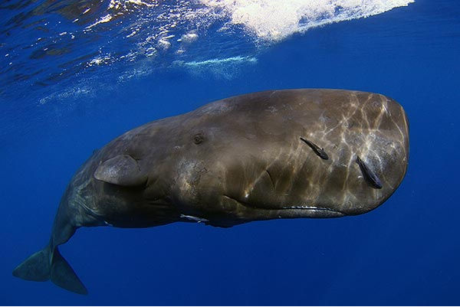
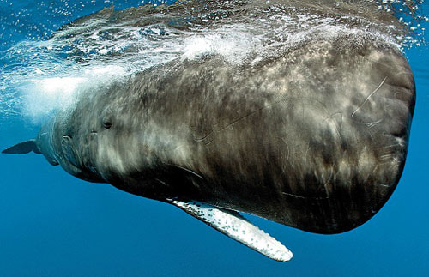
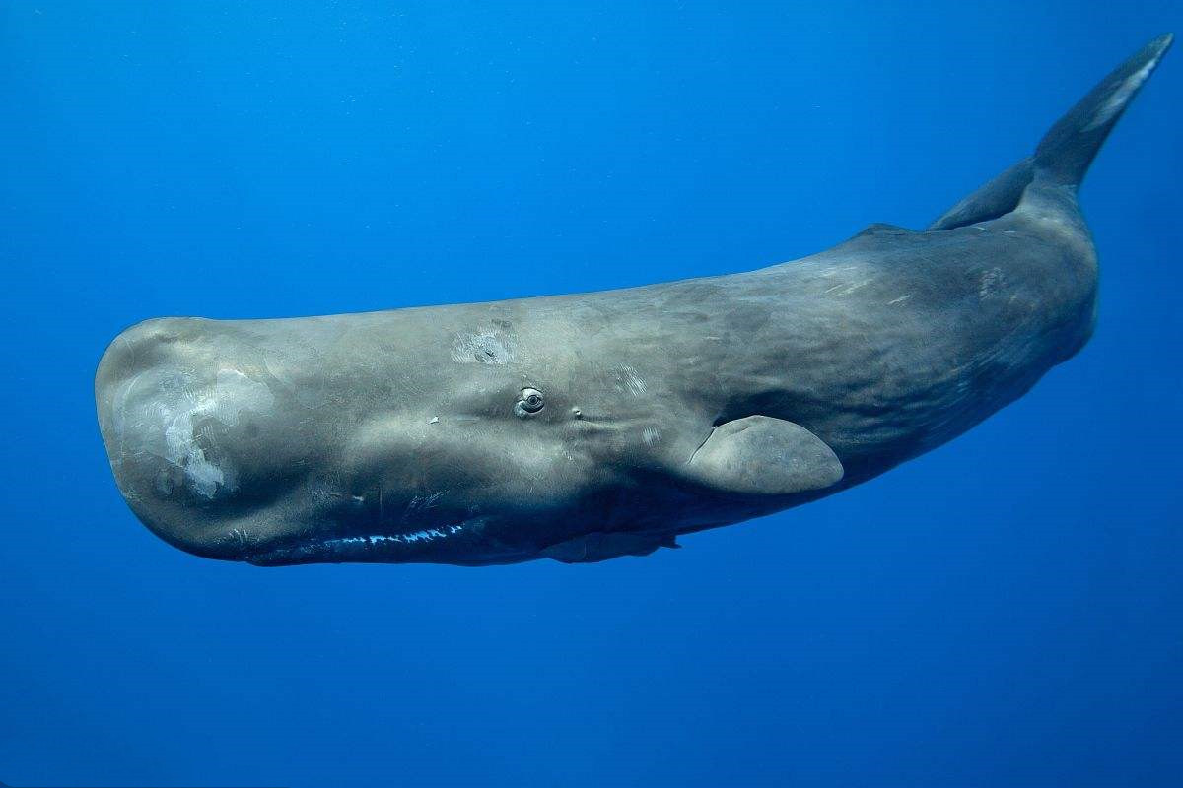
sperm whale

Slide 6
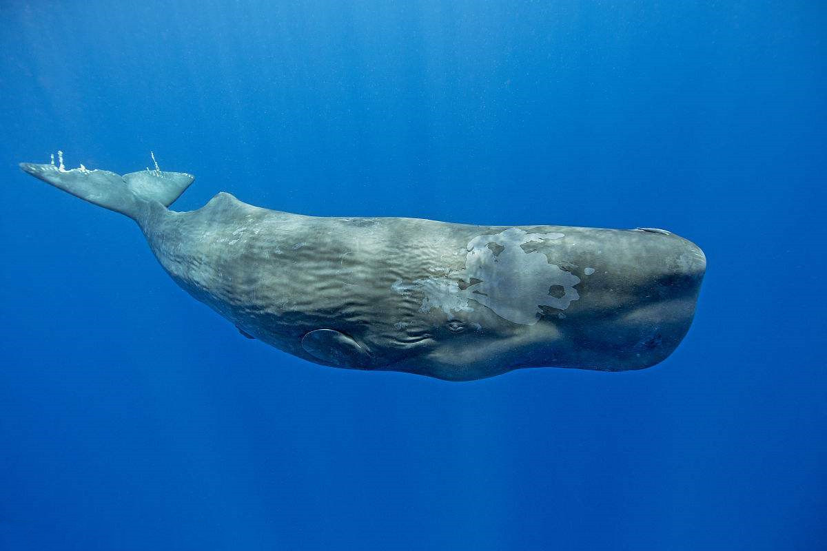
sperm whale
The sperm whale is the largest toothed whale（齿鲸）. It has the biggest head of any animal. The head can be about 20 feet (6.1 m) long, and is about one-third of the whale's body. Sperm whales are meat-eaters. They mostly hunt medium-sized squid. They also eat many kinds of fish. Sometimes they hunt giant squid that live on the ocean bottom at great depths.

Slide 7
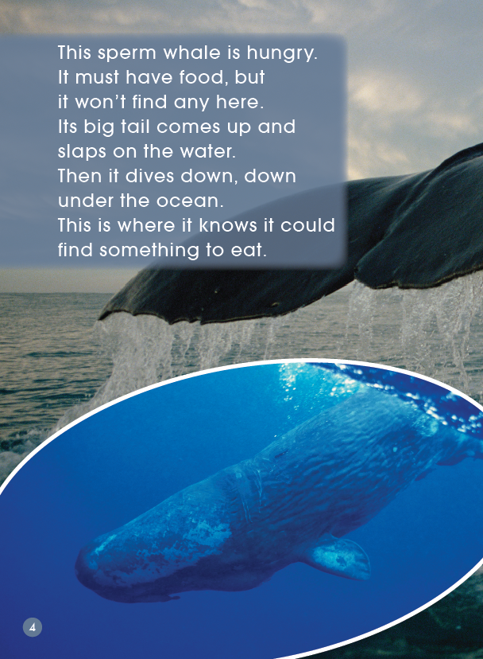
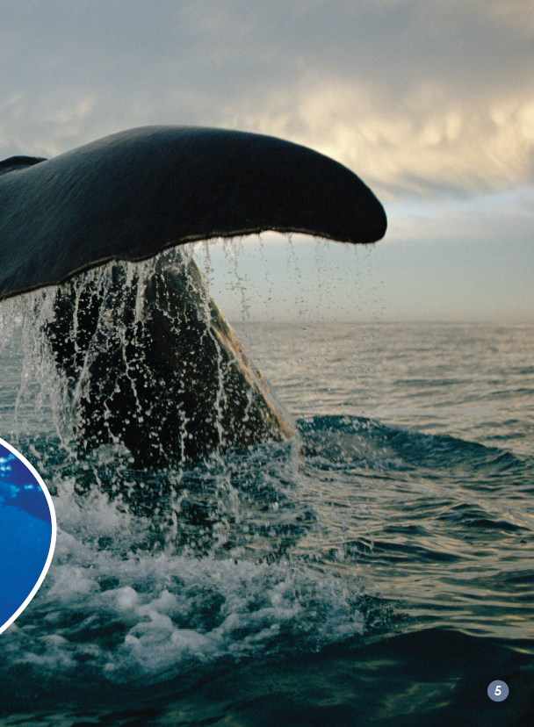
Why do you think the whale slaps its big tail on the water?

Slide 8
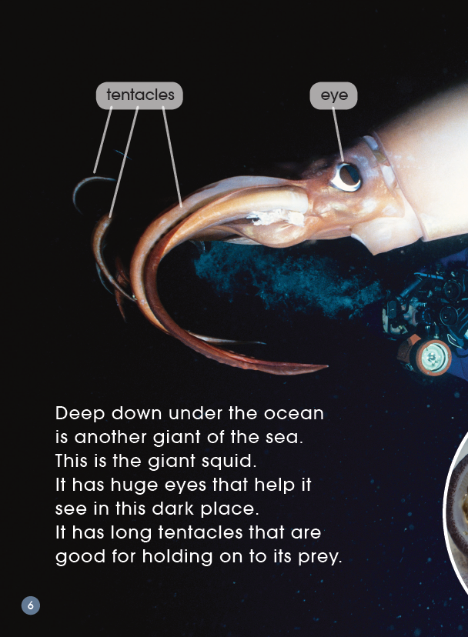
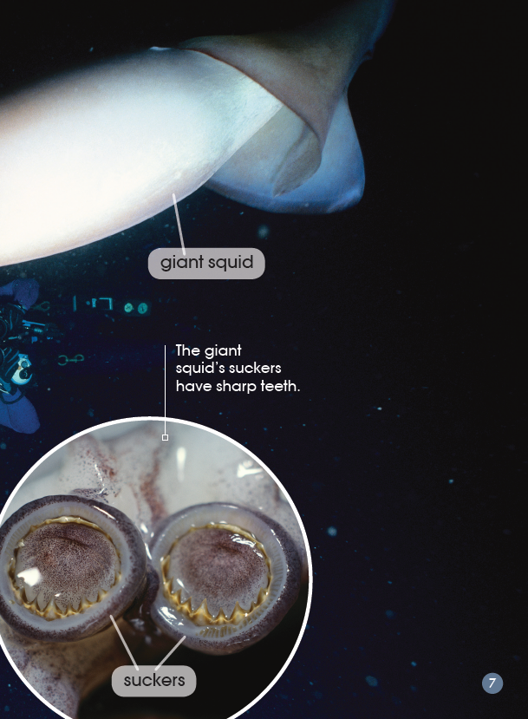
What animal is it? What do you know about it?

Slide 9
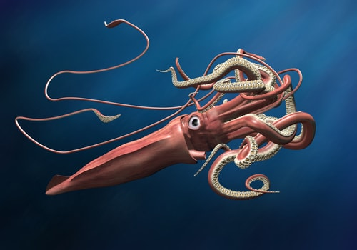
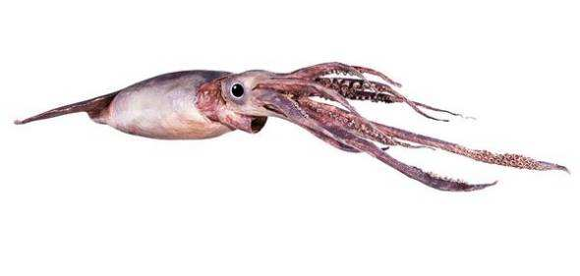
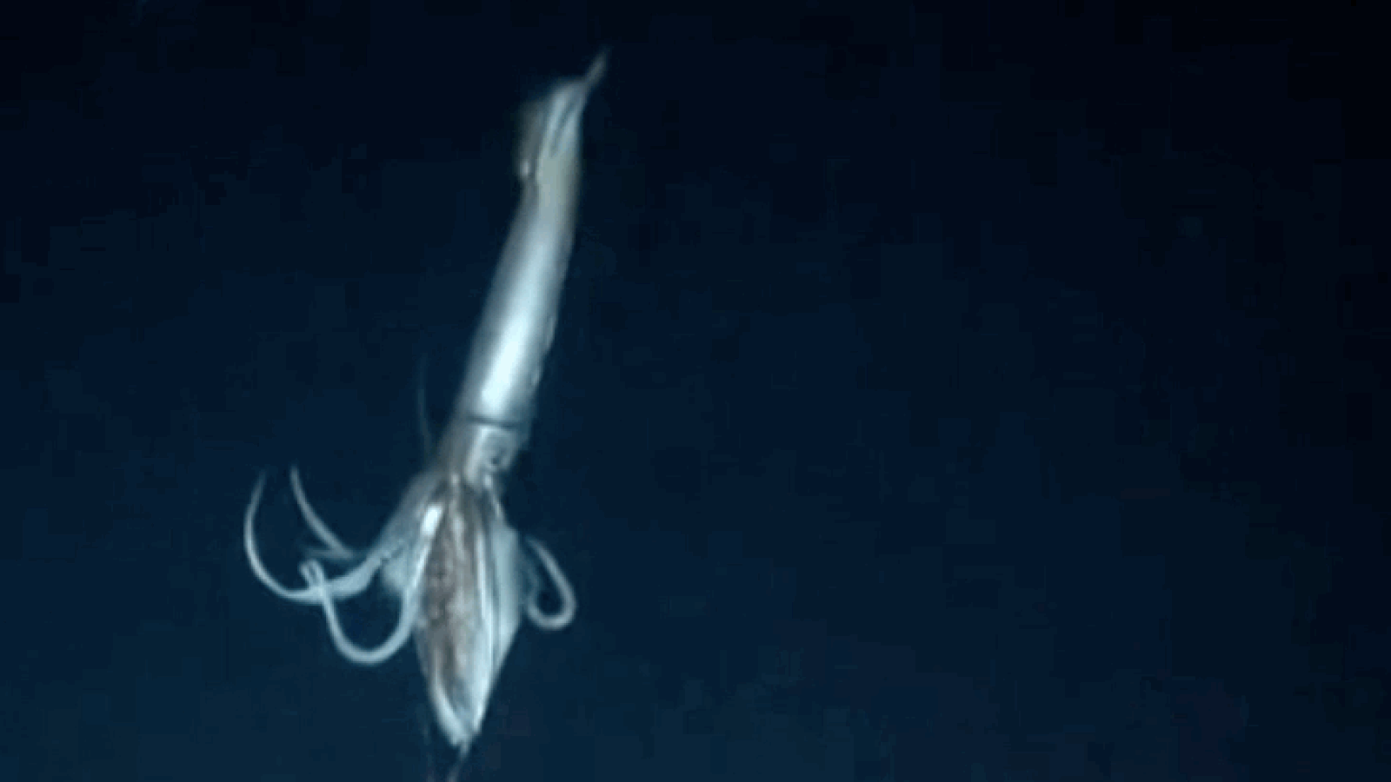
giant squid

Slide 10
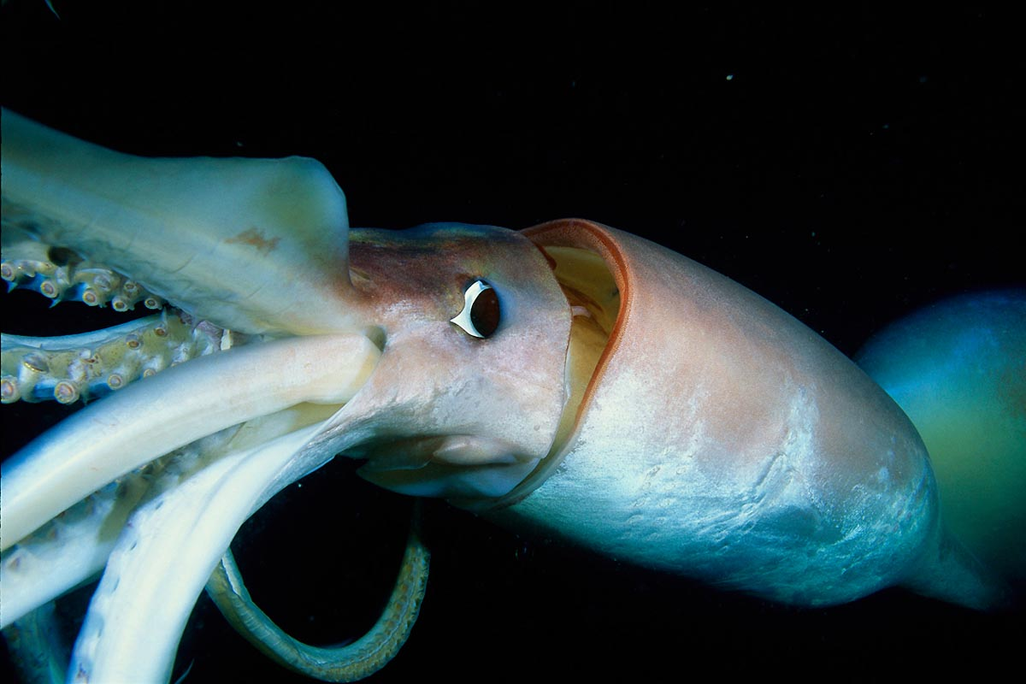
giant squid
Like all squid, a giant squid has a mantle (torso), eight arms, and two longer tentacles. The arms and tentacles account for much of the squid's great length, making it much lighter than its chief predator, the sperm whale.

Slide 11
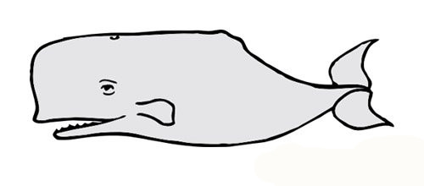

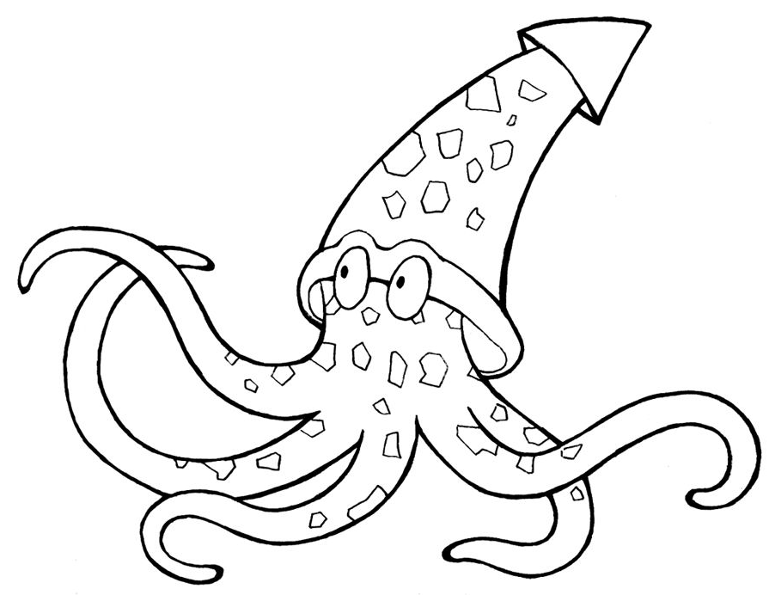

Slide 12
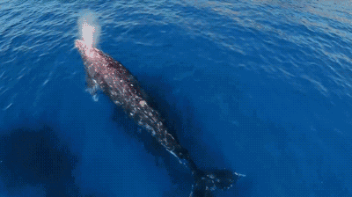


Slide 13
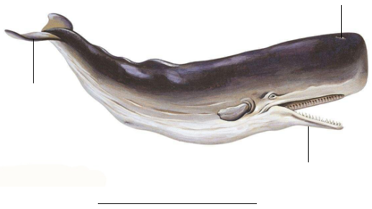
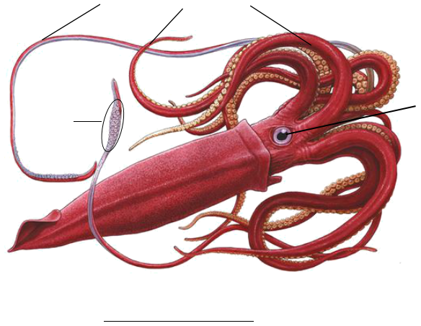

Slide 14

blowhole
tail
jaw
sperm whale

Slide 15

tentacles
eye
suckers
giant squid

Slide 16
Listen to the recording.

Slide 17
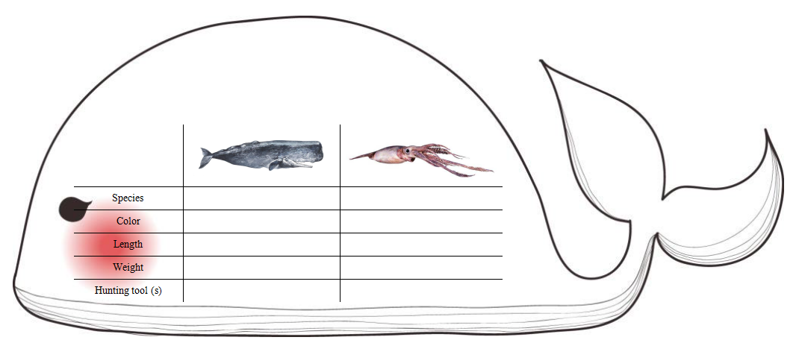

Slide 18

Adapt and share your story!

Slide 19

Which part of the book is your favourite?
What did you learn after reading this book?

Slide 20




1. Introduce this book to your parents and your friends.
2. Search more information (creatures/mysteries...) about the deep sea and make a poster about it.

