Slide 1
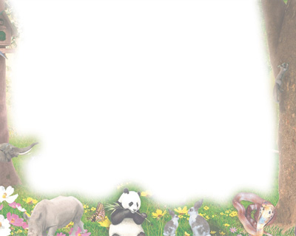
Harpy Eagle Chick
保护小角雕
选自《多维阅读第7级》

Slide 2
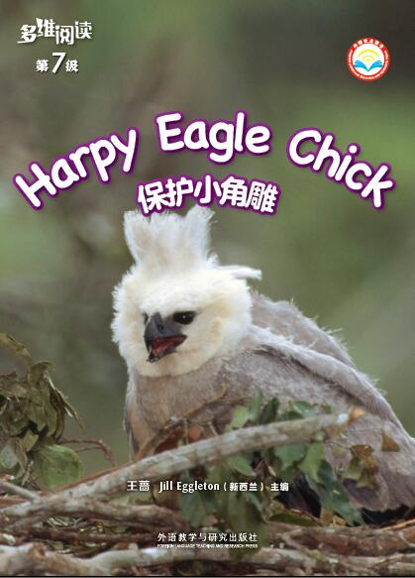
There are not many harpy eagles now.
What might be the reason?

Slide 3
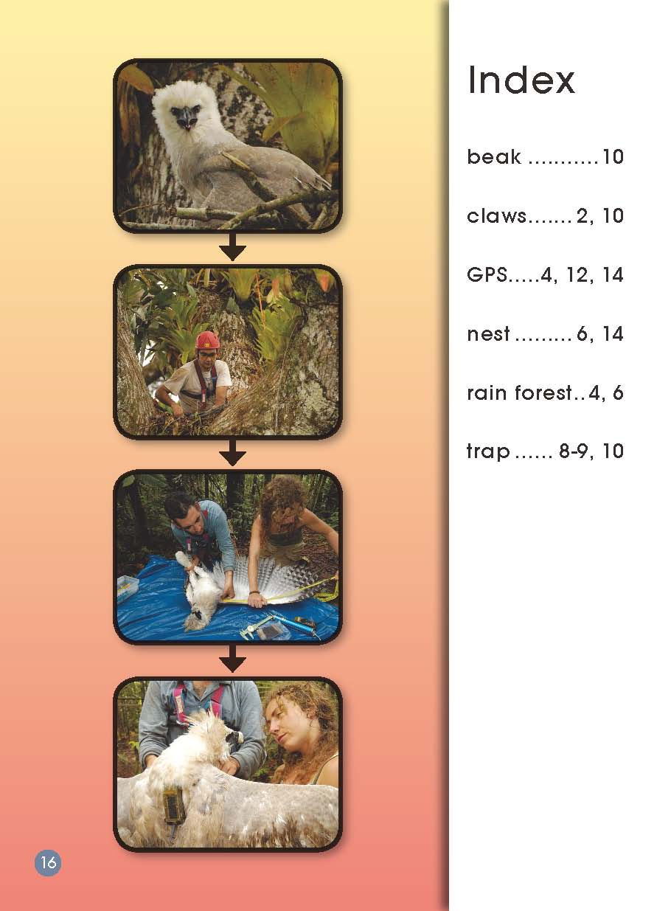
Where can we find these information in this book?
Which is the fast/easy way to find them?

Slide 4
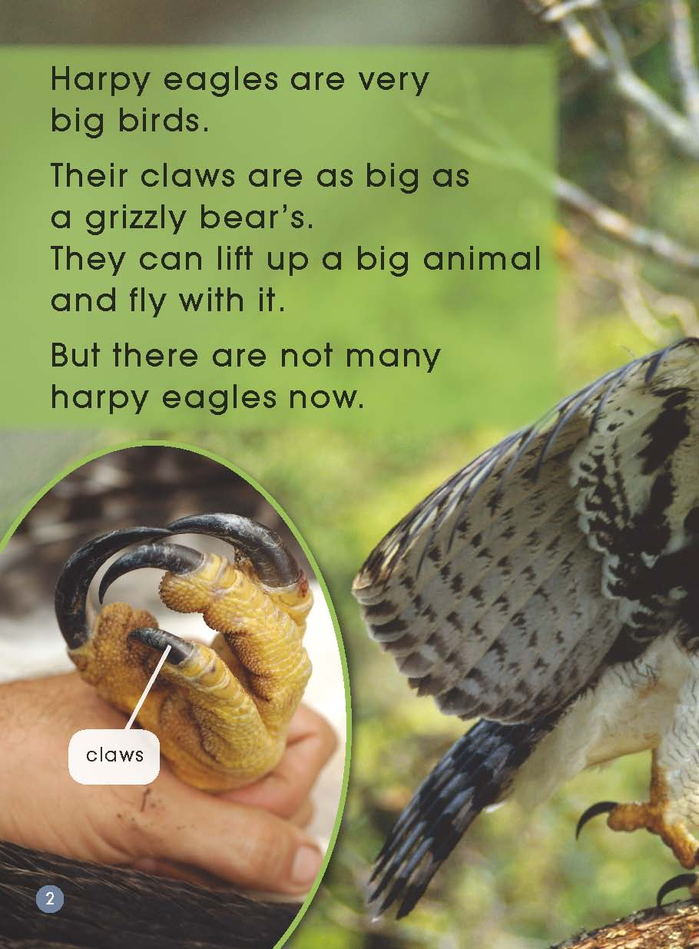
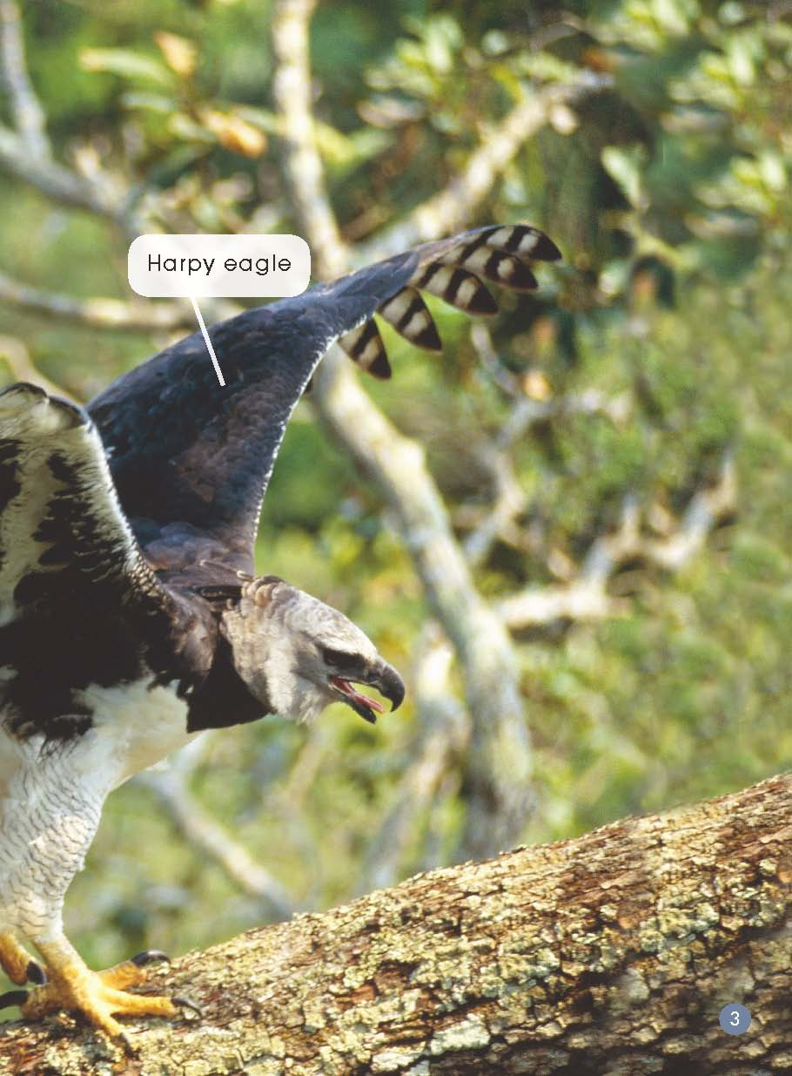
What do you know about harpy eagles?

Slide 5
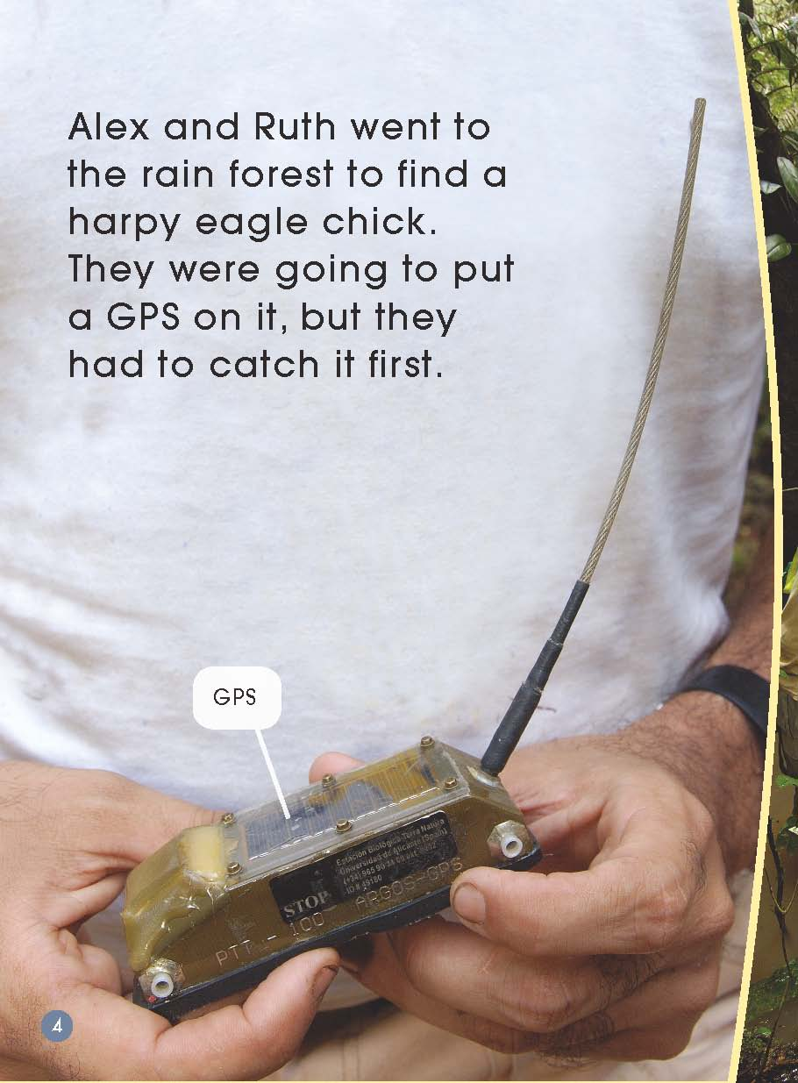
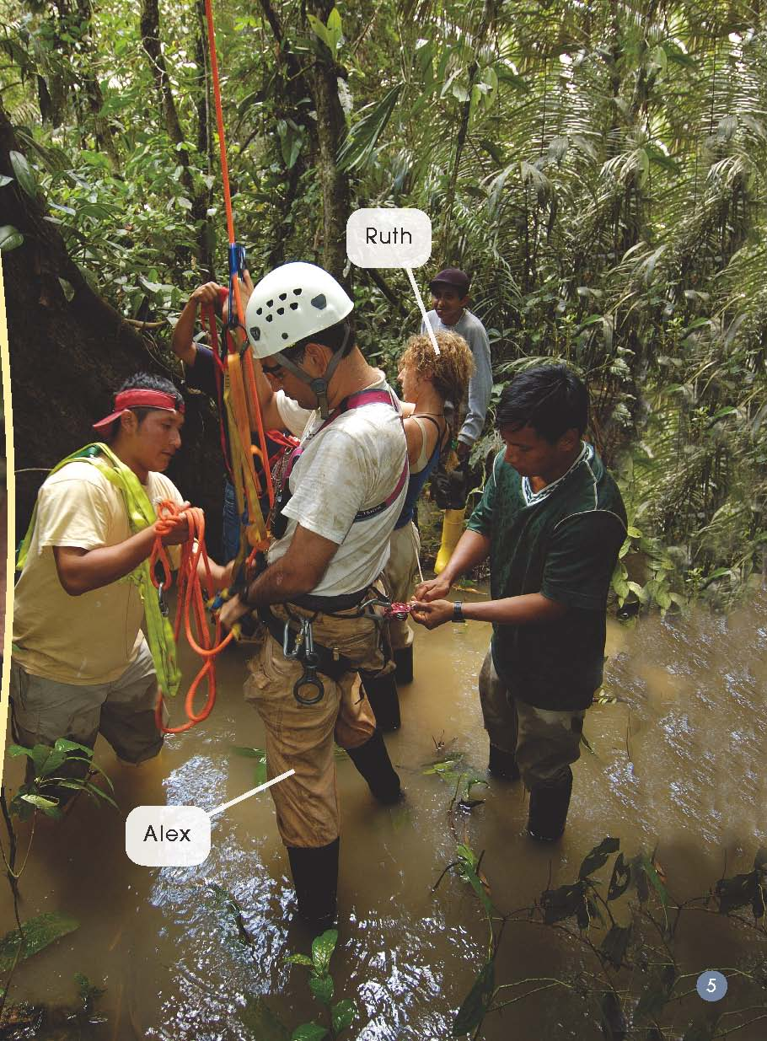
What do you think they might be doing?
What do you think might be difficult for them?

Slide 6
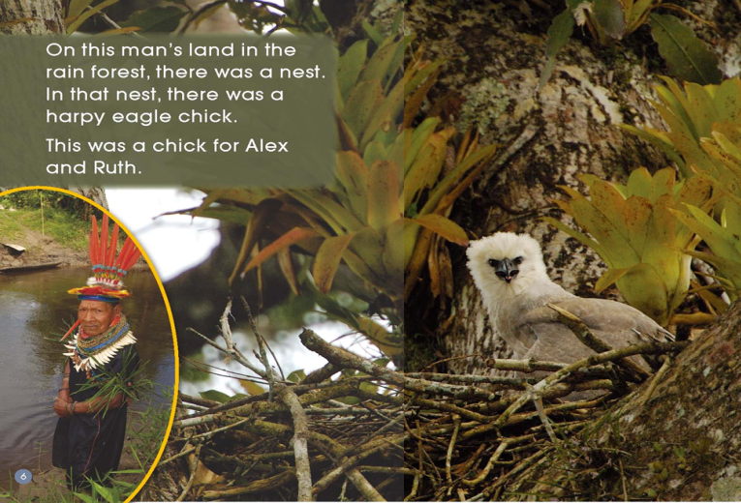
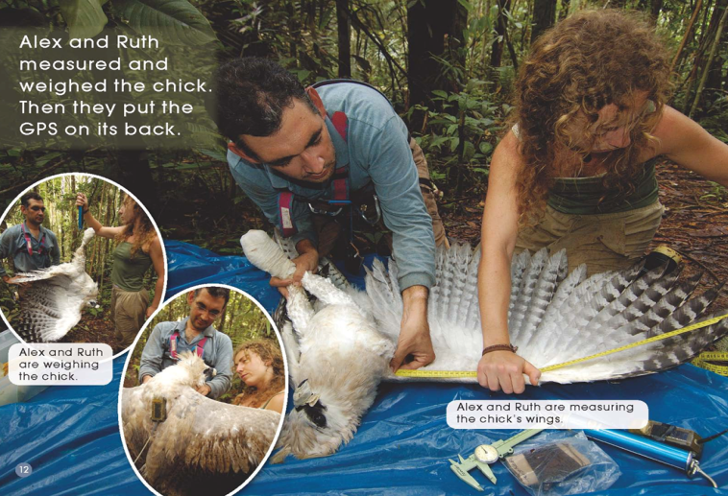
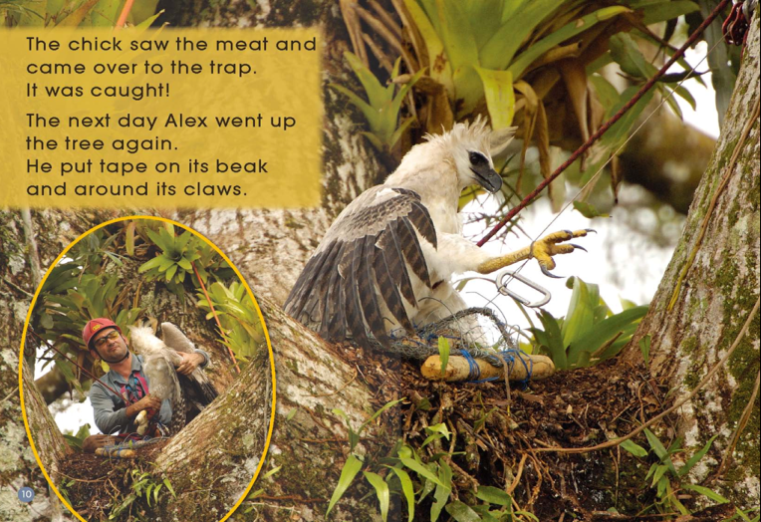
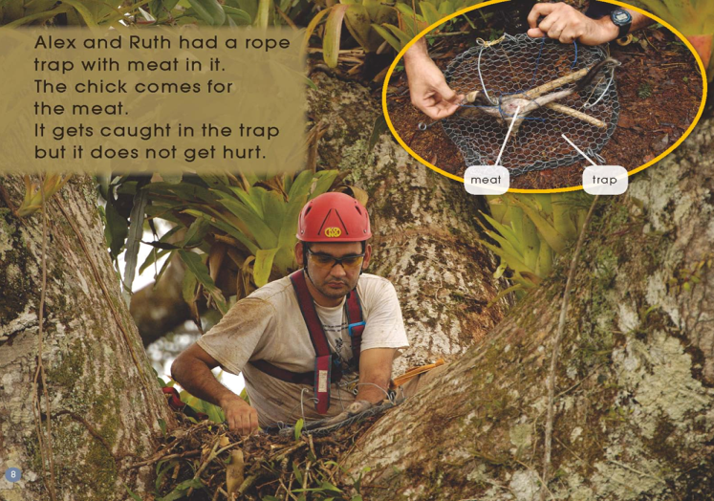
Put these pictures in order.
WHY?

Slide 7
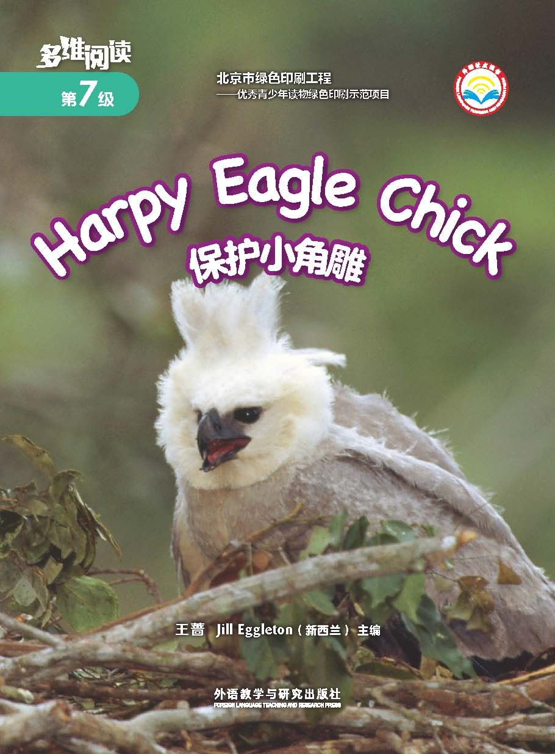
Read and answer the questions.
Where is the chick?
What would make the chick get caught in the trap?
Do they hurt the chick when they trapped the chick?
Where did they put the GPS?
Look at the picture on page 13, why do you think they
are measuring and weighing the chick?
What will the GPS do for Alex and Ruth?

Slide 8
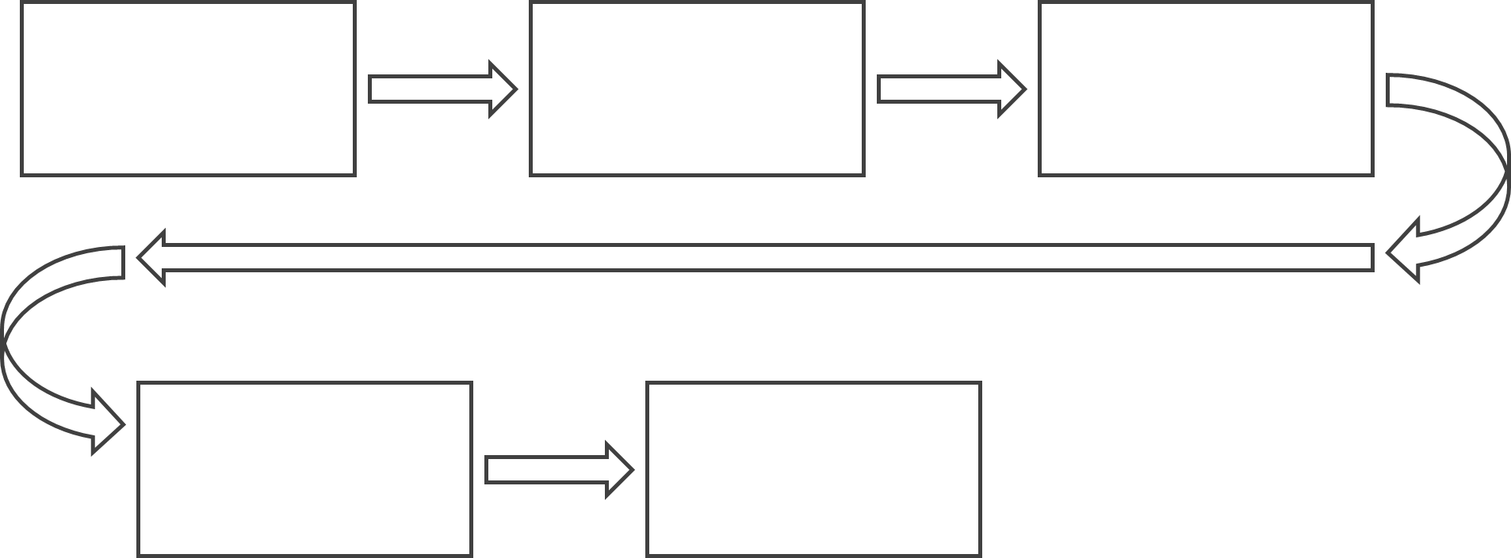
Finish the mind map.

Slide 10
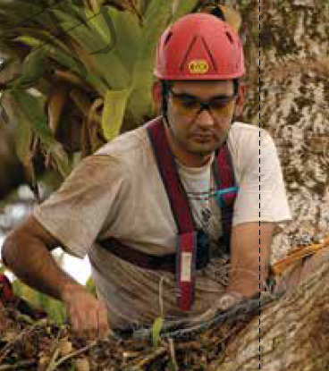
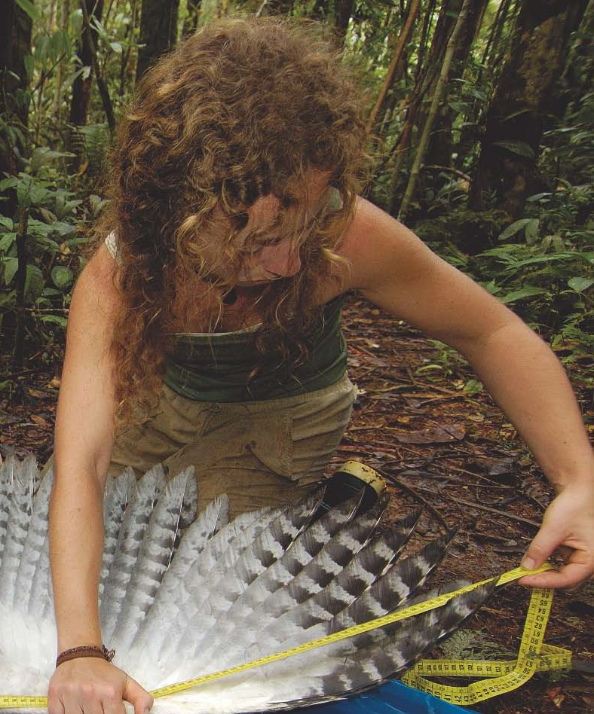
Role Play
?
Narrator
Alex
Ruth

Slide 11
Discuss in groups.
1. Do you think the title of this book is good?
Do you have any other ideas about the title?
2. Why does the author write the book?
3. What can we do to protect animals?

Slide 12
Homework
Make a poster of an animal
that is in danger of extinction.
2. Find more information about
how to protect those animals.

