Slide 1


Let’s read
第6级

Slide 2
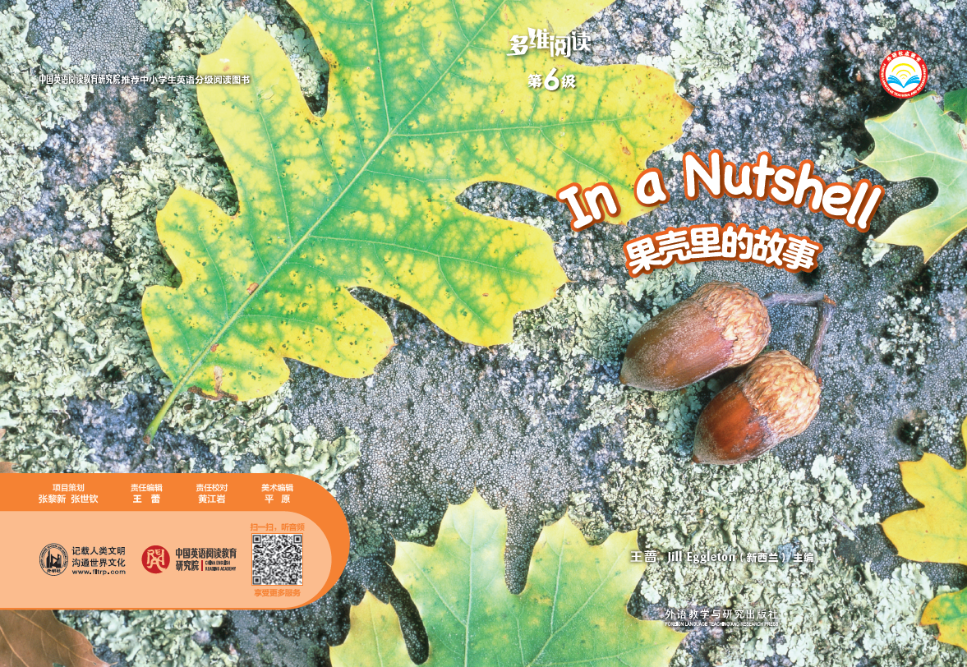
Series name
Level
Which season is it?
Title
Authors
Publisher

Slide 3

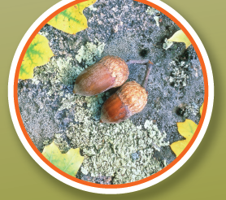

1. What do you know about nuts?
2. What do you want to know from the text?

Slide 4

Read and answer
1. What do you know from the text?
2. What animals or insects can you see in the book?

Slide 5
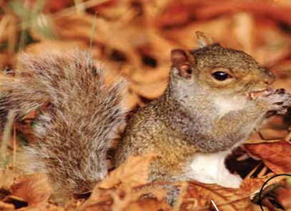
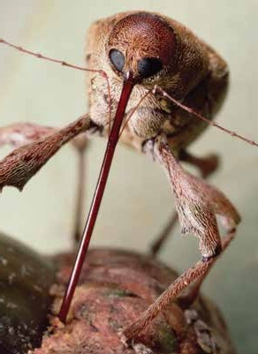
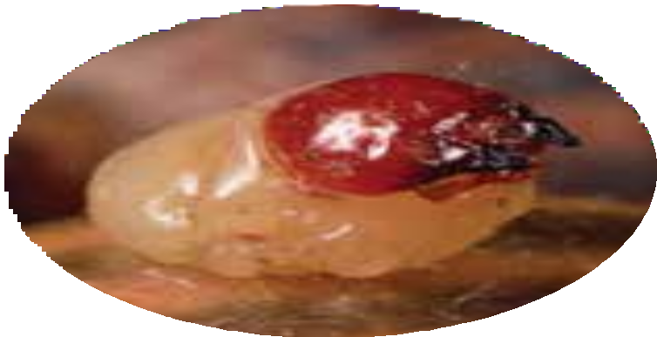
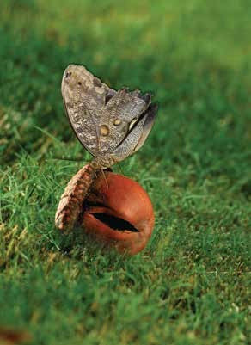
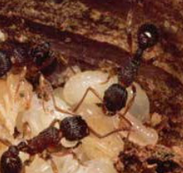
How can they make use of the nuts?
squirrel
weevil
grub
moth
ant

Slide 6
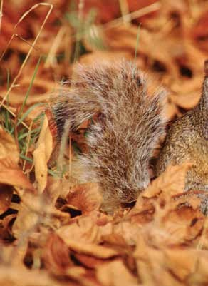
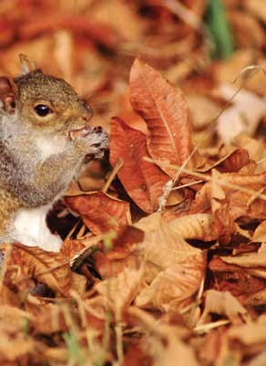
What is it doing?

Slide 7
What three things did it do with the nut?
Up comes a weevil.
It sees a nut too.
It makes a hole in the shell.
The weevil eats some
of the nut and lays eggs in the hole.

Slide 8
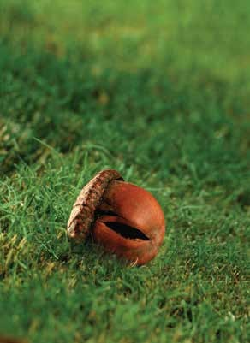

How did the grubs get out of the nut?
They eat their way out of the nut and go under
the ground.
grub

Slide 9
How can the moth make use of the nut?
Can you guess what will happen?

Slide 10
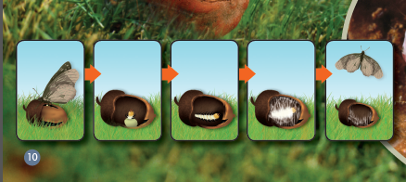
Read and choose
（A）
（C）
（B）
（D）
（E）
A: A moth comes.
B: A caterpillar comes out of the egg.
C: A moth lays eggs in the nut.
D: It makes a cocoon in the shell.
E: A moth comes out of the nut.

Slide 11
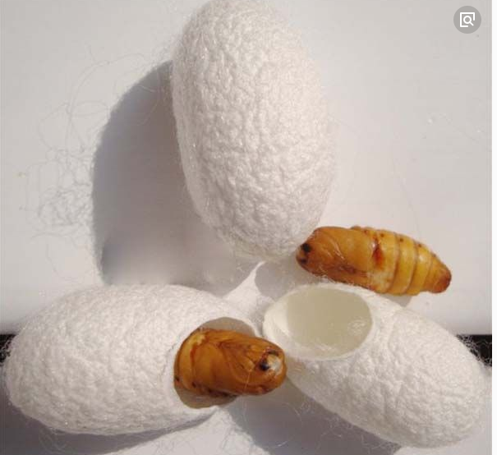
What other animals make a cocoon?
cocoon

Slide 12

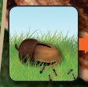
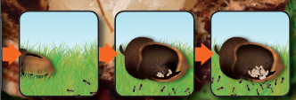
Watch and say
Try to say a word or phrase.
The ants see a nut.
The ants go away
from the nut.
The queen lay
eggs in the nut.
The ants look
after the eggs.

Slide 13
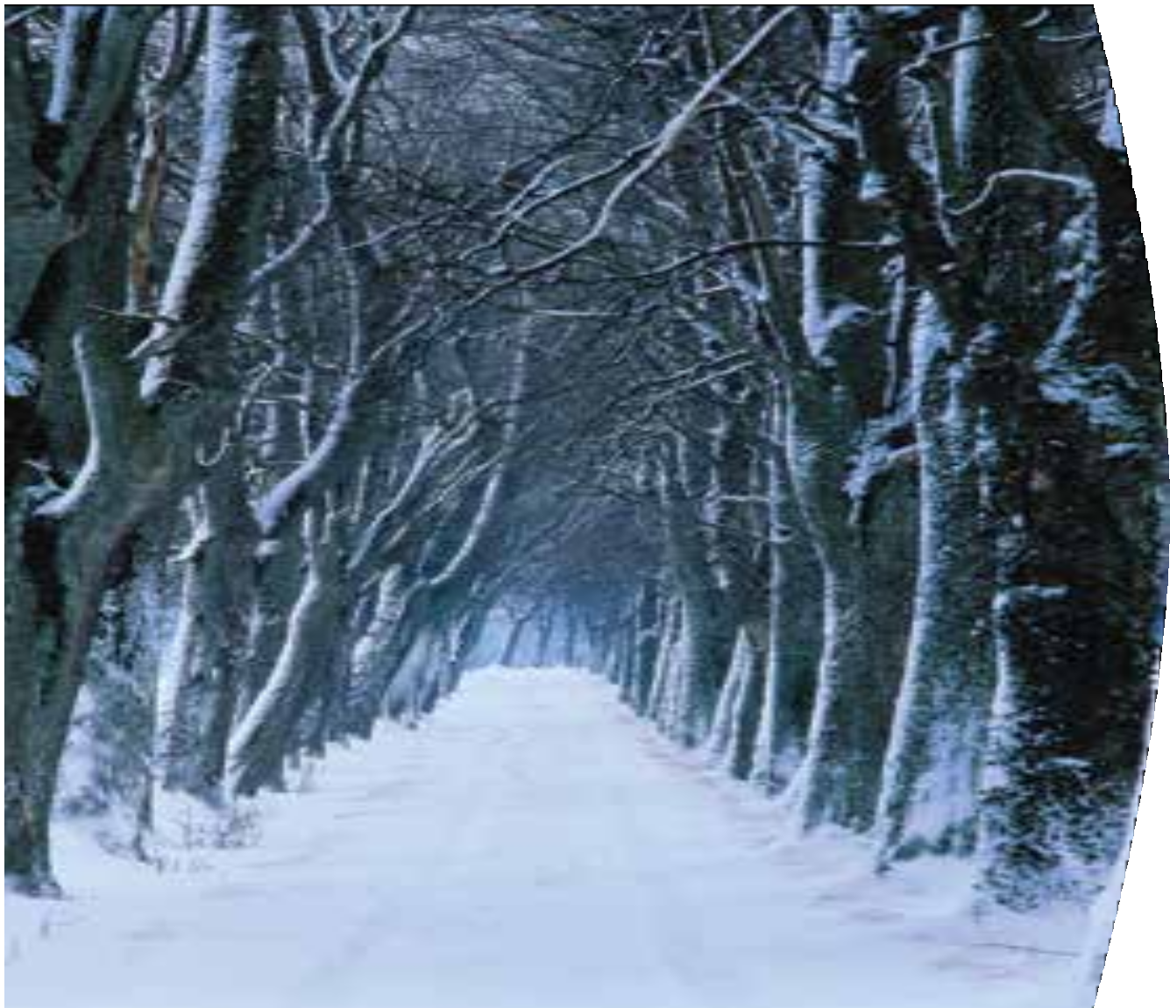
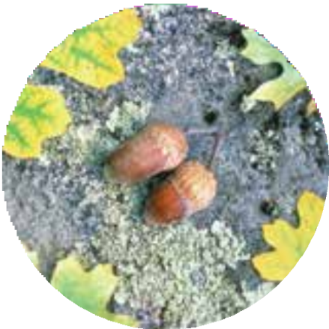
Which season is it now?
Are there any nuts now?

Slide 14


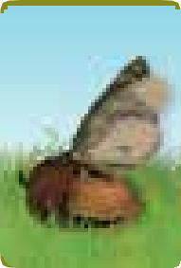
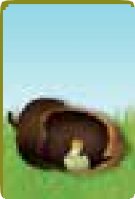
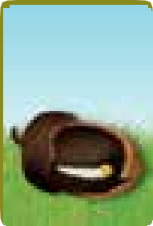
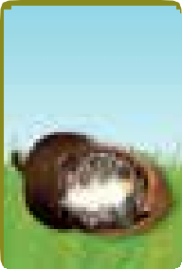
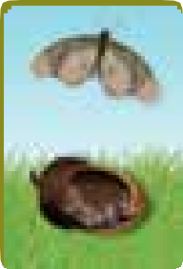
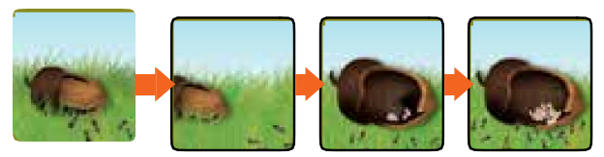
Read and think
1. Can you find a cycle in the book?
2. What else can you think of that is like a cycle?

Slide 15

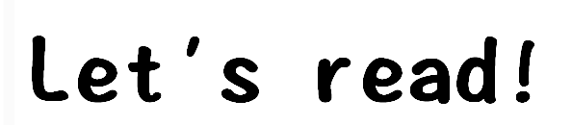
1. Read the text by yourself.
2. Follow to read.

Slide 16
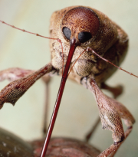



Read and match

Slide 17

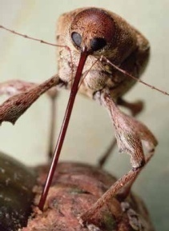

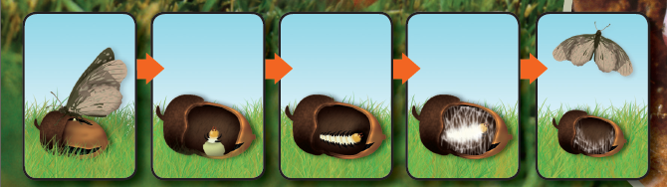
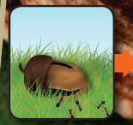
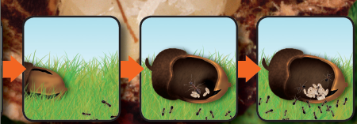
Group work
choose one insect
talk in groups
It is autumn, the nut falls from the tree.
Up comes___, it can____.
The nut is still on the ground.
Up comes___, it can___.
It is winter, no nuts are there now.
1
2
3

Slide 18

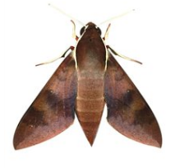
Think and share
1. Why do you think a moth would choose a nut to lay its eggs in?
2. Do you think a nut is a good place for a caterpillar to make cocoon?
3. Where else can they lay eggs?

Slide 19
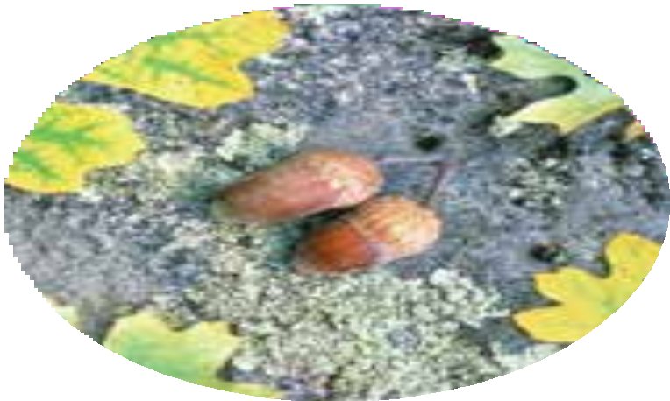
Homework
1. Think how you can make use of the nuts.
2. Make a diagram of how a weevil makes use of a nut.

