Slide 1
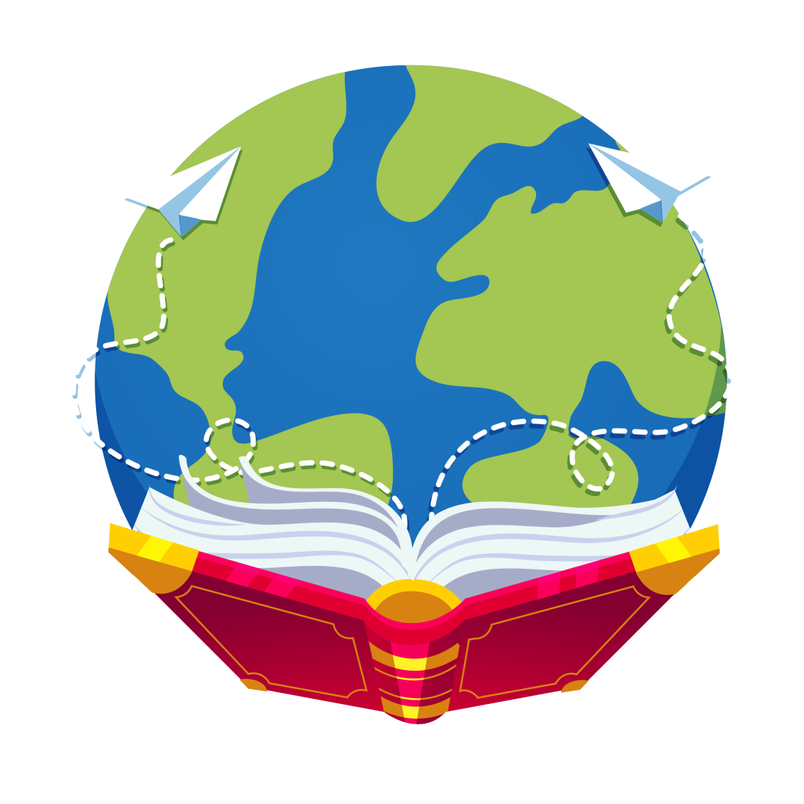
Let’s read
第6级

Slide 2
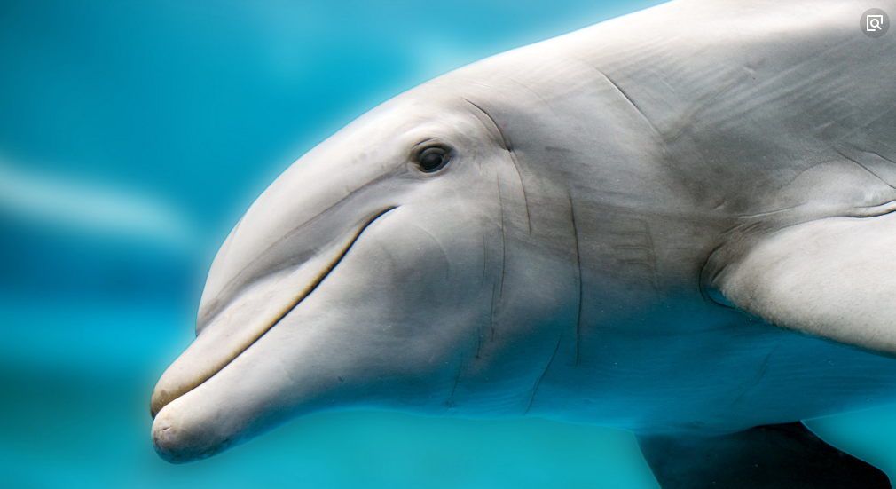
Let's guess
What else do you konw about dolphins?

Slide 3
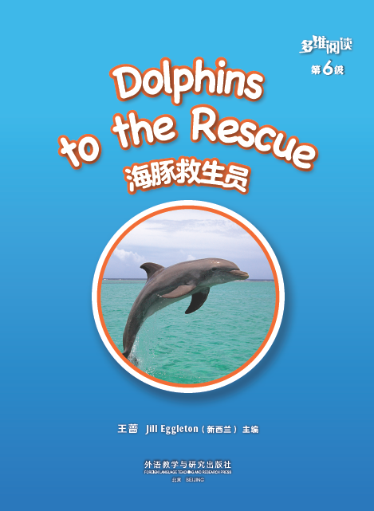
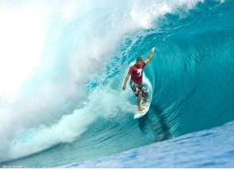
Who are the characters in the book?
Where might the story happen?

Slide 4
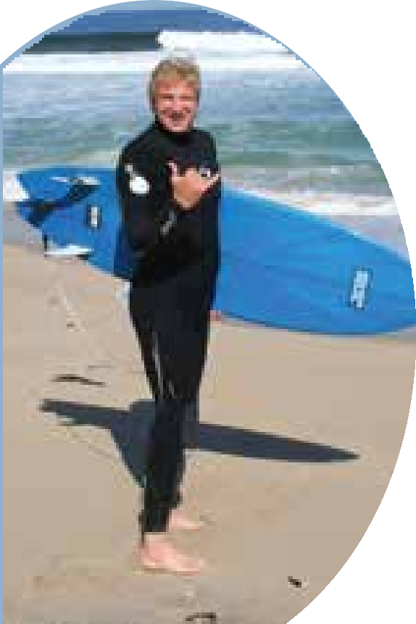
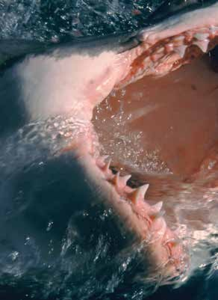
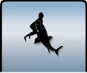
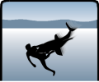
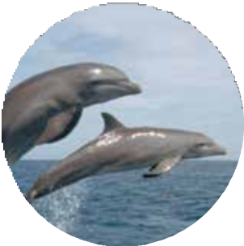
Read and answer
1. Who is the surfer?
2. What happened to him?
3. When and where did the story happen?
4. Who saved his life?
Todd
hit
Dolphins

Slide 5
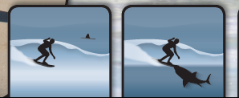
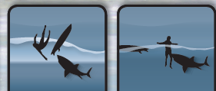
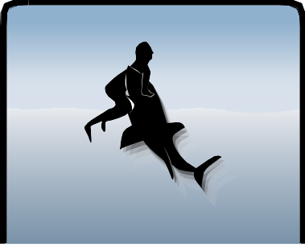
Read and Say
surfed on the
surfboard
saw a shark
fell into the sea
hit again and again
went up in
the air

Slide 6
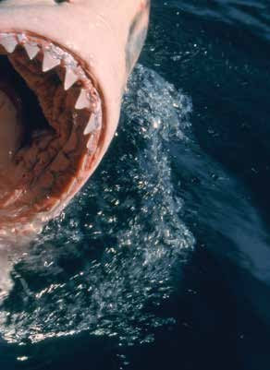
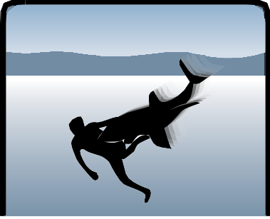
What do you know about shark's jaws and teeth?
How are they different to your teeth?
kicked the shark
had ... in its
jaws

Slide 7
Read and write
circle
go
him bleeding
a helicopter
hospital

Slide 8
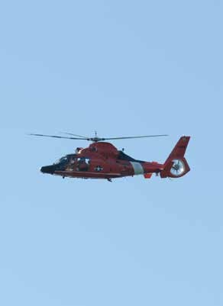
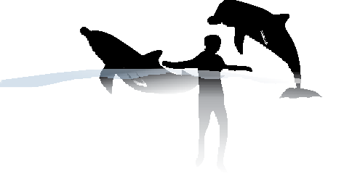
come to rescue
call the helicopter

Slide 9
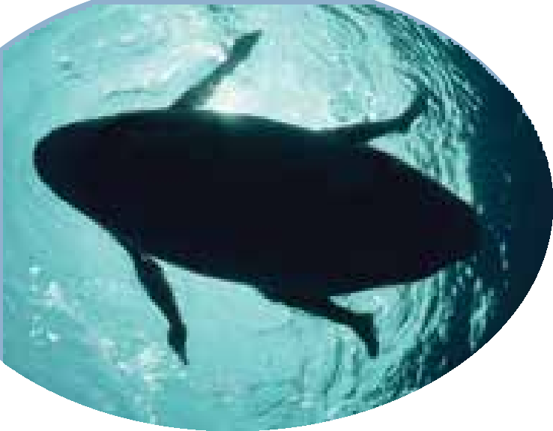
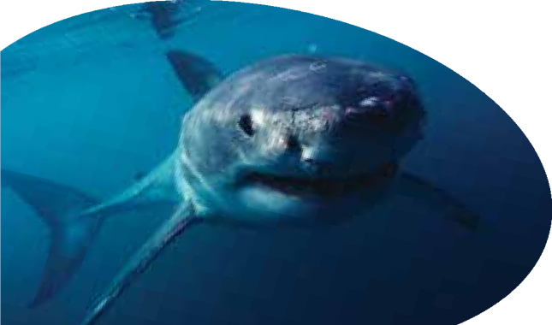
Think and talk
Why did the shark hit Todd?
home of the shark
looks like a seal

Slide 10
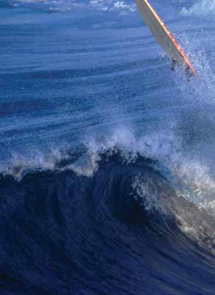
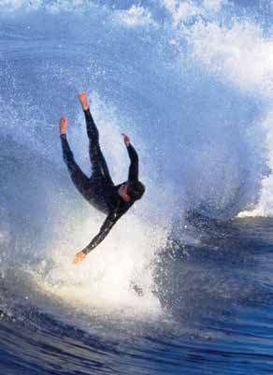
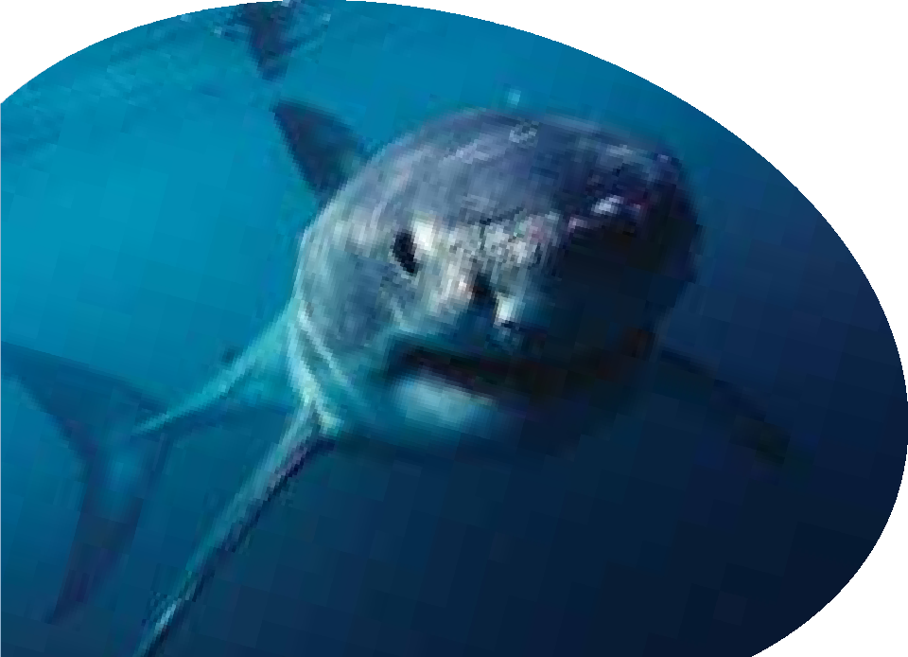
crash

Slide 11
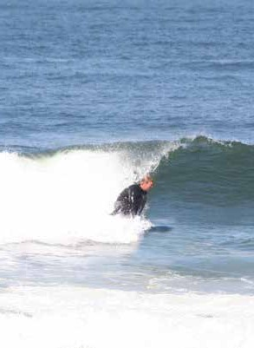
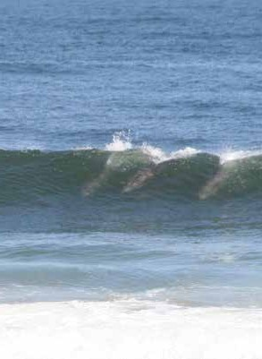
Todd is back surfing again!
What do you think of Todd?
I think he is ..., because ...

Slide 12
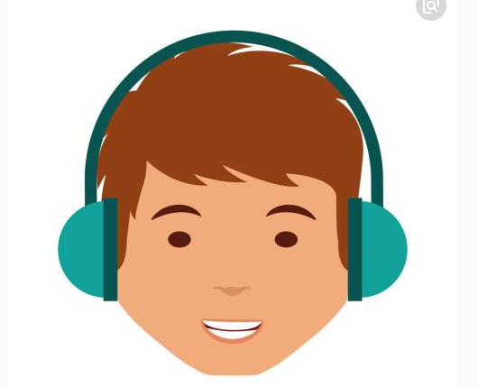
●
Read the text by yourself.
● Follow to read.

Slide 13
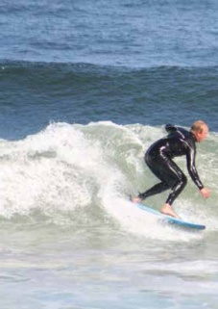
News conference
● Work in groups of four, one is Todd,
and others are reporters.
Questions you may ask:
What did you do in the sea?
What happened to you?
How did the dolphins help you?
Why do you surf again?
...

Slide 15
Read and think
Six weeks later, he went surfing at Marina State Beach again, “You really have to face your fears,” Todd said “I’m a surfer at heart, and that’s not something I can give up easily. ” He kept surfing and became a vocal advocate(发声者) for protecting(保护) great whites.

Slide 16
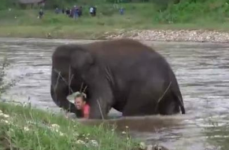
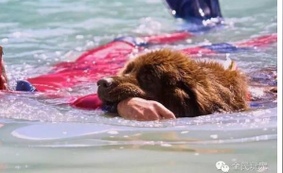
Let's share
What other animal stories do you know about?
How can we live in harmony with animals?

Slide 17
Homework
1. Find more facts about dolphins.
2. Draw a picture and write about something that made you frightened and how you solved the problem.

