Slide 1
Let’s read
第5级

Slide 2
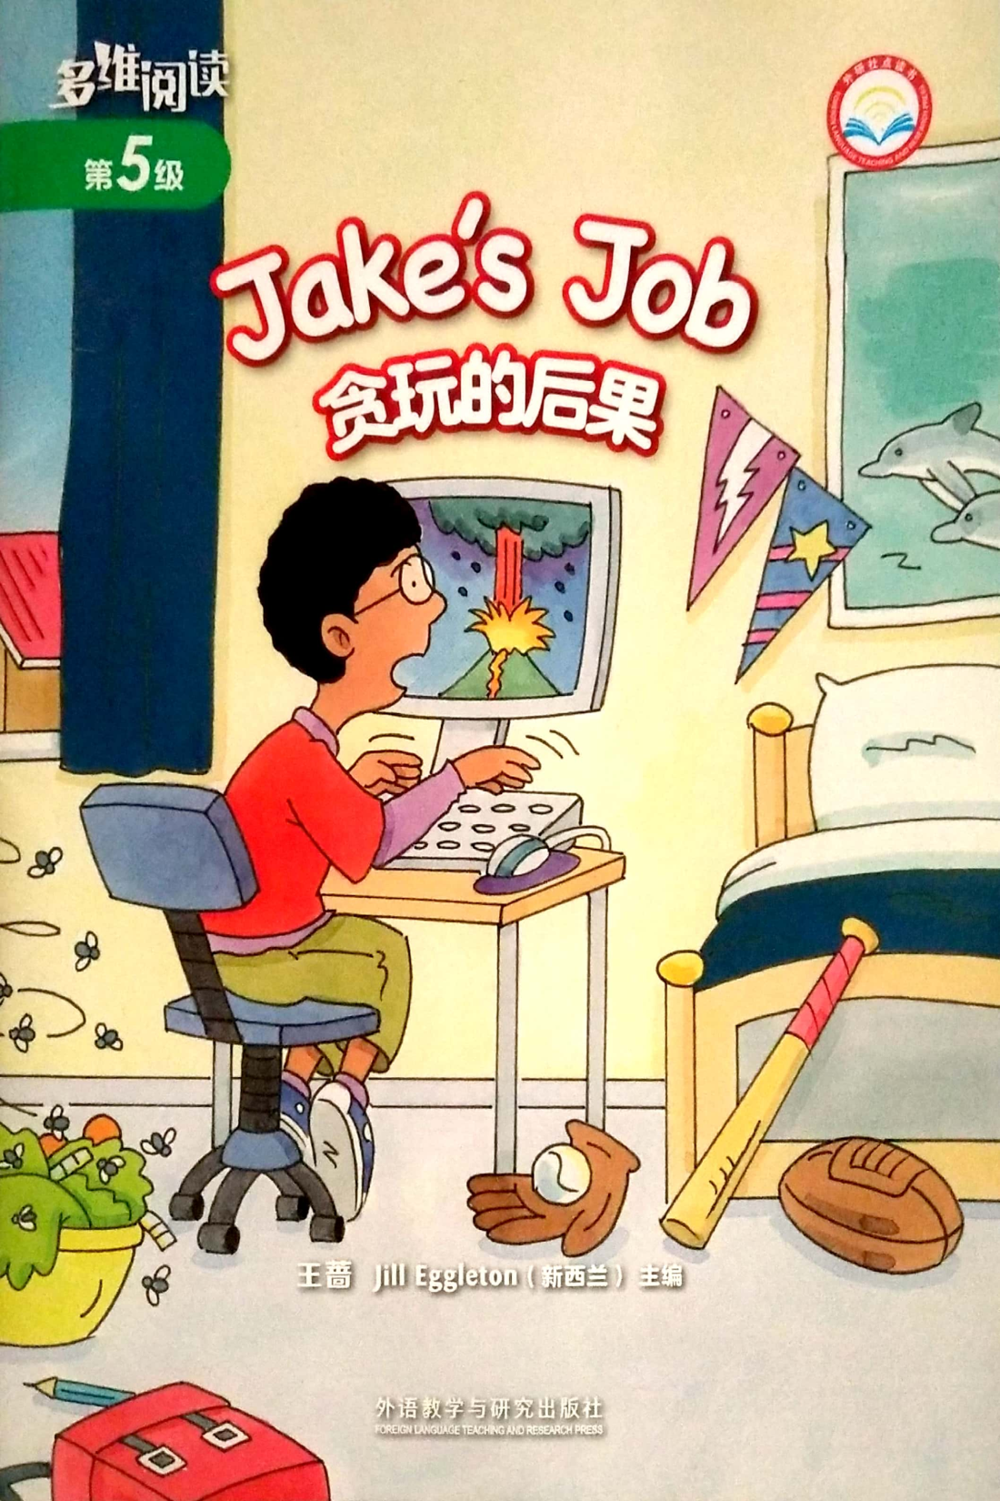
Series name
What do you think of this bedroom?
Where was the boy?
Level
Title
What was
Jake’s job?
Why was there
a bowl of food?
Authors
Publisher

Slide 3
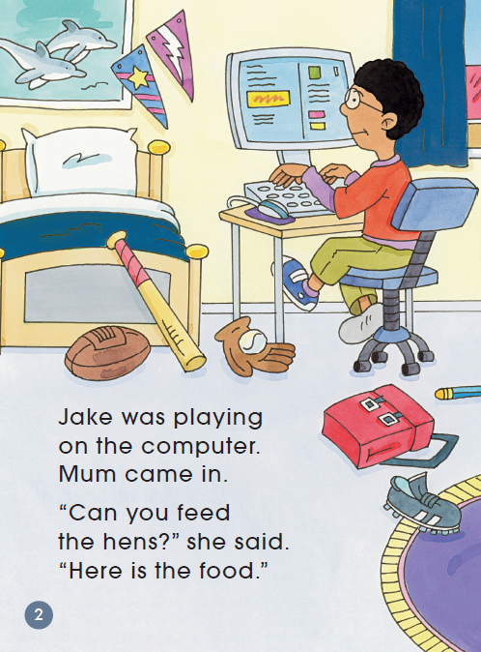
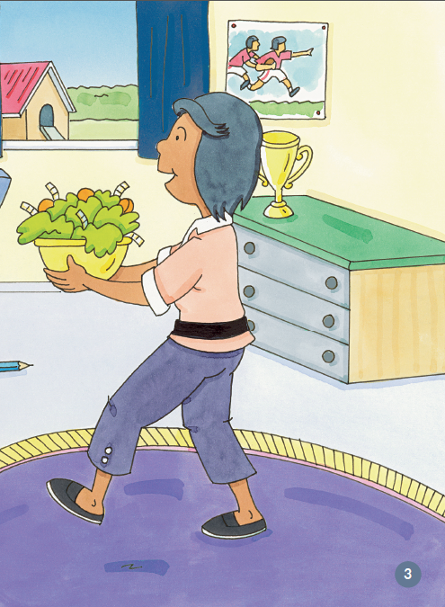
What was Jake doing?
Why did Mum come in
with a bowl of food?

Slide 4
feed the hens

Slide 5
Did Jake feed the hens?
Why or why not?

Slide 6
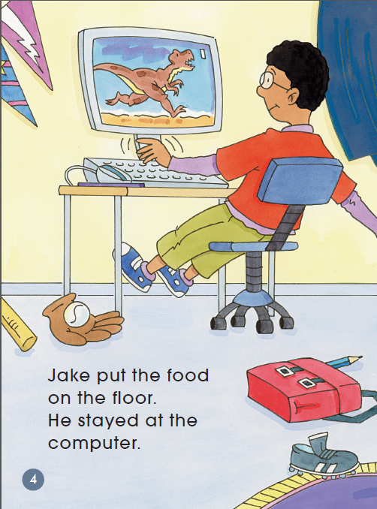
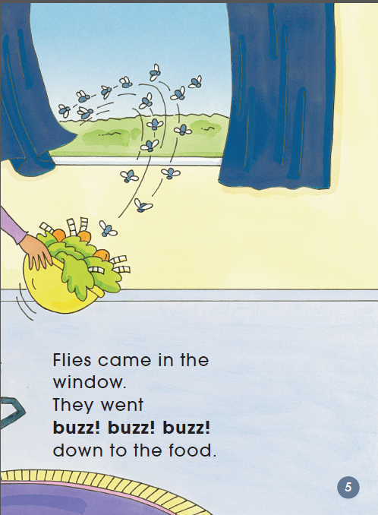
Why did the flies come in?
flies
put the food on the floor

Slide 7
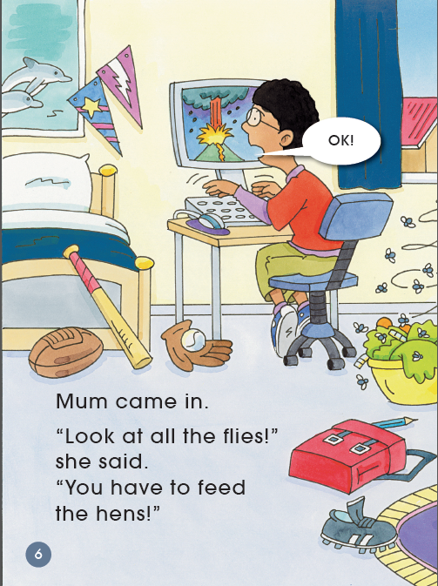
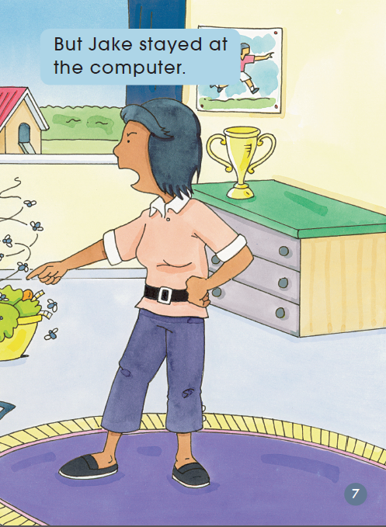
How did Mum feel?
What was Mum saying?
“Look at all the flies!
You have to feed the hens!”

Slide 8
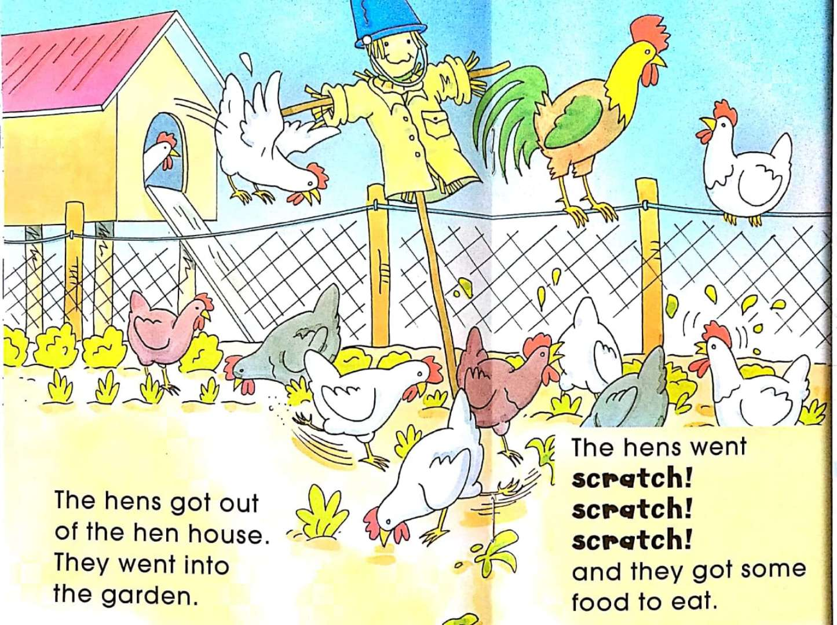
What did the hens do?
They went into the garden and made a mess.

Slide 9
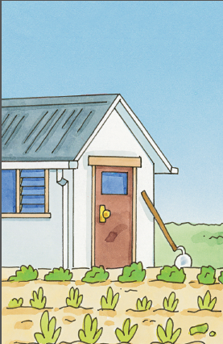
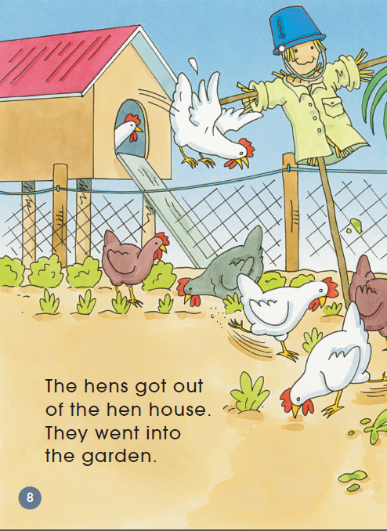
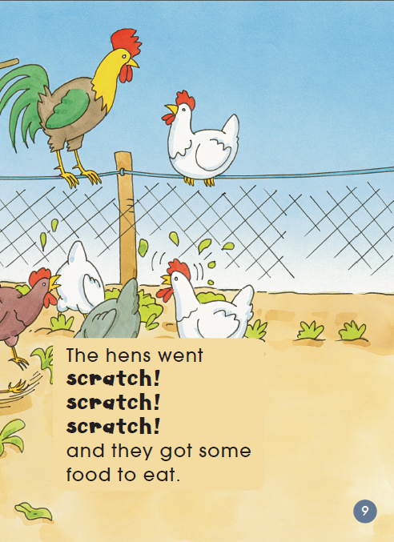
clean
messy

Slide 10
Why did the hens go into the garden?

Slide 11
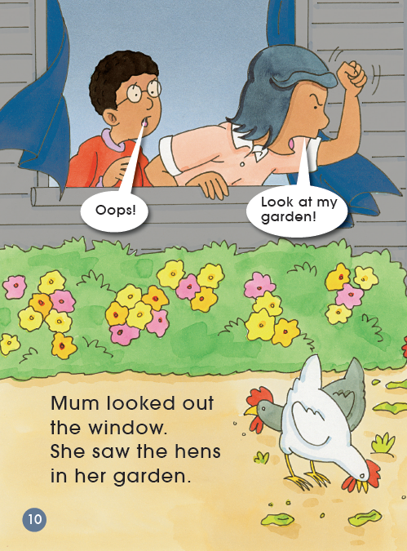
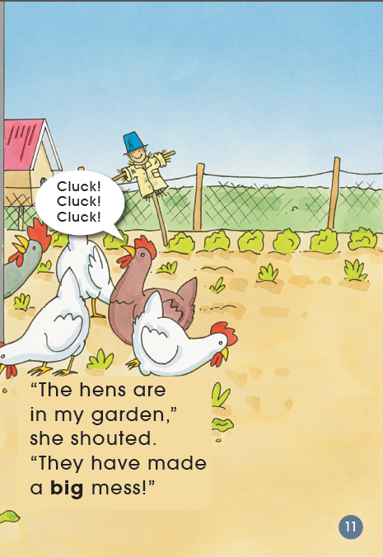
What was Jake thinking?

Slide 12
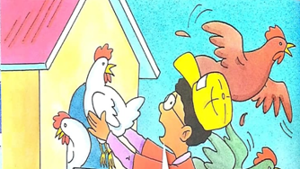
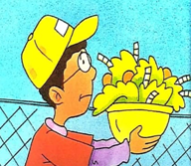
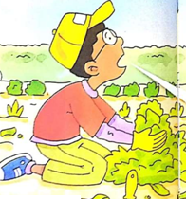
Q: What did Jake have to do?
Tips:
1. Read PP 12-15.
2. Discuss with your
partner.
Useful sentence:
Jake had to…
put the hens back
feed the hens
clean up the garden

Slide 13
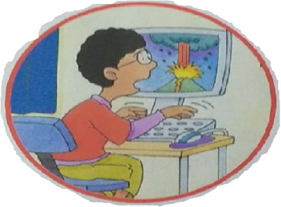
Q: What do you think of Jake?
Tips:
Talk in pairs.
Useful structures:
I think he is… Please look at Page…
Smart?
Lazy?
…

Slide 14
Listen and repeat
Tips:
1. Listen carefully.
2. Follow to read.
3. Point with finger.
4. Read emotionally.

Slide 15
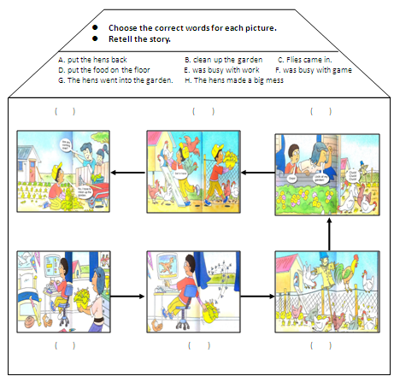
Write and retell
Tips:
1. Finish the story map.
2. Retell the story with
your partner.

Slide 16
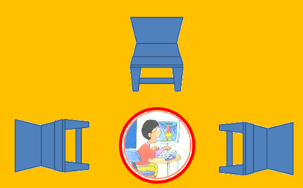
Game: Hot Seat
Tips:
1. Four students play in one group.
2. One student is “Jake”.
Others sit around “Jake” and ask “him” questions.
Useful words:
What/Who/Where/Why/When/How

Slide 17
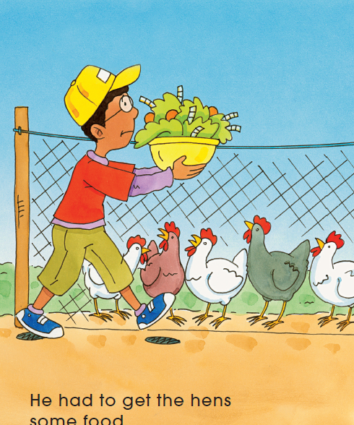
Q: If Jake fed the hens at the beginning, what would happen?

Slide 18
Q1: Has anything like this ever happened to you or anyone you know?
Q2:What should we do when we get a job?
Never forget your job because of games!

Slide 19
Homework
1.Draw a picture of a job you have to do.
2.Reorder the pictures to make a new story.

