Slide 1
Let’s read
第5级

Slide 2
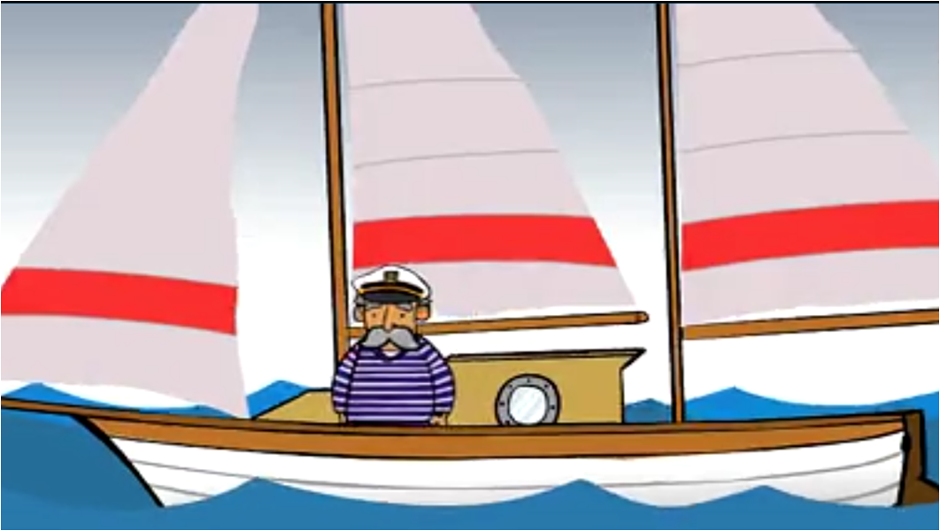
Q: Who is he?
He is a …
Sailor

Slide 3
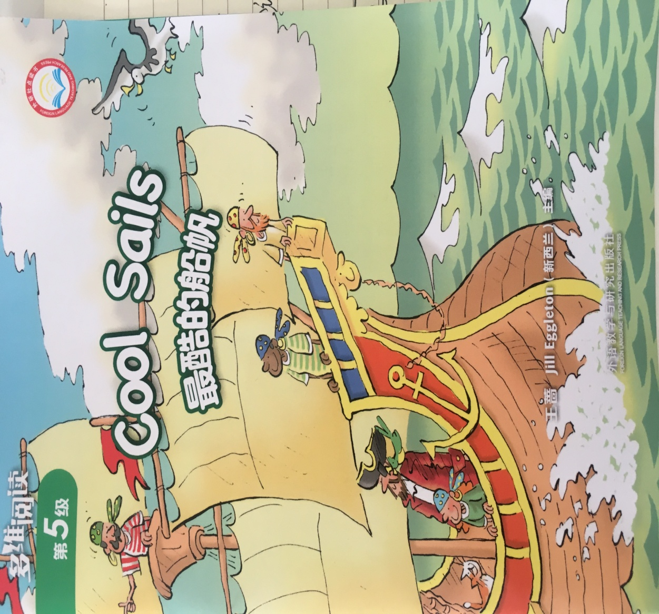
Series
Level
Maybe he is pointing to …
Title
Authors
Publisher

Slide 4
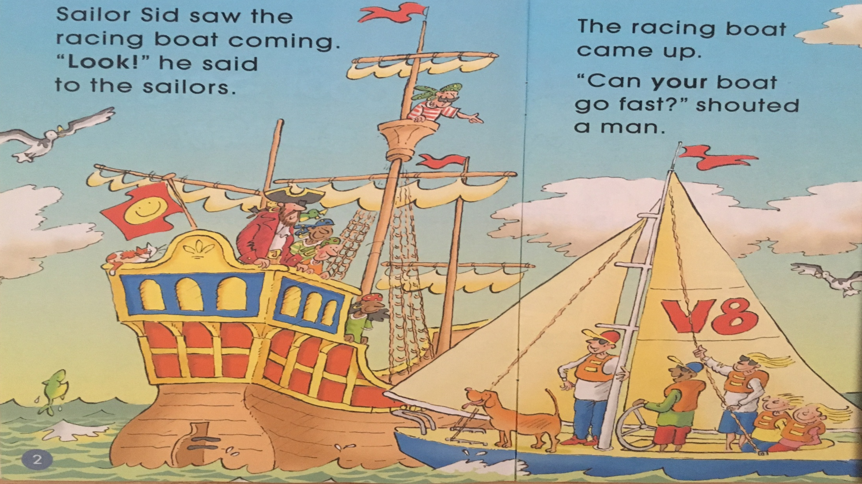
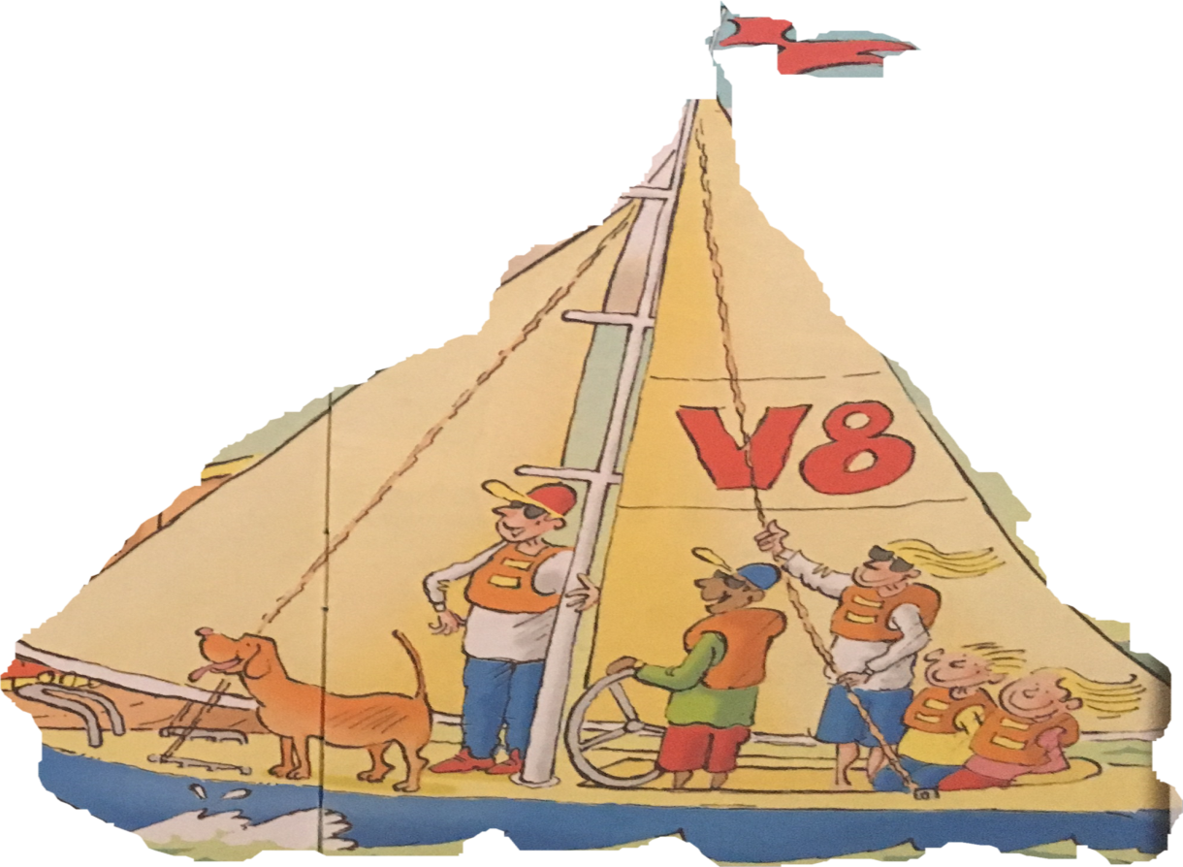
racing boat
Look!

Slide 5
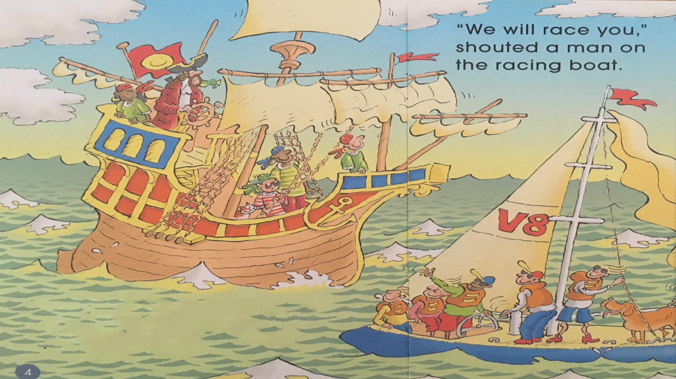
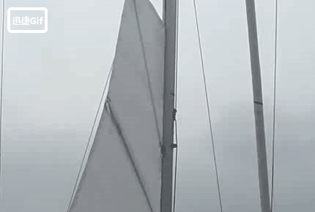
Which boat won the race?
Sailor Sid put up the sails.
he said.
“This boat can go fast,”

Slide 6
Fast-reading
Tips:
1. Read PP 6-15.
2. Find the ending.
Q: Which boat won the race?
PK
V8
Sailor Sid’s boat
Racing boat

Slide 7
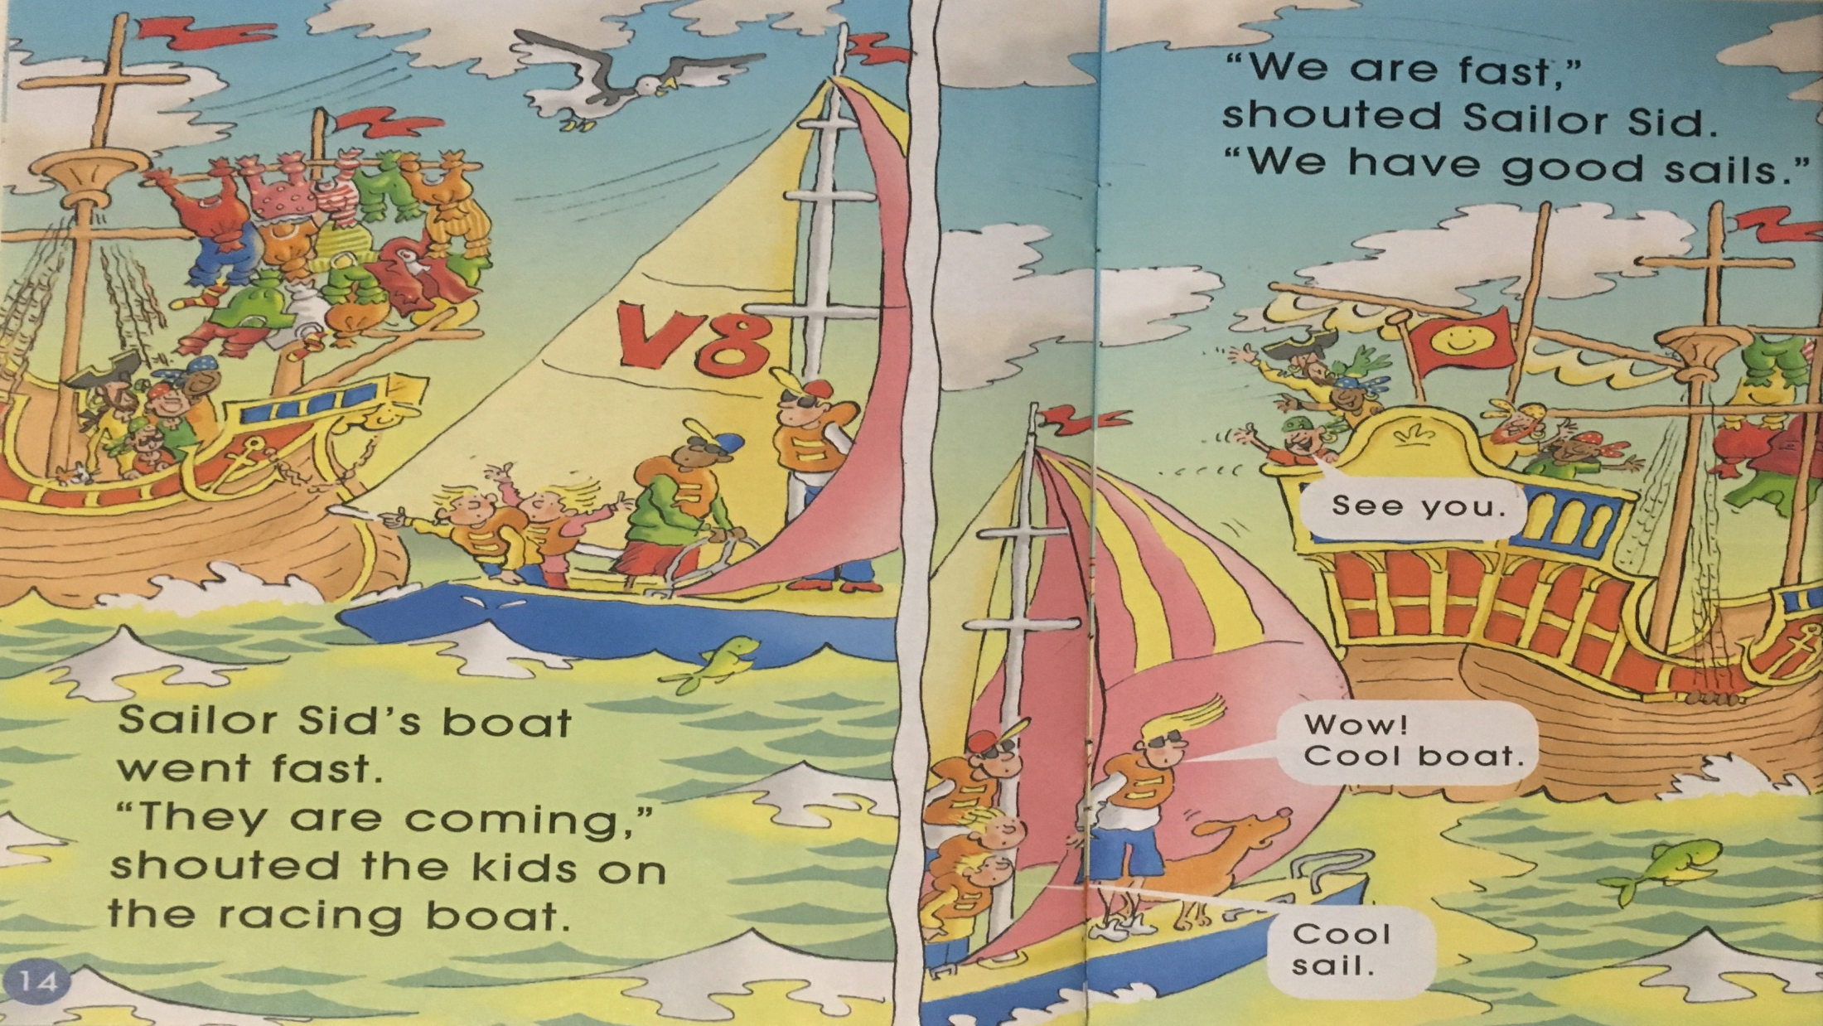

Slide 8
Self-reading
Tips:
1. Read PP 6-13.
2. Finish the story map.
Q1: What was the problem?
Q2: How did Sailor Sid solve it?

Slide 9
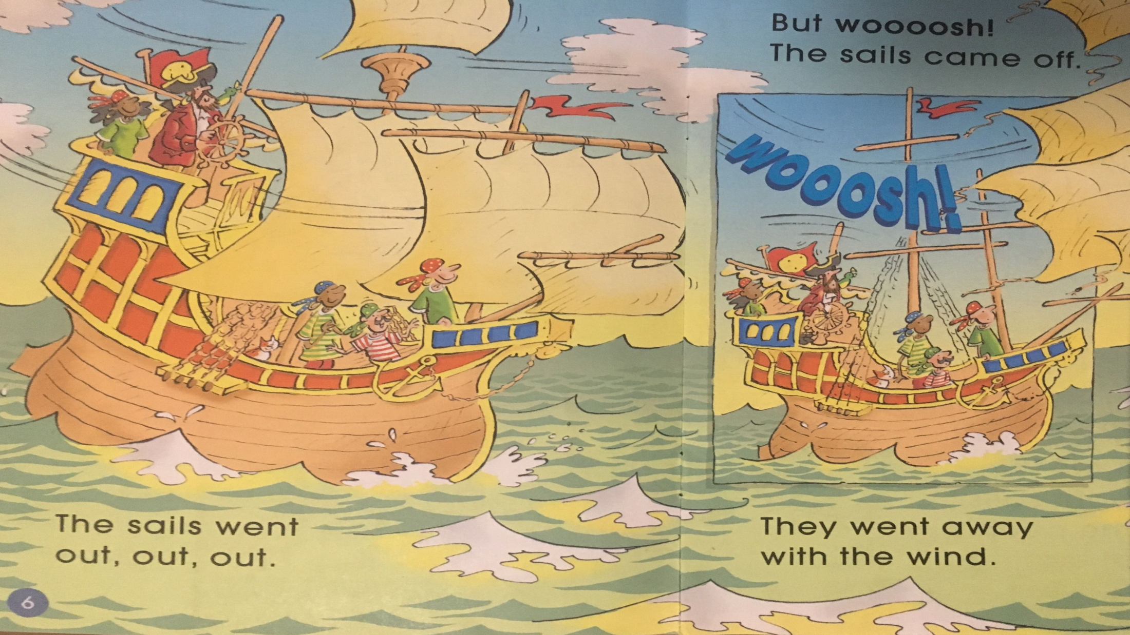
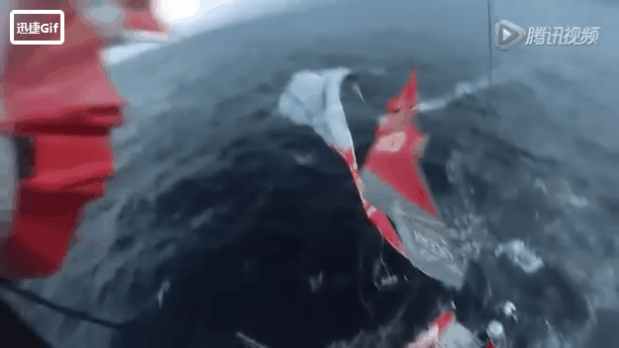
Q: What was the problem?

Slide 10
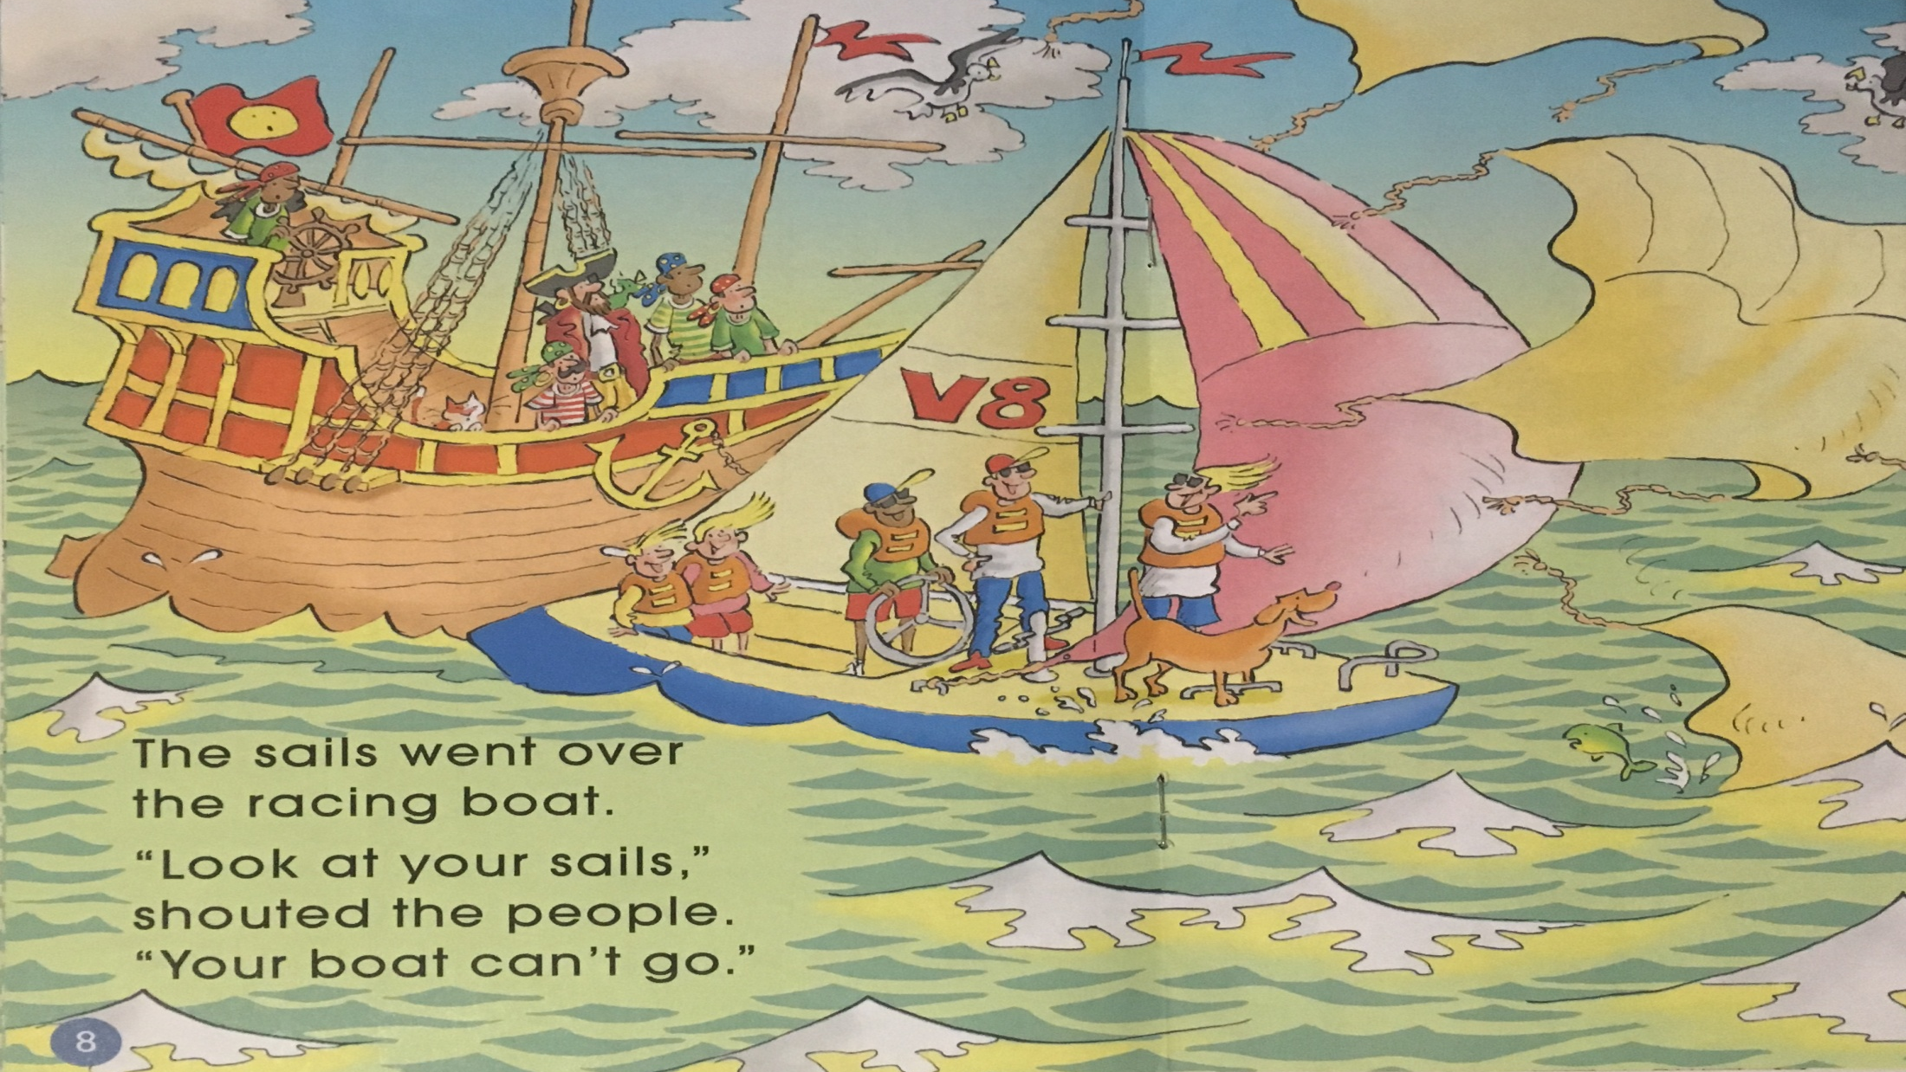
Q: How did people on the racing boat feel?

Slide 11
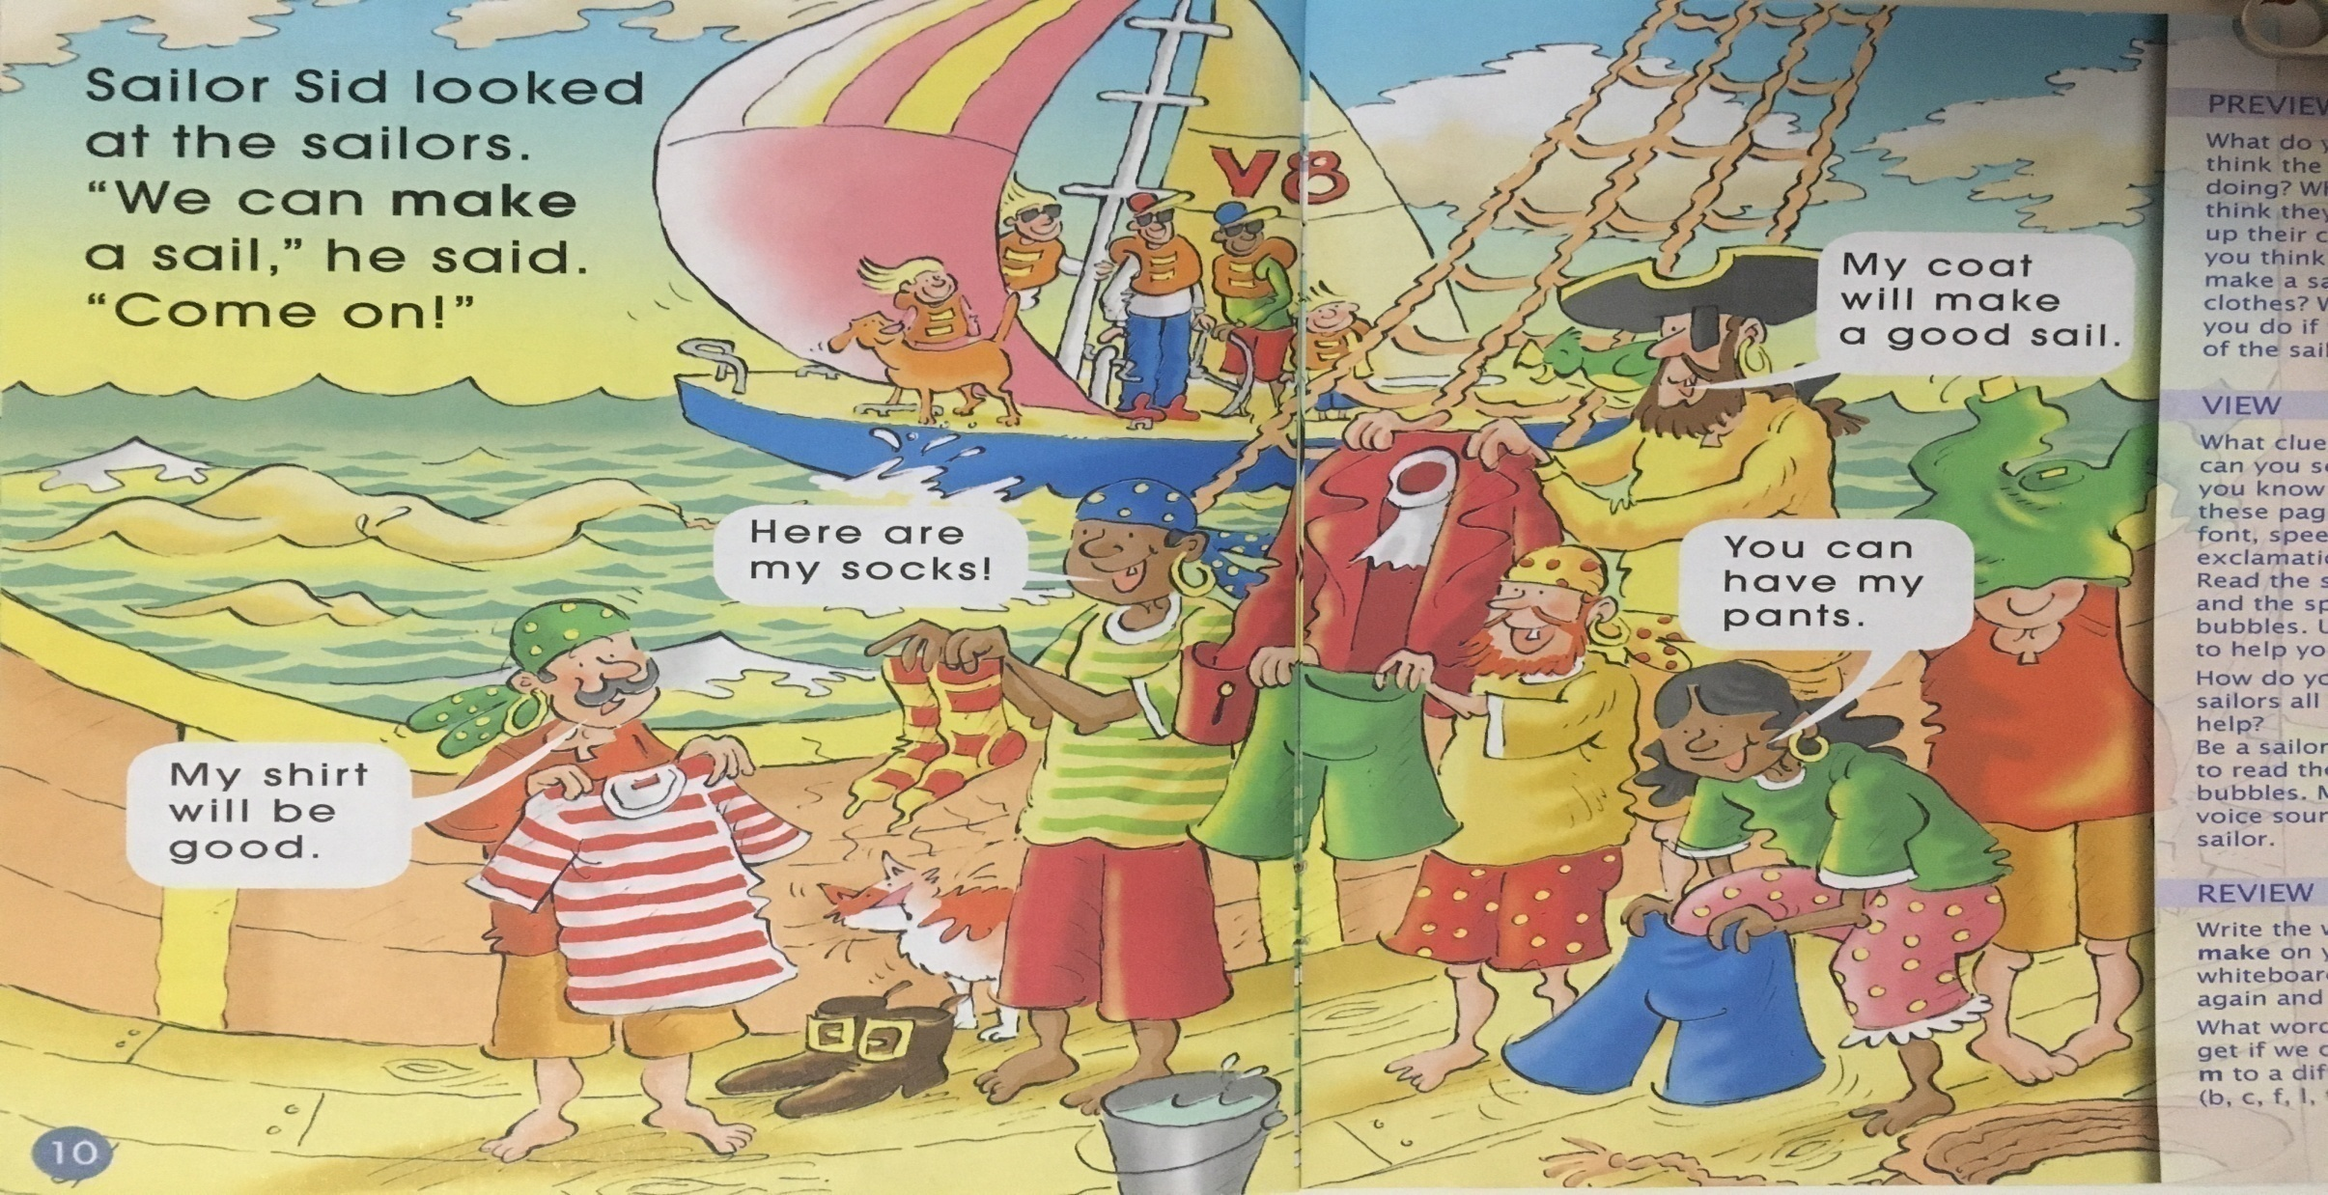
Q: What did they use to make a sail?
Q: How did Sailor Sid solve it?

Slide 12
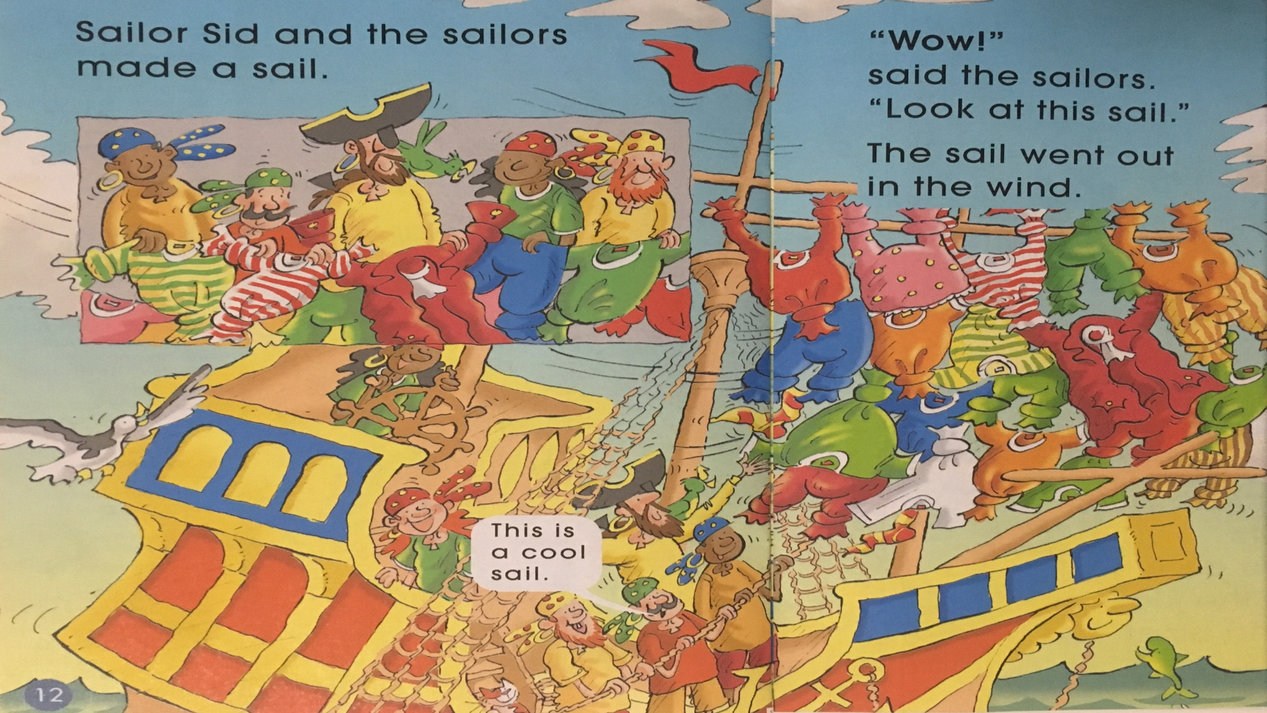

Slide 13
Q:Why did Sailor Sid’s boat win the race?
Q: What are people on the racing boat saying now?

Slide 14
Listen and repeat
Tips:
1. Listen carefully.
2. Follow to read.
3. Point with finger.

Slide 15
Let’s act
Tips:
1. Group work.
2. Act with full emotion.
3. Do some actions.
PK
V8
Useful sentences

Slide 16
Share your story
Q: What was your problem and how did you fix it?
idea
succeed
problem

Slide 17
Q: What’s our attitudes(态度) when we have a problem?
fighting

Slide 18
Homework
1. Draw the picture about the problem and the solution in your story.
2. Read another story about Sailor Sid, and share it with your friends.

