Slide 1
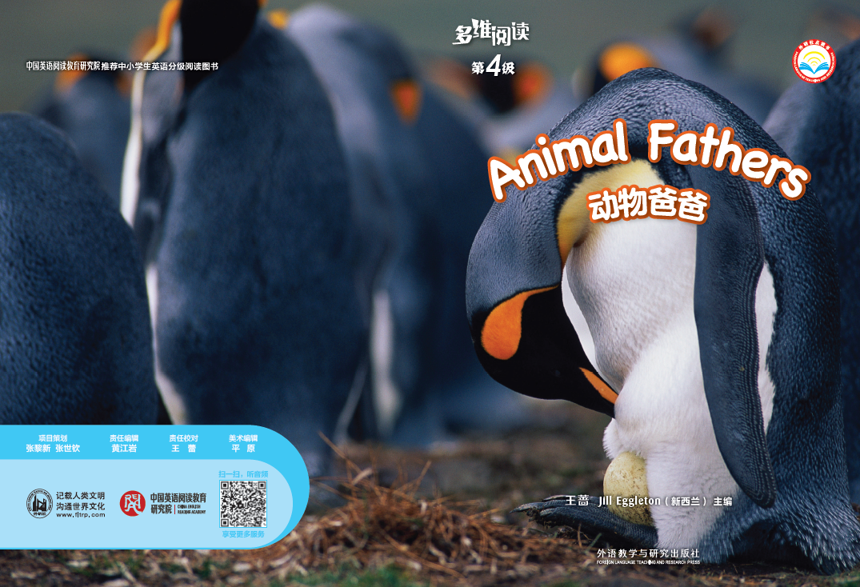
多维阅读第4级
Animal Fathers

Slide 2
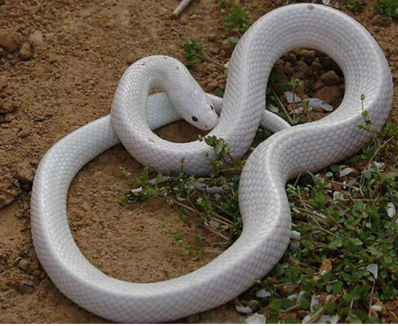
Read , guess and answer.
a snake

Slide 3
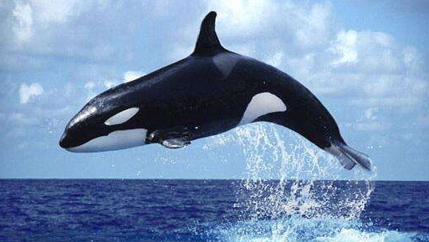
a whale

Slide 4
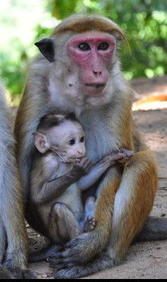
monkeys
look after
mother monkey
is female monkey
baby monkey

Slide 5
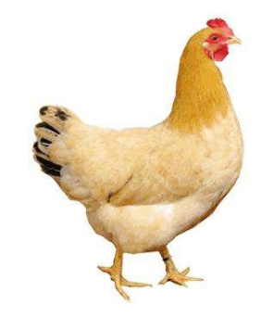
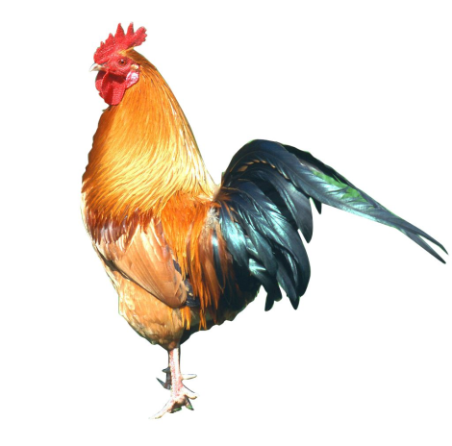
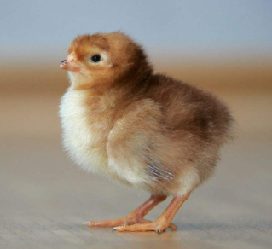
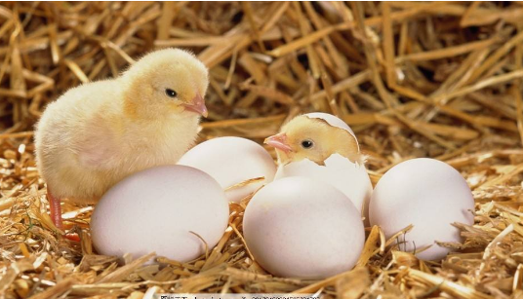
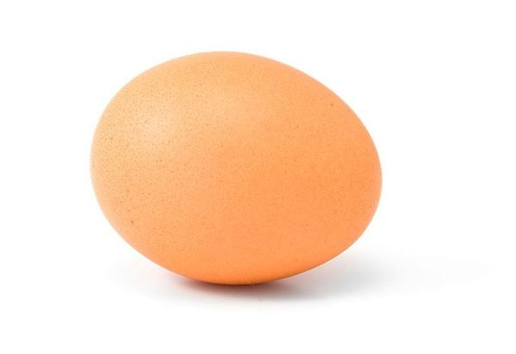
baby chicken
female
father chicken
boy
mother chicken
male
hatch
look after
Where is a baby chicken from?
an egg

Slide 6

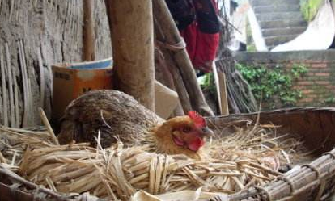
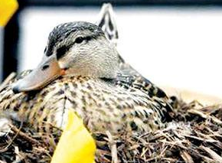
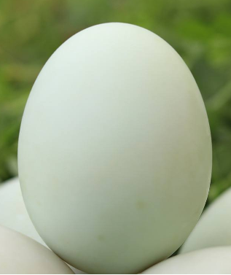
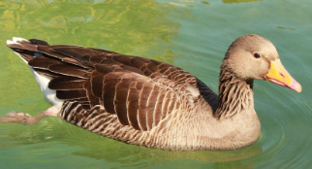
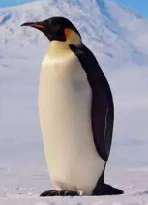
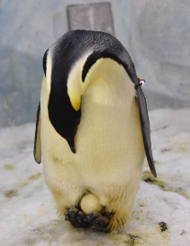
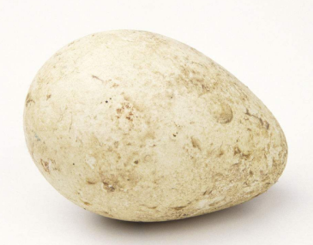
Whose eggs are these?
Who look after the eggs?
mother chicken
mother duck
penguin
father penguin

Slide 7
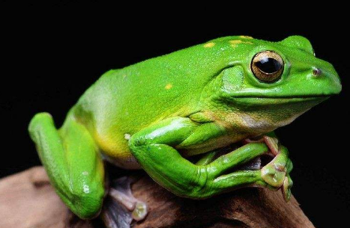
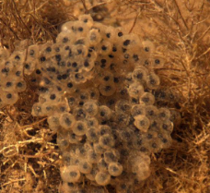
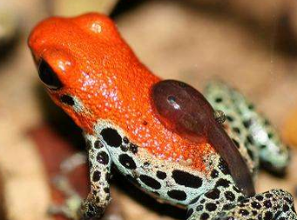

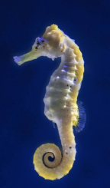
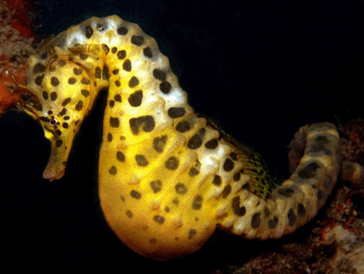
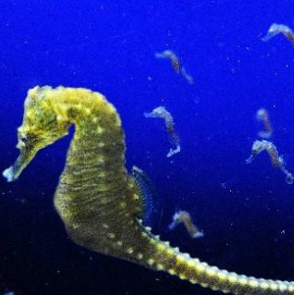
Guess: Do they have eggs?
Where are the eggs?
Who looks after the babies?
hatch
tadpole
father frog
in water
hatch
seahorse
in father seahorse's pouch
father seahorse

Slide 8
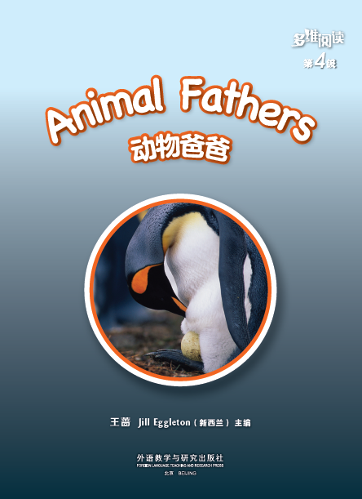
How do the fathers take care of the babies?
Title 标题
Writer作者

Slide 9
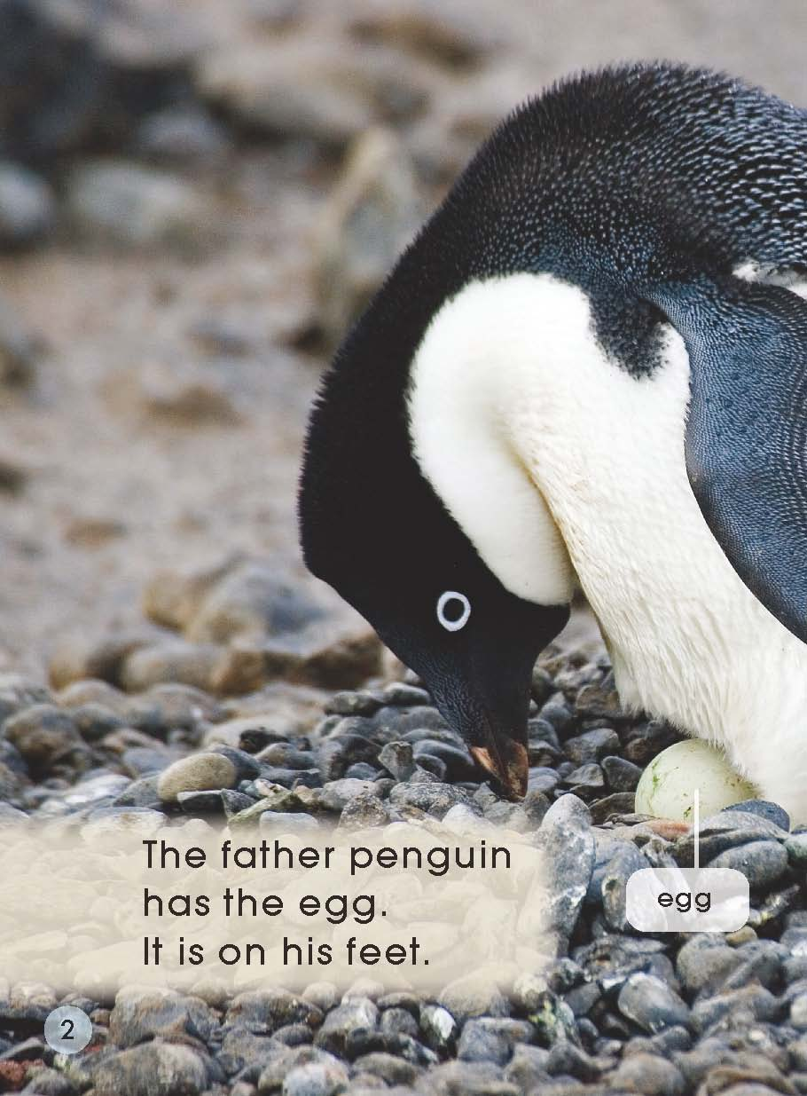
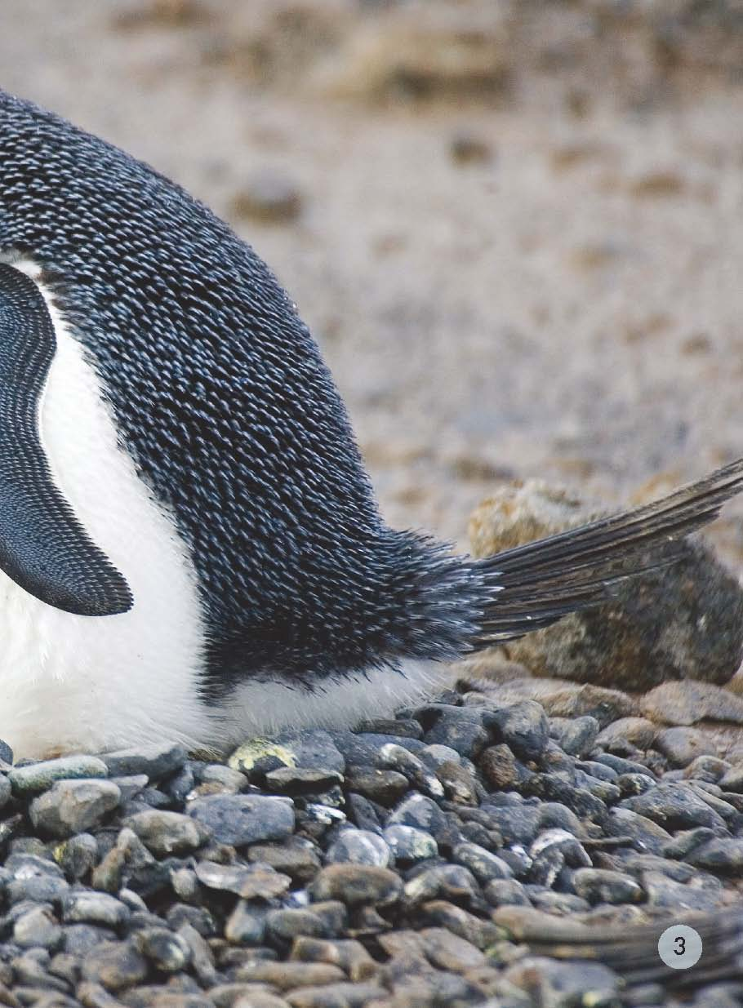
Who is it?
Where is the egg?

Slide 10
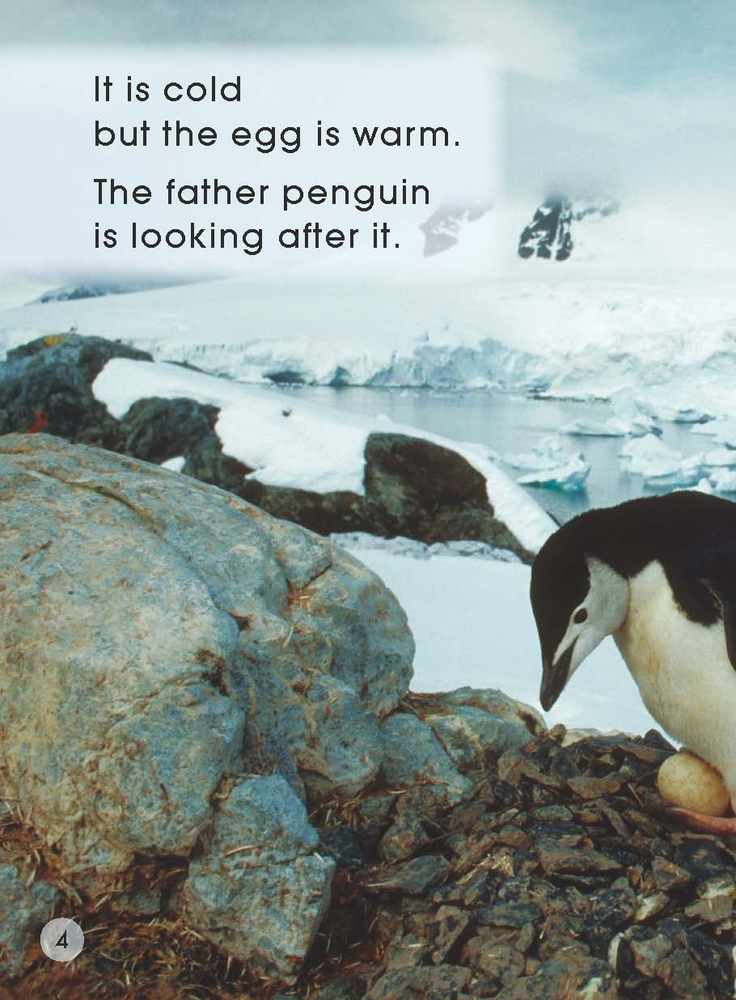
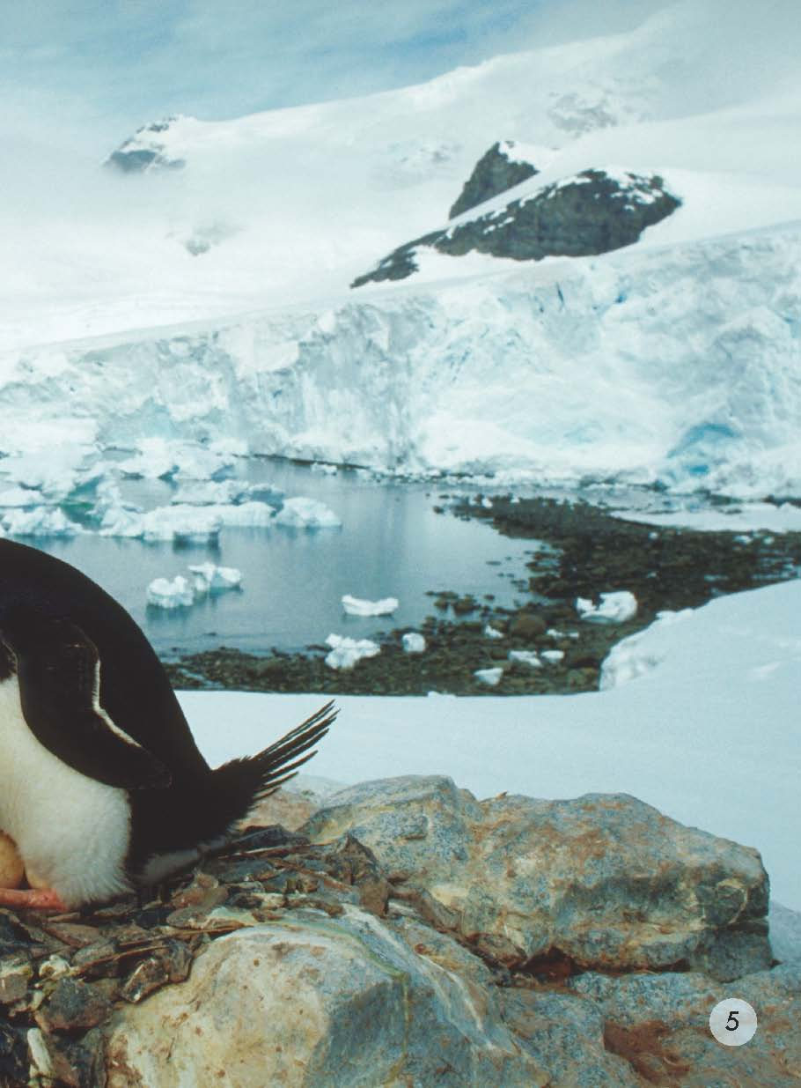
Where do they live?
Why does he put the egg on his feet?
What would happen to the baby penguin if the egg gets cold?

Slide 11
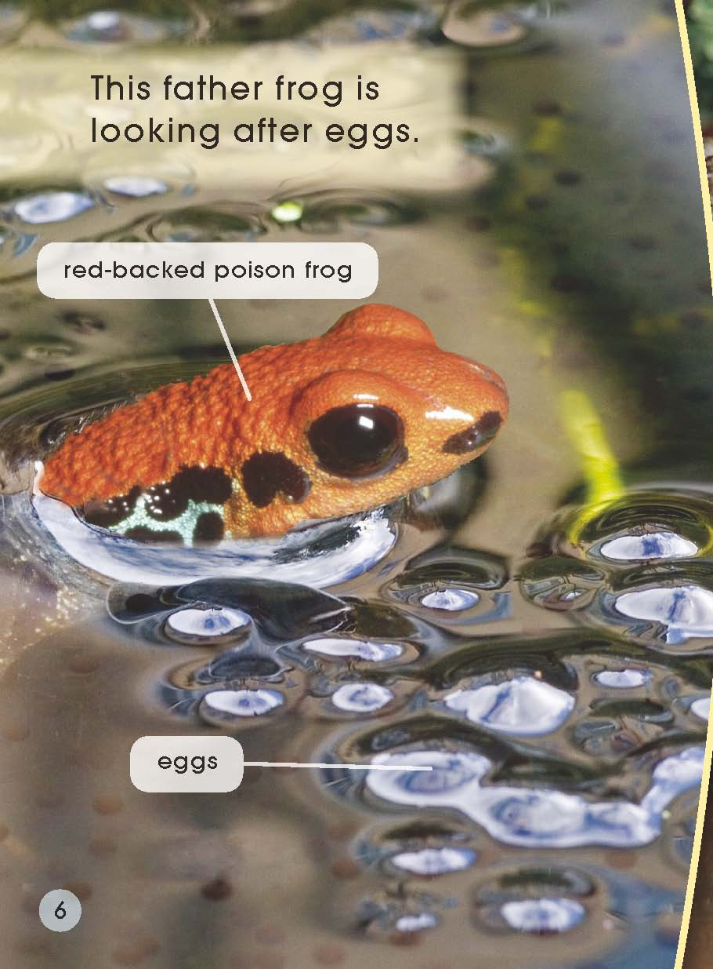
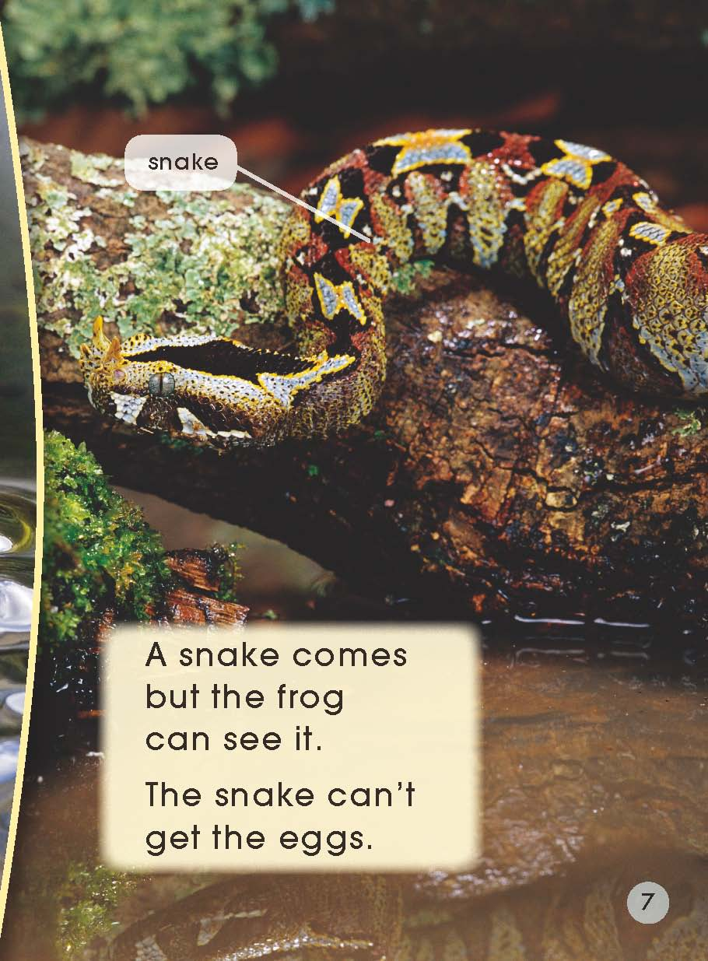
Where are the eggs?
What is the snake looking at?
How is he looking after the eggs?

Slide 12
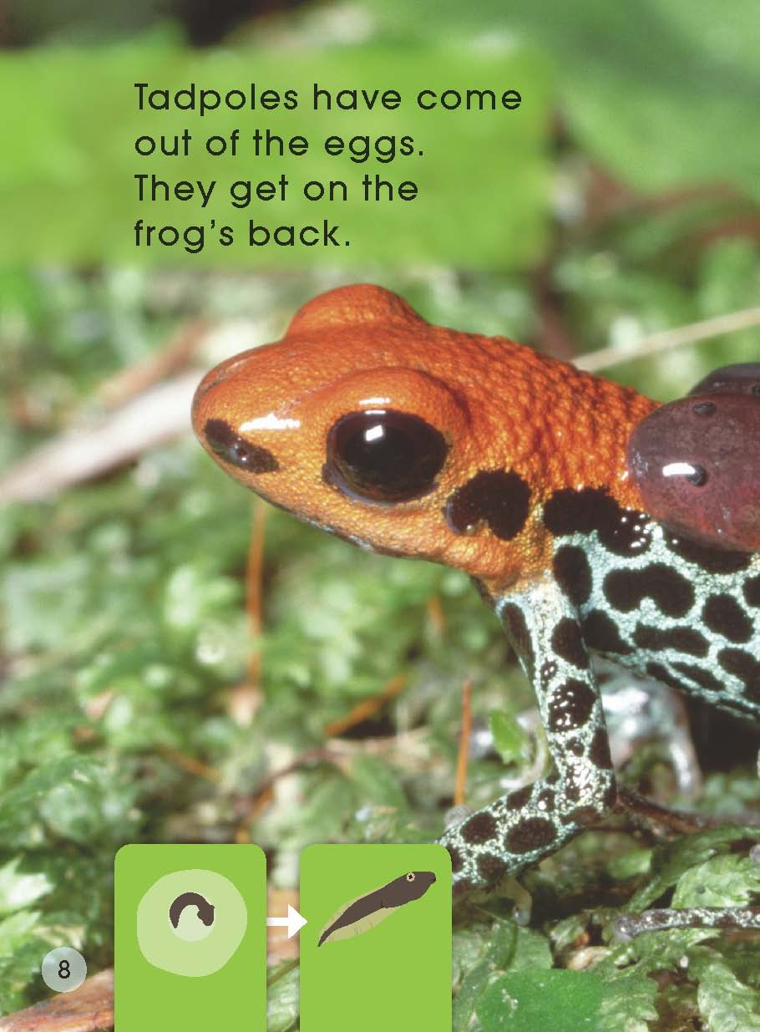
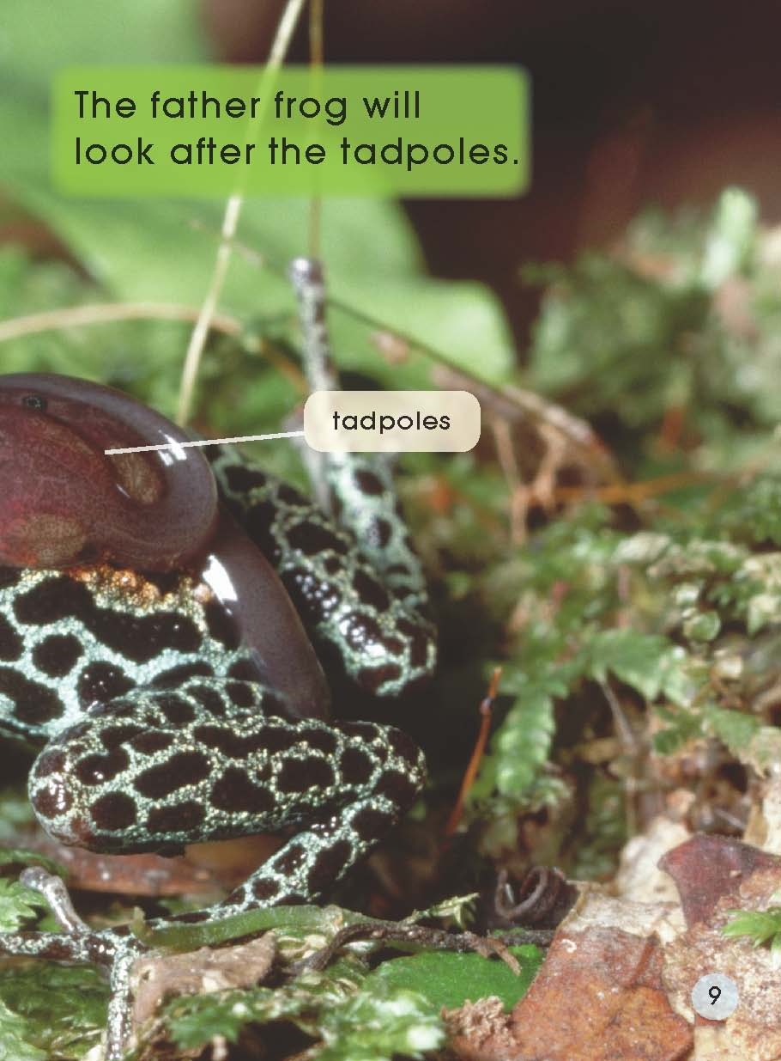
Why does the father frog have the tadpoles on his back?
Where do the tadpoles come from?
Where are they going?

Slide 13
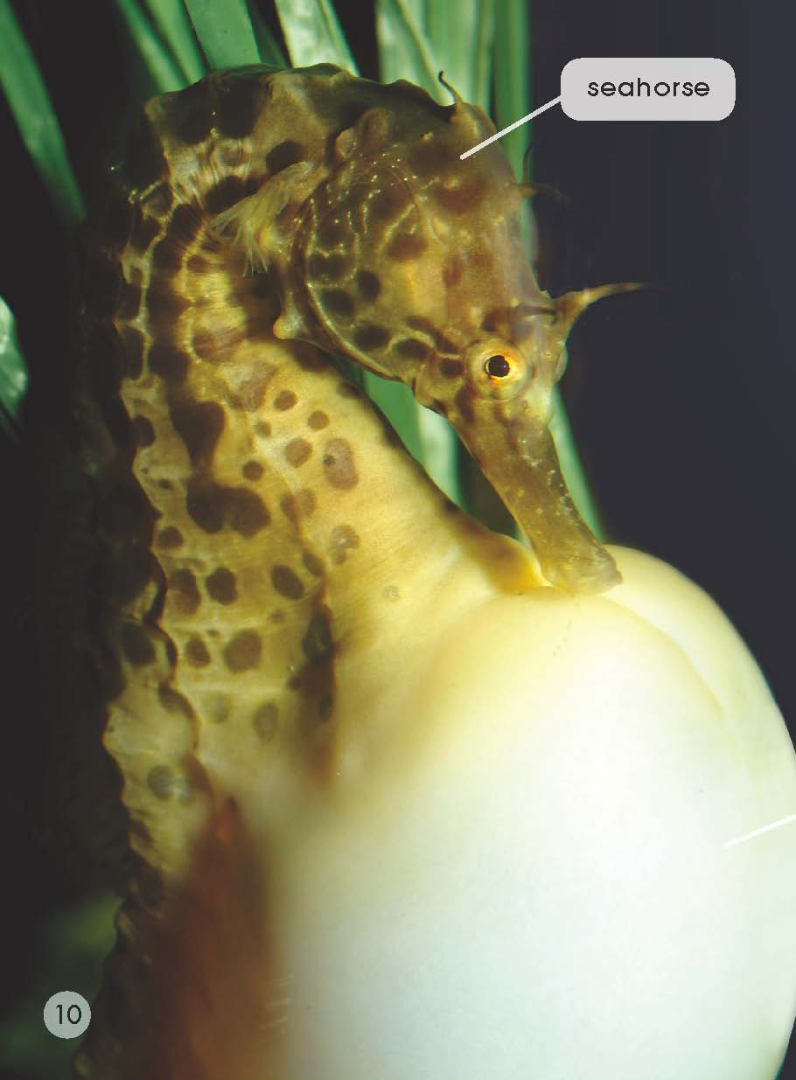
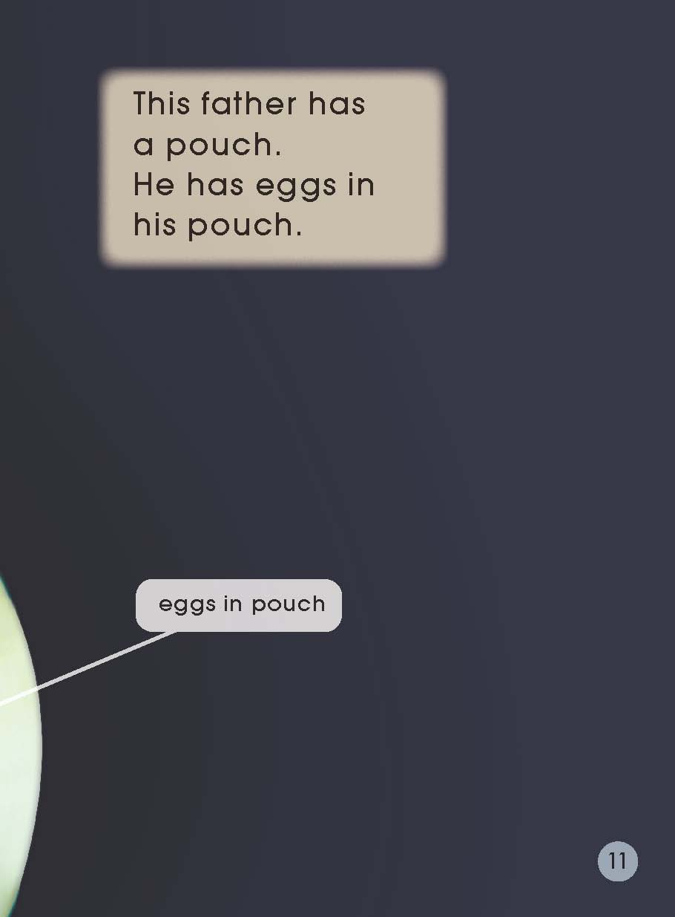
Why is it called a seahorse?
A father seahorse has a pouch. Can you find it?
What are in the pouch?

Slide 14
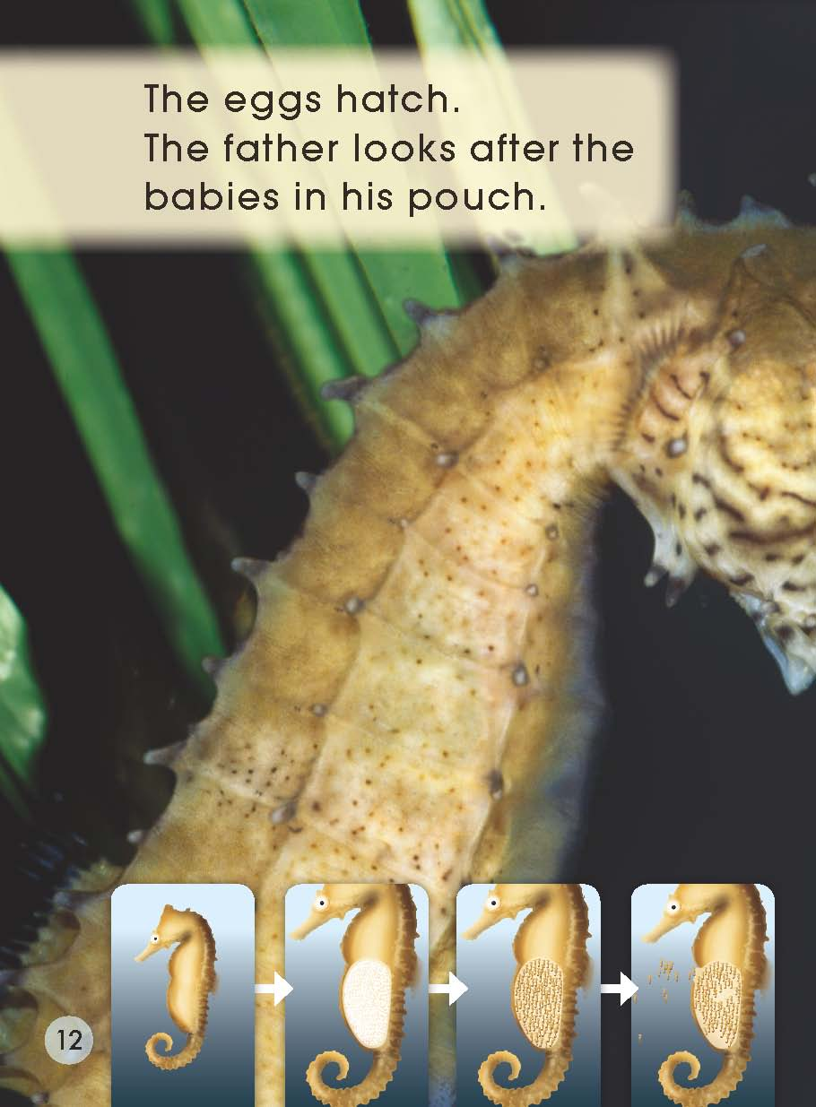
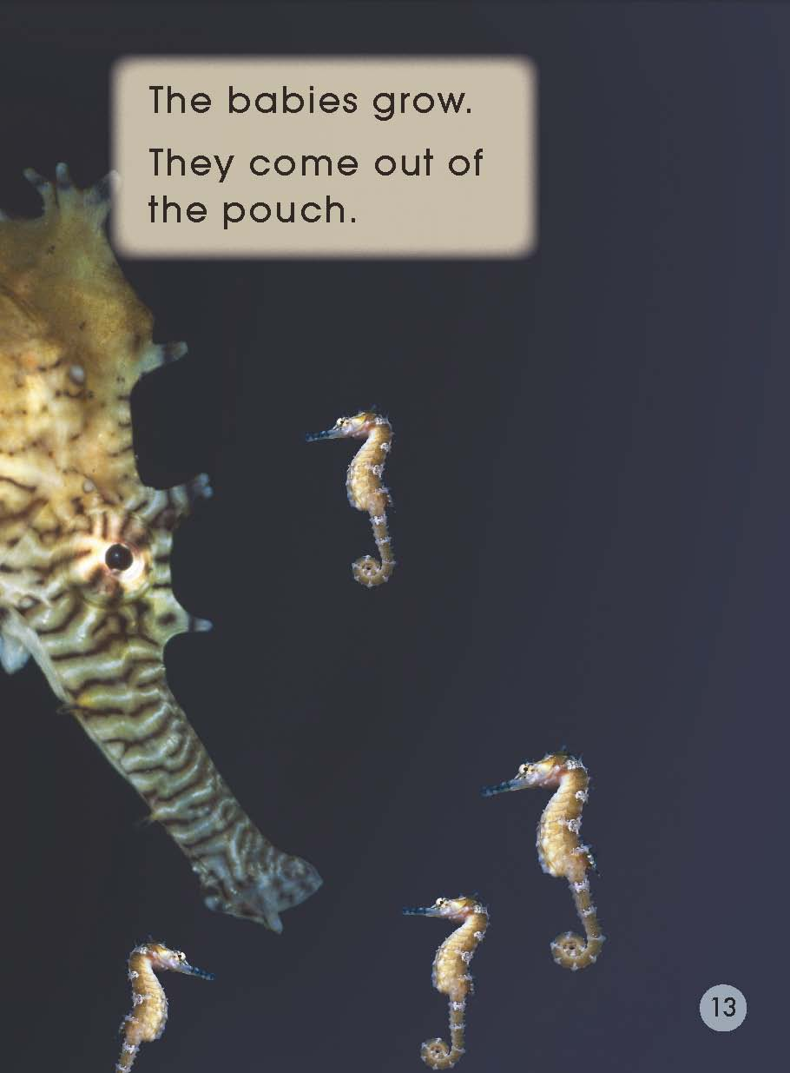
What is happening to the eggs in the pouch?
What can baby seahorses do when they grow?

Slide 15
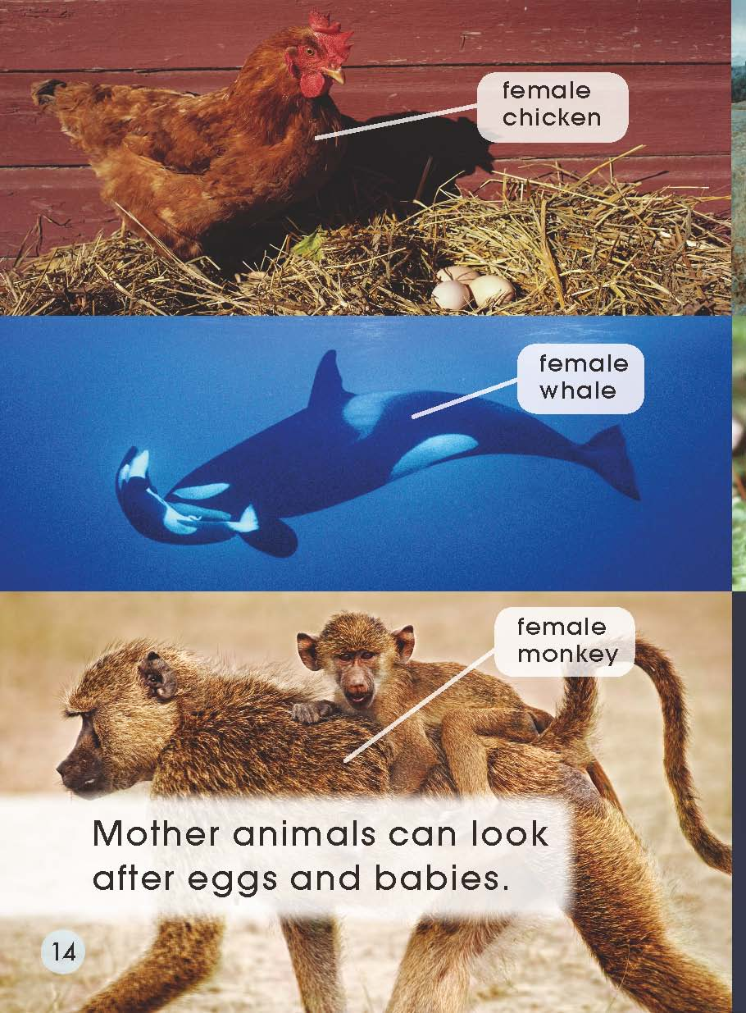
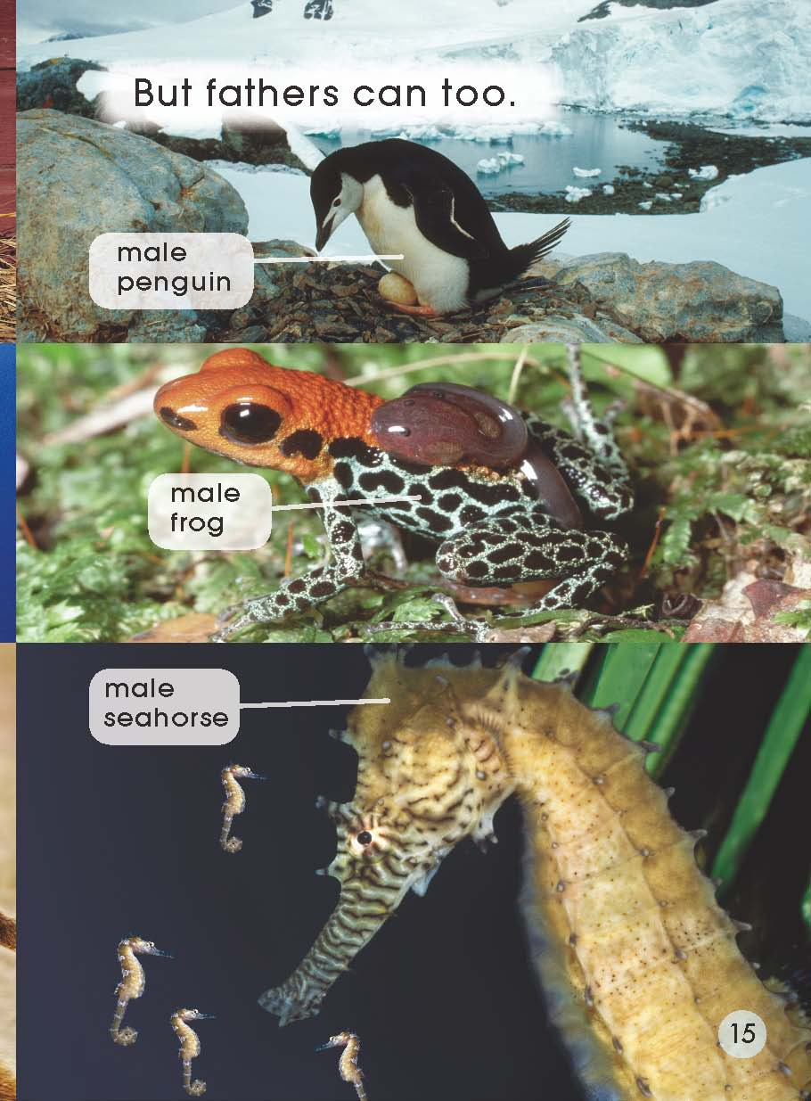
What are they?
How do they look after the egg and babies?

Slide 16
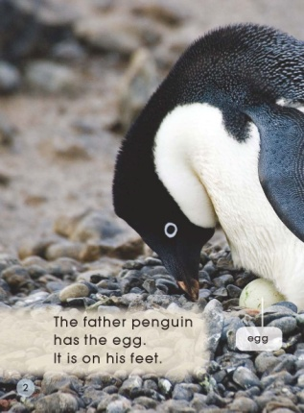

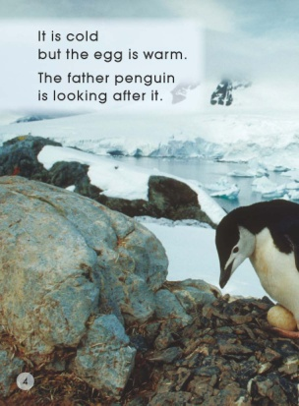











Listen and point.
Listen again and read after it.

Slide 17
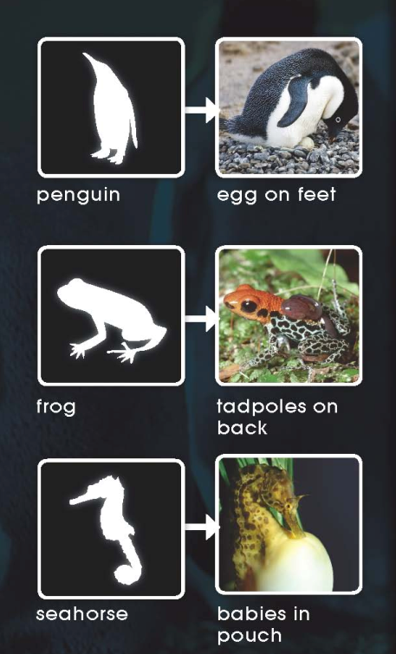
What does look after mean in the story?
A 照顾
B 喜欢
C 和……玩耍
D 陪伴成长
look after

Slide 18
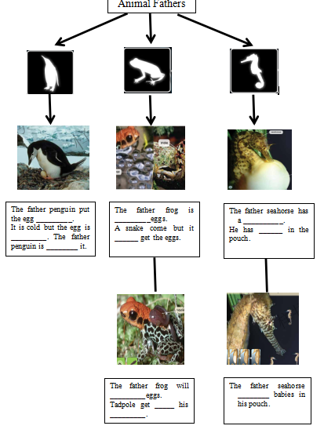
Please complete the diagram to show what happened in the story.
Retell the story with your partner using the story map.

Slide 19
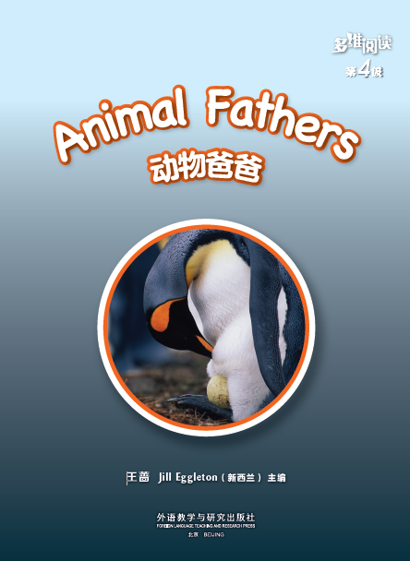
Read again and answer the questions.

Slide 20
Which words tell you where the egg is?

Slide 21
Read the word father, what sound does er make?
Can you find another word with er on this page?

Slide 22
Find the word can. Which word is the opposite to it?
Which part of the word eggs tells you there is more than one egg?

Slide 24
Which word says pouch? How do you know?

Slide 25
What happens after the babies grow? Read the sentence that tells you.
Find the words pouch and hatch. What sound is at the end of the words?

Slide 27
Work in pairs and discuss.
What is the book about?
What do you think of the animal fathers? Why?
What other father animals do you know that look after the eggs and babies?
Do you like the story? Why?

Slide 28
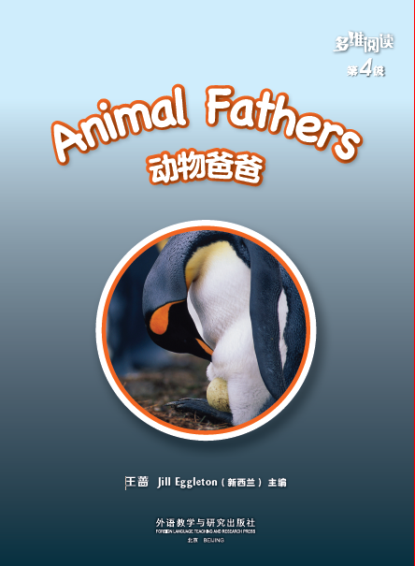
Read the story with your partner.

Slide 29
Retell the story again.

Slide 30
Homework
学生从老师布置的两个个作业中任选一项并完成。
课后和小组成员一起利用网络或者图书馆查询资料，了解还有哪些动物爸爸会照顾孩子以及以什么方式照顾孩子，选择相应的方式进行汇报。
学生与小组成员合作，制作一幅海报，仿照本课问题，介绍另一种动物爸爸，在全班进行展示。

Slide 31
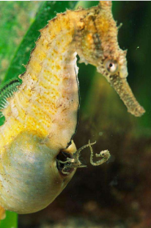
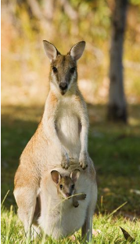
What other animal have a pouch?
father seahorse
mother kangaroo
pouch
pouch

