Slide 1
多维阅读第3级
Frogs in the Pool

Slide 2
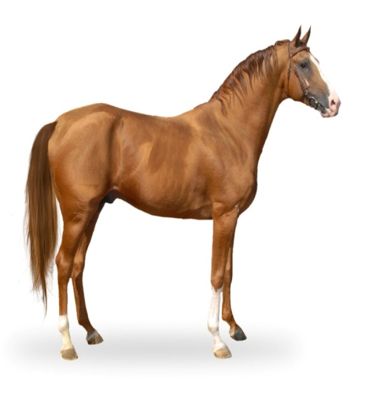
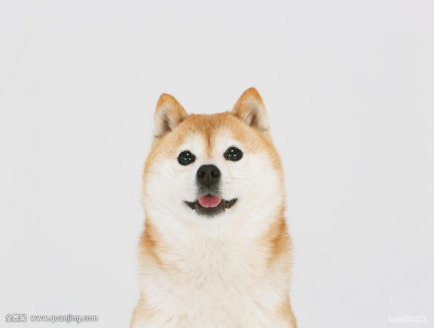
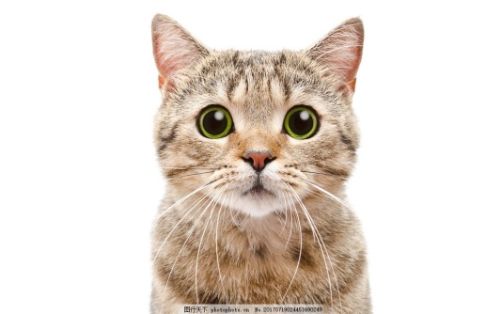
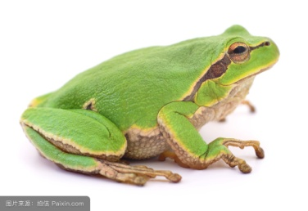
What animals are they?
policeman, pilot…

Slide 3
Read the cover of the book and answer the questions.
What can you see from the front cover ?
What’s the title?
Who is the writer?
What do you think Mum might be going to do?

Slide 4
Read the story and answer the questions.
Did Mum go swimming in the pool?
What can you see in the pool?

Slide 5
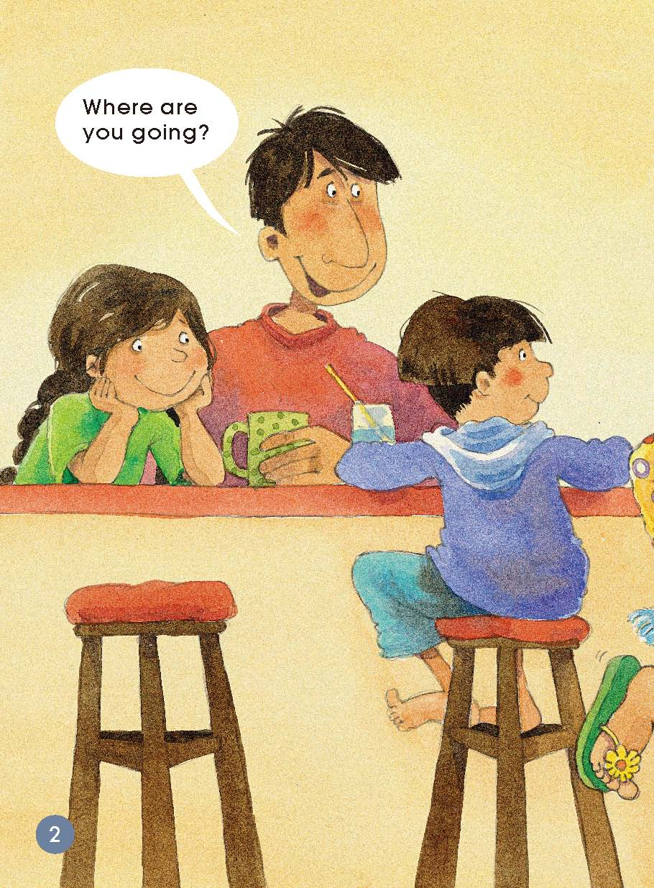
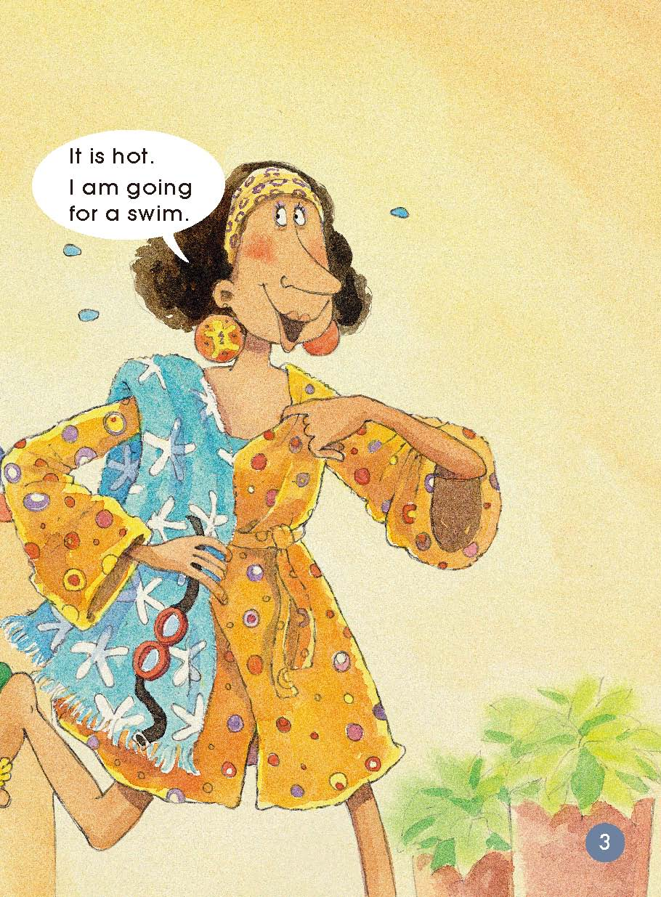
Answer these questions.
（Pages 2-3）
Who was talking?
Why was Mum going for a swim?
Where can we go for a swim?

Slide 6
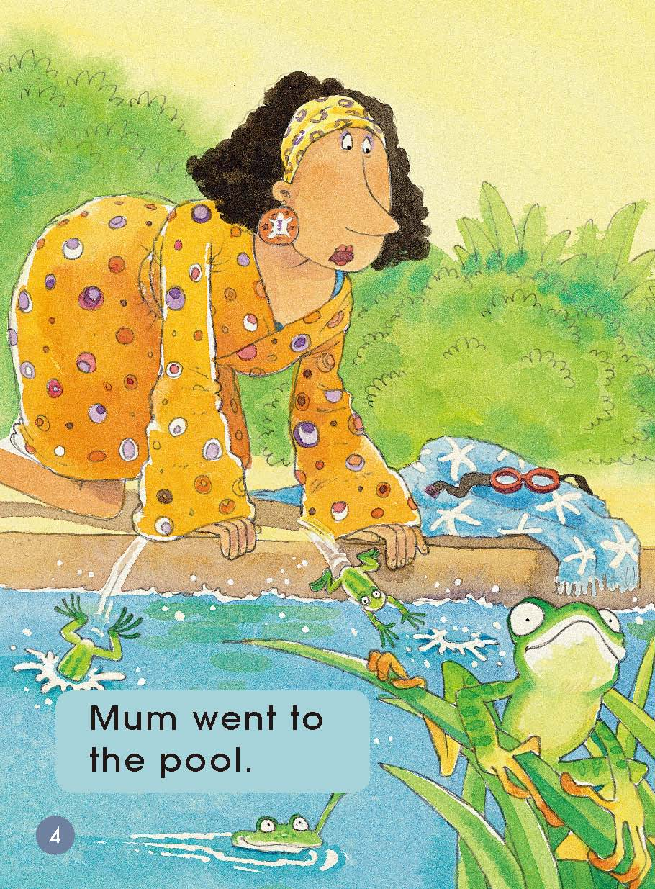
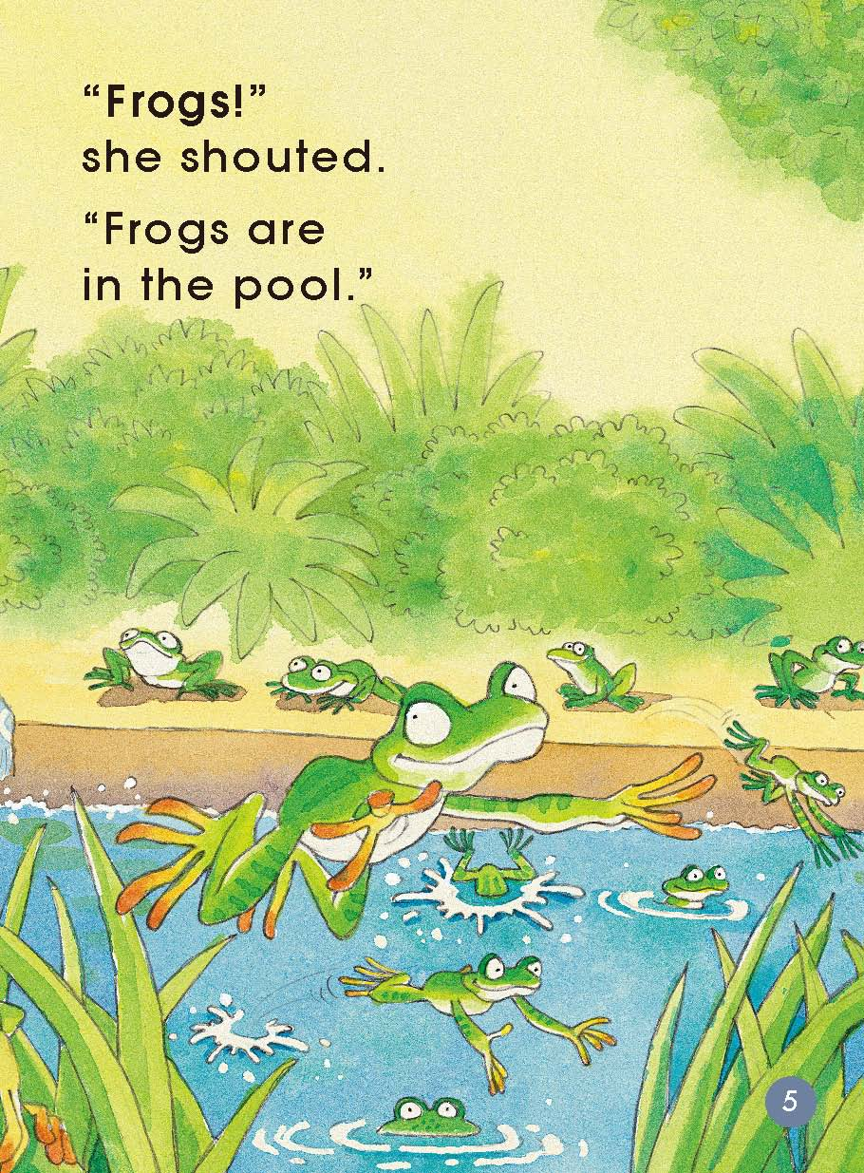
Answer these questions.
（Pages 4-5）
How do you think Mum was feeling? Why do you think that?
Why do you think the frogs were in the pool?

Slide 7
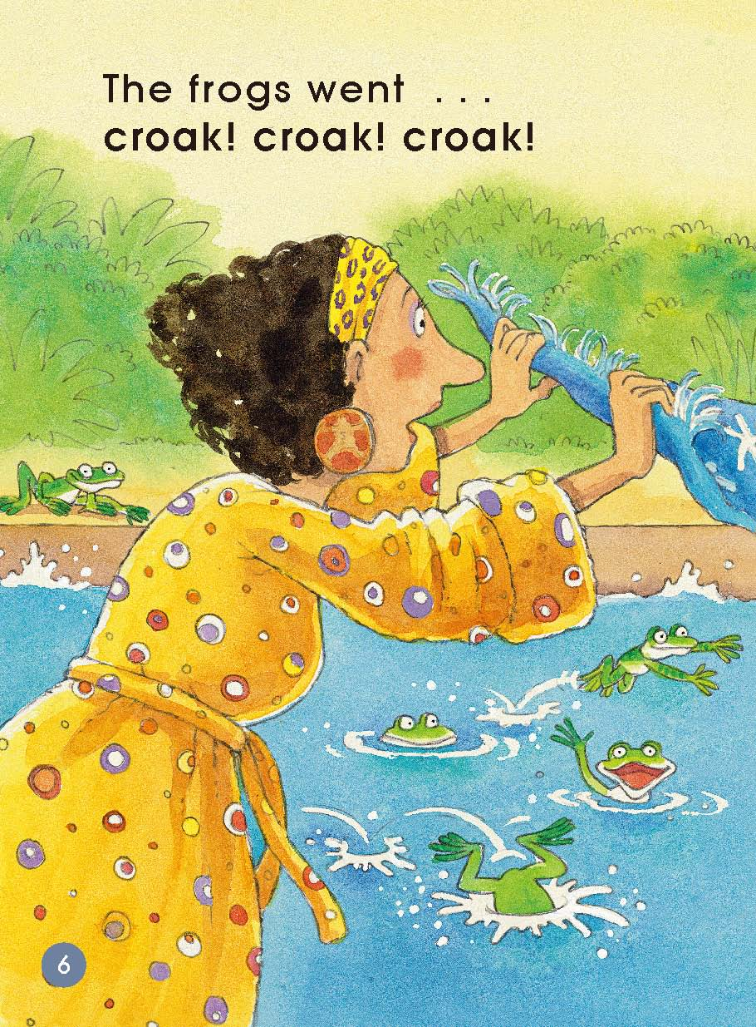
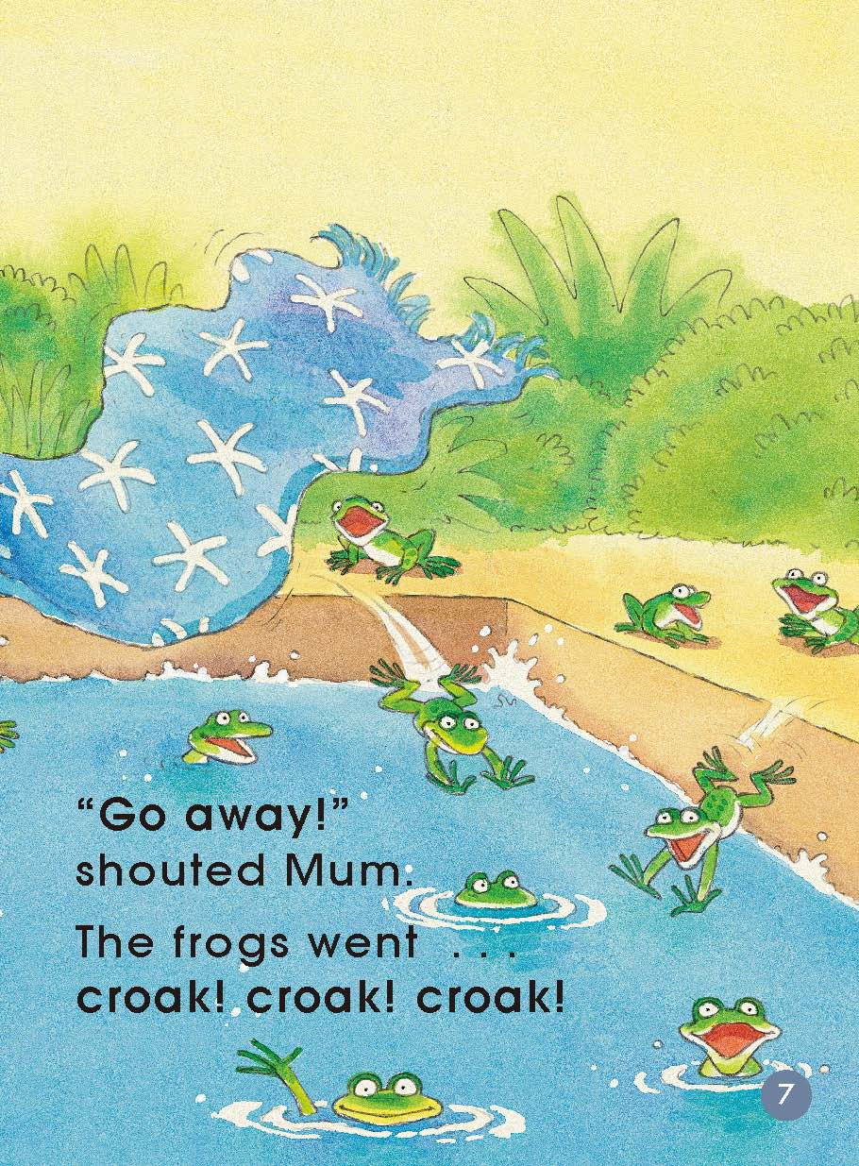
Answer these questions.
（Pages 6-7）
What do you think Mum was doing?
Do you think frogs would go away? Why do you think that?
What do you think that might happen next?
Can you find the word that tells you the sound that frogs make? What is it?

Slide 8
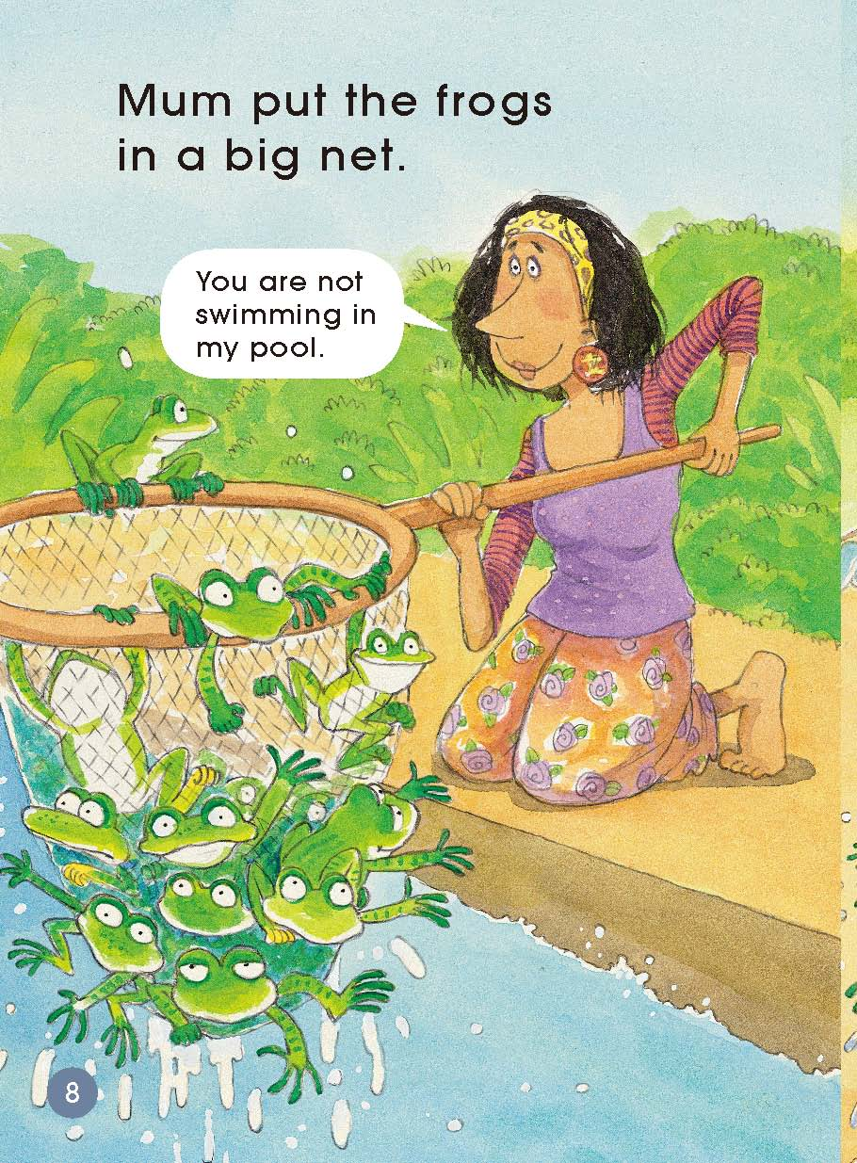
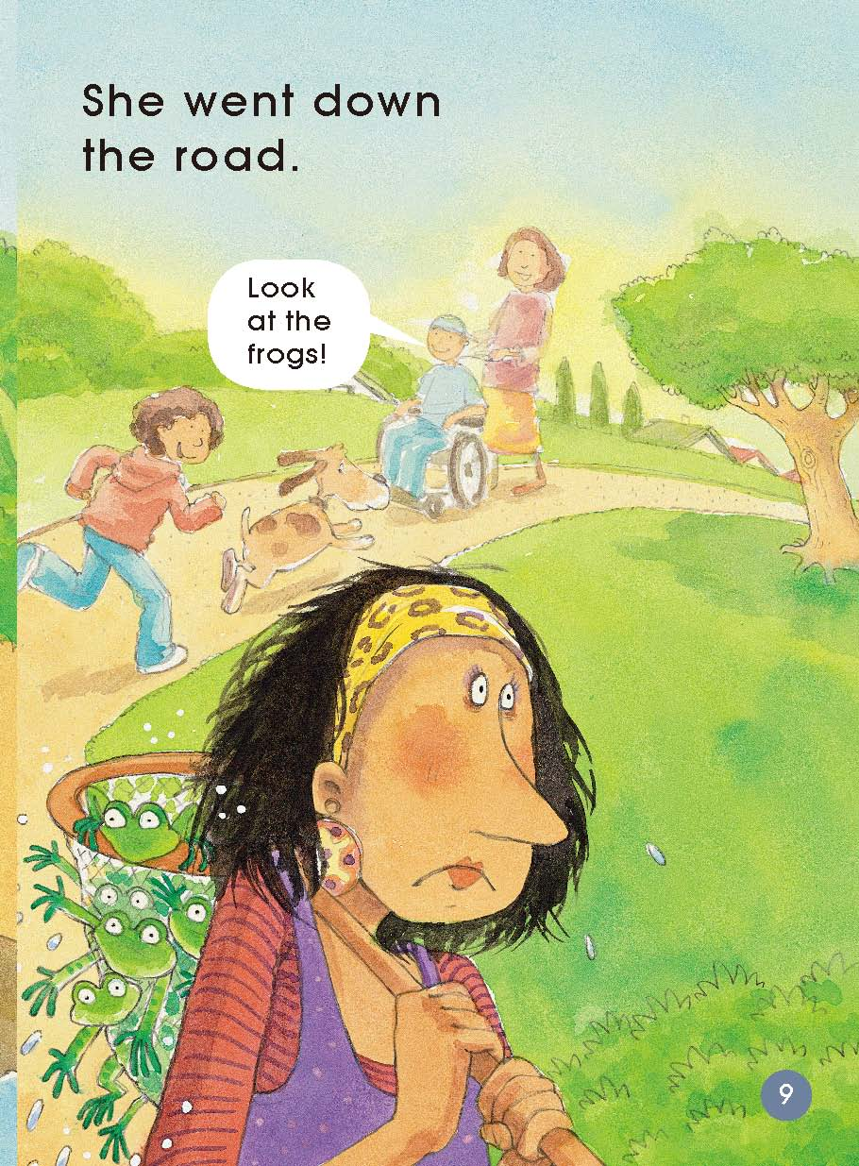
Answer these questions.
（Pages 8-9）
What was Mum doing?
Where do you think she might be taking the frogs?
What would you do if you were her?

Slide 9
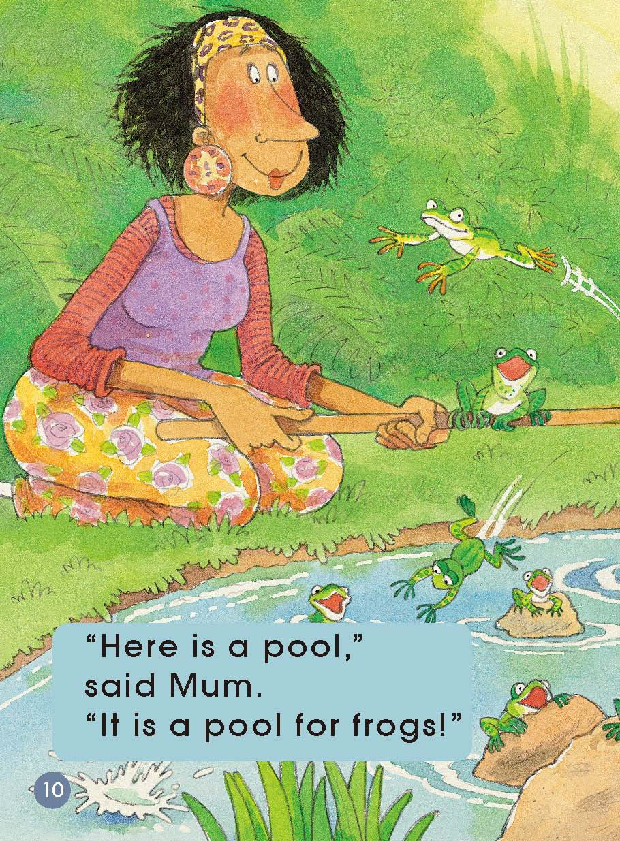
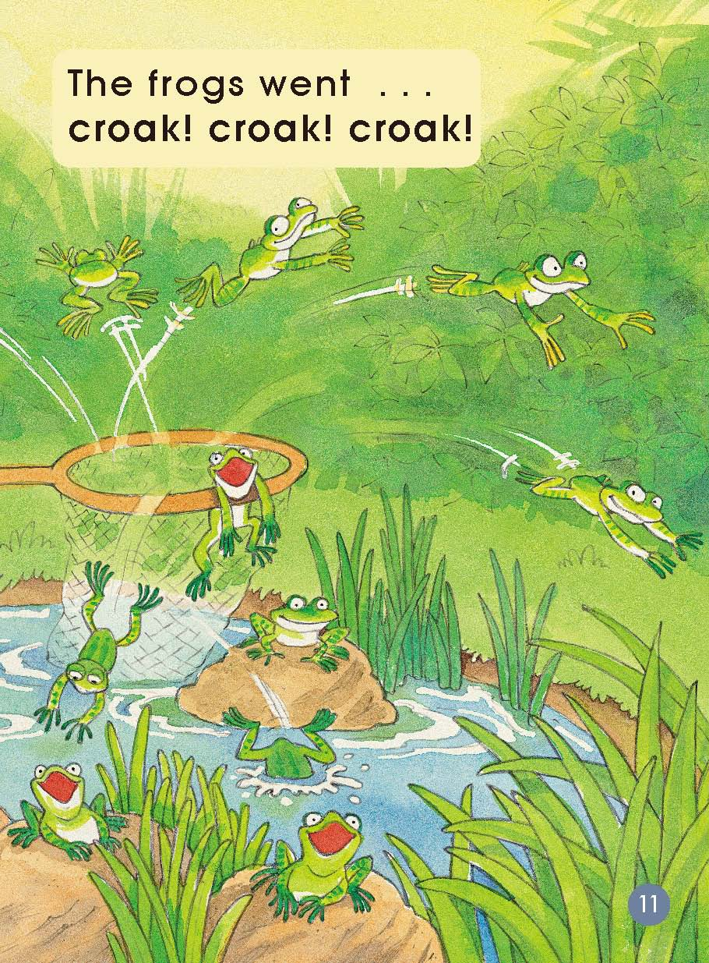
Answer these questions.
（Pages 10-11）
What was Mum doing?
Do you think the frogs were happy? Why?

Slide 10
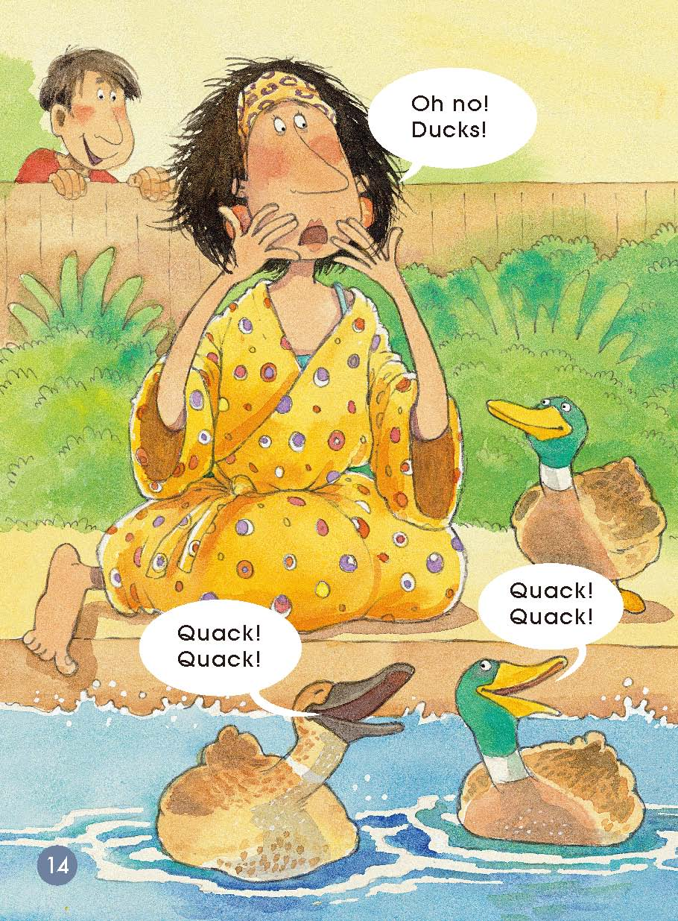
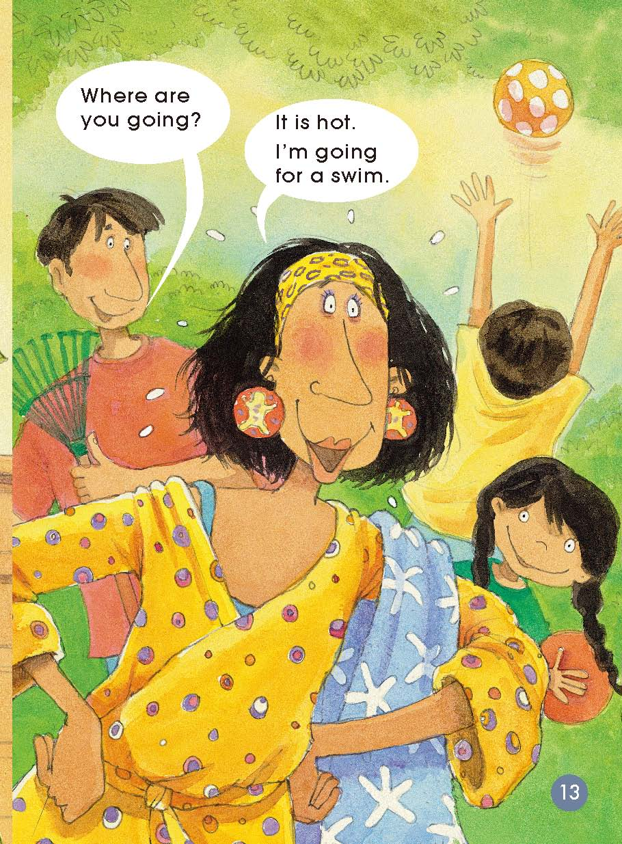
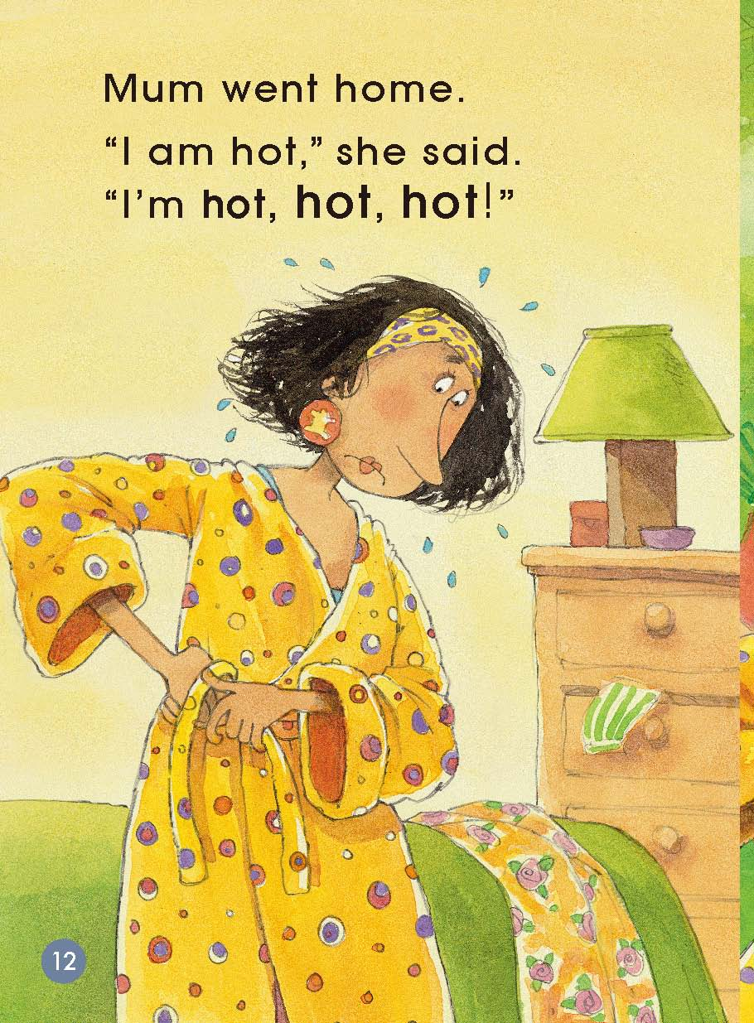
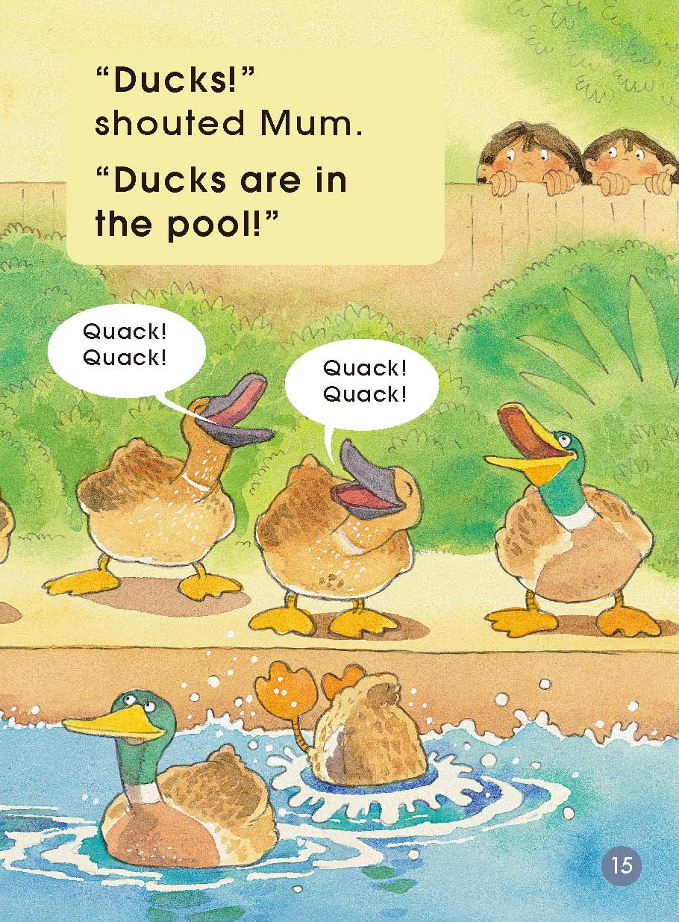
Answer these questions.
（Pages 12-14）
Where was Mum now?
What was she going to do?
What had happened ?
How do you think Mum was feeling? What do you think she would do?
If you were the family member, what would you do?

Slide 11
Answer these questions.
Circle the sh in each word. This is how we write the /ʃ/ sound in these words. What other words do you know that start with /ʃ/?

Slide 12
Answer these questions:
What is the first sound in frog? What is the next sound in frog?
What other words start with the /f/ /r/ sounds?
Can you find the word that tells you the sound that frogs make? What is it? Can you make your voice sound like a frog?

Slide 13
Answer these question.
What word do we make if we put a /p/ sound in front of /ɪt/?

Slide 14
Discussion
What was the first problem in the story? How did it get fixed?
What was the next problem? What do you think Mum might do?
Have you ever had a problem? What did you do to fix it?

Slide 15
Read and number.

Slide 16
Homework
Tell the story to your parents or friends.
（1）学生与小组成员合作，制作一幅海报，介绍自己知道的相关寻宝知识，可以进行相关拓展。在全班进行展示。
（2）课后和小组成员一起利用网络或者图书馆查询资料。看看是否有其他方面的寻宝知识。在全班汇报调查结果。

