Slide 1
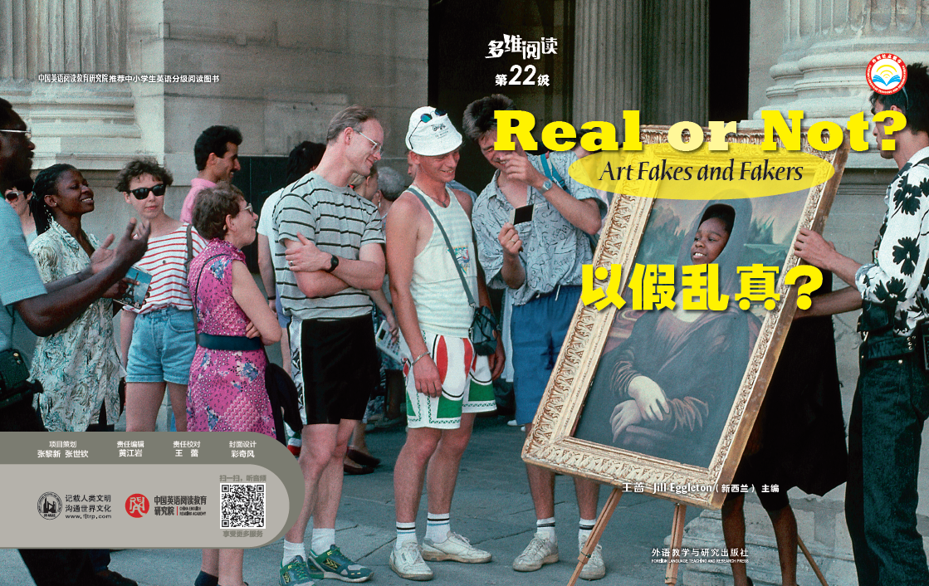
Real OR NOT
多维阅读第22级
Art Fakes and Fakers

Slide 2
Pre-reading Skim the titles, pictures, and captions in the book and think about the following questions.
1. What is a forgery? Is it legal?
2. Why did some artists forge others’ works？How did
they make the forgeries convincing? Do you know
some ways to tell if an artwork is a forgery?
3. What does the title of the last part “Staying Ahead
of the Forgers” mean?

Slide 3
Reading Read the book and discuss the questions with each other and complete the two flowcharts: The Faking process and Busting a Faker on pages 26-27.
1. What is a forgery? Is it legal?
A forgery is a piece of artwork copying original art and is sold for money, which is illegal.
2. If an art student copies the styles of other artists, can it be called a forgery?
No, this is not a forgery. Forgery occurs when someone strives to deceive others by producing and selling fakes for money.

Slide 4
3. Who were the earliest art forgers?
The earliest art forgers were Phonenicians.
4. What kind of artworks did they forge?
They forged ceramics and metalwork.
5. What is the main reason for forging?
Money is the main reason for forging.
6. What are the basic methods of forgery?
First, to make an exact copy of a certain piece of art. Second, to borrow different ideas and elements from several pieces of an artist’s original work. Third, to mimic a well-known artist’s style and materials and sign the artist’s name. Last, to restore old works of original art.

Slide 5
7. What did the two infamous forgers do?
Han van Meegeren forged famous art works and sold them for a great deal of money. He even sold his forgery to Nazis.
Elmyr de Hory sold his forgeries to art galleries, passing them off as part of his family’s collection.
8. What kind of consequences did they face?
Han van Meegeren was charged with the crime of forgery and sentenced to prison. He died before he ever began serving his sentence.
Elmyr de Hory died a poor man, facing criminal charges.

Slide 6
9. How is a painting made to look old?
1) By scratching the paint with a needle and then wipe black ink over it;
2) By baking and then cooling and rolling the canvas;
3) By painting varnish on the canvas with a stippling brush;
4) By using egg whites with pigment to get a natural, cracked look.
10. What should the forgers do to pull off a successful fake?
To really pull off a successful fake, expert forgers have to carefully study everything about the artist they plan to copy—style, techniques, paints, brushes, signature, and how it is framed, mounted and displayed. Last, forgers have to create a story about the art.

Slide 7
11. What is a fake buster’s job?
The fake buster’s job is to uncover art crime. They try to discover whether or not a work of art is a phony.
12. What are the tools the fake busters use to help them work?
They use microscope, X-ray and chemical test.

Slide 8
13. What did the author mean in the title?
We should continue to improve the technology of examining forgeries in order to protect the original artworks.
14. What are the differences between original
artworks and forgeries?
Forgeries are like dead objects—they might fool their owners temporarily but they would never provide lasting pleasure. An original work of art has the touch, the feelings, the interpretation of its creator and this is what gives it its mark of originality.

Slide 9
Reading Read the book and discuss the questions with each other and complete the two flowcharts: The Faking process and Busting a Faker on pages 26-27.
The Faking Process
Study everything about the artist.
Find a canvas as old.
Make their paintings look as old.
Create a story about the art.
Busting a Faker
Look at it by eyes.
Use tools.
Paper trail.
Stay ahead

Slide 10
Post-reading Based on the flowchart The Faking Process and the book, find the key elements needed for faking an artwork and add them to the chart.
The Faking Process
Study everything about the artist.
Find a canvas as old.
Make their paintings look as old.
Create a story about the art.

Slide 11
Group discussion Compare the two flowcharts, find the corresponding busting methods for different faking techniques, and complete the mind map in groups.

Slide 12
Reflection
1. Why does the author write the book?
2. Why did he advise people to stay ahead of the forgers in the last part?

Slide 13
Homework
1. Search on the Internet for the information about a famous artist, including his/her life story and masterpieces. Give a brief presentation to the class.
2. Search on the Internet for some infamous art forgers, learn about their ways of forging and the bad effect they have caused. Show the whole class the results of your investigation.

