Slide 1
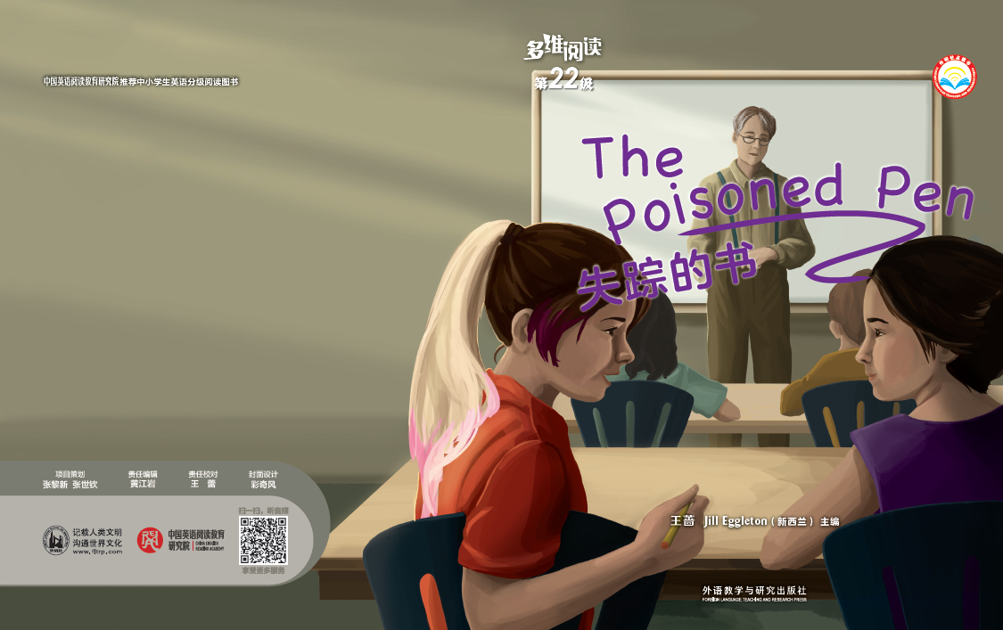
多维阅读第22级

Slide 2
Warm up
What is the poisoned pen? Is it a pen owned by one of the characters in the story?
2. What is special with the pen?
What happens to the pen in the story?

Slide 3
Question-answer
The beginning of the story:
1. How did I feel when I first met Saskia?
2. What did the students think of Mr. Brown?
3. Why did Saskia want to revenge?
The development of the story
1.What did Mr. Brown say about the book?
2. How did the students feel about the book?
3. Who do you think removed the book?
4. Why did I ask Squitty to give back the book?
5. Why did I tell the secret to my classmates?
The climax and ending of the story
1. Why was Saskia so quiet that day?
2. How will Mr. Brown and Squitty get along with each other?
Why do you think so?

Slide 4
Squitty’s Attitude to Mr. Brown
Squitty thought Mr. Brown was________, ________ and _________. She was _______when Mr. Brown doubted her writing and wanted to ________ after Mr. Brown stopped her quarrelling with Tony. She thought The Poisoned Pen was ______, so when Mr. Brown was worried about the missing of the book, she looked ______. She didn’t ______ ______ Mr. Brown’s friend. On the day the book was returned, she was ________ and ______. But ever since then, she ________ Mr. Brown.

Slide 5
Mr. Brown’s Attitude to Squitty
Mr. Brown was strict. He expected hard work and no nonsense. So when Squitty knocked her backpack to the floor, his eyes ____ ____ Squitty’s, ______ her to make another sound. When Squitty quarreled with Tony, he gave her a _________. While he was introducing The Poisoned Pen to the students, Squitty poked some gum in her mouth and began to chew loudly, Mr. Brown barely ______ _____ her and _______ to give her another detention. When Squitty said the book was boring, he ______ her as if she were a ______. As Squitty put in ear buds, Mr. Brown _______ ______ her phone without even stopping reading. Squitty began to tap away loudly, Mr. Brown _______ and warned to ask her to ________ the room.
When the book was finally returned, he gave Squitty a ________ look and smiled ______. About the letter of apology, he said__________ and forgave Squitty at last.

Slide 6
My Attitude to Squitty
I ______ her the moment I saw her because I thought she was ____, but I also felt sitting beside her is like sitting next to a ____ ready to go off. When I realized that she removed the book, I felt ______ and pleaded to her to give back the book in _________. When she refused to return the book, I felt ________ and ______. I even doubted if I really ______ her. When the book was finally returned, I found a ______ and _______ Squitty and I still _____ her.

Slide 7
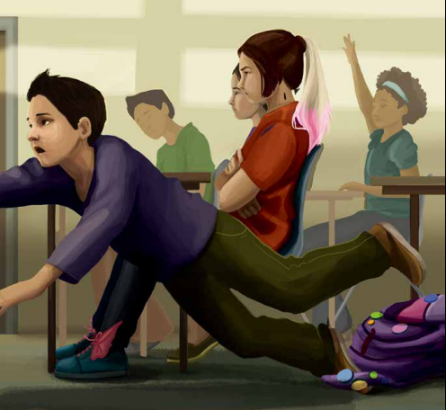
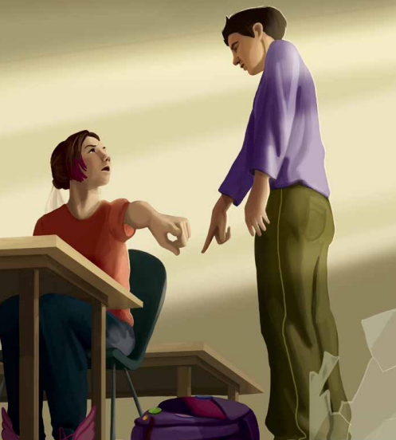
Role-play
Act out the different scenes in the story:
Tony tripped over Squitty’s backpack.

Slide 8
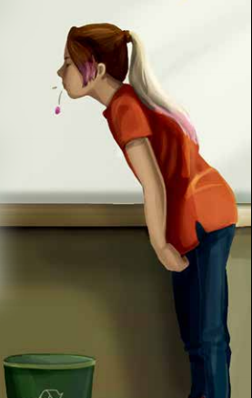
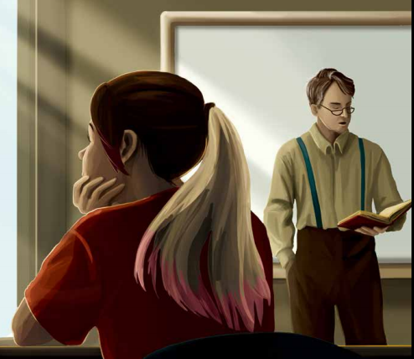
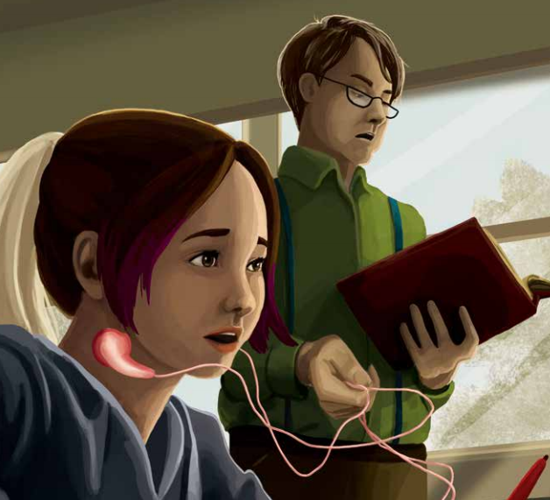
Role- play
Act out the different scenes in the story:
Mr. Brown read The Poisoned Pen.

Slide 9
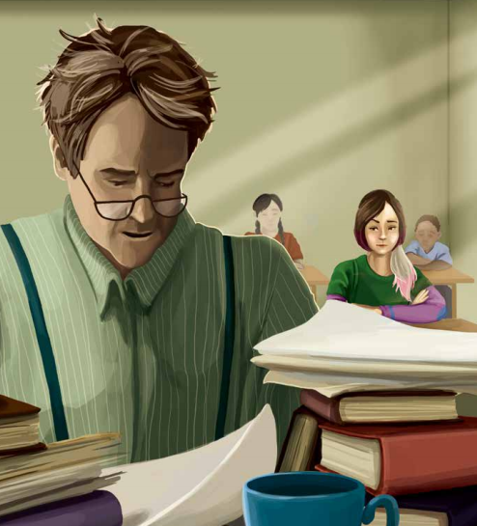
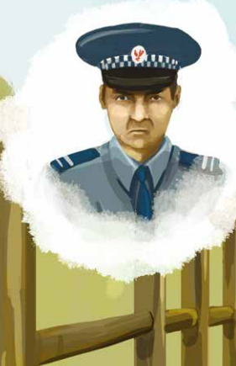
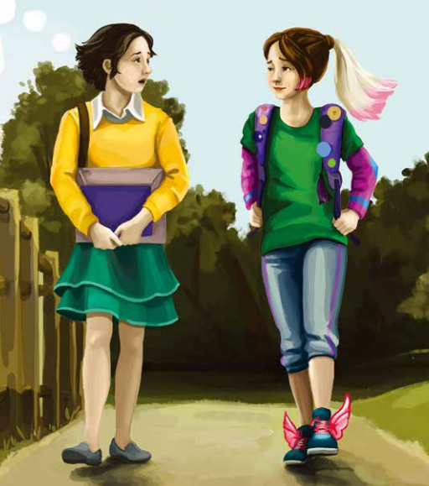
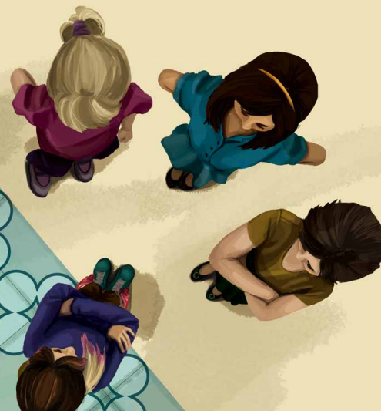
Role-play
Act out the different scenes in the story:
The book was missing.

Slide 10
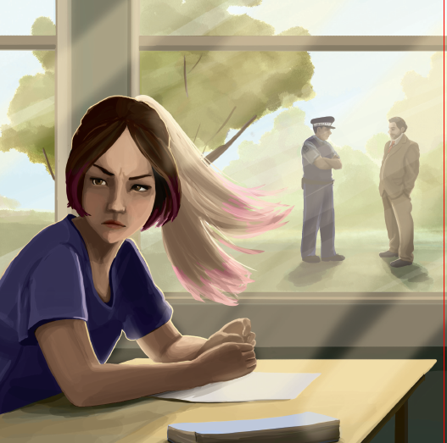
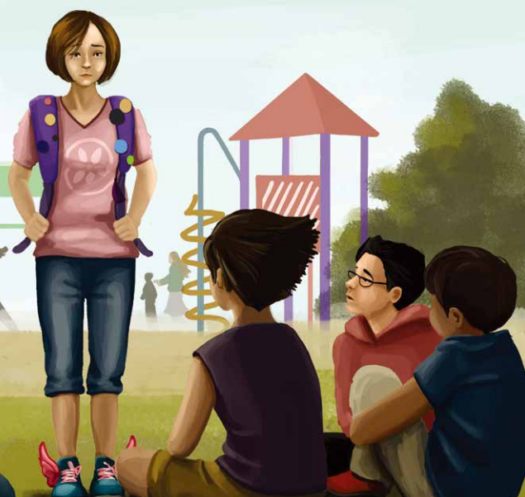
Role-play
Act out the different scenes in the story:
The whole book was returned.

Slide 11
Listen-speak
Listen to my story.
I am Mr. Brown. Saskia is one of my students, and Jane is her best friend…
My name is Saskia, but they all call me Squitty…
I’m Tony. Jane is a new student in my class…
The rest of you can ask different questions while listening.

Slide 12
Group-discussion
1. Do you think Jane should tell her father or
not betray her friend? Why?
2. Who do you think reported the incident to
the police?
After discussion, the captain of each group will
report what you have discussed.

Slide 13
What are the similarities and differences between Squitty and Jane?
Squitty
Jane
What they have
in common

Slide 14
Homework
Do you agree with what they do in the story?
If you were Mr. Brown/ Saskia/Tony, what would you do?
After The Poisoned Pen was missing, nobody knew what happened in the book , can you go on with it?

