Slide 1
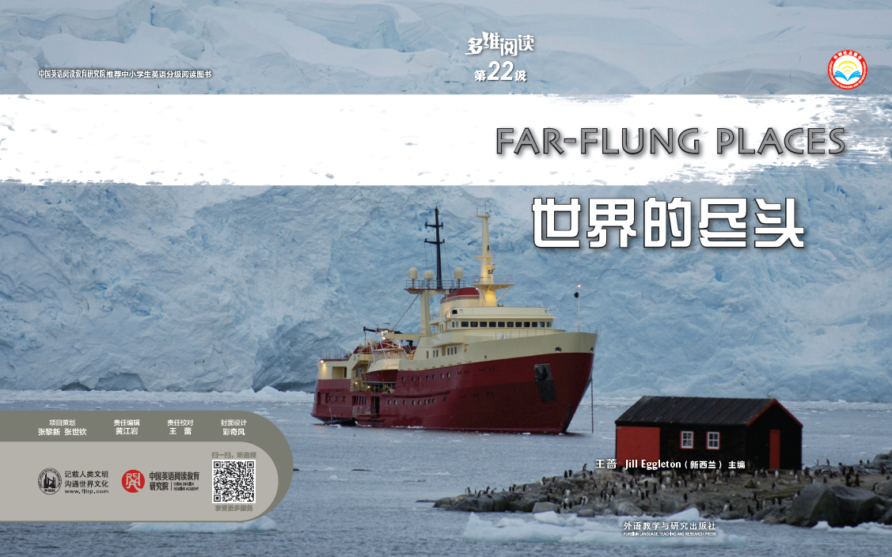
多维阅读第22级

Slide 2

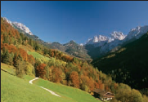
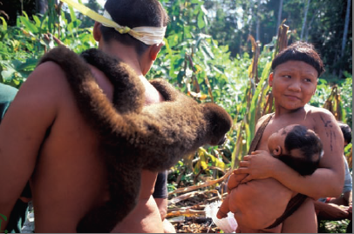
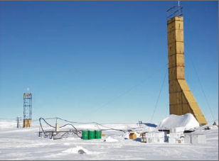
Warming up
Make a list of the things that modern city people cannot live without.
Browse the pictures and predict what the book is about.

Slide 3
Pre-reading
Do you think the life necessities on your list are really necessary for people living and working in these far-flung places?
Suppose you were to live and work in these places, what do you think would be necessary?
What do you expect to learn from the book?

Slide 4
Reading
Group work: Work in groups of 4 and complete the table below.
Pages 2-13 | Pages 14-23
Student A: Natural environment in far-flung places: ___________________________________ Reasons to settle in far-flung places: ___________________________________ | Student C: Living and working conditions in isolated working places: ___________________________________ Value of their work: _______________________________________
Student B: Indigenous people’s ways of living: ___________________________________ Consequences of connecting with the outside world: ___________________________________ | Student B: Challenges and problems facing the isolated workers: ___________________________________ Ways to adapt and make life and work easier: _______________________________________

Slide 5
Reading
Group work: Find out how the author describes far-flung places.
Student A: Expressions of natural environment
_____________________________________________________________
Student B: Expressions of the living ways of the local people _____________________________________________________________
Student C: Expressions of life/work challenges
_____________________________________________________________
Student D: Expressions of influences of the outsiders
_____________________________________________________________

Slide 6
Reading
Oral report:
Share your findings with your group partners. Draw a mind map about “Far-flung Places” and report them to the class.
Far-flung Places

Slide 7
Reading
List the issues worth exploring around the topic “Far-flung Places”.
Question 1: _______________________________________________________________.
Question 2: _______________________________________________________________.
Question 3: _______________________________________________________________.

Slide 8
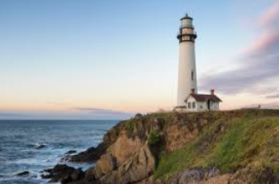
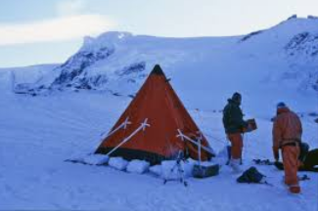
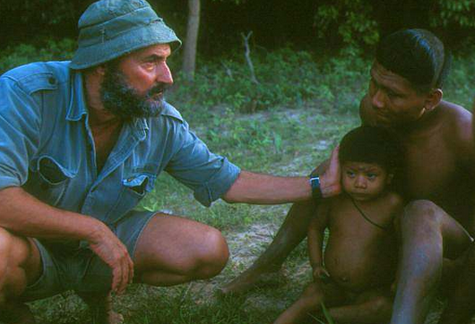
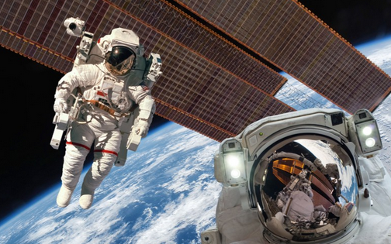
Post-reading
Role-play: “A Day in Far-flung Places”
Work in groups of four and act out the daily life and work in far-
flung places.

Slide 9
Post-reading
Group discussion:
Why does the author write the book?
2. What can we do to protect the isolated indigenous groups and
help preserve their indigenous culture? (On the part of the
“outsiders”, such as world leaders, explorers, sightseers,
scientists, artists, linguistic experts, etc.)
3. What does the future hold for far-flung places and people living
and working there?
4. What are other threats facing the indigenous groups apart from
the ones mentioned in the book?

Slide 10
Extension
Group discussion:
5. Do indigenous groups also benefit from their connection with the
outside world? If so, what are the benefits?
6. How do indigenous people protect themselves against possible
harms from the “outsiders”?
7. With their connection to the outside world, will there be some
indigenous people giving up their isolated lifestyles and stepping
into modern society? If so, what challenges will they face and
how can they adapt?
8. How can we improve the working conditions in far-flung places?

Slide 11

Homework
Search for more information about one of the far-flung places in the book and write a blog post to introduce it.

Slide 12
Thank you!

