Slide 1
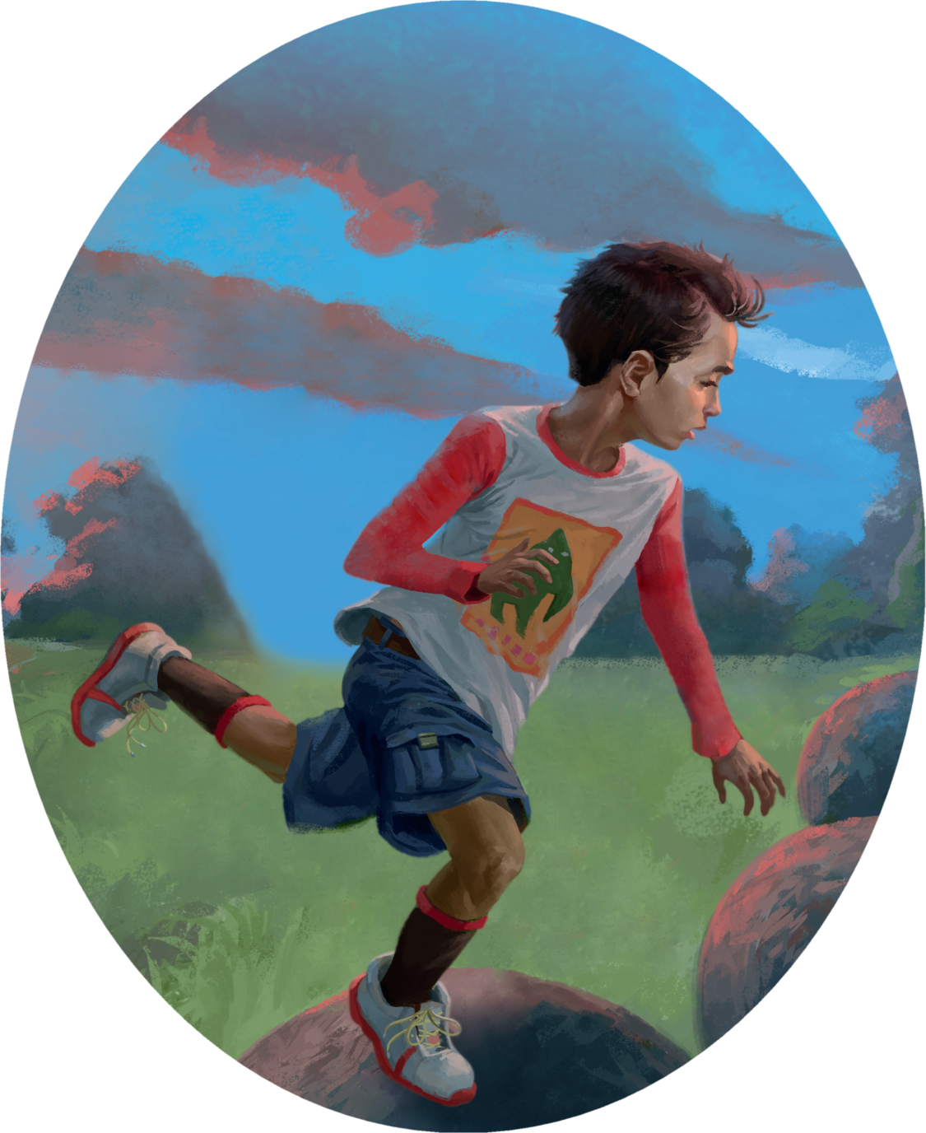
Game On!
游戏开始
选自《多维阅读第21级》

Slide 2
Pre-reading
1. What can you see from the cover?
2. What does the title mean?
3. How many characters are there in the book? And who are they?

Slide 3
Read the story and answer the questions in pairs.
The museum day
1. Why did Simon’s mother take Simon to the museum?
2. What did Simon think of the squid?
3. What did Simon usually do with his father at home?
4. What was Simon’s mother’s ideal weekend?

Slide 4
Read the story and answer the questions in pairs.
The weekend morning
1. How did the family decide to spend the weekend?
2. What did Simon think of this plan? Why?
3. Where did they arrive?
4. Do you think Simon will enjoy the walk? What makes you think so?

Slide 5
Read the story and answer the questions in pairs.
The game was on
1. How many places did they pass along the way?
2. What did Simon’s parents say about the sacred stones?
3. What did Simon do to the rocks and what happened later?
4. What did Simon think of this trip?

Slide 6
Vocabulary Learning
Read the following sentences and fill in the blanks with the correct words.

Slide 7
glare, stare, glance, gaze
stare
1. Children should be taught not to ______ at the disabled people.
2. He _______ at the audience, and he began to speak.
3. The child ______ at the toys in the shop window.
4. Don't ______ at me like that. You deserved the scolding
glanced
gazed
glared

Slide 8
groan, sigh, whisper
1. The kids all ________ when I switched off the TV.
2. James leaned over to whisper something to Michael.
3. He ______ with despair at the thought of all the opportunities he had missed.
sighed

Slide 9
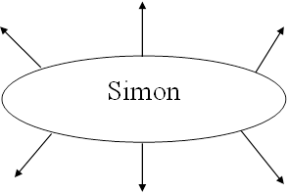
Draw the mind-map with some basic information about how Simon changed his idea towards computer games.

Slide 10
Group Work
Summarize the reasons that lead to the change of Simon’s attitudes towards computer games.

Slide 11
Reading Circle
Work in groups of four and each member undertakes a role and leads the discussion in Reading Circle.

Slide 12
Character Captain
1. What do you think of Simon? Why？
2. What do you think of Simon’s father? Why？
3. What do you think of Simon’s mother? Why？

Slide 13
Creative Connector
1. Do you like playing computer games? How do you balance them with your study and family life?
2. Are you addicted to cellphones? What have your parents done with it?
3. How does your family spend the weekend? Do you often go outdoors together?
4. Have you once witnessed any natural wonders? How did you feel at that time?

Slide 14
Cultural Collector
Can you find out some cultural similarities and differences between Simon’s family life and spare-time activities with yours?

Slide 15
Moral Master
1. What are the influences of computer games on children?
2. How should we build up a harmonious family?

Slide 16
Acting Out!
Suppose you were addicted to computer games, how would your parents help you and what would you do to help yourself balance the time spent on study and computer games?

Slide 17
Homework
1. Write down what we should do to make the best use of the Internet and cellphones.
2. Write down one of your stories of exploring and experiencing wonders of nature.

