Slide 1
Brodie’s Story 父亲的小提琴
选自《多维阅读第21级》

Slide 2
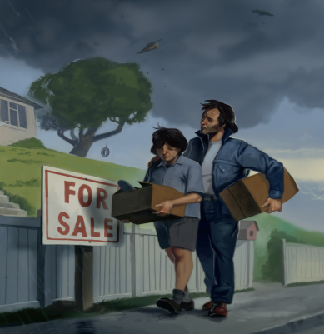
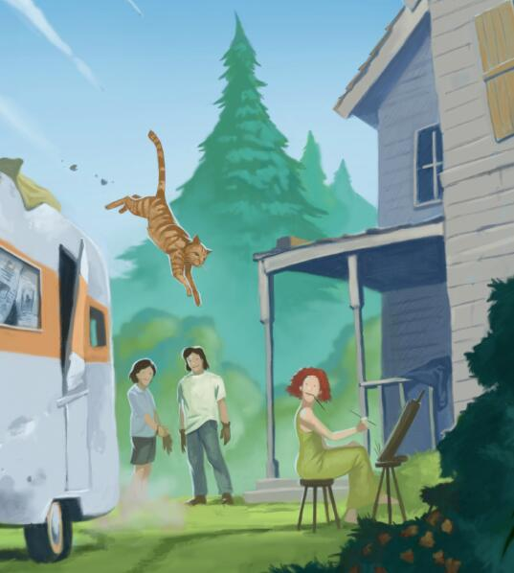
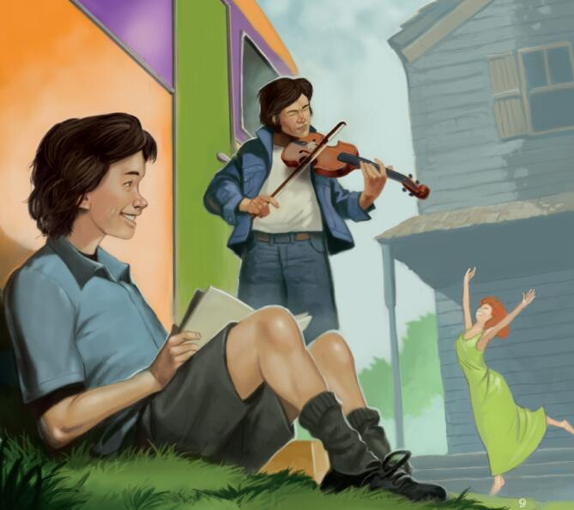
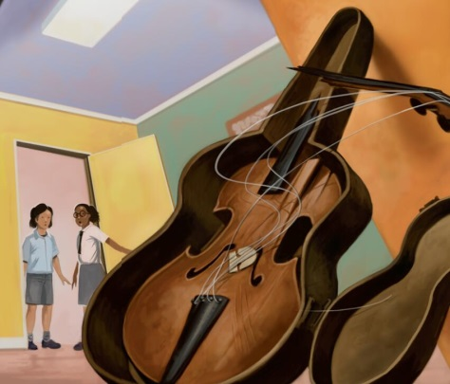
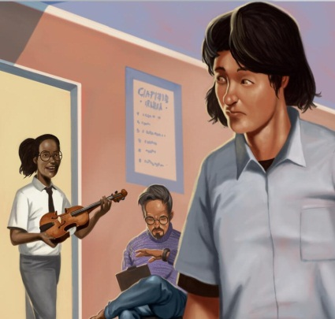
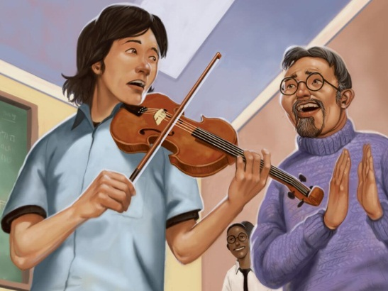
What do you think will happen in the story?
Which person in the pictures do you think is Brodie?

Slide 3
Read the story and answer the questions.
Beginning (Pages 2-6)
Development
(Pages 8-16)
Climax
(Pages 18-22)
Ending
(Pages 24)
Notes:
指导学生了解叙事类文体的四个部分：起因，发展，高潮，结局。点击四个部分可以超链接到每部分相应的PPT页面。

Slide 4

Beginning
Why did Brodie’s father sell their house?
Who was Martha?
Where did Brodie and his father live after selling their house?
Why didn’t Brodie tell anyone he lived in a caravan?
Notes:
点击右下按钮可回到第三页。
Possible answers:
His father lost his job and they couldn’t pay the mortgage.
She was an artist who lived in a huge villa not far away.
They lived in the caravan in Martha’s backyard.
4. His father, who used to be a famous violin player, taught Brodie to play the violin.

Slide 5
Development
How did Brodie start to play the violin? Was he good at it?
What changed Brodie’s mind to take part in the trial run?
What did Brodie’s teacher and classmates think of his performance?

Slide 6
Climax
Why did Brodie put his father’s violin on a high shelf?
What happened to his father’s violin?
What did Hollie do to help Brodie?
Why did the talent scout say that day was his lucky day?

Slide 7
Ending
What happened to Brodie and his father at the end of the story?
Why do you think Brodie and Hollie could become friends?

Slide 8
Retell the story with help of your timeline.
Complete the timeline of the story.
Brodie’s
mother died
Notes:
请学生基于找出的故事要素，根据情节发展过程，提取主要事件，在讲义上画出时间轴，并利用自己画出的时间轴在小组内（4人一个小组）讲述故事。

Slide 9
Character Analysis
What kind of person do you think Brodie/ Mack/ Martha/ Hollie is? Why do you think so?
Can you use some details from the book to support your ideas?
Notes:
把全班学生分成四个部分，每部分指定Brodie, Mack, Martha和Hollie中的某一个人物，学生每四人为一个小组，阅读文本，分别找到文本中对Brodie, Mack, Martha或Hollie外貌、语言、心理、动作的细节描写，并分析这四个人物的性格特点。

Slide 10
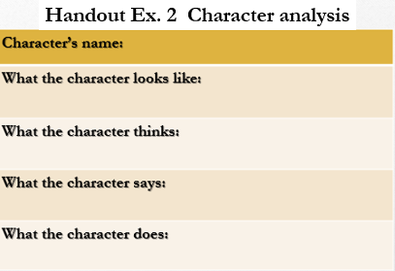
Group work: What kind of person do you think Brodie/ Mack/ Martha/ Hollie is?
Brodie
Mack
Martha
Hollie
Notes:
把全班学生分成四个部分，每部分指定Brodie, Mack, Martha和Hollie中的某一个人物，学生每四人为一个小组，阅读文本，分别找到文本中对Brodie, Mack, Martha或Hollie外貌、语言、心理、动作的细节描写，并分析这四个人物的性格特点。 提示学生把笔记记在学案练习2上。

Slide 11
Share your opinions
Brodie
Mack
Martha
Hollie
Notes:
学生重新分组，每四人为一个小组，四名成员分别来自前一轮讨论的四个小组。学生彼此分享前一轮讨论中对四个人物形象的分析，并用细节支持自己的观点。

Slide 12
Let’s act out the story!
Situation 1: Brodie tries out for the musical.
Roles: Brodie, Hollie, the teacher and
the talent scout
Situation 2: Brodie hears about the theft.
Roles: Brodie, Mack, Martha and
the policeman
Notes:
四个学生为一小组，在两个情景中选择一个演出。

Slide 13
Discussion
What helped Brodie overcome difficulties in his life and his lack of confidence and finally achieve “brightness”?
How do you understand the sentence “Everything looks brighter from behind a smile.”?

Slide 14


