Slide 1
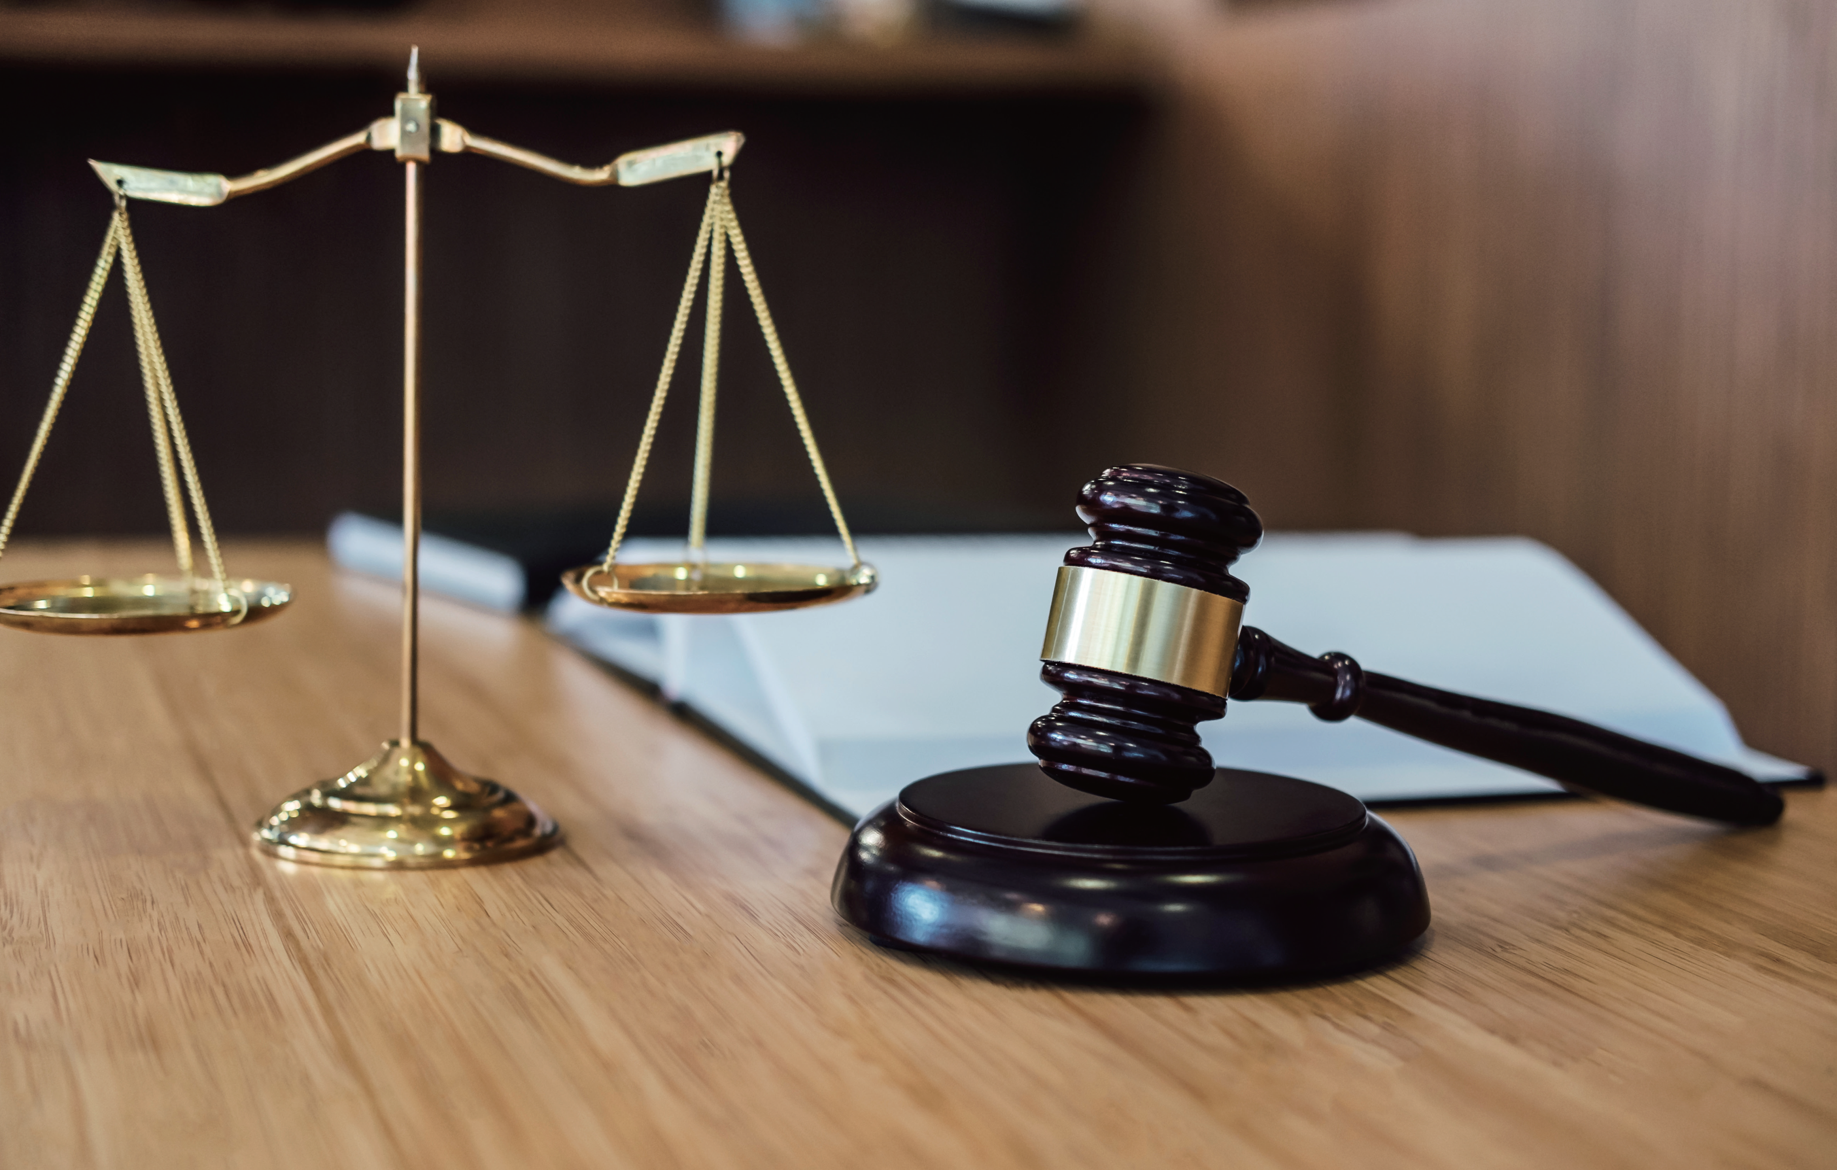
The Eye of the Law
法眼看世界
选自《多维阅读第21级》

Slide 2
Answer questions
Do you think laws are important in our life? Why?
How much do you know about laws?
What do you think is the value of laws?

Slide 3
Make predictions
What do you think this book will tell you?

Slide 4
Analyze the structure
1. How many parts can the book be divided into?
2. What’s the main idea of each part?

Slide 5
Draw a mind-map and discuss
1. What can we learn from the history of laws?
2. What are the differences between ancient laws and modern laws?
3. What’s the value of adopting laws in the past and now?

Slide 6
Voice opinions
1. Do you think laws all around the world should be the same? Why? Why not?
2. Do you think it is important for new laws to be made? Why? Why not?
3. Do you think the silly laws should ever have been made? Why? Why not?

Slide 7
Make connections
1. What connections can you make with the idea of being responsible for your actions?
2. What should we do to make full use of laws today?

Slide 8
Homework
Choose one topic to write a composition:
1. Do you want to be a lawyer? Why?
2. Do you think it is important for new laws to be made? Why? Why not?

