Slide 1
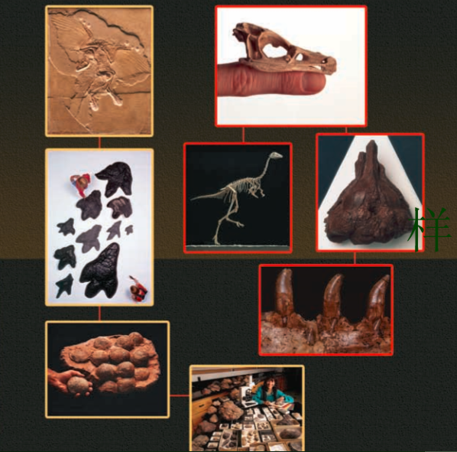
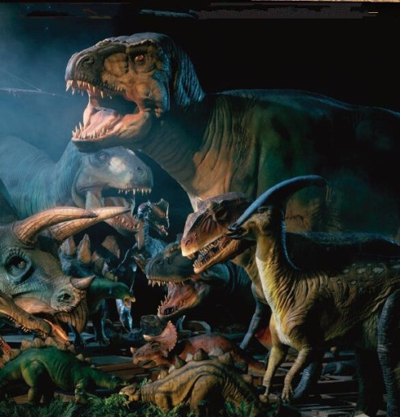
LEAVING A MARK −
DINOSAUR DISCOVERIES
远古的足迹
工作单位：XXXXXXXXX
主讲人：XXX
标题标题标题
选自《多维阅读第21级》

Slide 2
Leading-in
Have you seen any dinosaurs? Where have you seen them? Are they real dinosaurs?
How can people create dinosaur models after they died out?

Slide 3
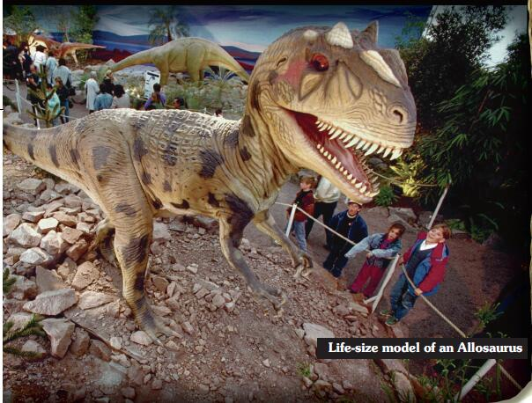
Prediction
What do you think a book about dinosaur discoveries will tell you?

Slide 4
Reading for Basic Understanding
How many parts can the book be divided into?
Three
What’s the main idea of each part?
Part 1: Signs of dinosaurs have been found all over the world and the meaning of those findings to scientists.
Part 2: Analysis of two types of dinosaur fossils and their roles in helping us know more about dinosaurs.
Part 3: The importance of learning dinosaur fossils.

Slide 5
Reading for Detailed Understanding
Group work (Mind Map)
Each group has a discussion about the two types of fossils that help to explain the scientific discoveries of dinosaurs. Summarize the detailed information of each type of fossils and explain the learning about dinosaurs from the findings of each fossil by drawing a mind map. Any form could be adopted.
Possible questions for you to consider while drawing the mind map:
What are the probable body/ trace fossils? Any differences between them?
What does body/ trace fossils consist of?
What can we learn about dinosaurs from the findings of each fossil?

Slide 6
Example
Dinosaur Fossils
Body Fossils
Trace Fossils
remains of dinosaurs
marks a dinosaur left behind
teeth
rarest fossils
bones
foot
prints
toothmarks
skin impressions
drop-pings
nests&
eggs
heart
brain
lungs
The size, height, movement, speed, position, environment, group
What they might look like; protection
What they ate; How they ate; the shape of the insides
Skull, tiny claws, teeth
Dinosaur’s hearing and eyesight

Slide 7
Reading for Deep Learning
What’s the value of dinosaur discoveries to scientists?
Allow them to piece together the puzzle of how and why dinosaurs lived and died;
Help people understand the way that environments can change;
Dig more about our planet.

Slide 8
Discussion
What other values can people get from dinosaur discoveries?
Commercial values---movies; fiction; products related to dinosaurs
Economic benefits
Scientific breakthrough---cloning of dinosaurs
…
Should we continue with advanced dinosaur discoveries?

Slide 9
Critical Thinking
What are the advantages and disadvantages of scientific discoveries?
Advantages:
know more about the unknown world
witness continuous scientific breakthrough
bring more economic benefits …
Disadvantages:
moral deficiency
ecological imbalance (destruction to the original ecology)
Inharmonious relationship between human and nature …
How should we treat our relationship with nature as we continue with our scientific discoveries?
We should conduct our scientific research in an appropriate way with respect for nature.

Slide 10
Life will find its way.
Please respect every possibility of any creature’s survival or extinction in nature.

Slide 11
Homework
Creative writing:
Please choose either of the topics and write an essay no more than 150 words.
Do you want to see a park with real dinosaurs (e.g. cloned dinosaurs) inside? Why?
Do you have any interest in one specific scientific research? If yes, please share it with us.

