Slide 1
Up to the Challenge 直面挑战
选自《多维阅读第20级》

Slide 2
Predict
1. Read the cover first.
2. What kind of challenge do you think will be discussed in the book?

Slide 3
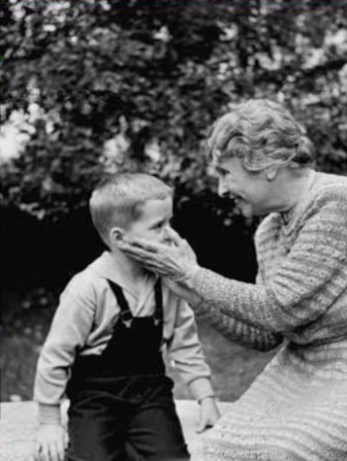
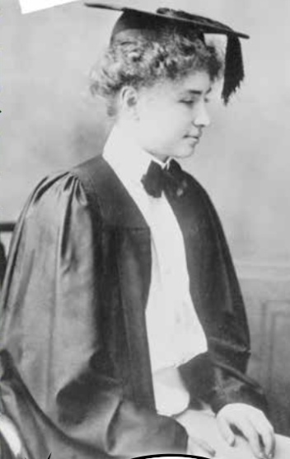
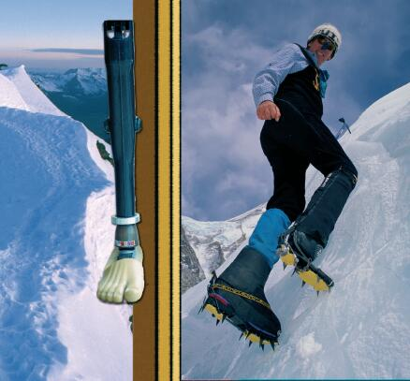
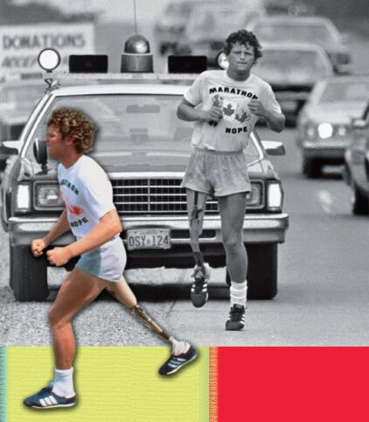
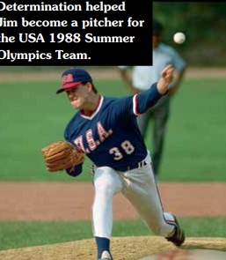
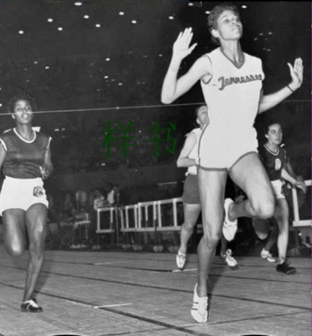
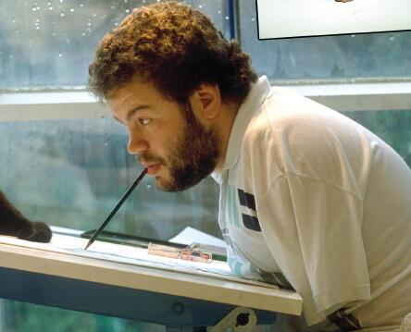
Group work
Each group leader comes to pick a card.

Slide 4
Read and find the answers in groups
1. What happened that made the person in this story become disabled?
2. What do you think the person couldn’t do after he/she became disabled?
3. What dream did the person have?

Slide 5
Read and find the answers in groups
4. What did the person do in order to achieve his/her dream?
5. Why do you think the person could succeed?
6. What can we learn from the person’s success?

Slide 6
Self-designed quiz
The group selected will answer a few questions from the other groups. Each group will ask one question.

Slide 7
Let’s think
What other difficulties do you think disabled people may encounter?

Slide 8
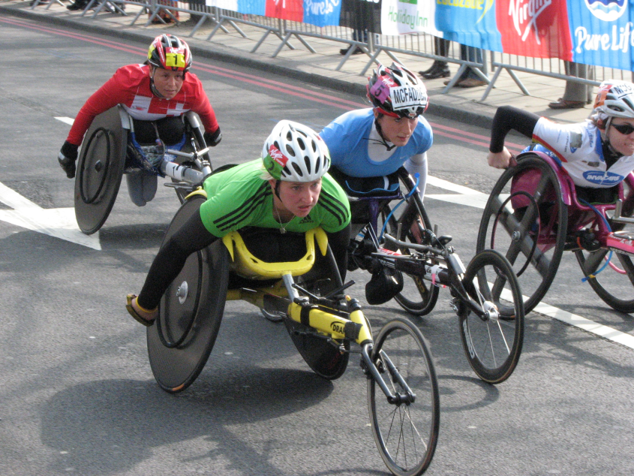
Matching
Story A
Your American friend Tom is disabled and has to use a wheelchair. However, he loves sports and wants to win the wheelchair marathon.
Find a story to encourage him.

Slide 9
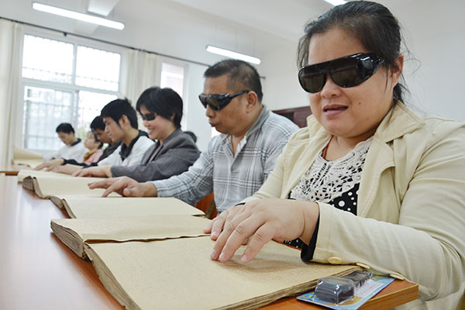
Matching
Story B
A blind girl is learning to read special books designed for blind people. This blind girl is wondering whether she can read books quickly.
Use a story to tell her that blind people can read even faster than sighted people.

Slide 10
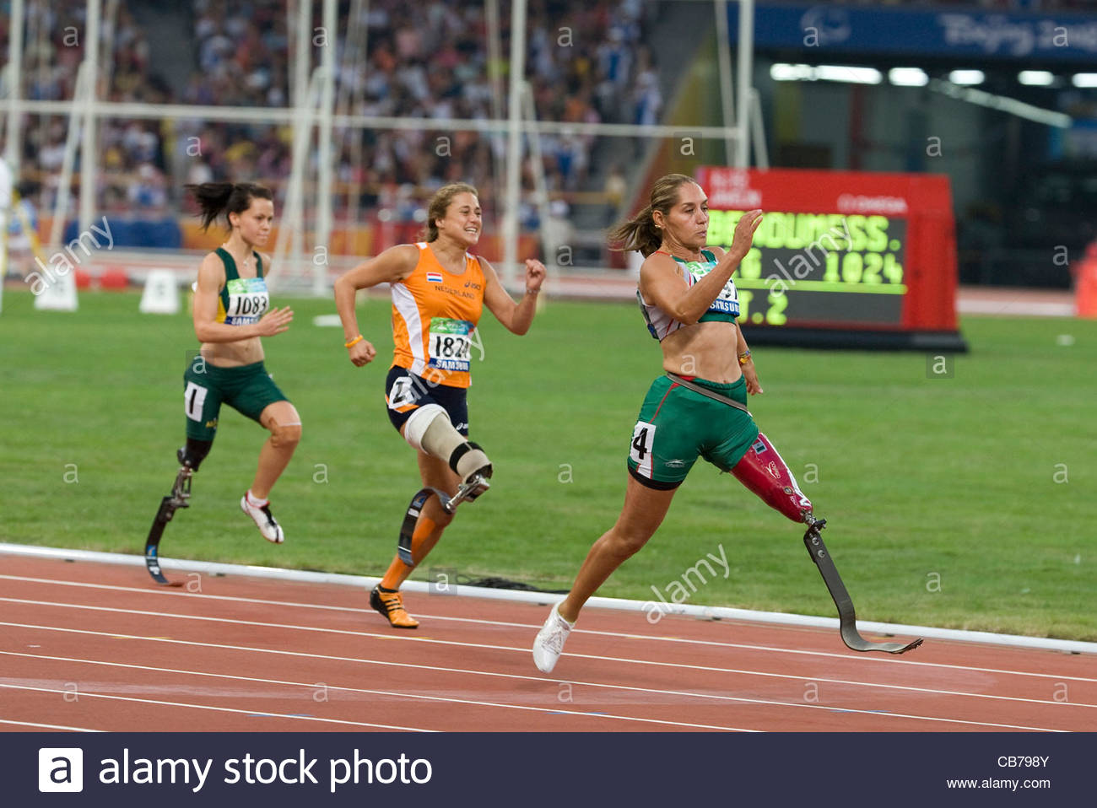
Matching
Story C
Your classmate is a big fan of the Olympic games and is hoping to find out who was the woman that ran the fastest in 1960 Rome Olympics.

Slide 11
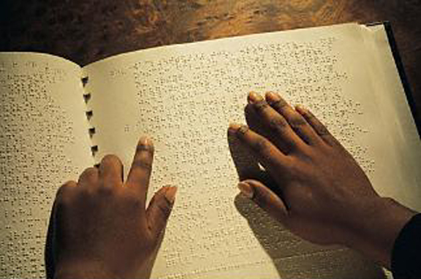
Matching
Story D
Your brother is interested in finding out more about the person who created a system for blind people to read and write.

Slide 12
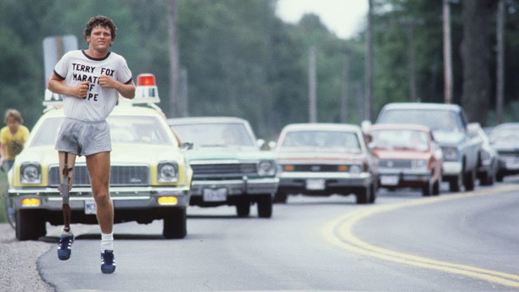
Matching
Story E
Your British acquaintance is preparing for a presentation about the Marathon of Hope.

Slide 13
Matching
Story F
One of your friend loves traditional Chinese painting. Yet he is frustrated because he has never won any contest.
Find an example to encourage him to keep on working on his traditional Chinese painting.

Slide 14
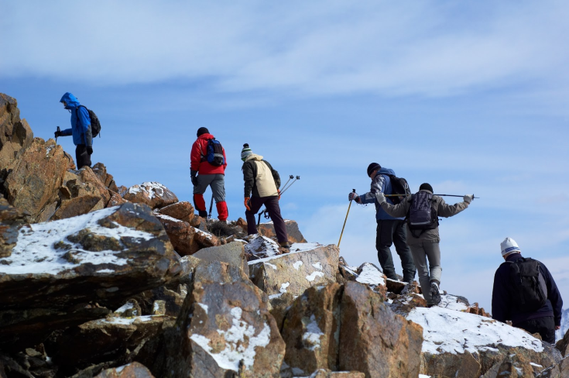
Matching
Story G
Your friend loves mountain climbing. However, last year, he fell over and hurt his leg when he was climbing a mountain. Since then, he has been afraid to climb any mountains or hills.
Encourage your friend to pick up this hobby again.

Slide 15
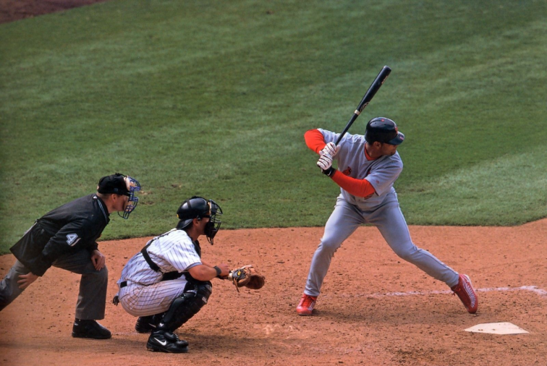
Matching
Story H
Your roommate becomes interested in baseball and wants to become a baseball player someday in the future. However, he is laughed at by his classmates because they say that your roommate’s hands are not nimble enough so it may be difficult for him to pitch and catch the baseball.
Use a story to encourage your roommate.

Slide 16
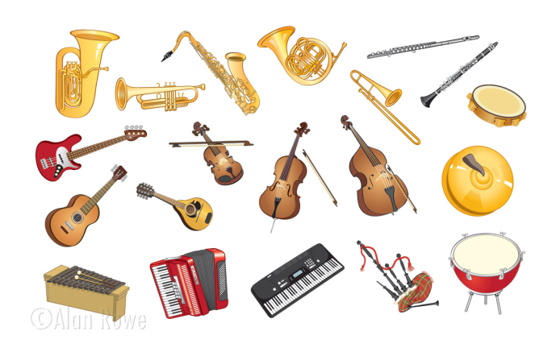
Matching
Story I
Your friend is seriously near sighted and wears a pair of thick glasses. He wants to learn to play musical instruments. Unfortunately, his friends think it is ridiculous and make jokes about him.
Say something to your friend to persuade him not to give up his dream.

Slide 17
Self-designed matching
On the paper, each group writes a simple story similar to your group's story; later on other groups will do the matching.

Slide 18
Group Work
Imagine you have a friend who has some kind of disability. What will your friend do in order to overcome it?
Your answer should contain:
1.What kind of quality should a disabled person have if he/she wants to succeed?
2.What will your friend do in order to overcome the disability?

Slide 19
Homework
Write about a similar person who overcomes great difficulty and achieves his life goal.
It is not the falling down, but the getting back up that matters.

