Slide 1
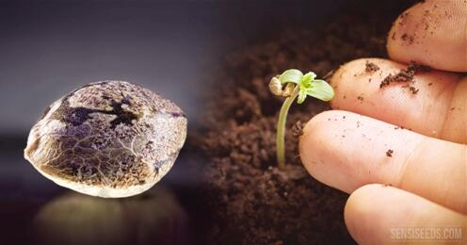
An Idea Seed 创意的种子
选自《多维阅读第20级》

Slide 2
Lead-in
Read the cover and the contents of the book. Answer the questions:
1. What do you expect to read about in this book?
2. In what ways does an idea have anything to do with a seed?

Slide 3
First-reading
Read the book and finish the following activities.
Complete the mind-map with some basic information you can find in the book about “inventions”.
Inventions

Slide 4
First-reading
2. Completet the chart below about “Ancient Inventions”.
Ancient Inventions
Invention | Inventor | Original Purpose | Further Use | Category

Slide 5
First-reading
3. Completet the chart below about “From Past to Present”.
From Past to Present
Invention | Development | Category
 | _____________________ _____________________ _____________________ | Communication
 | ________________________________ ________________________________ ________________________________ ________________________________ ________________________________ _________________________________
 | ________________________________ _______________________________ ________________________________ _______________________________

Slide 6
Second-reading
Group work: Describe in your own words one of the inventions you've read about in the book. In what ways does it make life easier for people?

Slide 7
Third-reading Read some of the passages carefully. Answer the questions:
An Idea Seed
1. What can you infer from “… but inventors have been at work since people first walked on Earth”?
The Success of an Invention
2. What’s implied by “… but many others never succeeded at all”?

Slide 8
Third-reading Read some of the passages carefully. Answer the questions:
Wacky Inventions
3. Does the writer laugh at these wacky inventions? How do you know?
4. Do you think people should try to invent things to change the world? Why or why not?

Slide 9
Third-reading Read some of the passages carefully. Answer the questions:
Thinking Outside the Box
5. What qualities do you find essential for an inventor?
Future Inventions
6. Are you confident that we humans can solve problems of today and problems in the future? Why?

Slide 10
Group discussion
1. Why does the author write the book?
2. Does the author simply want to inform us of some successful and practical inventions, and entertain us by describing a few wacky ones?
3. What does the writer intend to tell us?

Slide 11
Group conclusion
Why is the book entitled “An Idea Seed”?
“To plant a seed of creation in the minds of the readers so that it might take roots, blossom and fruit.”

Slide 12
Assignment : I am a Maker
1. Suppose you are a member of the “Maker’s Club” in the school.
2. Work in groups of 5.
3. Do some research into an existing problem that concerns you; use your imagination and creativity, then “invent” a new device/product.
4. Design a poster for your “invention” and give a presentation of your invention to the class.

Slide 13
Thank you!

