Slide 1
The Right to Survive
生存的权利
选自《多维阅读第20级》

Slide 2
Pre-reading Questions
What are the things that man cannot live without?

Slide 3
Making Predictions
The Right to Survive
What are the things that man cannot live without?
Water
Food
Shelter
Health care
School
Can everyone in the world enjoy all these rights?

Slide 4
All people have the right to enough food to eat and water to drink, and to have shelter. In many nations of the world, people also have the right to an education and health care. These rights, however, do not come as easily for some as they do for others.

Slide 5
Reading
Why does the writer say simply surviving each day can be a struggle?
a lack of
available
have access to

Slide 6
Work in groups and draw a mind map about each given theme. Share the map with the whole class and relate what the passage is about.
Group Work

Slide 7
Sample (In whatever form you like!!!)
A survival basic
water
Collecting water
Lack of water

Slide 8
Making Comparisons
Refer to the five mind maps and tell the similarities and differences.
health care
water
food
school
shelter

Slide 9
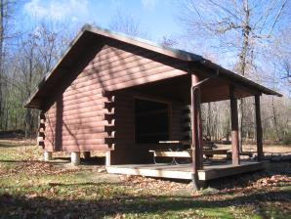
Think it over
Why doesn’t the writer include solution in the remaining three parts?
(A Safe Shelter, Health Care for
Everyone, School for All)

Slide 10
Assignment
Surf the Internet and find out possible solutions to shelter, health care and education problems.

Slide 11
Problem-solving Patterns
Which one is a cause and which one is an effect of water shortage?
The rain falls more in some places than others.
Many people around the world walk incredible distances to collect water.
Floods can destroy homes and make the water supply unclean.
C
E
C

Slide 12
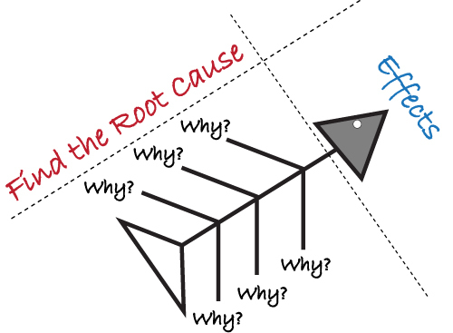
Finish the fishbone diagram to figure out the causes for each problem.

Slide 13
Group work
Share the information you obtained from the Internet with your group members.

Slide 14
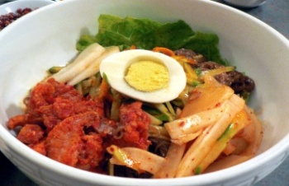
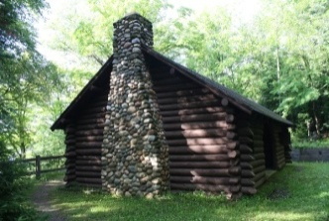
Think it over
Of the five basic human needs, which one affects your life most? If the problem were not properly dealt with, what would happen?

Slide 15
Giving solutions
From the text, we know we can solve the problem this way.
On a big scale …
On a smaller scale …
When there is a … problem, … often try to help.
In my opinion, the problems can be solved this way.
As far as I am concerned, …

Slide 16
Survival in the Future
What are the elements that restrict the development of the human society? How can we solve these problems?

Slide 17
Building a community with a shared future for mankind is in essence to connect the prospects and destinies of every nation and country closely together. — Xi Jinping, Chinese President

Slide 18
Turn Earth into a harmonious FAMILY!

