Slide 1
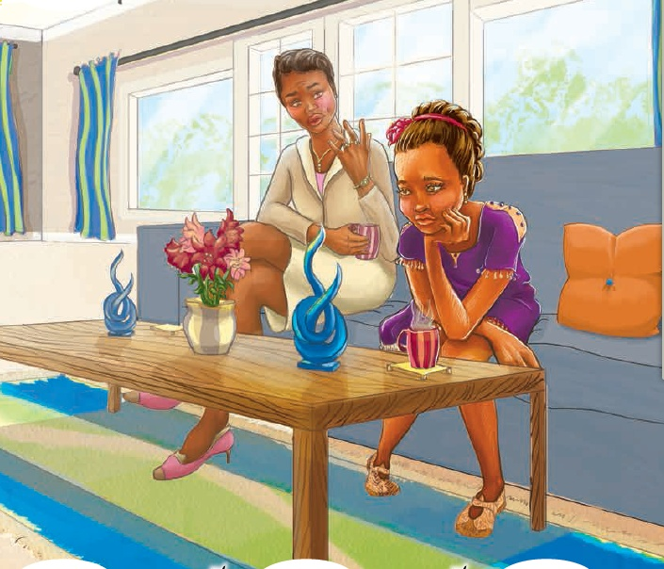
Lesson From Lea 丽娅的朋友
选自《多维阅读第20级》

Slide 2
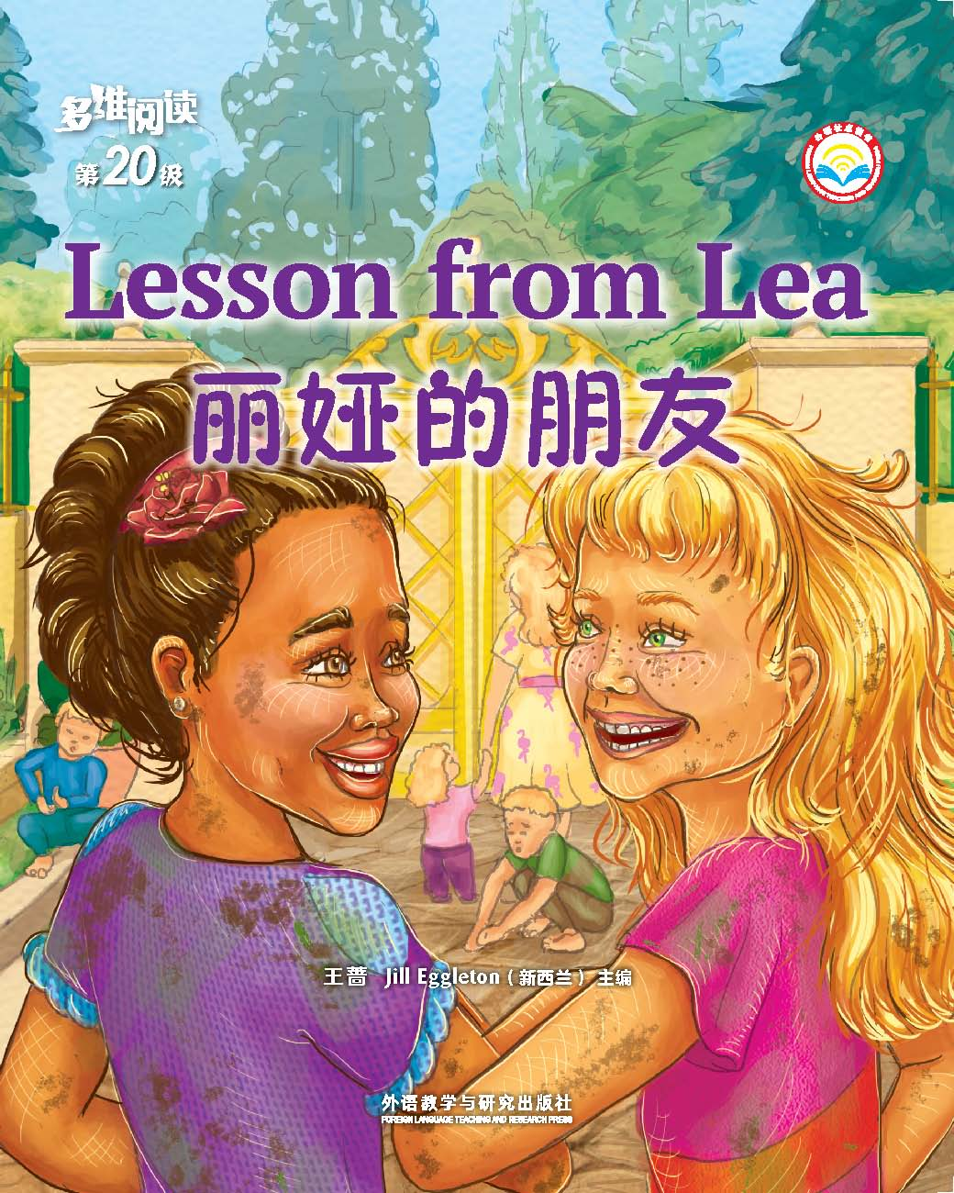
Prediction
Read the cover and predict what the story might be about.

Slide 3
Read for main ideas
1. How many parts can the passage be divided into?
2. What is the main idea of each part?

Slide 4
Read for main ideas
Part 1
(Pages 2-5)
Part 2
(Pages 6-15)
Part 3
(Pages 16-23)
Part 4
(pages 24-25)
A. The development of the story.
B. The ending of the story.
C. The beginning of the story.
D. The highlight of the story.

Slide 5
Read for details
The beginning of the story (Pages 2-5)
1. Was Lea a happy girl? Why?
2. What was Lea’s family like?
3. What do you think of her friend Izzie?
4. Why Lea’s mother didn’t like Lea to be friends with Izzie?

Slide 6
Read for details
The development of the story (Pages 6-15)
1. How was Izzie’s family like?
2. Did Lea enjoy herself in the Berryman family?
3. Why did Lea have to make some excuse every time Izzie asked her over?

Slide 7
Read for details
The highlight (精彩部分) of the story (Pages 16-23)
1. Why wasn’t Izzie invited to Lea’s birthday party ?
2. Why did Lea lie to her mother?
3. What suddenly happened to the Berrymans’ house?
4. What did Lea’s mother see in the Berrymans’ house? How did she feel?

Slide 8
Read for details
The ending of the story (Pages 24-25)
1. What happened to Lea and the Berryman family at the end of the story?
2. Why did Lea’s mother finally change her attitude?

Slide 9
Understand the text
1.Which character in the story impressed you most? Why?
2. What can you learn from the story?

Slide 10
Character appreciation
Lea
(1) “We are not a royal family,” said Lea. (P2)
(2) “I don't care about the house,” said Lea.“It is not important to friendship.” (P4)
(3) “But Mum,” cried Lea.“They are really nice people. It is not their fault they have no money.” (P10)
kind innocent

Slide 11
Character appreciation
Lea's mother
(1) “We are a well-known and respected family” “It would be embarrassing to have our daughter looking like a poor person” “You have to dress and behave a certain way.” (P2)
(2) “The Berryman house is in the valley,”she said ,“It doesn't look well cared for. What sort of people would live in a house like that?” (P4)
(3) “I don't think you should get too friendly with the Berrymans,” she said , “I want you to find some decent friends. More like us. ” (P10)
arrogant snobbish

Slide 12
Izzie
(1) Izzie didn’t care. She was one of five kids. She wore torn jeans and bear feet whenever she could.” (P4)
(2) Every time Izzie asked her over, she had to make some excuses. (P12)
(3) “Why wasn’t I invited?” she demanded.
(4) “Oh,” said Izzie. “Poor you.” (P16)
warm-hearted understanding

Slide 13
Mrs Berryman
(1) “Hi, Lea,” Mrs Berryman said. “Come in!” (P6)
(2) “You will just have to stay the night here,” said Mrs Berryman, giving Lea a warm hug. “We will light the fire and toast marshmallows. I will call your mum.” (P20)
(3)“Welcome,” said Mrs Berryman, extending her arms in a hug of greeting. (P22)
generous warm-hearted caring

Slide 14
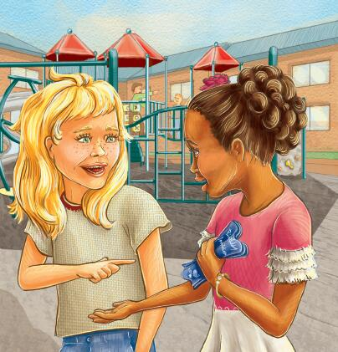
Divide the whole class into four groups and each group prepare one part of the story.
Role Play
Beginning------- Group 1
Development----- Group 2
Highlight------- Group 3
Ending-------- Group 4

Slide 15
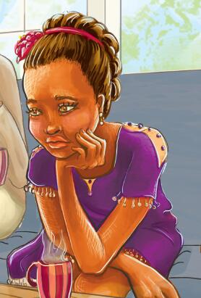
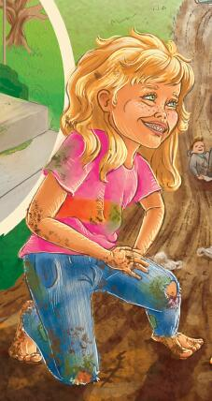
Analyze different characters of the story and create a new version to continue the story.
Writing
Lea
Izzie
Lea’s mother
Mrs Berryman

Slide 16
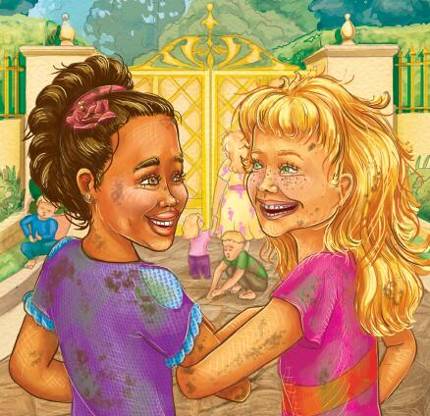
Homework
1.Talk about a similar story in the real life.
2.Write some effective advice on how to establish the correct values in the course of growing up.

