Slide 1
The World Beyond Earth
地球之外
选自《多维阅读第20级》

Slide 2
S
P
A
C
E
！
The World Beyond Earth
Reading

Slide 3
Learning Aims
Get to know the main idea of the whole book and each section. Develop the process map about human beings exploring the space.
Knowledge
Aims
01
Form an outlook on the future development of space exploration.
Ability
Aims
02
Improve awareness of the importance of exploring the unknown world and love of science.
Emotional Aims
03

Slide 4
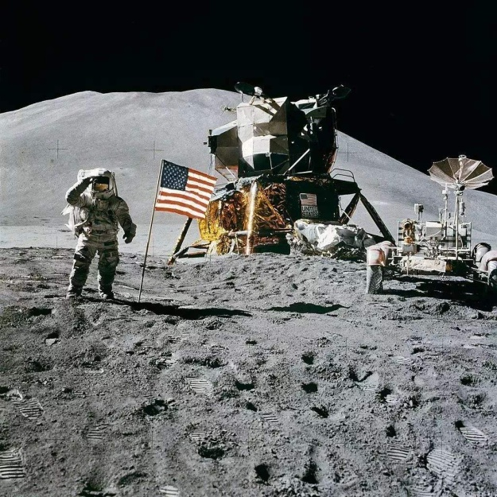
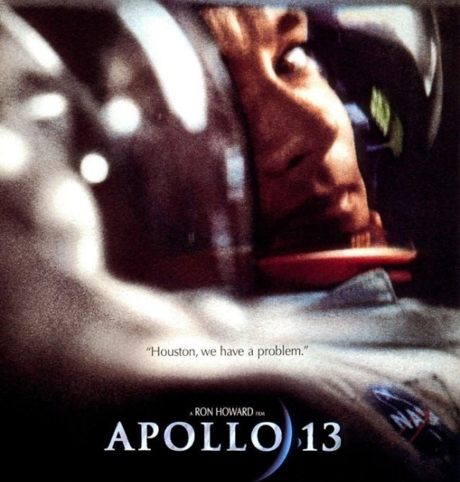
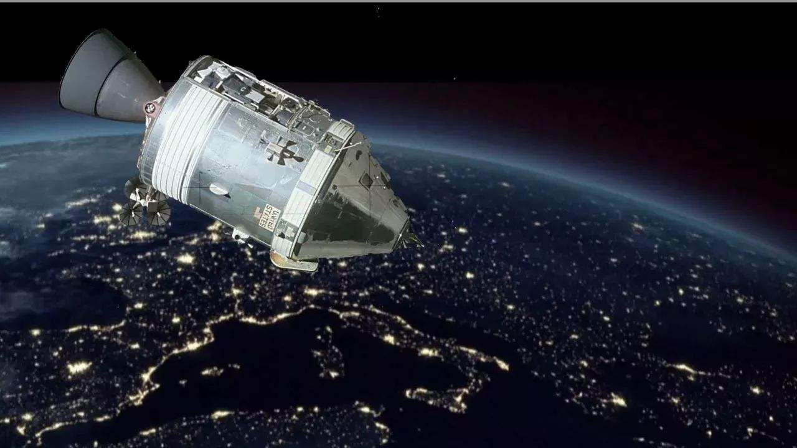
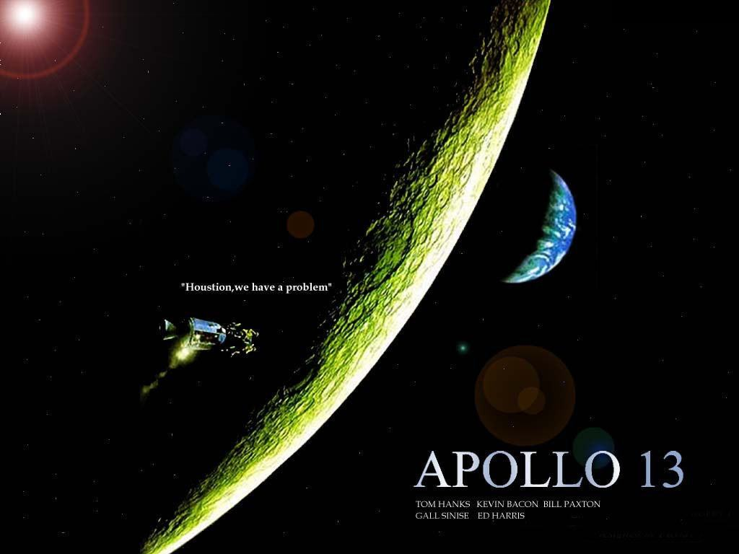
Do you know anything about Apollo 11 and Apollo 13?

Slide 5
Read the cover and the contents
1. What does the book mainly talk about?
2. What have human beings done to explore the space?
3. What problem does human activities cause to the space?

Slide 6
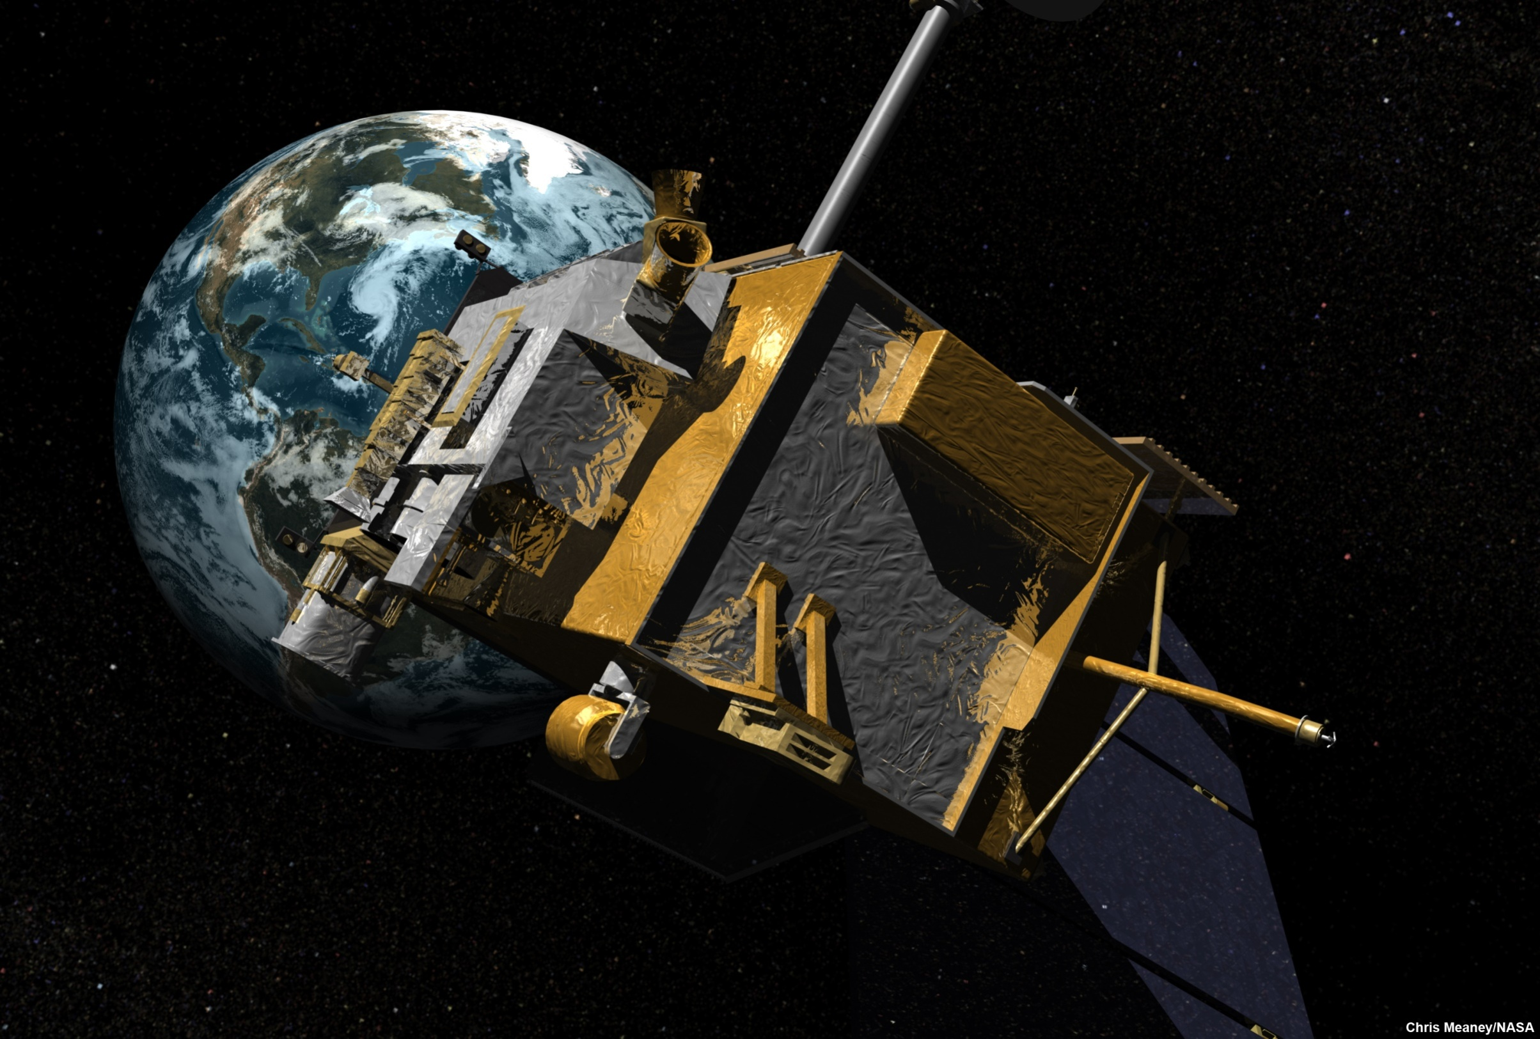

Slide 7
1. Unmanned Explorers and Orbiters
People always wonder about the mysteries of space.
What explanations did ancient people have about the mysteries of space?
Why have people known more about space now?

Slide 8
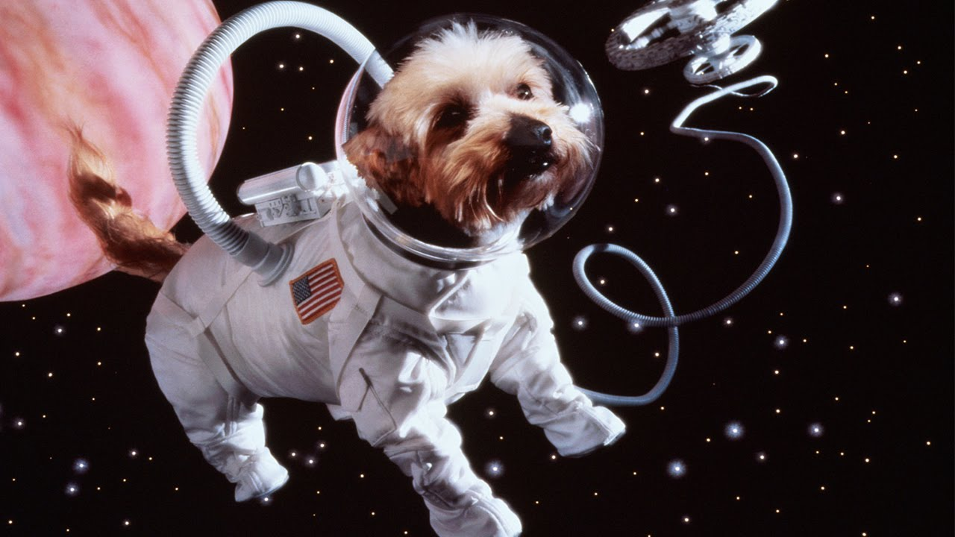

Slide 9
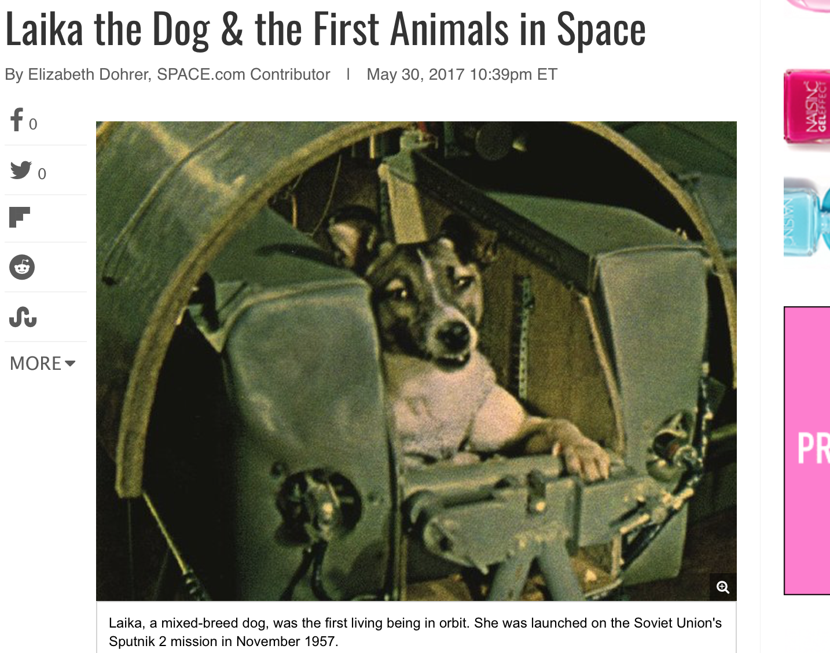

Slide 10
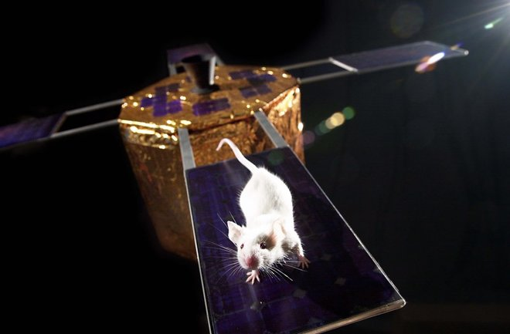

Slide 11
A. Animals in Space
Why did scientists send animals into space in the early days?
What can scientists know by using animals?
Why were chimpanzees sent into space?
What does many people feel about using animals in the space travel experiments?

Slide 12
B. Animal Reactions in Space
How have animals reacted to space travel differently?

Slide 13
A. Deep Space Probes
A. Deep Space Probes
A. Deep Space Probes
What’s the main use of space probes?
2. Sent From Earth
A. Deep Space Probes
What are deep space probes?
What’s the main use of space probes?

Slide 14
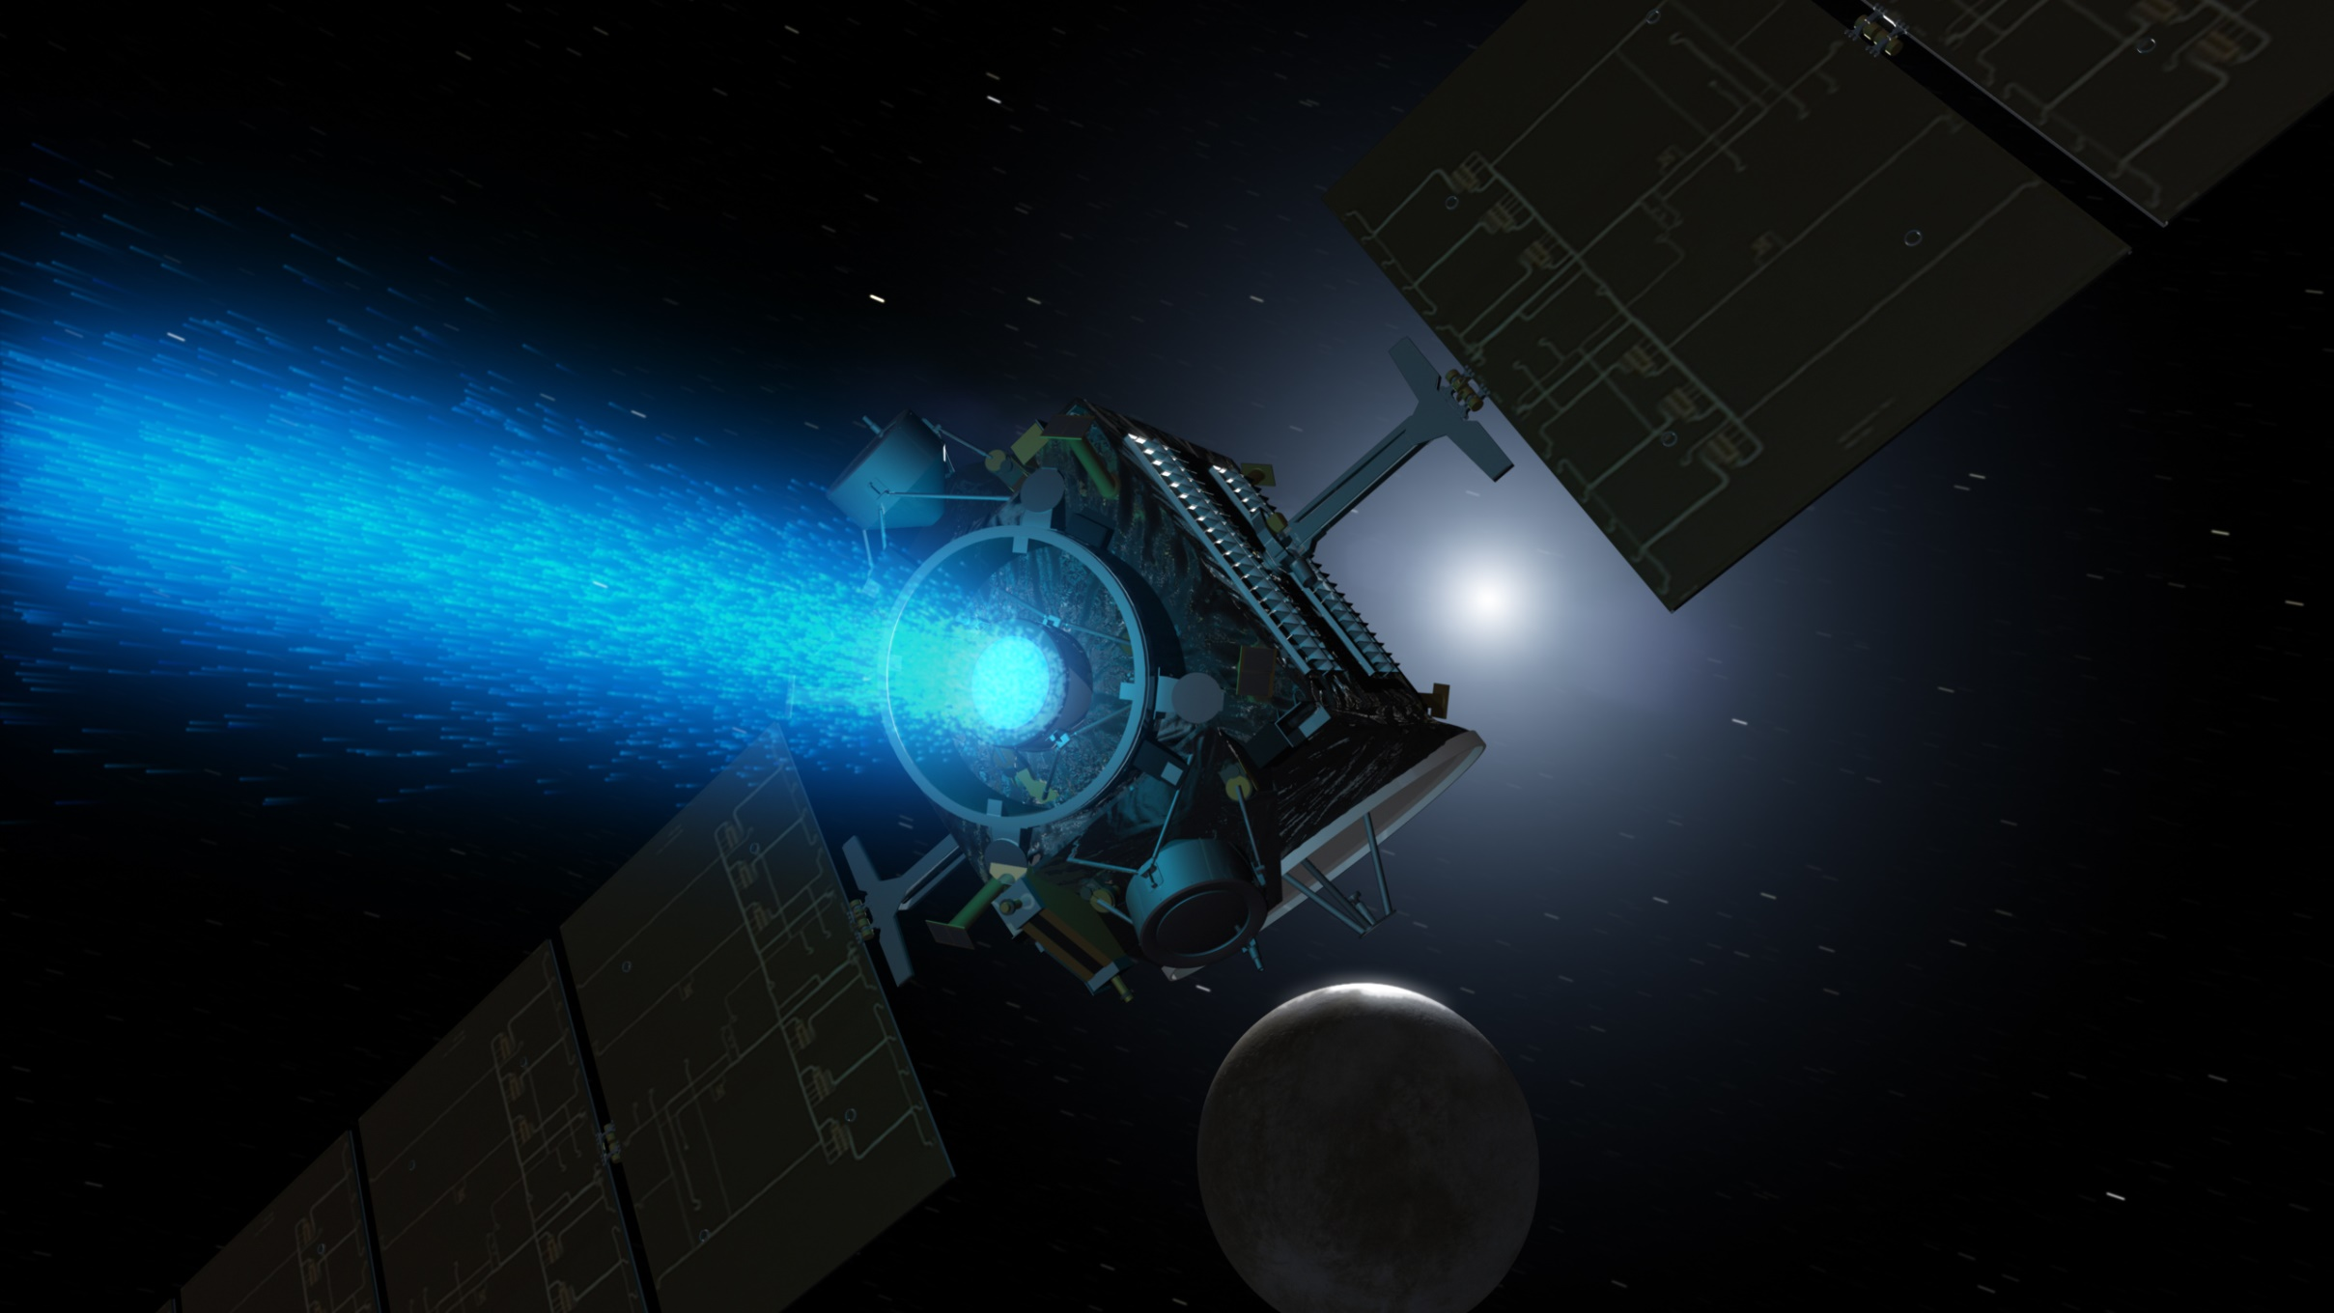

Slide 15
What have deep space probes done by now?
B. What a Deep Space Probes Does
What have deep space probes done by now?
How can space probes help astronauts?

Slide 16
C. Space Probes on Mars
How can space probes help scientists judge whether there is life on Mars?
Why are space probes an ideal way to explore space?

Slide 17
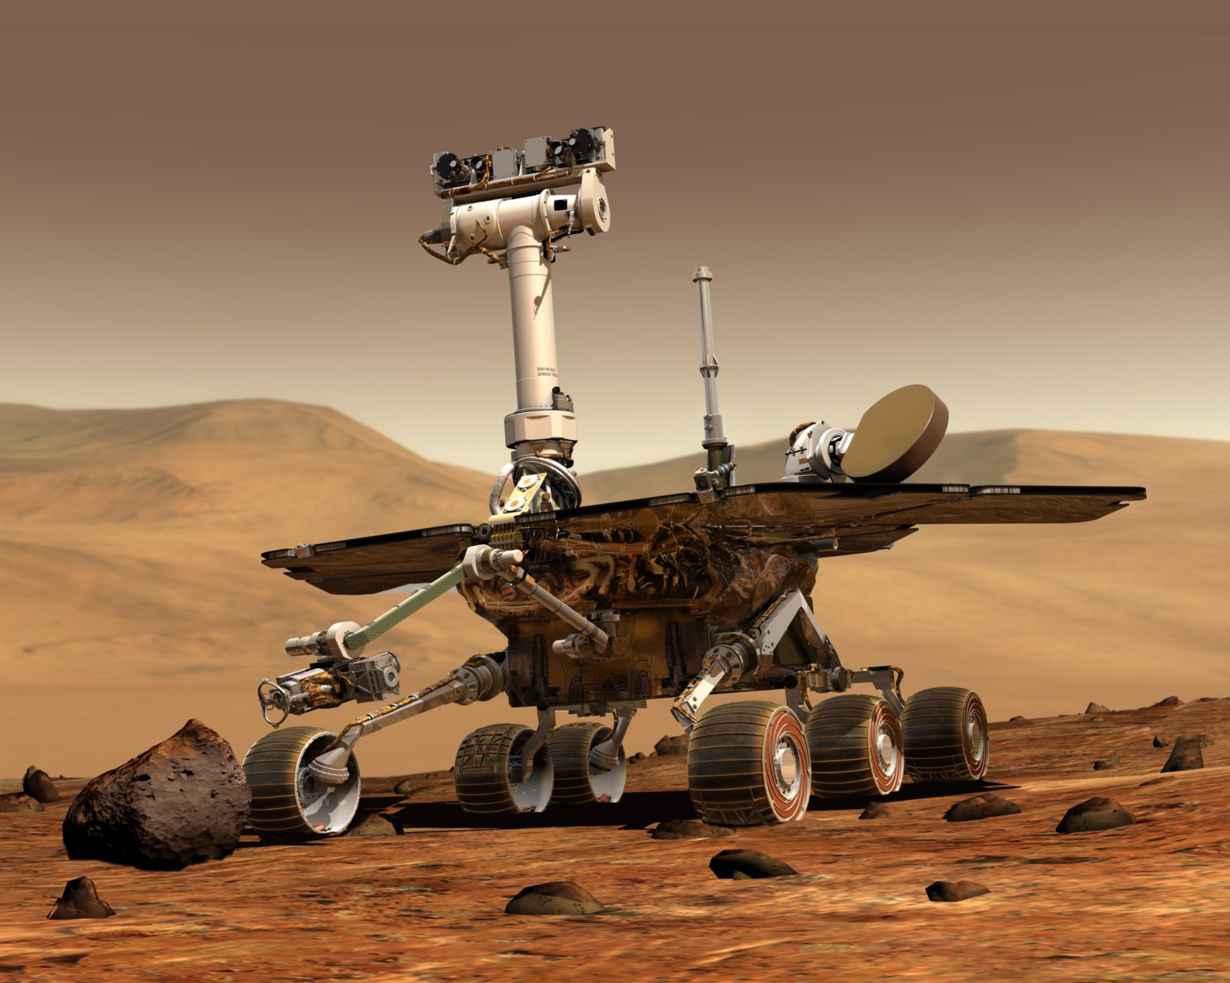

Slide 18
What are the uses of man-made satellites?
D. Orbiting Satellites
What are satellites?
What are the uses of man-made satellites?

Slide 19
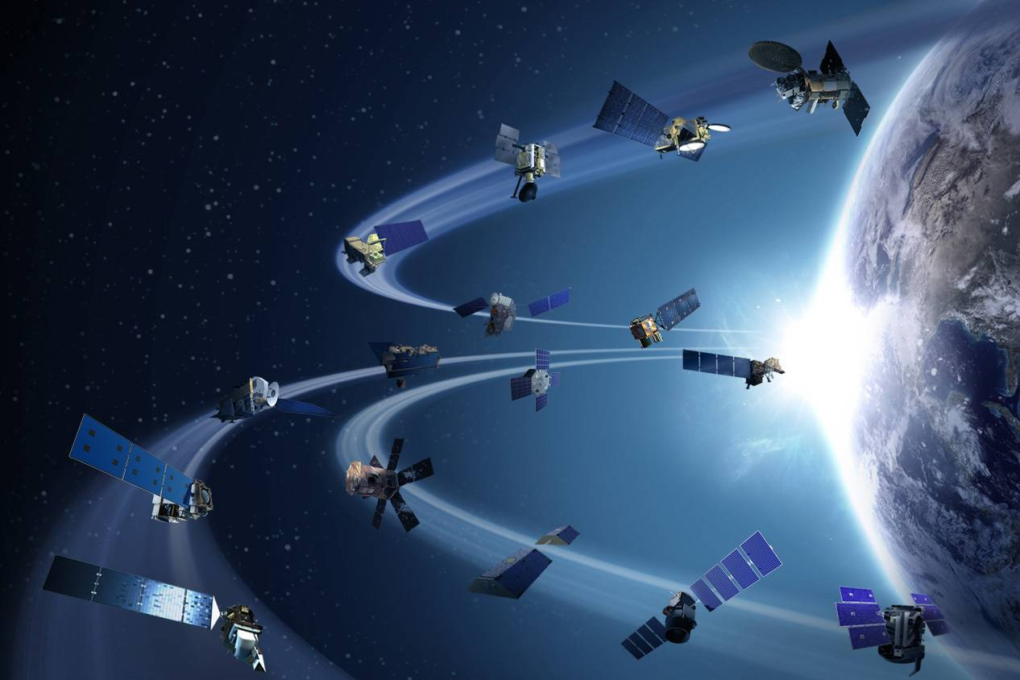

Slide 20
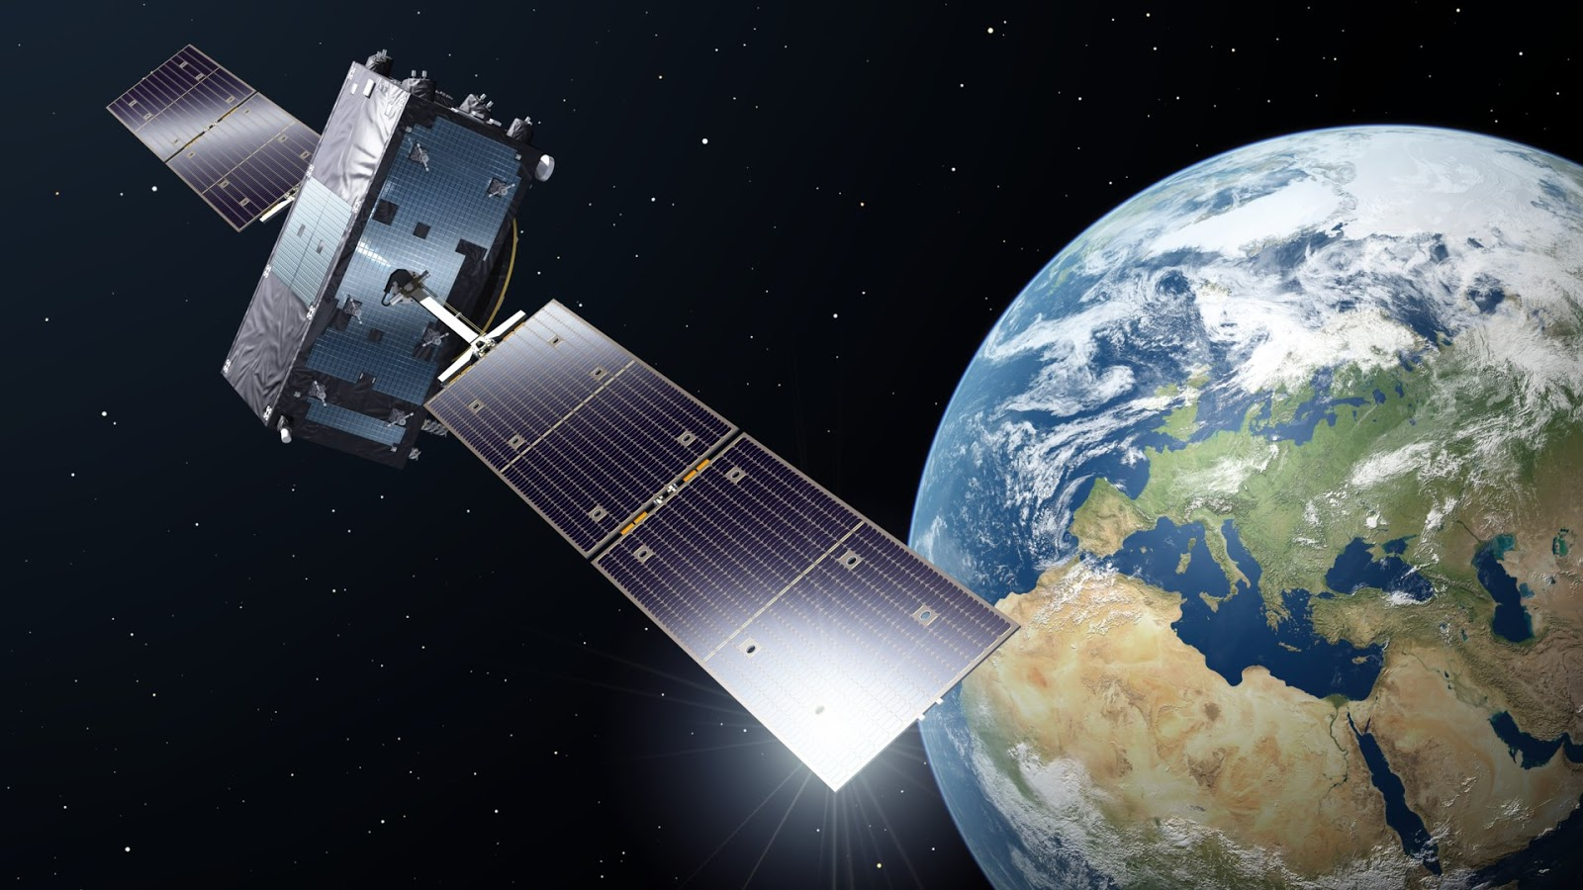

Slide 21
What is space junk?
What is space junk?
What is space junk?
Is space junk bad or good? Why?
3. Space Junk
What is space junk?
Is space junk good or bad? Why?

Slide 22
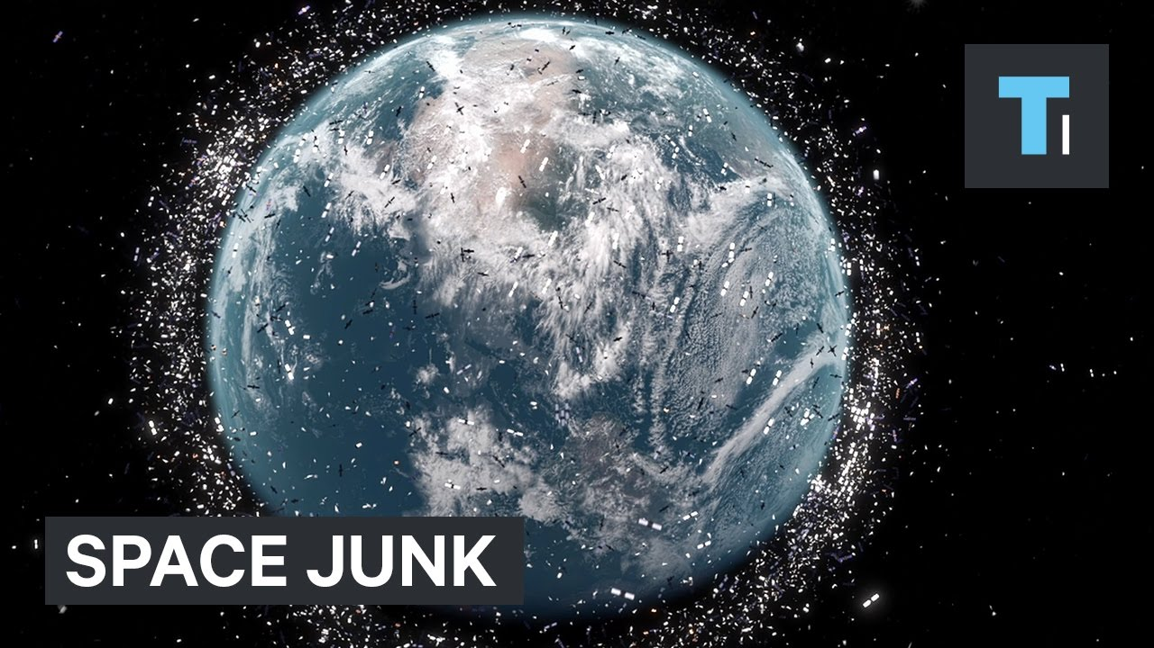

Slide 23
Space Junk on Planets
Where are the space junk from?
What will space junk become one day? Why?

Slide 24
4. Telescope-Space Eyes
Why do scientists call space telescope “space eyes”?

Slide 25
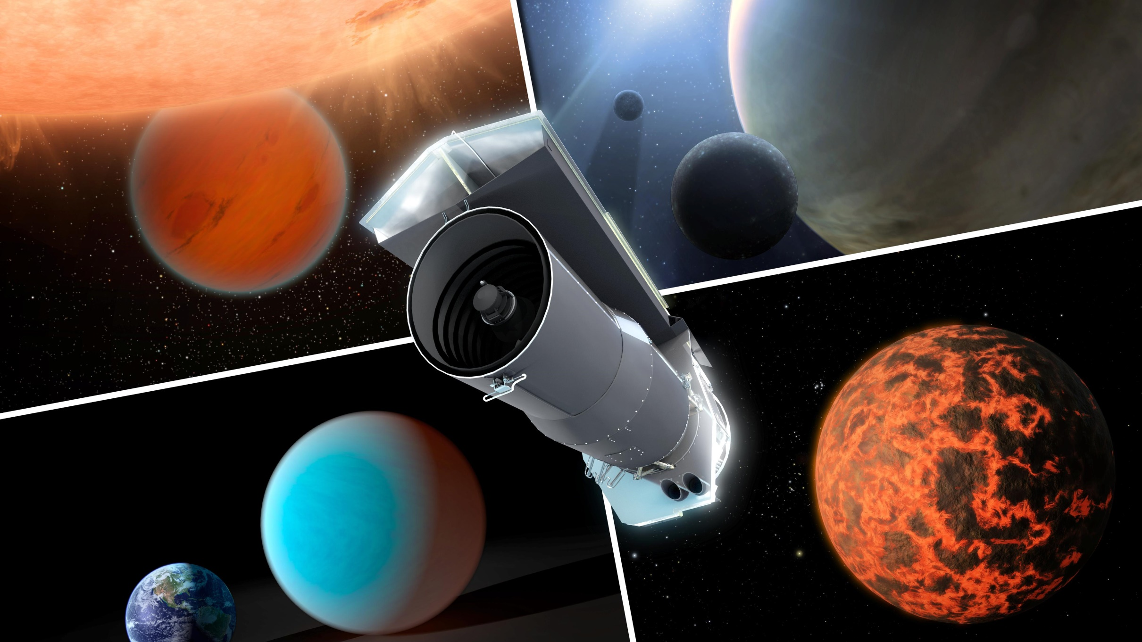

Slide 26
5. What Next?
5. What Next?
What new ways are scientists trying to invent to explore space?

Slide 27
Speaking & Presenting
Group Work:
Work in groups, discuss the part that interests you most.
After discussion, share your opinions with the class.
Your presentation needs to include the following points:
the achievements made so far
why this achievements matter
your outlook on its future development

Slide 28
1. What do we know from the chapter?
1. What do we know from the chapter?
1. What do we know from the chapter?
Discussion
1. What do we know from the book?
2. Why does the author write the book?
3. What can we do in the future?

Slide 29
Summary
1
We have known more things about the space.
We have developed good skills in presenting our
views and share them with others about space after teamwork.
2
3
We have realized the importance of exploring the unknown world and will learn more to share our knowledge with other people.

Slide 30
Homework
1.Compulsory:
Search online the latest news of space exploration and share your findings in the class.
2. Optional:
Work with your teammates and use your imagination to create a poster introducing a space flying machine, including its making material, function, uses etc.

Slide 31
S
P
A
C
E
！
The World Beyond Earth
Thank you for your attention!

