Slide 1
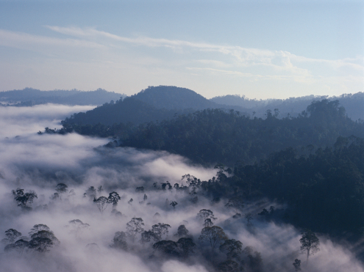
Looking After Our World 保护地球家园
选自《多维阅读第19级》

Slide 2
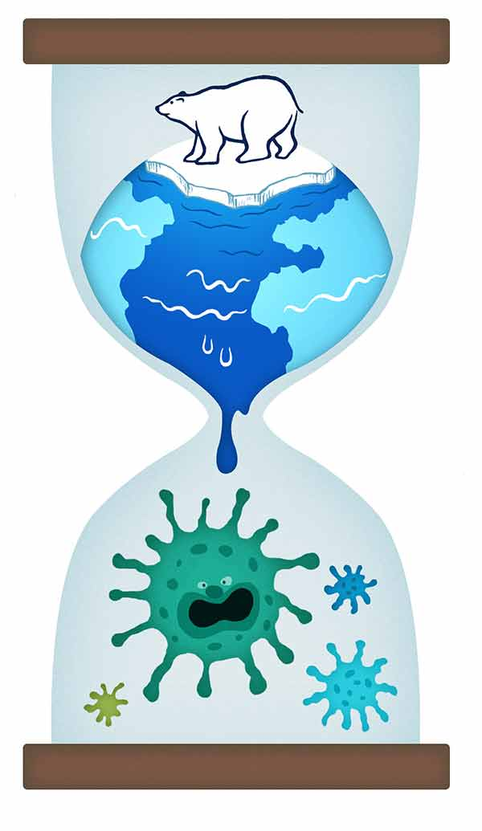
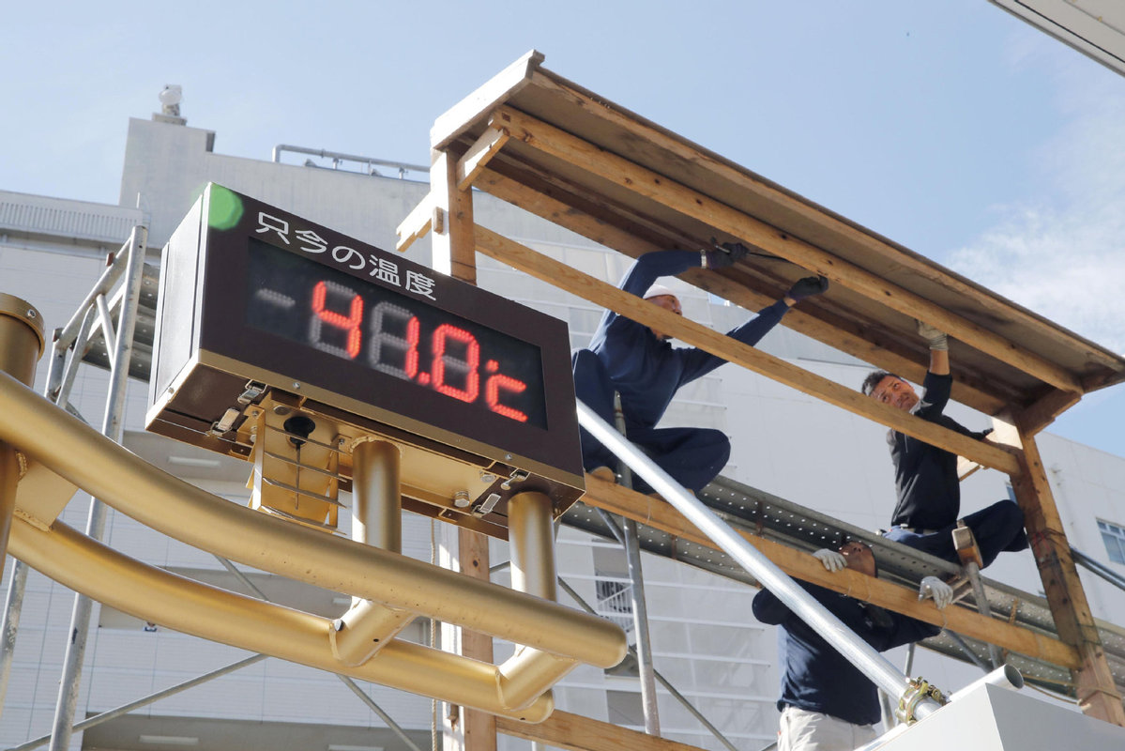
What can you see from the pictures?

Slide 4
1. What’s happening to the world?
2. Why is it happening?

Slide 5
When it comes to “environmental protection”, what comes to your mind first?
Energy waste?
Garbage?
Destroying forests?
......

Slide 6
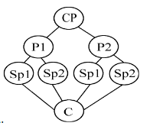
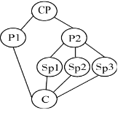
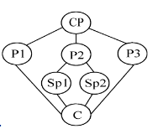
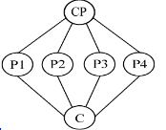
First reading Pair work: Structure and main idea
How many parts can the passage be divided into?
Follow the example to draw a structure map of the passage.

Slide 7
First reading Pair work: Structure and main idea
What’s the main idea of each part?

Slide 8
Second reading Group work: detailed information
Read from page 4 to page 20, follow the example on your handout to draw a mind map of the effects and suggestions of the given situation.

Slide 9
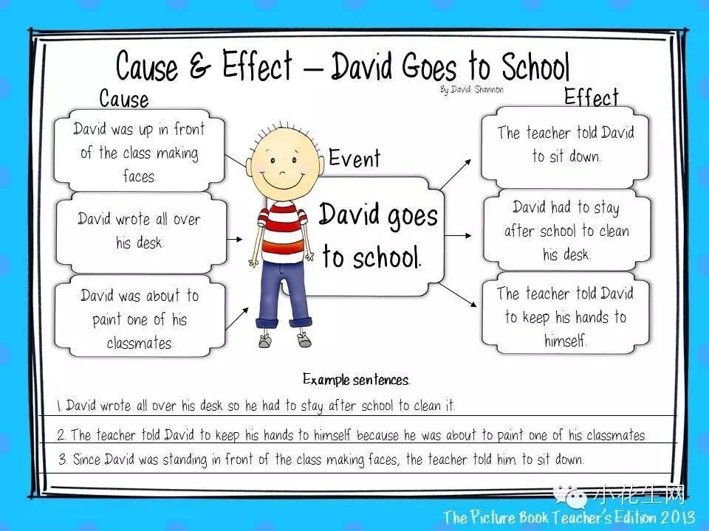

Slide 10
Second reading Group work: detailed information
Further thinking:
Are there any other effects or suggestions that you want to add to the list? What are they?
Are there any listed suggestions that you think are not practical? Why?

Slide 11
Third reading Further thinking: picture in mind
When you read,“Earth is groaning under its weight,” what picture do you get in your head?
When you read, “living in a friendly way with nature,” what picture do you get in your head?

Slide 12
Third reading Further thinking: your daily behavior
Unfriendly behavior | Friendly behavior
Other things we can do to protect the Earth:

Slide 13
Conclusion: title analysis
What does the title “Looking After Our World” mean?
What is the best way to look after our world?

