Slide 1
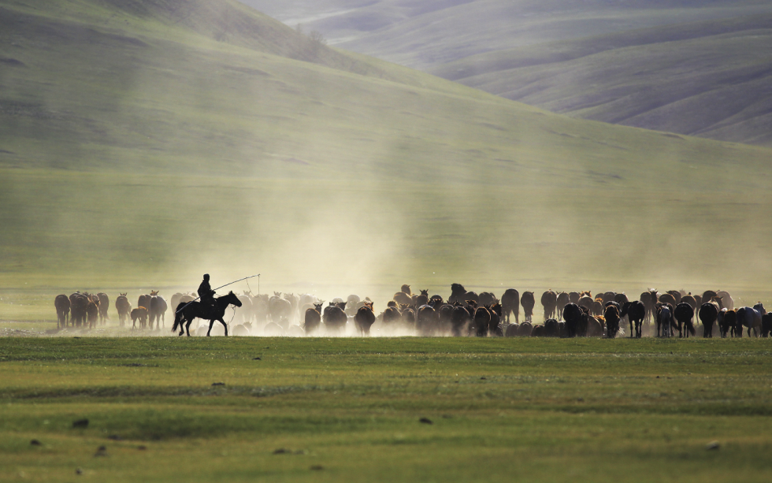
Nomads – A Wandering People 游牧民族
选自《多维阅读第19级》

Slide 2
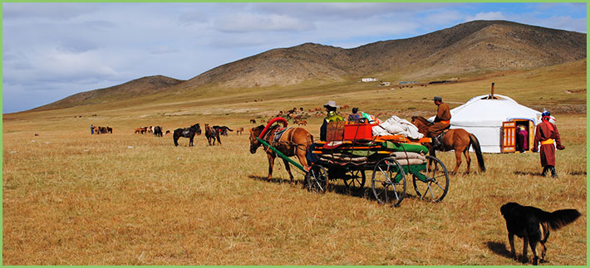
What do you know about them?
Who are they?
Where do they live?
How do they make a living?
…

Slide 3
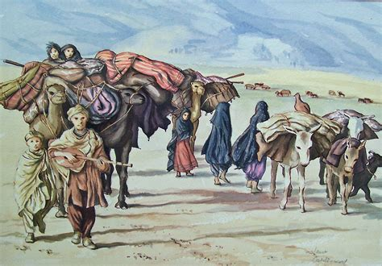
Read PP 2-3, and answer the following questions:
Who are they?
How do they live?
What kinds of nomads are introduced in the book?
What’s the main structure of the text?

Slide 4
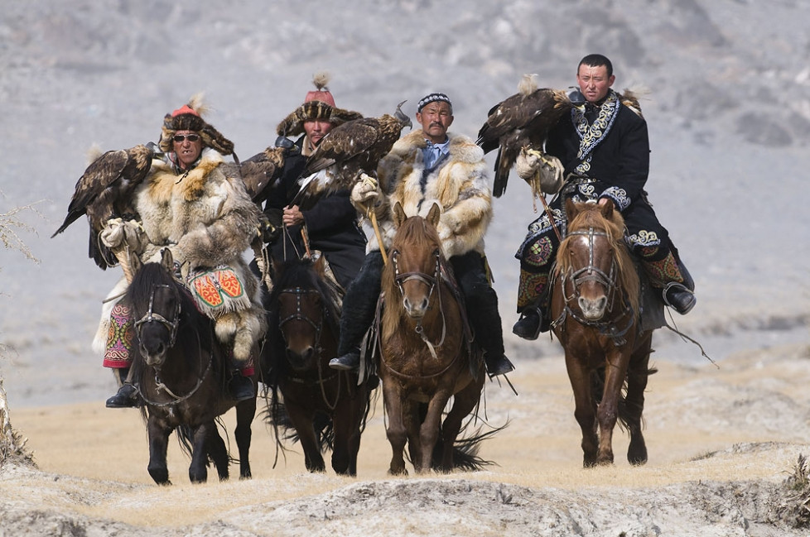
Read PP 2-3, and answer the following questions:
Who are they?
They are nomads – a wandering people.
How do they live?
They don’t live in just one place for long. Instead, they move around.
What kinds of nomads are introduced in the book?
There are pastoral nomads, hunter-gatherer nomads, and nomadic traders and craft workers.

Slide 5
Read PP 2-3, and answer the following questions:
What’s the main structure of the text?
Brief introduction
Three types of nomads
Threats and challenges

Slide 6
Reading for basic information
Read the remaining parts of the book and complete the table.
Nomads | Pastoral Nomads | Hunter-gatherers | Traders and Craft Workers
Homes (place, feature …)
Typical people
Purpose
Food and Animals
What do they value?

Slide 7
Introduce different types of nomads.
Nomads | Pastoral Nomads | Hunter-gatherers | Traders and Craft Workers
Homes (place, feature …)
Typical people
Purpose of moving
Food and animals
What do they value?
pasture, plateau
chum, ger, easy to
a camel caravan, a shelter
desert, rain forest
Nenets, Mongolian
San, Awa people
Tuareg
food and water for animals
food for themselves
work and trade
meat, milk …
yak, horse, sheep, cattle, reindeer …
animals, birds, nuts, honey, wild fruits …
animals
the land
work

Slide 8
Reading for deeper understanding
What can we learn from nomadic people’s way of life?
(What spirits do nomadic people have?)
They live a frugal and simple life and care little about material gains.
They live in a natural way. They have looked after and cared for the natural world. They respect the land – all that it provides and its limits.
They diversify our civilization and our world.
…

Slide 9
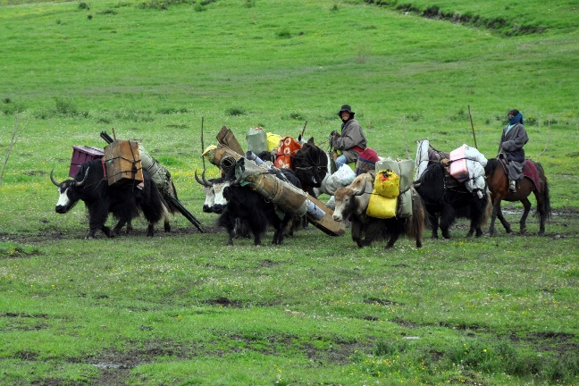
Reading for more information
What threats and challenges are nomads facing?
What causes them?
Due to changing land use or politics, they may have to stop moving around altogether.
For example, for Awa people, trees have been cut down for wood and land is used to feed cattle, they can no longer live their nomadic lifestyle.

Slide 10
Discuss and speak
The UN will hold a conference aiming to protect the homes of nomadic people and their way of living. As a representative of your tribe, please make a speech, introducing your tribe’s basic information, and what you think the world should do to help with your challenges.

