Slide 1
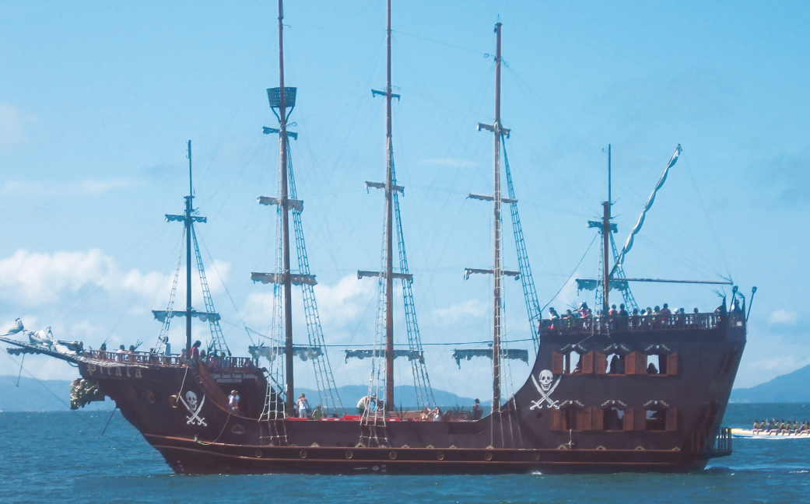
Treasures 真正的宝藏
选自《多维阅读第19级》

Slide 2
Lead-in
1. What can you see from the cover of the book?
2. What might the article talk about?

Slide 3
Reading for gist
How many parts can this book be divided into?
What’s the main idea of each part?

Slide 4
Reading for details
Treasures Lost
1. Why are many people interested in hidden treasures?
2. What are the assumptions about the loss of Zeugma?
3. Where is Zeugma at present?
4. What did the Statue of Zeus at Olympia look like?
5. What happened to the treasures in the Iraq Museum?

Slide 5
Reading for details
Treasures Found
1. What did archeologist Heinrich promise?
2. What did Heinrich do with the treasures uncovered in the city of Troy?
3. What was discovered in King Tut’s tomb?
4. How were the Terracotta warriors found in China?
5. What are the special features of the terracotta warriors?

Slide 6
Reading for details
Treasures Under the Sea
1. What are the problems with finding treasures under the sea?
2. How did Concepcion lose its treasure to the sea?

Slide 7
Reading for details
Treasure Hunters and Archaeologists
1. How do modern treasure hunters search for buried treasures?
2. What are the differences between treasure hunters and archaeologists?
3. Why are some items which have no monetary value regarded as treasures?

Slide 8
What are the differences between treasure hunters and archaeologists?
They both look for treasures.
treasure
hunters
archaeologists

Slide 9
Group work
Work in groups of four, compare the different experiences of ancient treasures listed in the book, and analyze the influence of human activities on historical relics.

Slide 10
Homework
Write about some treasure that has been over-exploited and your suggestions to use it more properly.
Or
Introduce something which has no monetary value but is very precious to your family in class.

