Slide 1
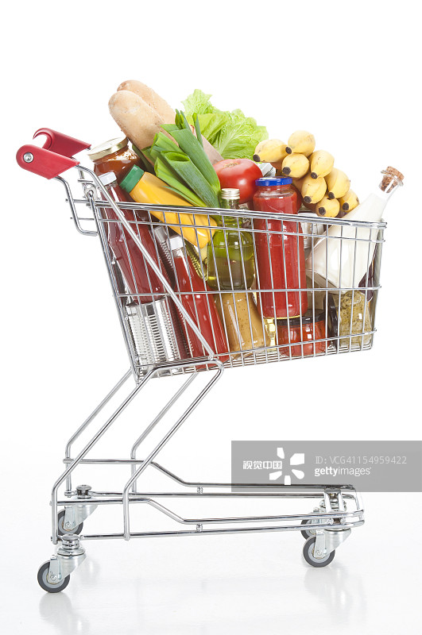
The Wrong Trolley 将错就错
选自《多维阅读第19级》
Notes:
视觉中国，图片编号VCG41154959422

Slide 2
Lead-in
Look at the title and the cover of the book. Answer the following questions:
1. What can you see from the cover?
2. Where does this story probably take place?
3. What has probably happened in the story?

Slide 3
First reading
Read the story and answer the following questions.
Who is the narrator of the story?
What’s the story about?
How many major parts can the story be divided into? What is the main idea of each part?

Slide 4
First reading
Read the story and answer the following questions.
1. Who is the narrator of the story?
Jessica, the daughter.
2. What’s the story about?
It’s about how Jessica and her dad and brother managed to cook a nice dish with the things they accidentally bought after they took the wrong trolley while shopping.

Slide 5
First reading
Read the story and answer the following questions.
3. How many major parts can the story be divided into? What is the main idea of each part?
It can be divided into four major parts.
Beginning: Busy shopping
Development: Wrong trolley
Climax: New cooking
Ending: Nice dinner

Slide 6
Second reading
Read each part again in detail and answer the following questions.
Beginning
1. What was the supermarket like when the family arrived?
2. How did the family work like a well-oiled machine?
3. Why did they skip the “exotic foods” section altogether?
4. What was the new tactic they decided on?
5. What did the children get as rewards for their help?

Slide 7
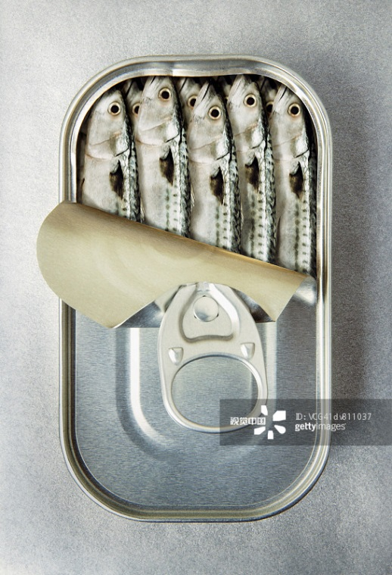
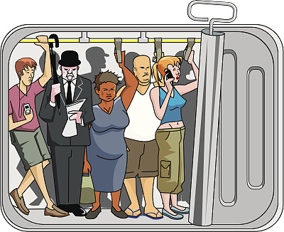
Second reading
Read each part again in detail and answer the following questions.
Beginning
1. What was the supermarket like when the family arrived?
It’s packed like sardines in a tin.
(very crowded)
Notes:
视觉中国，第一幅图片编号VCG41dv811037
第二幅图编号VCG41N118293404

Slide 8
Second reading
Read each part again in detail and answer the following questions.
2. How did the family work like a well-oiled machine?
work like a well-oiled machine=cooperate well
Ollie drives, Jessica checks the list and Dad does the running and the grabbing.
3. Why did they skip the “exotic foods” section altogether?
Because the family isn’t very good with new foods.

Slide 9
Second reading
Read each part again in detail and answer the following questions.
4. What was the new tactic they decided on?
Park and ride.
5. What did the children get as rewards for their help?
Hotdogs.

Slide 10
Second reading
Read each part again in detail and answer the following questions.
Development
1. Why did the family find some of the things from their list but a whole lot that wasn’t when they were back home?
2. What might make them take the wrong trolley?
3. What did the family plan to do with the things they bought?

Slide 11
Second reading
Read each part again in detail and answer the following questions.
Development
1. Why did the family find some of the things from their list but a whole lot that wasn’t when they were back home?
Because they took the wrong trolley to the checkout.
2. What might make them take the wrong trolley?
Maybe because they used the “park and ride” strategy during the busy shopping and Dad didn’t pay much attention while checking out.

Slide 12
Second reading
Read each part again in detail and answer the following questions.
3. What did the family plan to do with the things they bought?
They searched the Internet to get to know the things and planned to cook with them.

Slide 13
Second reading
Read each part again in detail and answer the following questions.
Climax
1. What is a tagine?
2. Who did the cooking that afternoon?
3. How did Dad feel about the cooking?
4. How would the new dish likely taste?

Slide 14
Second reading
Read each part again in detail and answer the following questions.
Climax
1. What is a tagine?
A tagine is a dish found across North Africa. It is usually a spicy stew of vegetables, fruit and meat often served with couscous.
2. Who did the cooking that afternoon?
Jessica.

Slide 15
Second reading
Read each part again in detail and answer the following questions.
3. How did Dad feel about the cooking?
He didn’t quite like the smell and watched Jessica cook with suspicion.
(① Dad said the house was getting smelly with garlic and opened the windows; ② I thought it smelled really good, but Dad wasn’t sure; ③ Dad waved around a tea towel and opened some more windows;④ “Are you sure about this, Jess?” he said, ...;⑤ Dad and Ollie watched as I added the meat.)

Slide 16
Second reading
Read each part again in detail and answer the following questions.
4. How would the new dish likely taste?
Spicy.
(① Dad said the house was getting smelly with garlic …; ② Next we had to cook the spices — to let the flavours out; ③ I added another spice.)

Slide 17
Second reading
Read each part again in detail and answer the following questions.
Ending
1. How did Dad explain to Mum why they took the wrong trolley?
2. What did Jessica use the pan to cook? What did it look like?
3. How did Dad like the new dish in the end?
4. What did Mum mean when she said “that’s a first in this house and I hope not the last”?

Slide 18
Second reading
Read each part again in detail and answer the following questions.
Ending
1. How did Dad explain to Mum why they took the wrong trolley?
It was a jungle out there.
2. What did Jessica use the pan to cook? What did it look like?
The tagine. It had a golden-brown color and looked soft.

Slide 19
Second reading
Read each part again in detail and answer the following questions.
3. How did Dad like the new dish in the end?
He thought it was great.
4. What did Mum mean when she said “that’s a first in this house and I hope not the last”?
She liked the new dish and hoped the family would try more in the future.

Slide 20
Third reading
Read the story again and draw a mind map to illustrate the significant moments in the story and mark the feelings of the character. You may choose either Dad’s or Jessica’s perspective.

Slide 21
Pair work
Use the mind map to retell the story to each other and ask for feedback. You may have a further discussion about your agreements and disagreements.
Notes:
视觉中国，图片编号VCG41N680767868

Slide 22
Reading Circle
Read the tasks for different roles in the reading circle. Choose one role and finish the task. Then share your findings in your circle.
Reading Circle
Character Captain
Cultural Collector
Creative Connector
Language Master

Slide 23
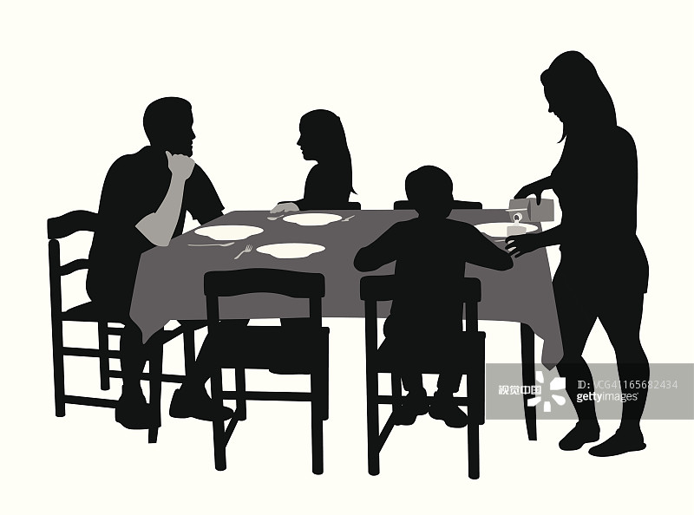
Group work
Work in groups of four. Imagine you were Mum, Dad, Jessica and Ollie. You would have a talk after dinner mainly about what you have learnt from “the wrong trolley” incident. Choose your role and act it out as a group.
Notes:
视觉中国，图片编号VCG41165682434

Slide 24
Show time
Act out your talk in front of the class.
You may also introduce why your group designed the talk in this way.

Slide 25
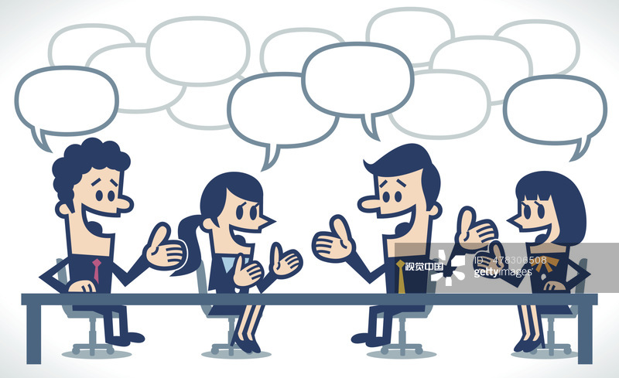
Discussion
If accidents happen in our family, how could we help or what should we do?
Notes:
视觉中国，图片编号478306508

Slide 26
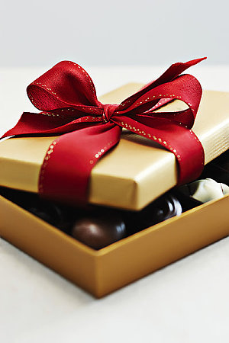
“Life is like a box of chocolates. You never know what you’re gonna get.”
Notes:
全景网，图片编号ID: QJ8168937362

Slide 27
Homework
You may choose one task.
Write down what we should do if accidents happen in our family.
Write down another possible ending to the story.
Notes:
视觉中国，图片编号VCG41155386867

