Slide 1
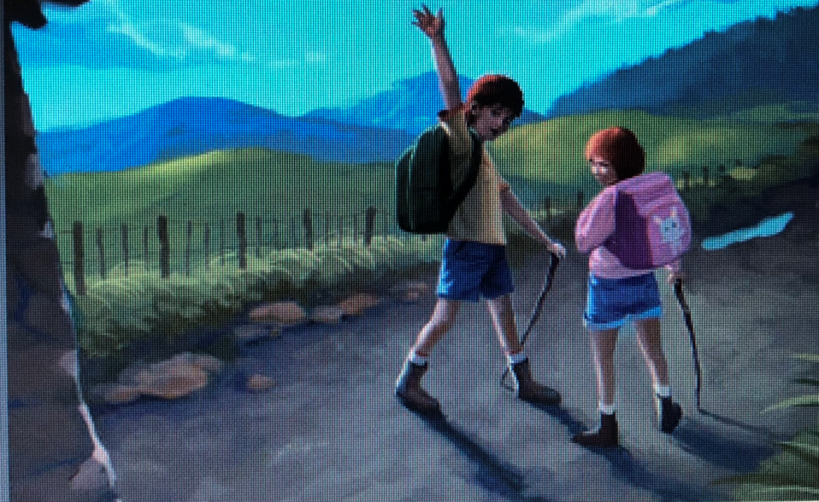
Cotton Wool Kids 丛林惊魂
选自《多维阅读第19级》

Slide 2
Warm up
What can you see from the cover?
What’s the title and what do you think the meaning of the title might be?
What kind of story might the text be?

Slide 3
Reading
Before they went over the fence (P2－P8 para.1)
What did Banjo and Mog decide to do that morning?
What advice did their parents give to them?
How did Bangjo react to his parents’ advice?
Can you guess the meaning of “cotton wool kids”?

Slide 4
Reading
Before they went over the fence (P2－P8 para. 1)
Who do you think “Gran” refers to?
Can you guess the meaning of “helicopter parents”?
How did Banjo persuade Mog to go to adventure with him?

Slide 5
Reading
After they went over the fence (P8 para. 2－P22 para. 4)
What did Banjo and Mog find when looking through the trees?
Why did they try hitting the old car with acorns?
What happened next after they made the loud noise?
What was the old man’s attitude towards their intrusion?

Slide 6
Reading
After they went over the fence (P8 para. 2－P22 para. 4)
What did the kids do after the old man shouted at them?
What wild thoughts raced through Mog’s mind while she was running?
Why did Banjo fail to find Mog?

Slide 7
Reading
After they went over the fence (P8 para. 2－P22 para. 4)
What did Banjo do to save Mog?
How did the old man respond to
Banjo’s appeal?
10. How did the old man manage to save Mog
out?

Slide 8
Reading
After they went back home
How did Banjo intend to tell their parents the incident?
How did Banjo tell their parents the incident after seeing them?
What was his parents’ reaction?
Did they visit the old man again?
Why did the old man live in the hut?

Slide 9

Draw a mind map to demonstrate the development of the story.
When
Where
Who
What
Why
How
Notes:
视觉中国， 图片编号ID：VCG41200479126-007

Slide 10

Draw a mind map to demonstrate the development of the story.
Beginning
Development
Climax
Ending
Notes:
视觉中国， 图片编号ID：VCG41504580230

Slide 11
Story-telling suggestions:
建议1：用5个wh的记叙方法讲述故事；
建议2：用故事的情节变化线讲述故事；
建议3：用老师建议的分部阅读方式分别讲述 故事；
建议4：小组内分角色讲述故事 。

Slide 12
Character analysis
1. Banjo
(1) Confident
“Aw, Ma,” said Banjo, “we’re not babies.” (P2)
(2) Blunt
“They have let us come here,” said Banjo, “because there is nothing risky. Besides, we know this place as well as our backyard.” (P4)

Slide 13
Character analysis
2. Mog
(1) Considerate
“Maybe it’s because they care,” replied Mog. (P4)
(2) Cautious
“Do you think we should leave a note on this tree?” suggested Mog. (P6)

Slide 14
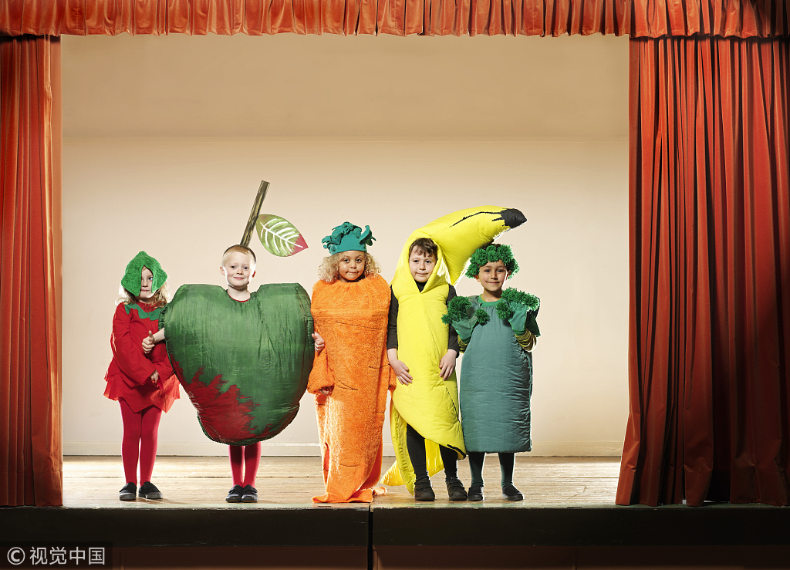
Role play Divide the whole class into three groups and each group prepares one part of the story.
Notes:
视觉中国， 图片编号ID：VCG41200419988-001

Slide 15
Optional task
Adapt the story into a different version.

Slide 16
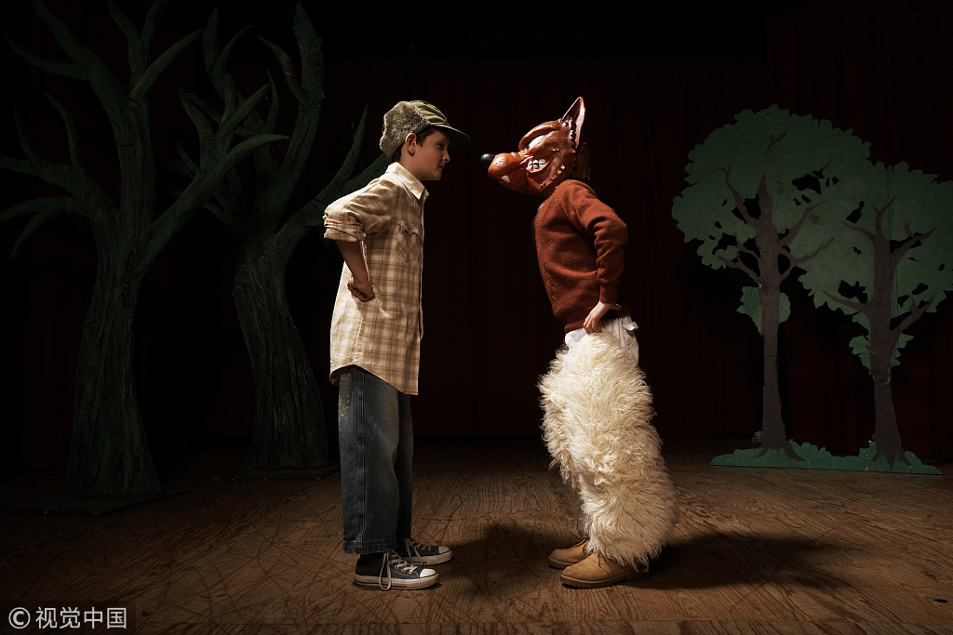
Role play Volunteer to do role play according to how you rewrote the story.
Notes:
视觉中国， 图片编号ID：VCG41200419988-001

Slide 17
Conclusion
What have you learnt from this story?

Slide 18
Survival skills learning
We’ll leave a trail with these acorns, just in case. (P6 Banjo)
Banjo took a handful of acorns out of his backpack. “Let’s try hitting the old car,” he said. (P8 Banjo)
For some strange reason Mog was reminded of a book she had read about the jungle and how everything is being hunted ‒ only the silent and the careful survive. (P12 Mog)

Slide 19
Survival skills learning
He could feel his heart pounding but he had to keep calm, for Mog’s sake. (P16 Banjo)
Take off your sweater and tie it around your leg. (P16 Banjo)
You have to stay calm. Close your eyes. Think of something good. I will be back as quick as I can. (P16 Banjo)

Slide 20
Survival skills learning
Banjo could see where he had walked through the long grass and he was able to find the hole where Mog was. (P20 Banjo)
“I’m going down,” he said, “to see if she is badly injured. If she is, I won’t be moving her.” (P20 River Stone)
And next time you go exploring, take a map. (P22 River Stone)

Slide 21
Background learning
cotton wool kid
由于家长的过度保护和娇生惯养，一些孩子没有自立能力, 不能面对困难局面和严酷环境的考验、承受不了挫折，这些孩子被称作cotton wool kids。
helicopter parents
用来形容过度焦虑和溺爱孩子的父母，他们无时无刻不盘旋在孩子的周围，插手大小事情。

Slide 22

Homework
Rewrite Cotton Wool Kids into a play.
Write some advice on Parental Education in cooperation with your parents.
Notes:
视觉中国，图片编号ID:VCG41155386867

