Slide 1
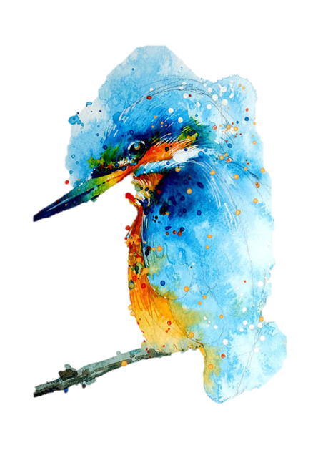
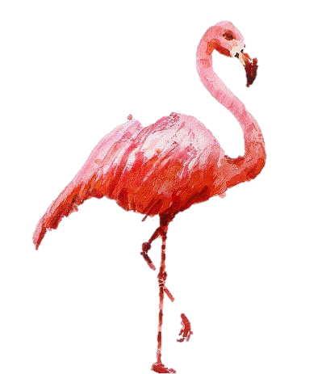
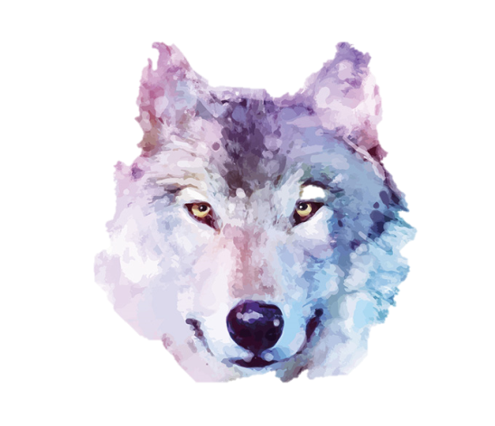
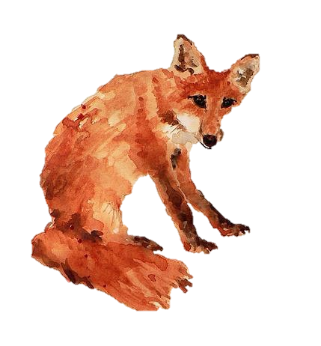
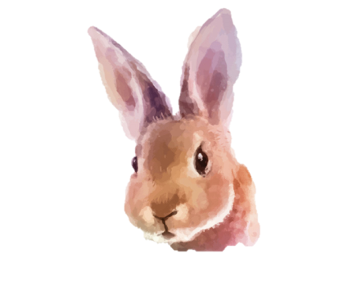
Caring for Others 关爱
选自《多维阅读第18级》

Slide 2
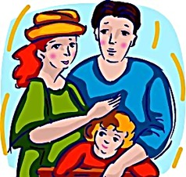
Who often cares for others?
What about the animals?

Slide 3
The disfigured elephant is looked after by the herd.

Slide 4
Please look at the picture and make a guess about the story of the elephant.
Why do you think the elephant might have had almost no trunk?
In your opinion, what might other elephants do to this special elephant?

Slide 5
Read the 2nd paragraph of page 2, and answer these questions.
What happened to the elephant? What could be the result of this?
What did other elephants do to it?
What does this action make you think of? How do you like this behavior?

Slide 6
Please read pages 4-15 carefully and finish Exercise 1 in the worksheet.
How did the animals care for others in the story?
Can you name the animals which care for others and the animals which are taken care of?

Slide 7
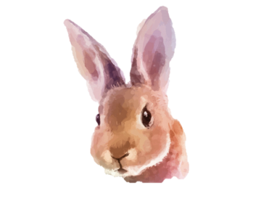
Pages 4-7 Caring for their own & Caring for other species

Slide 8
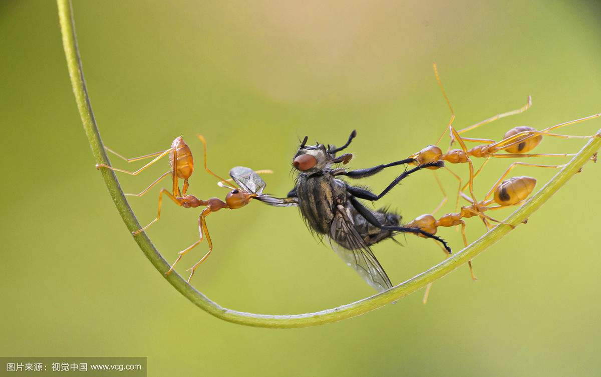
dig away
bite
dig...out of...
drag sb. out
ants

Slide 9
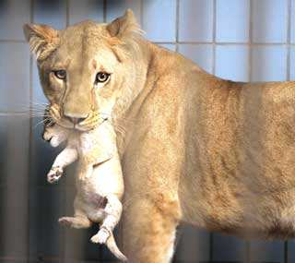
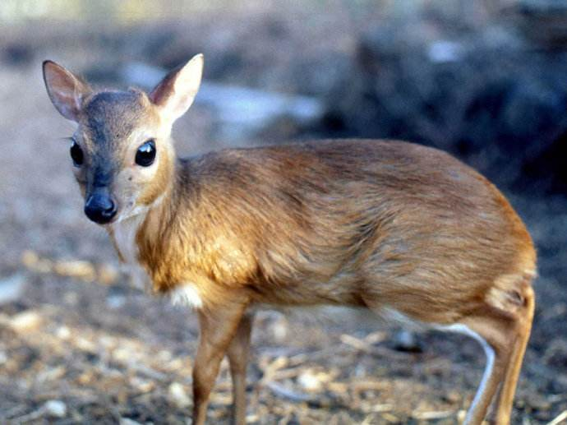
take care of
as if
lioness
antelope

Slide 10
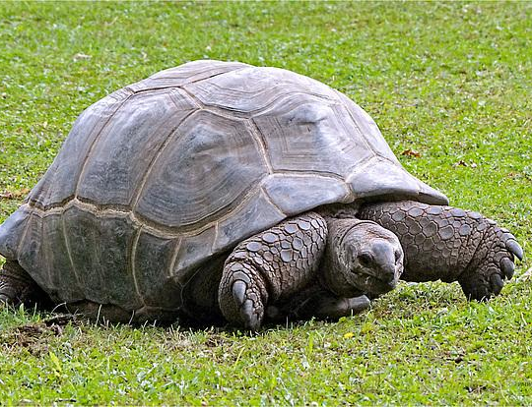
signs of affection
hang about
tortoise
antelope

Slide 11
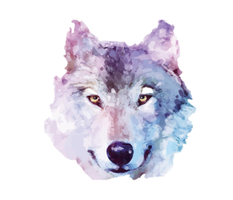
Pages 8-11 Reason for caring behavior & Strange caring bonds

Slide 12
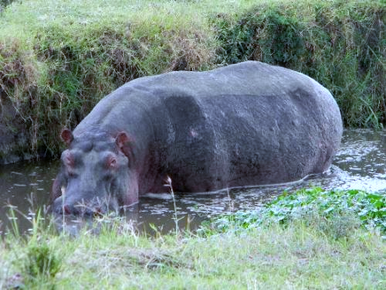
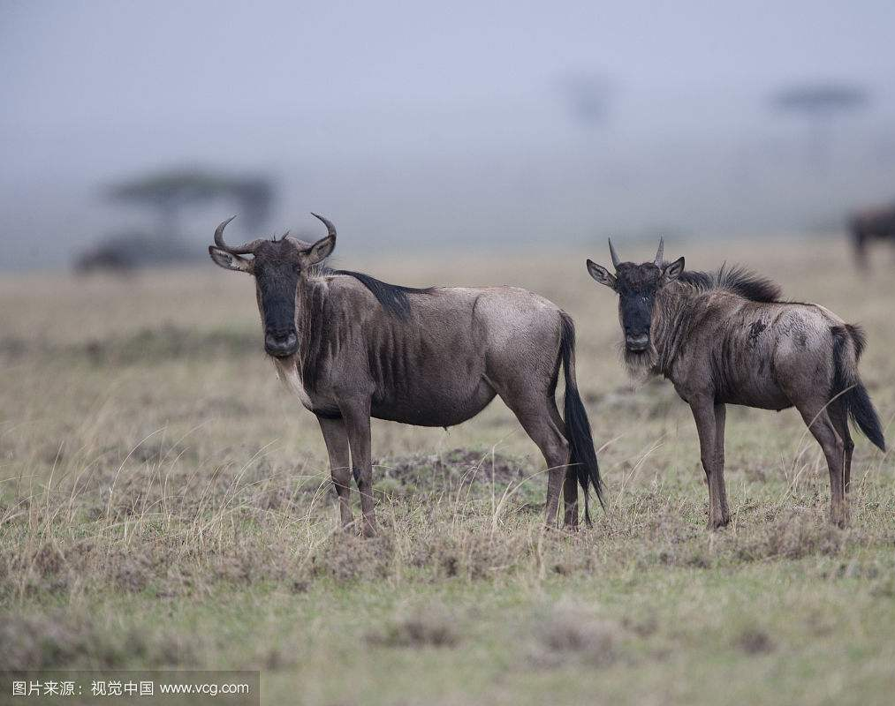
guide...to...
sweep away
chase
guard
hippo
wildebeest calf

Slide 13
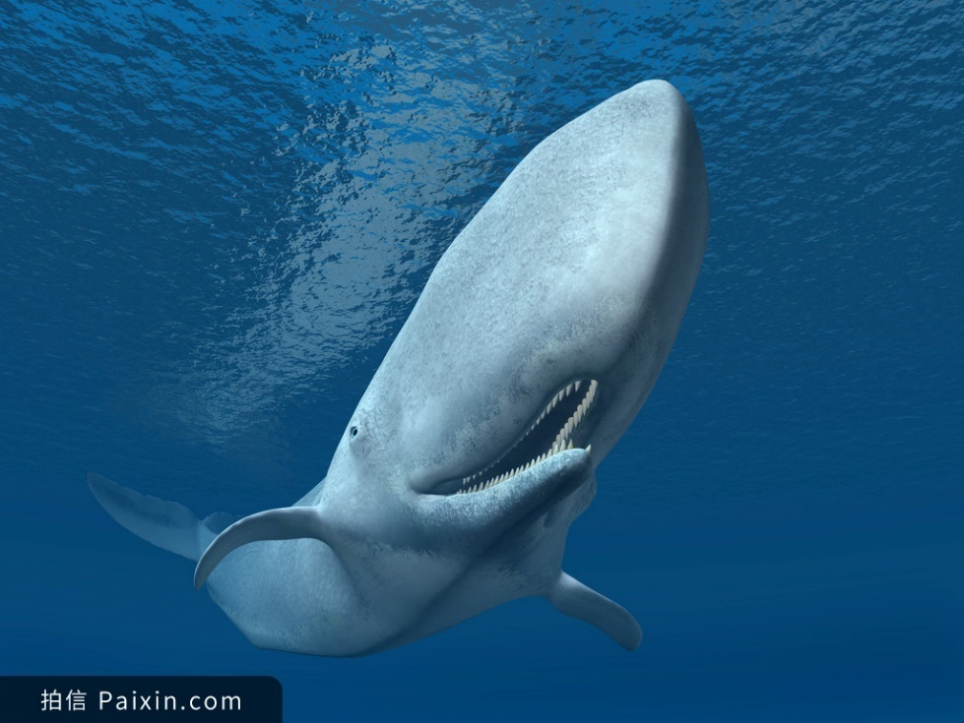
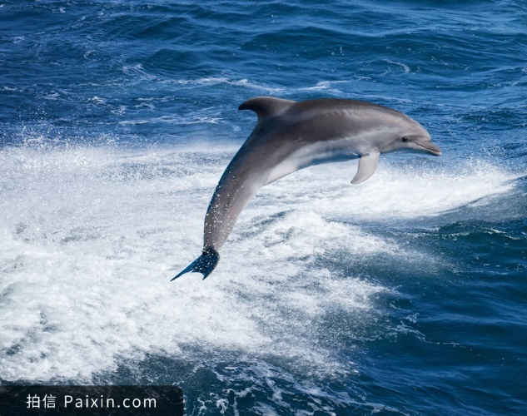
swim
feed
nuzzle
sperm whale
dolphin

Slide 14
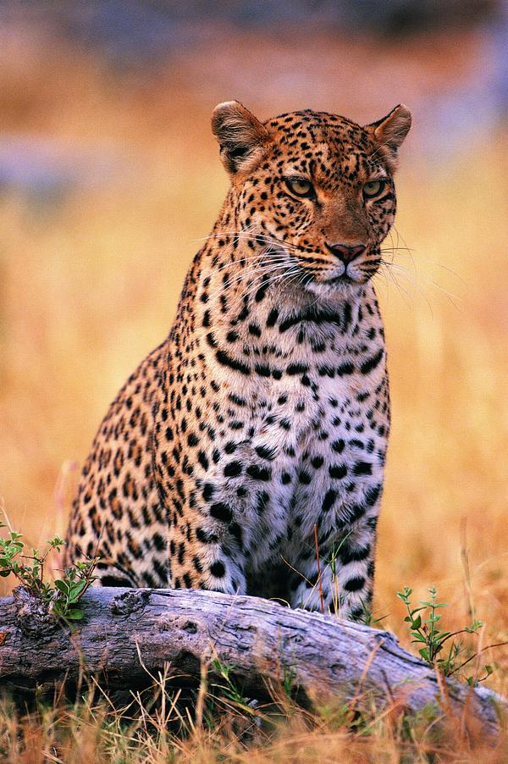
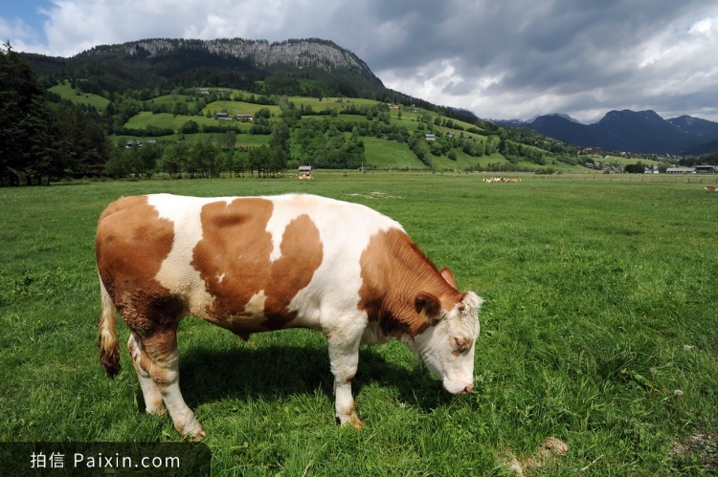
nuzzle
as if
cub
leopard
cow

Slide 15
Pages 12-15 Caring for people & Believable or unbelievable?

Slide 16
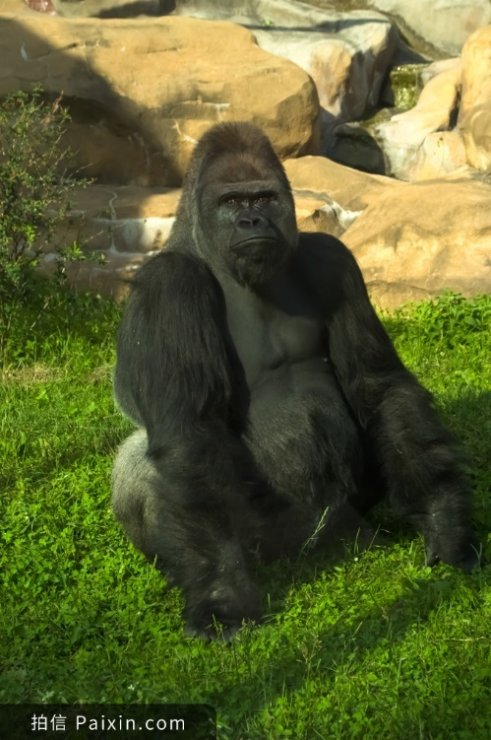
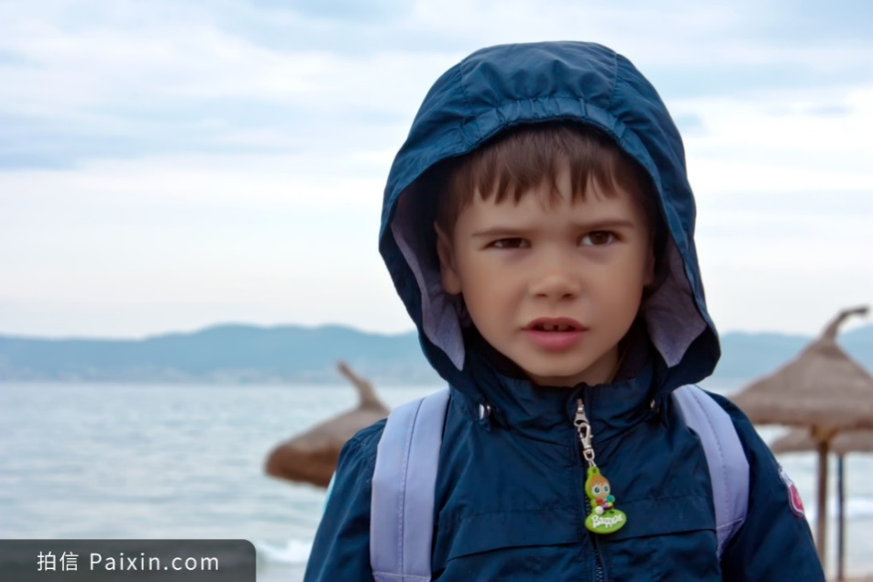
keep away
pick up
carry to
rescuer
gorilla
3-year-old boy

Slide 17
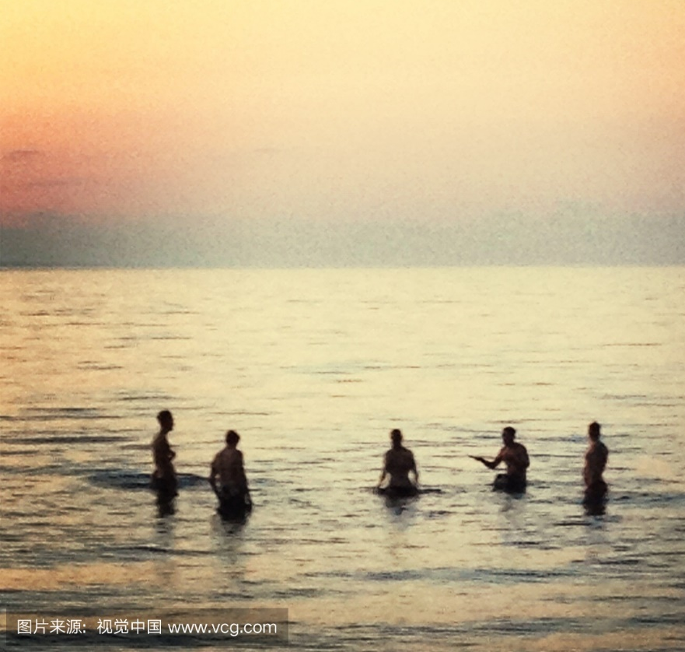
come to one’s rescue
in need
dolphin
victims

Slide 18
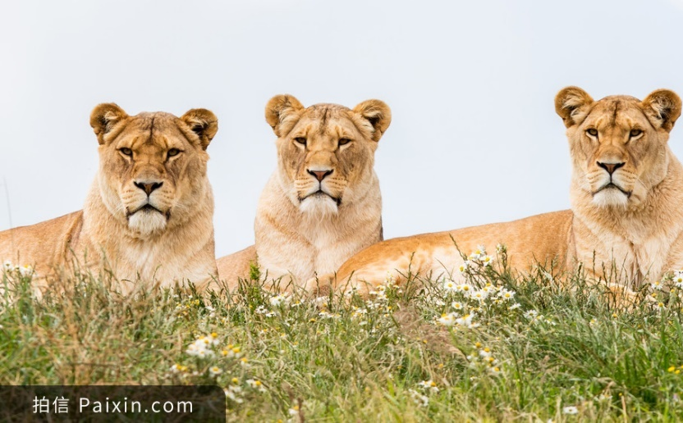
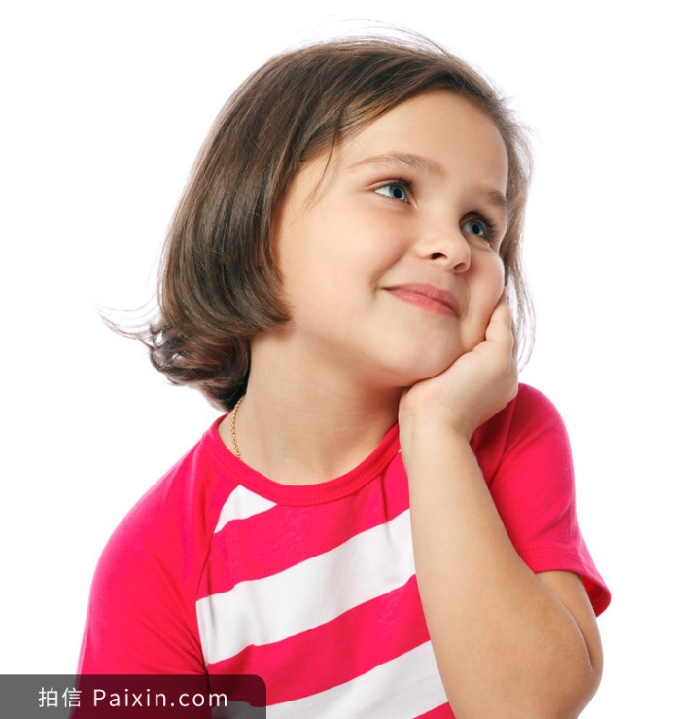
chase away
stand guard over
arrive
lions
a girl

Slide 19
Please read through pages 4-17 and answer this question.
Why did these animals care for others?

Slide 20
own species
friend
instinct
baby
food
want the calf for itself
relieve the pain of the loss
be raised by hand; be close to human beings
emotion
do really sense others in need

Slide 21
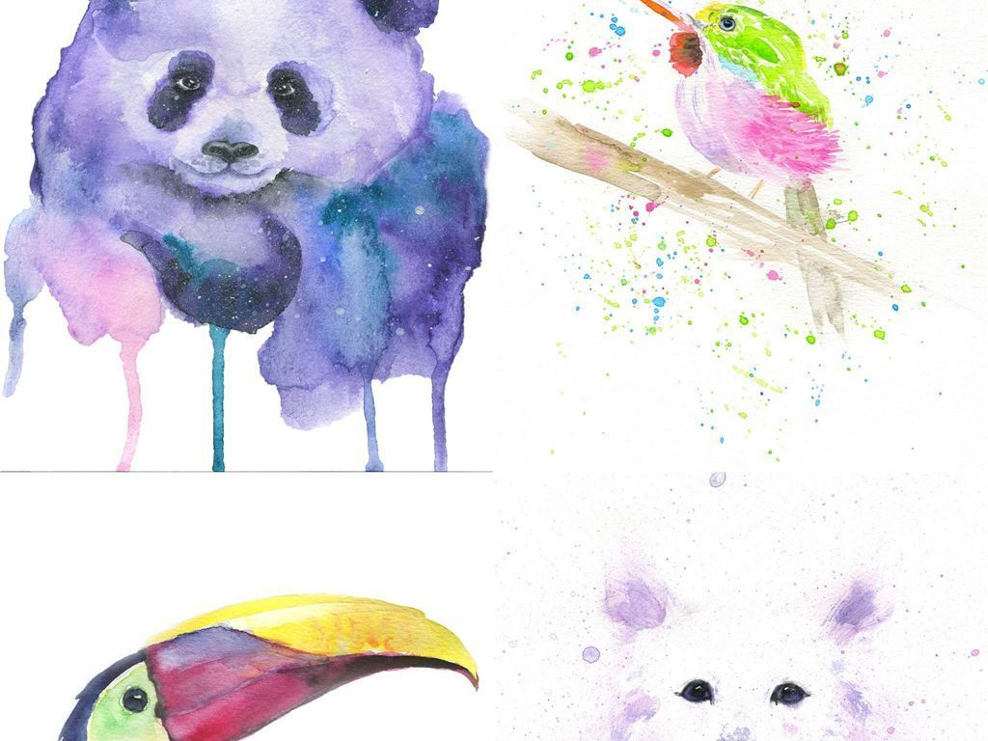
SHARING MEETING
OF
NATURE
ANIMALS

Slide 22
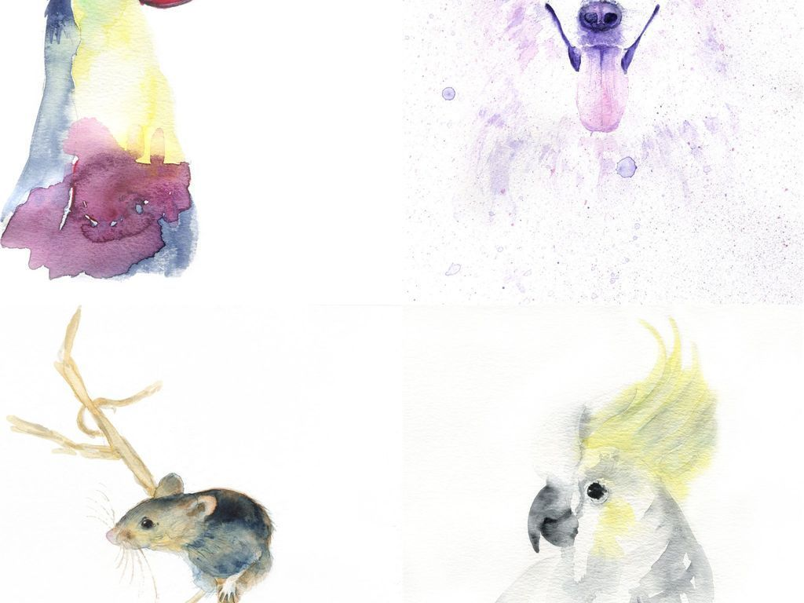
You are invited to share
how animals care for others in the sharing meeting.
Please prepare a mini-speech with at least 4-5 sentences.

Slide 23
Please prepare the speech from the perspective of animals.
Possible version:
I’m XXX (the name of the animal).
I did ...(what). I ...(how).
The reason why I did this is ...

Slide 24
Possible Version 1:
Animal & Animal
I’m an ant. Once we found one ant of our species buried in sand. Then we worked together to dig away the sand and bite the thread to free it. I did this because it is the instinct of our species to help others in difficulty. I would help my family members as much as possible.

Slide 25
Possible Version 2:
Animal & Human beings
I’m a lion. Once I, together with other lions, heard a strange sound. Finally we found that it was from a girl. She looked different from us but her crying sounded like the mewing of a cub. She seemed to be in danger. We decided to protect her. Then we chased the bad guy away and stood guard over her until the rescuer arrived. When we took care of our cubs, we would manage to protect them no matter how dangerous the condition is. This was the reason why I did this.

Slide 26
What have you learnt from this story?

Slide 27
Please design a poster and share with your class.
The topics are as follows. You can choose one of them.
Your comments on Caring for Others
Other stories about how animals care for others
Your thinking on the relationship between animals and human beings
...

Slide 28
Homework
Please search for more stories about animals caring for others and share them in class.
Tips: You can search with the help of dictionary, Internet or books about nature in the library.

Slide 29
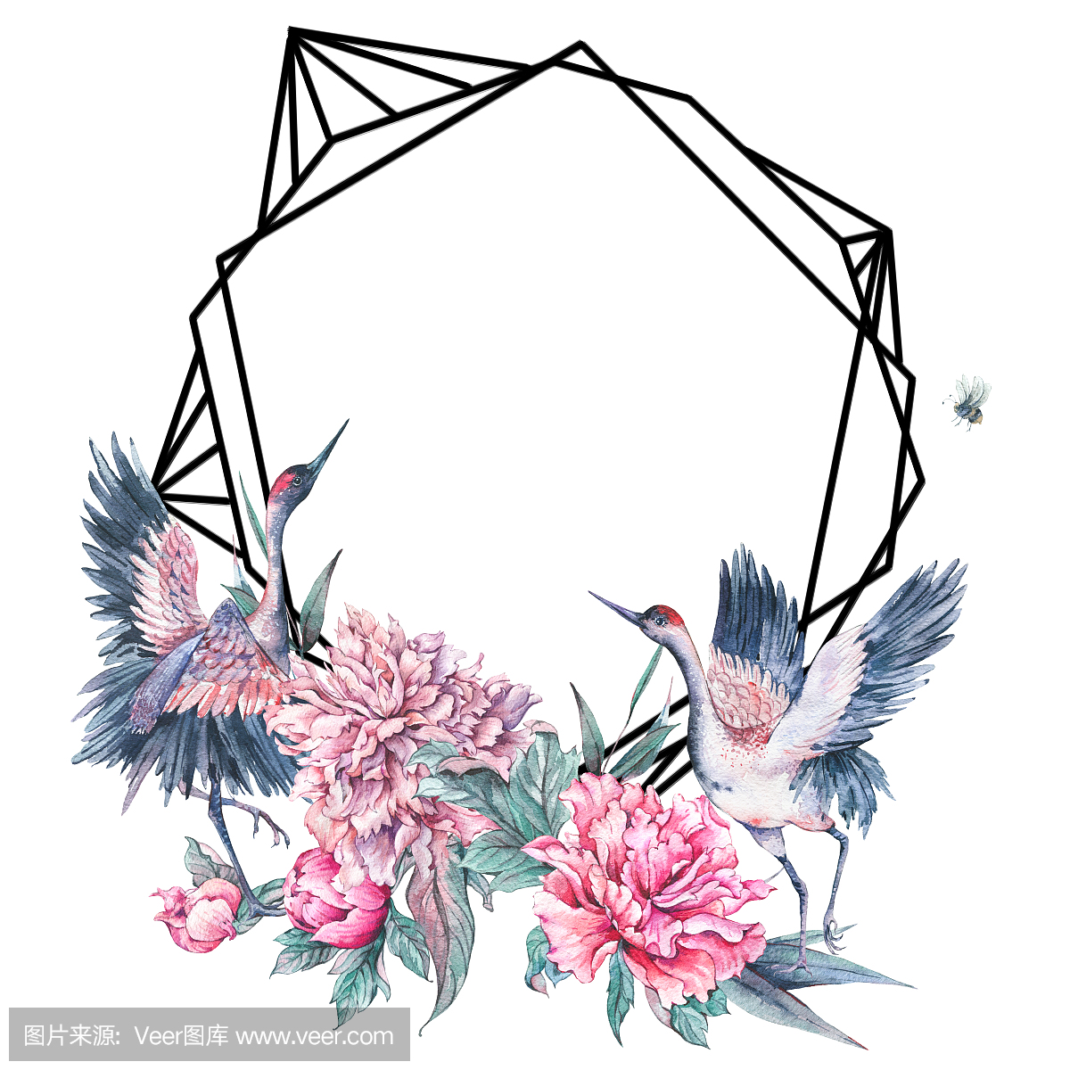
Thank you!

