Slide 1
Leaving Home
流亡他乡
选自《多维阅读第18级》

Slide 2
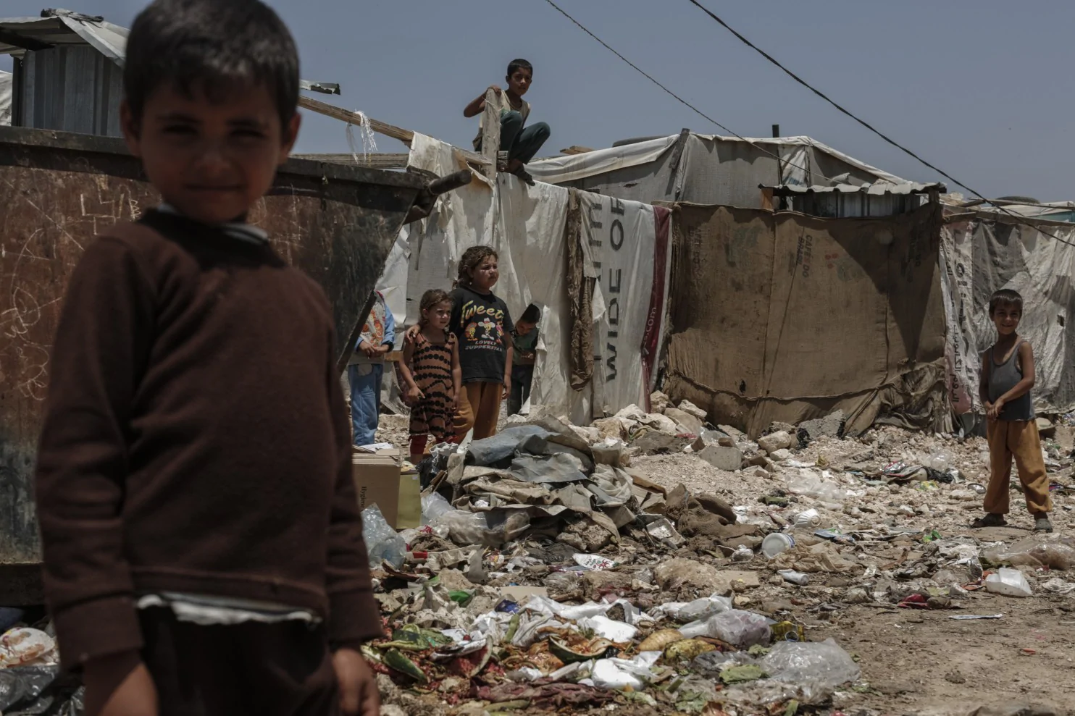
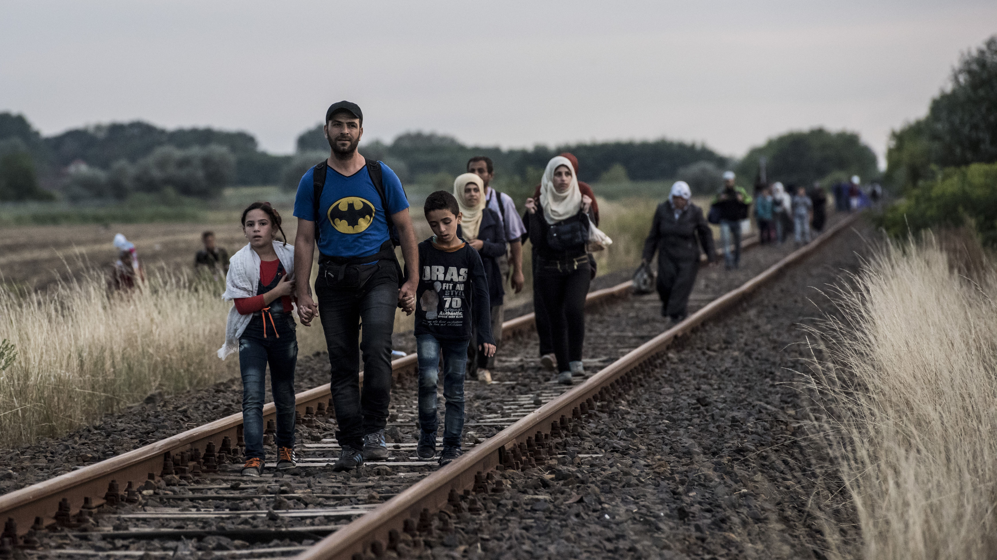
What are the pictures about?
Why?
Notes:
激活学生关于难民问题的背景知识

Slide 3
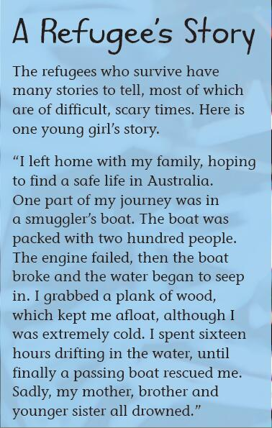
Read and think
What’s the picture on pages 10-11 about? Why do you think so?
What did the girl go through? How did she feel?
What is a refugee? Why did the girl become a refugee? How can we help?

Slide 4
Refugees refer to…
people who find their lives in danger and must leave their country to a country where they can feel safe and have a better future
(Page 2)
Notes:
结合上下文理解词义，可以对学生进行阅读策略的指导，如圈画关键词、分辨事实与观点等。

Slide 5
Read and Think
Please read and ask questions about this book.
Please draw a mindmap based on the book.
Please share your mindmap with your classmates.
Notes:
学生可以分组自主提问，也可以根据教师提供的问题链提炼关键信息。
提问建议：
Leaving Home (pp4-5)
What are refugees?
Why do people become refugees? （阅读策略：圈画关键词）
What are some of the facts in this part? Some of the opinions? （阅读策略：分辨事实和观点）
What do you think could be some of the dangers that a refugee might face?
Problems (pp6-13)
Overall question:
What problems may the refugees have when they are leaving home?
What are some of the facts in this part? Some of the opinions? （阅读策略：分辨事实和观点）
Detailed question:
(pp6-7) Do refugees have a lot of belongings? Will they reach another country safe and fast? Why or why not?
(pp8-9) What are people smugglers? How do they help the refugees? When dealing with people smugglers, what kinds of danger can the refugees meet?
(pp10-11) What kinds of danger could the refugees meet in the sea? Why?
(pp12-13) What kinds of danger did the girl meet as a refugee? What do you think this girl could have been thinking as she floated in the water?
Help (p14-19)
What kinds of help are offered to the refugees?
What feature enables the robot to rescue refugees? What advantages do you think the robot might have over lifeguards?
What are the advantages and disadvantages of refugee camps?
What other ways are there to help the refugees? What do you think would be the most important way to help the refugees?

Slide 6
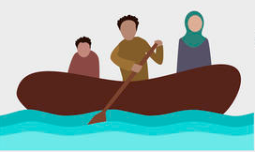
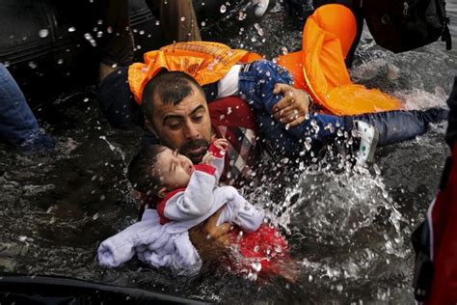
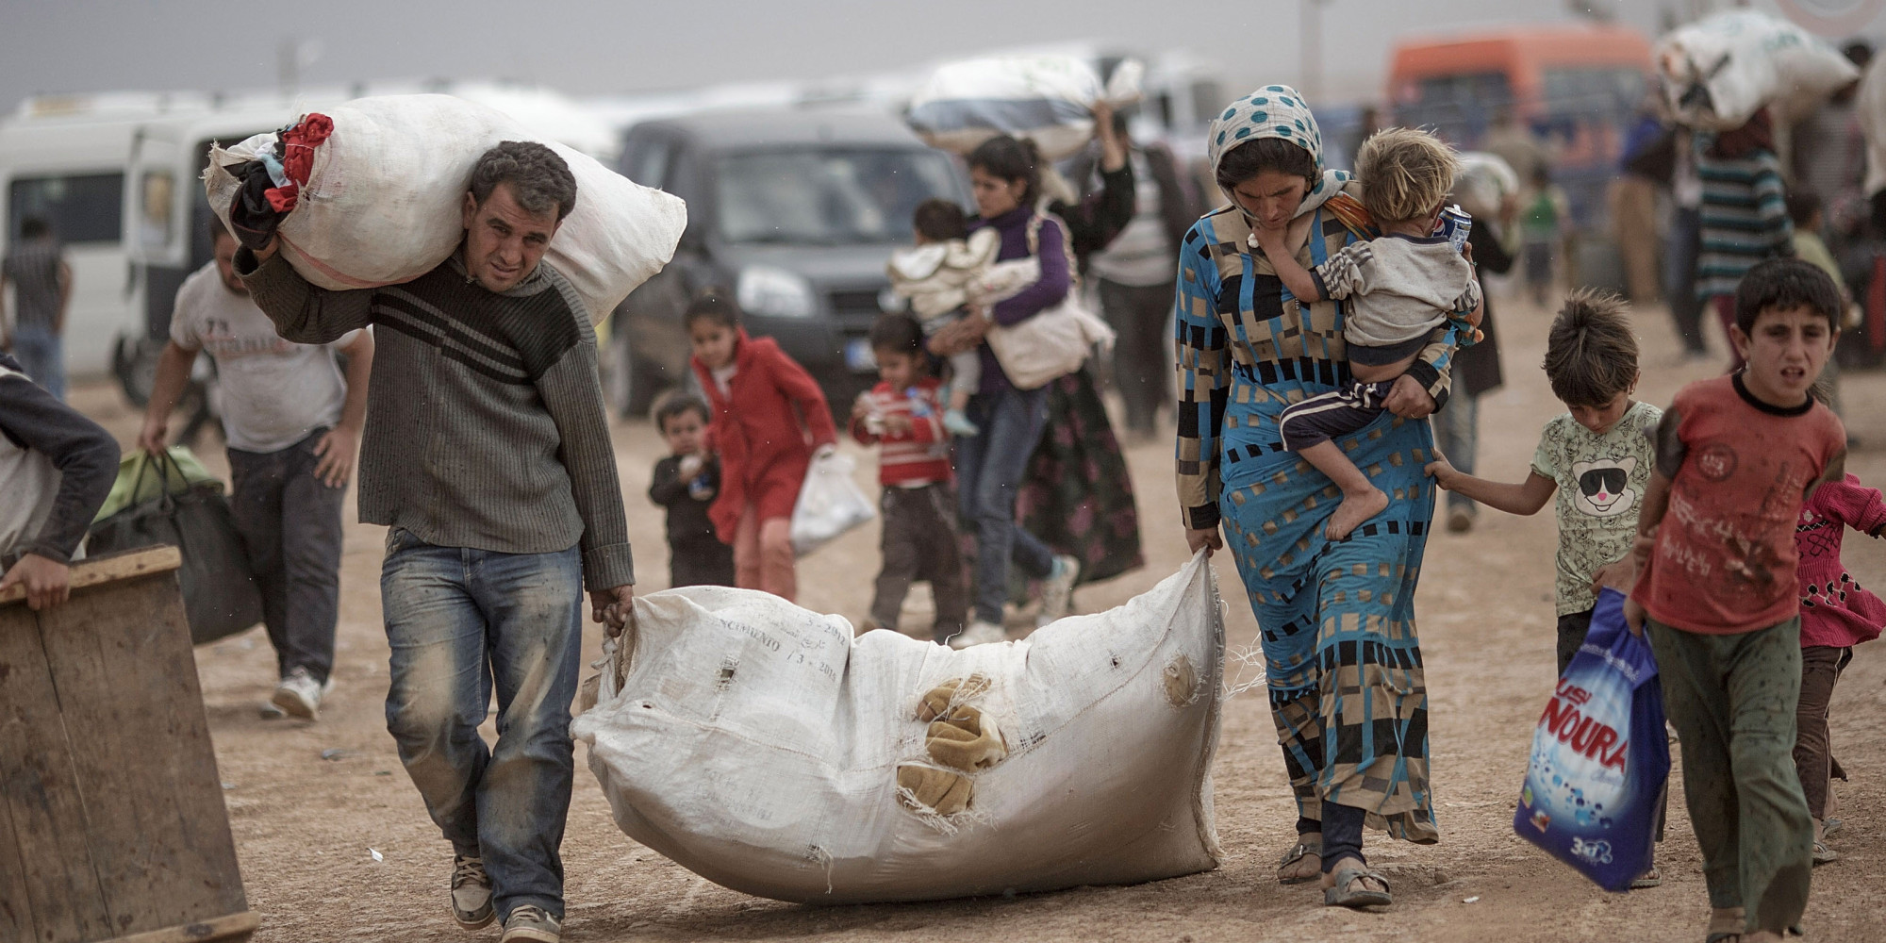
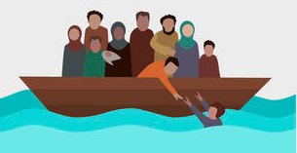
My Refugee story
In groups of six, decide your role using role cards.
Read your role cards and handouts carefully, and underline all the useful information, for example, place, your nationality and what happened.
Discuss and create a refugee story as a group. Don’t forget to use what you read in the book.
Notes:
学生分组进行角色扮演，站在不同角色的立场上批判性看待难民问题，口头陈述对难民问题成因、难民遭遇及救济措施的看法。

Slide 7
You are a journalist. You need to ask a group of people about their story to write a report on refugee problems and solutions.
You are a refugee. You just left your home in Syria and you are now in the refugee camp in Greece.
You are a people smuggler, who helped the refugees travel from Syria to Greece.
You are a coast guard who pulled the refugees out of the water on the coast of Greece.
You are a captain, who carried the refugees across the sea from Israel to Greece in your boat. You are hired by the people smuggler.
You are a staff member in the refugee camp in Greece.

Slide 9
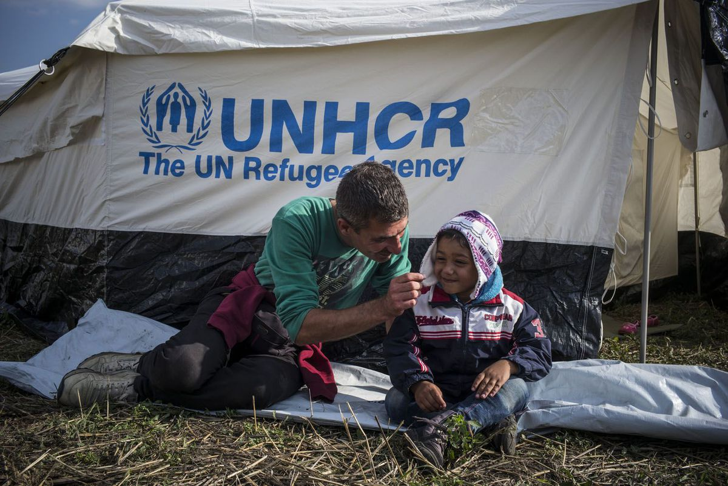
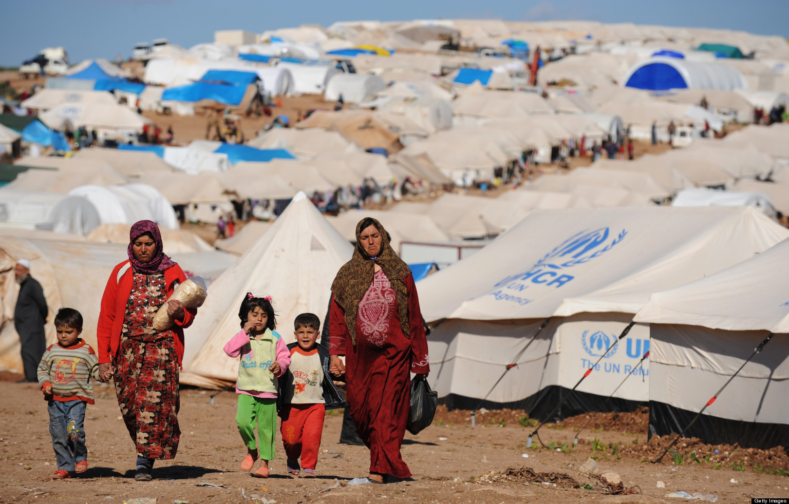

Slide 10
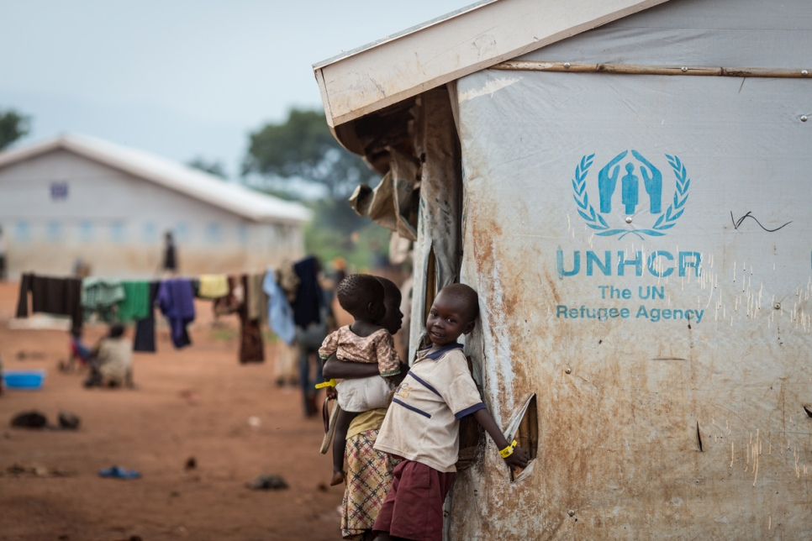
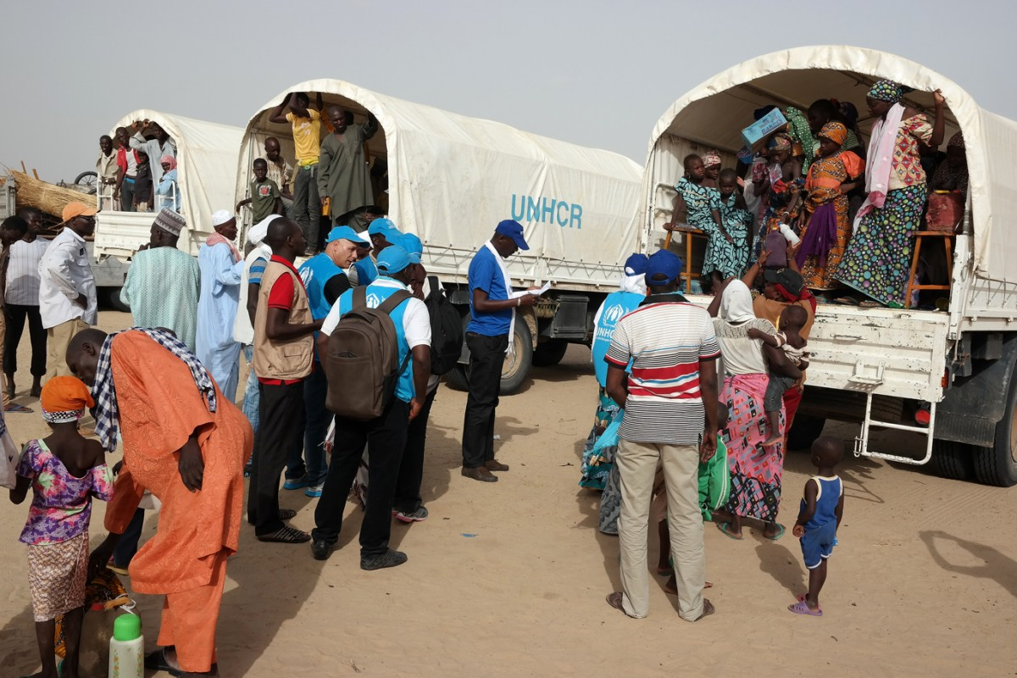
Call from unhcr
UNHCR: The agency watches the interview and wants to know more about your opinions!
What do you think is the biggest problem that refugees face?
What do you think can the global society do to help the refugees?

Slide 11
homework
Choose one task from the two tasks below.
Write to UNHCR as a refugee, a people smuggler, a captain, a coast guard, a staff member in the refugee camp or a journalist about (1) what you know about refugee issues; (2) what you think can solve the problem.
Search for further information in a library or on the Internet together with your learning group. List the controversies around refugee issues and other reasons, status quo and solution for the issues. Present your findings with a poster, a mindmap or a PowerPoint slide.

Slide 12
