Slide 1
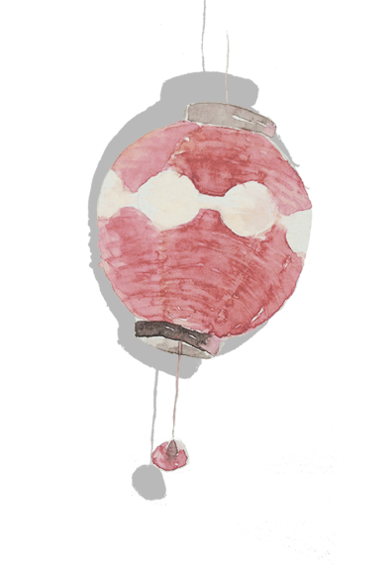
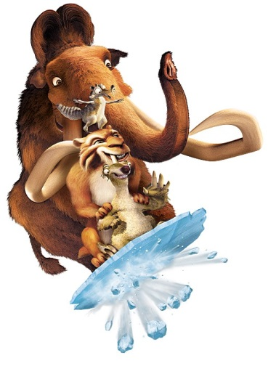
Mammoth—Questions for Scientists
猛犸象之谜
选自《多维阅读第18级》

Slide 2
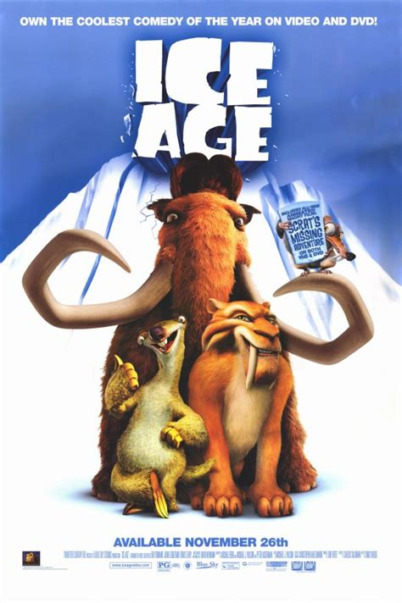
Watch a movie clip from Ice Age.

Slide 3
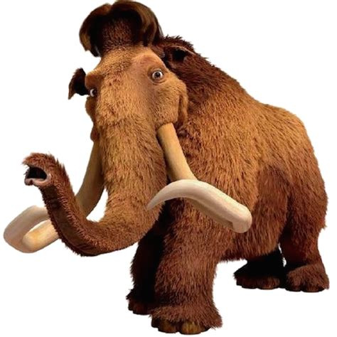
What do you know about the mammoth from the movie clip?
living environment
Appearances

Slide 4
Read pages 2-5. Make notes about the KWL information.
Know
Want to Know
Learnt
Before Reading
After Reading
Notes:
4

Slide 5
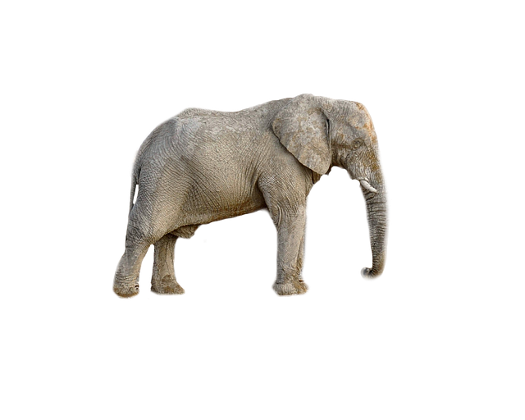
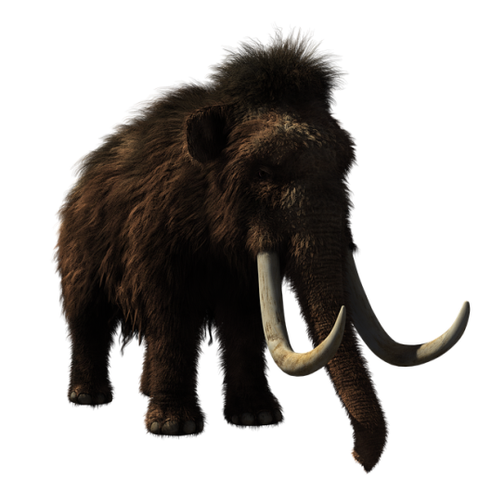
Differences | Woolly Mammoths | Modern Elephants
Ears
Tails
Tusks
Fur

Slide 6
Read pages 6-7. Why does the scientists study mammoth remains?

Slide 7
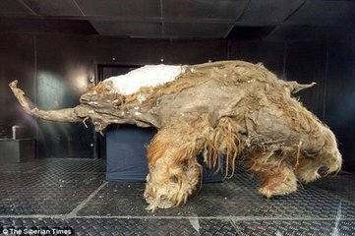
Complete the chart with the information in the book
Yuka | Findings | Scientists’ guess
 | thick fur and whole foot-pads, with some of the flesh | most likely two and a half years

Slide 8
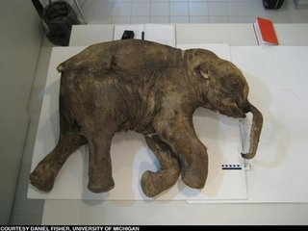
Complete the chart with the information in the book
Lyuba | Findings | Scientists’ guessing
 | trunk was full of earth | drowned in the mud

Slide 9
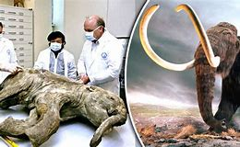
Do you think woolly mammoth should be brought back to life by cloning? Why or why not?

Slide 10
Find out more information about woolly mammoths,
and make a poster about them.

