Slide 1


Uncle Al – Trouble Again
阿尔叔叔的麻烦事
选自《多维阅读第18级》

Slide 2

Observe the cover
who
where
what
why
Notes:
1. What can you see on the front cover?
2. Where is Uncle Al?
3. What do you think of Uncle Al from the cover?
4. Why does the author use the word “again” in the title?

Slide 3
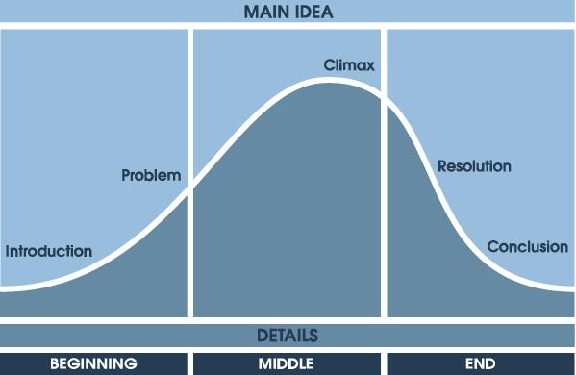
Fast Reading
The plot of stories could usually be divided into 5 parts, as shown on the picture above.
Sometimes the ending is very short and comes directly after the resolution.
Notes:
First, please number the paragraphs of the story.

Slide 4
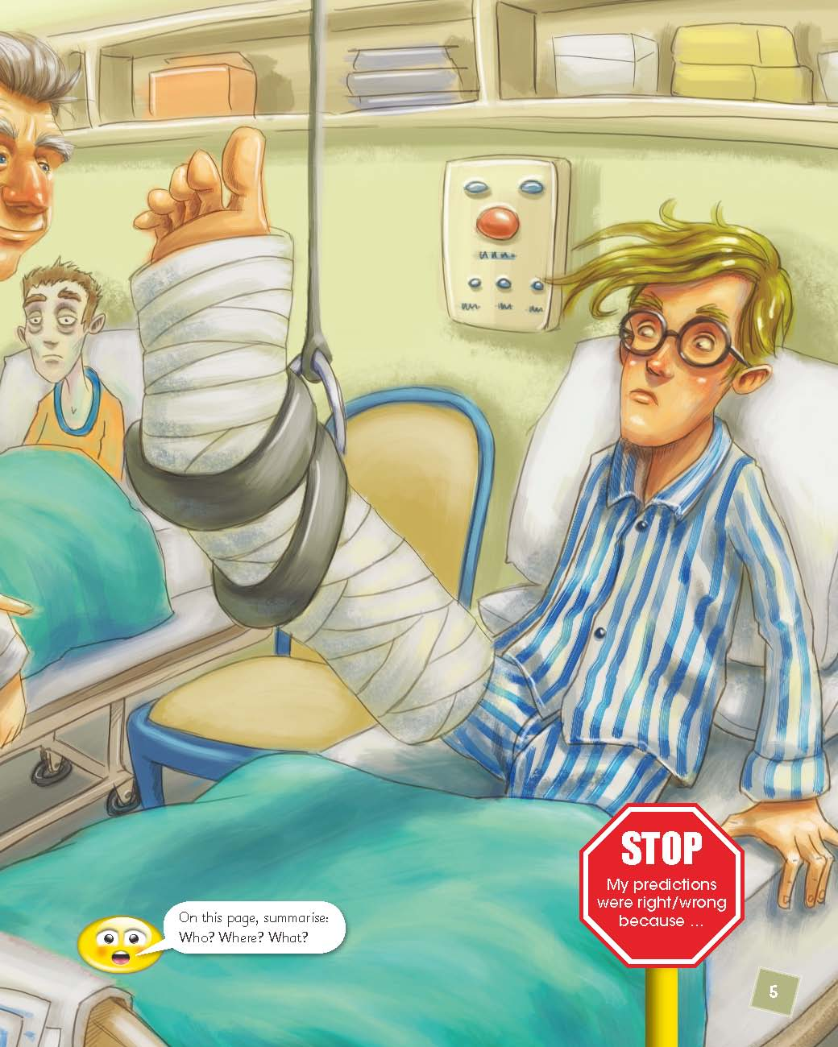
Beginning
A bad break
Who are the main characters?
Where are they?
What happened to the narrator?

Slide 5
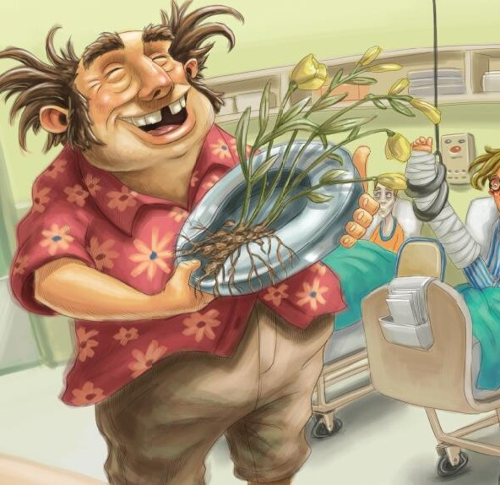
Middle (problem)
Flowers in bedpan
1. How did the narrator feel about getting flowers? Why?
2. Why do you think the narrator didn’t own up to Uncle Al being his uncle?

Slide 6
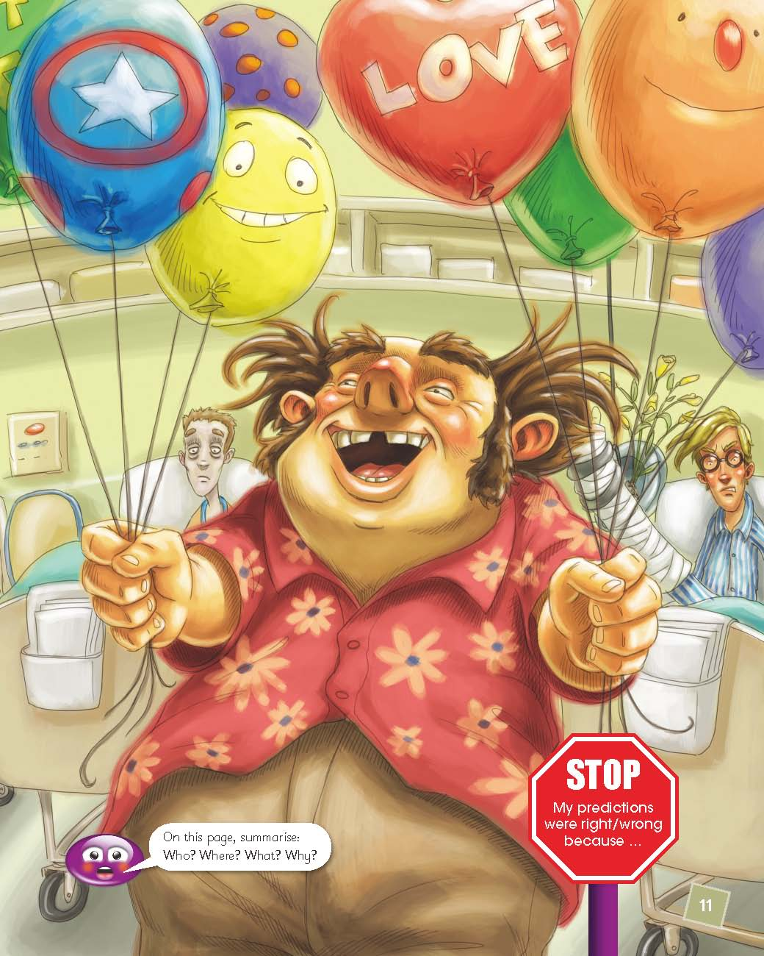
Middle (problem)
Special balloons
3. What did Uncle Al bring the second time? What trouble did he make?

Slide 7
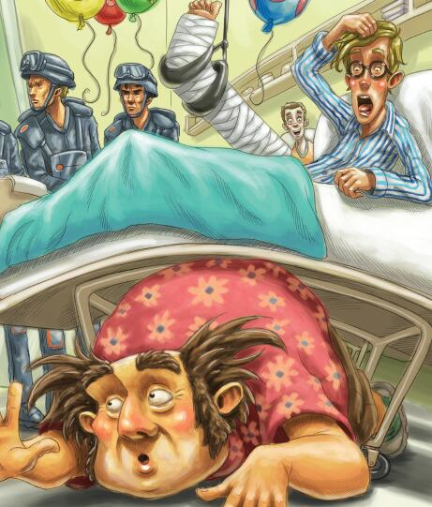
Middle (climax)
Balloon grenades
1. Why do you think the nurse reacted the way she did?
2. Why do you think the commander was getting impatient with Uncle Al?

Slide 8
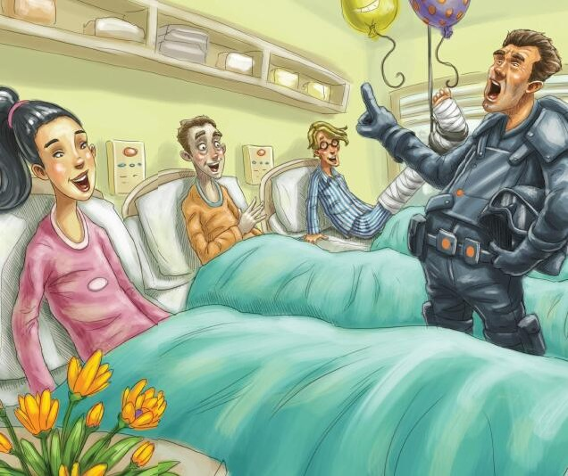
Resolution and Ending
End of “disaster”
1. How was Reece changed?
2. Do you think the narrator’s attitude towards Uncle Al changed? Why or why not?

Slide 9
first visit
second visit

Slide 10
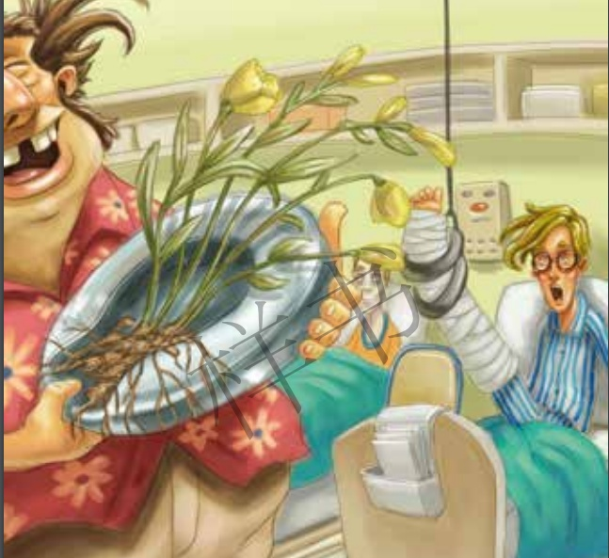
Retell the story
beginning
first visit
second visit
ending

Slide 11

Reading Circle

Slide 12
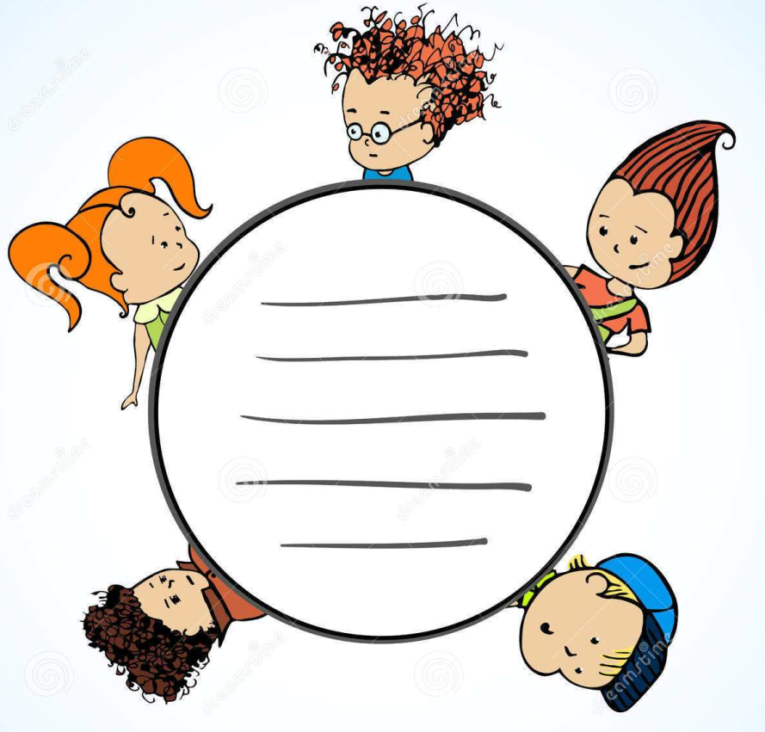
Reading circle
Quick Questioner
Super Summarizer
Passage Picker
Character Captain
Moral Master

Slide 13

Quick Questioner
The book
The author
The characters
Yourself
…

Slide 14
Super Summarizer
Title
Setting |  | Characters
Beginning | Middle 1st & 2nd visit |  | Ending

Slide 15

Passage Picker
My favorite part is from page _ to page _ because __________________

Slide 16
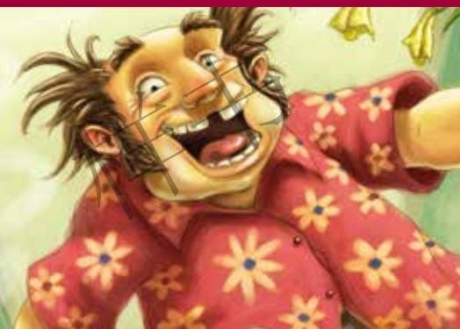
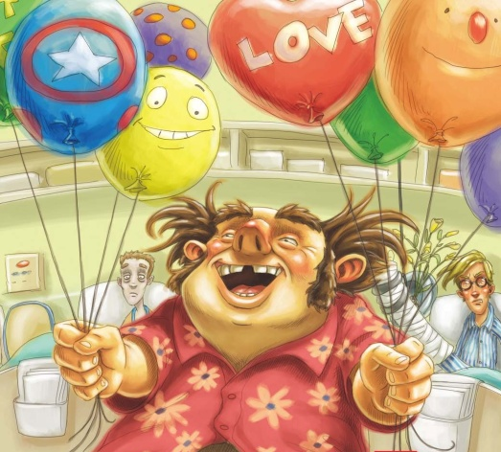
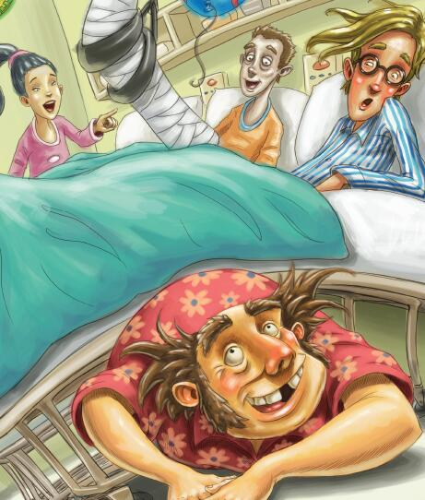

Character Captain
I think Uncle Al is … because …

Slide 17
Moral Master
What changes did Uncle Al bring to the ward?
What can we learn from Uncle Al?
Do you think he is a good uncle? Why or why not?

Slide 18

Youth Theater

Slide 19
Pre-performance – assign tasks in groups
words
action, emotion, feelings
setting
when, where, props
roles
main characters

Slide 20
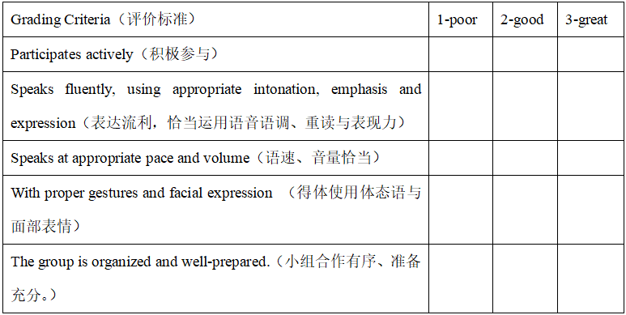
While-performance – be a good audience

Slide 21

Post-performance – comment and reflection

Slide 22

Keep your face to the sunshine and you cannot see a shadow.
－Helen Keller

