Slide 1
Ancient Navigators
古代航海家
选自《多维阅读第18级》

Slide 2
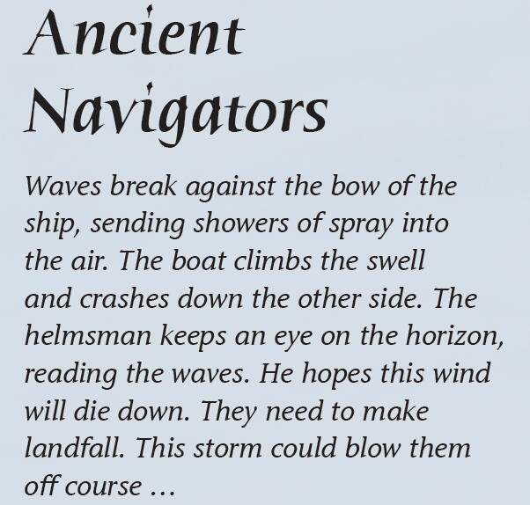
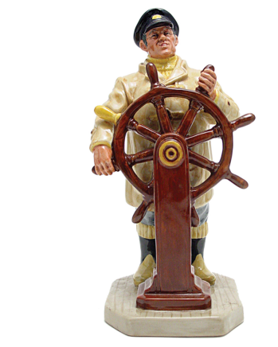
Read and Think
Read the story in italics on page 2 and think about these questions.
What is a helmsman?
What difficulty did the helmsman meet?
How could the helmsman solve the problem?
What else do you know about the helmsman?
Notes:
创设情境，熟悉主题；激活学生关于航海定位导航的背景知识

Slide 3
What problems might the ancient navigators meet when they were at sea?

Slide 4
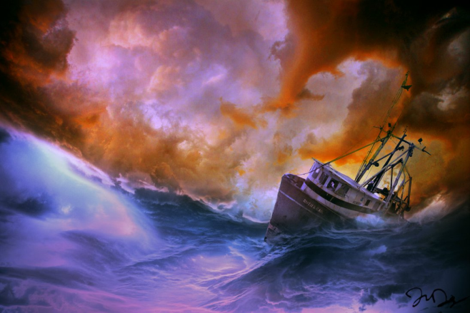
Ancient Ways to Navigate
Help those helmsmen to find the correct way in the sea.
Read on and underline useful information about navigation in the ancient times.
Share your findings with your classmates.
Notes:
提问建议：
How did Ancient Polynesian and Viking navigators manage to cross the seas?
What methods were used?
Who used the methods?
How did the methods work?
Could ancient navigators trust the methods? What was important for the methods to work?
What are the advantages and disadvantages of the methods?

Slide 5
Ancient Ways to Navigate
How to navigate | Who used the methods | Important factors for it to work | Disadvantages
Using the sun and the stars | The Polynesian and Viking navigators | The navigators needed to be able to read the position of the sun and the stars | It could only be used in clear weather
Reading the sea
Using animals
Using clouds and charts

Slide 6
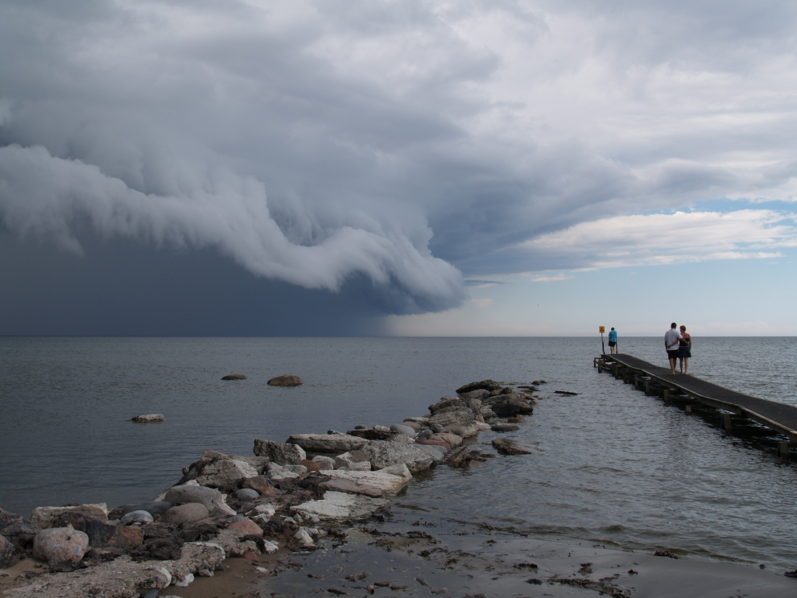
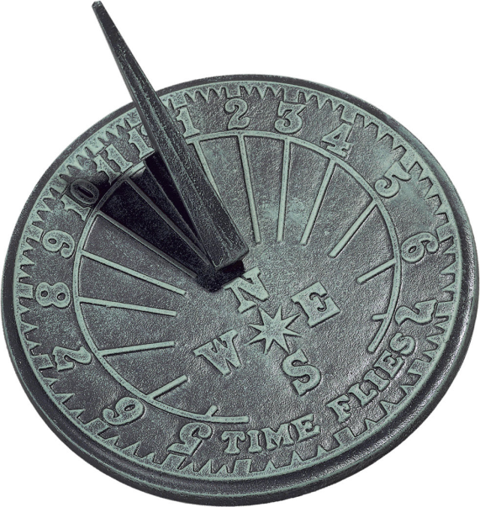
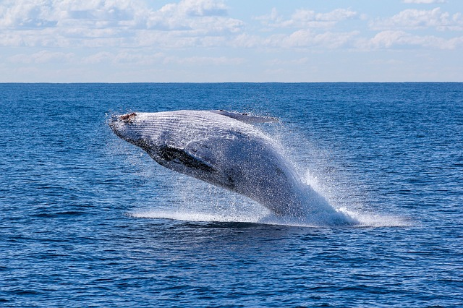
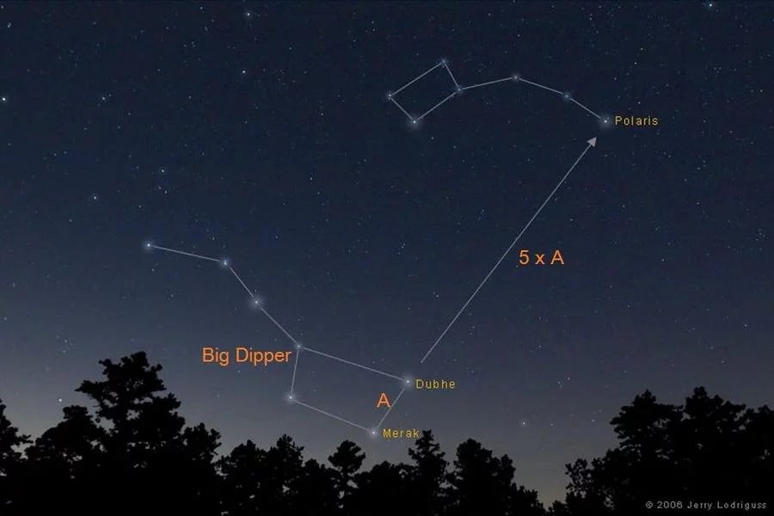
The Navigators’ Meeting
Which way should we use to navigate?
Are they reliable?
Are they accessible?
Notes:
根据思维导图，学生分组讨论各种导航方法的利弊。教师可以提供评价优缺点的标准（reliable, accessible），也可以请学生讨论评价标准。
根据方法利弊的讨论，学生为即将出海的新人推荐一种或多种导航方法。

Slide 7
The Navigators’ Meeting
Method that I recommend
Science Behind the Method
Advantages | Disadvantages

Slide 8
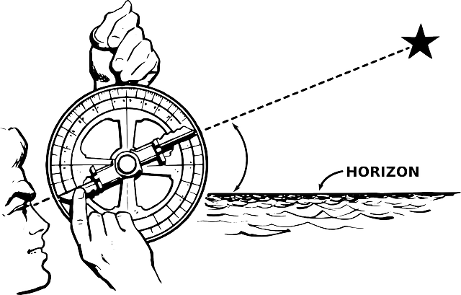
Some More Recent Ways to Navigate

Slide 9
Old vs. New Way to Navigate
What are some of the ancient methods that are still used today?
Why can’t we use some of the ancient methods today?
What have changed and what have not?
Notes:
引导学生基于事实，对比后做出判断，列举异同；
引导学生思考科技方法的变化，人与自然的关系变化；
鼓励小组合作和观点分享

Slide 10
When Old Navigators Meet New Navigators
Notes:
学生根据前3个活动的讨论，整合所得到的事实和观点，创编情景短剧。
情景一：古代维京航海家/波利尼西亚航海家在海上迷失方向
情景二：古代中国航海家郑和在海上迷失方向
情景三：当代中国航海家在海上迷失方向
学生根据书中提取的导航方法、其背后的科学原理以及优缺点，选取情境中的人物角色，选择一种导航方法进行表演和阐释。

Slide 11
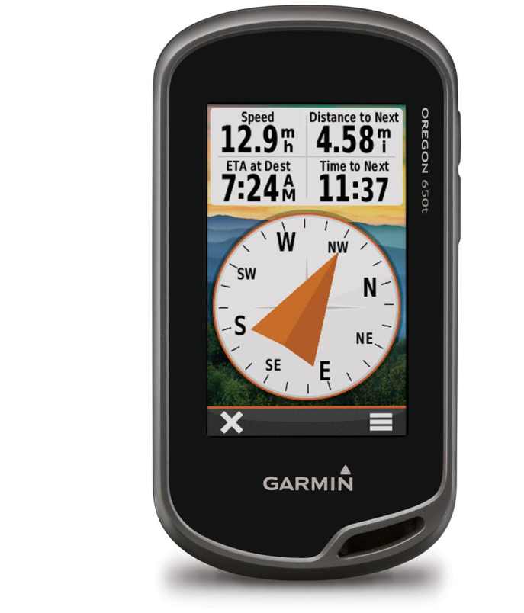
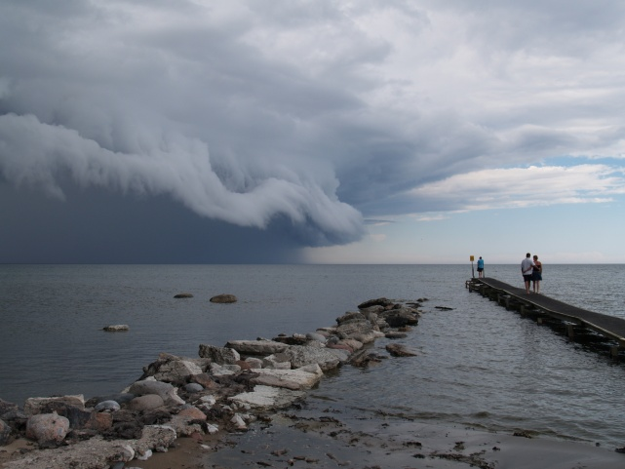
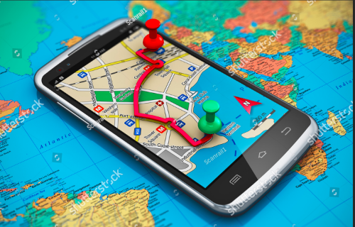
Then
Now

Slide 12
Homework
Choose one from the following two tasks.
Write a story about an ancient navigator meeting a modern navigator in 2019. Include at least two ways to navigate and how they work.
Find out more about old and new ways to navigate using the library or the Internet. Check out the science behind the methods and evaluate whether the methods work. Share your findings with the whole class.

