Slide 1

Fake Nature
人造自然
选自《多维阅读第18级》

Slide 2
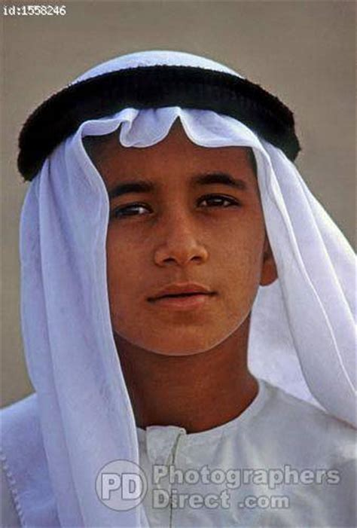
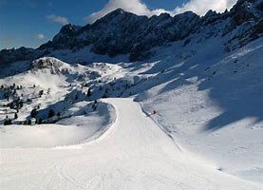
Brainstorm
Hadnom comes from Dubai, an extremely hot place. He always dreams about skiing. Can you think of a solution to help realize his dream?
Dubai

Slide 3
What’s the title?
What’s the meaning of “fake”?
Can you give us an example of “Fake Nature”?
Why do you think people want to fake nature?

Slide 4




Look at the locations on the map, and then find out the fake nature in these locations from the book.

Slide 5
Complete the mind map with some basic information from this book about fake nature.
Reasons
Methods
Fake Snow
Advantages
Disadvantages

Slide 6
Complete the mind map with some basic information from this book about fake nature.
Reasons
Methods
Tropical Island Resort
Advantages
Disadvantages

Slide 7
Complete the mind map with some basic information from this book about fake nature.
Methods
Reasons
Bio-dome
Advantages
Disadvantages

Slide 8

Read the other types of fake nature in the book, and note down the reasons for making these fake nature.

Slide 9

In the Sahara Desert, people are desperate to see the ocean and experience surfing. Design a poster.
Fake nature
Usage
Working
method

Slide 10

What are the pros and cons of the fake nature?

Slide 11
Do you think faking nature is a good thing? Why do you think that?

Slide 12

Thanks for listening!

