Slide 1
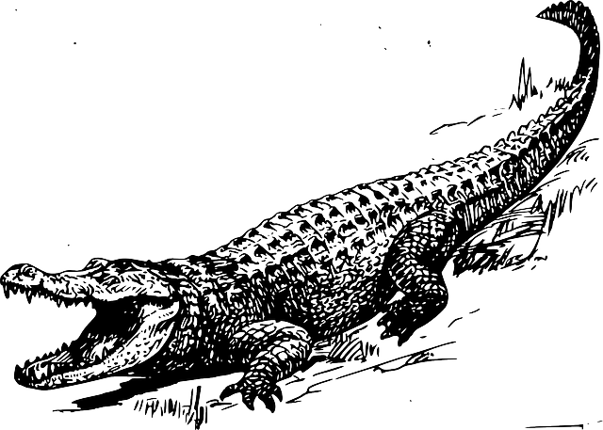
Lucky Survivors
幸存者
选自《多维阅读第17级》

Slide 2
hippo
Notes:
Watch a video to know more about the hippo. (03:38-04:38)
视频网址：http://www.iqiyi.com/w_19ru2mjdq1.html

Slide 3
Kenya Wildlife Service
Notes:
Read the news and talk about:
1. Why did the hippo attack these two tourists?
2. What should we pay attention to when travelling in the wild?

Slide 4
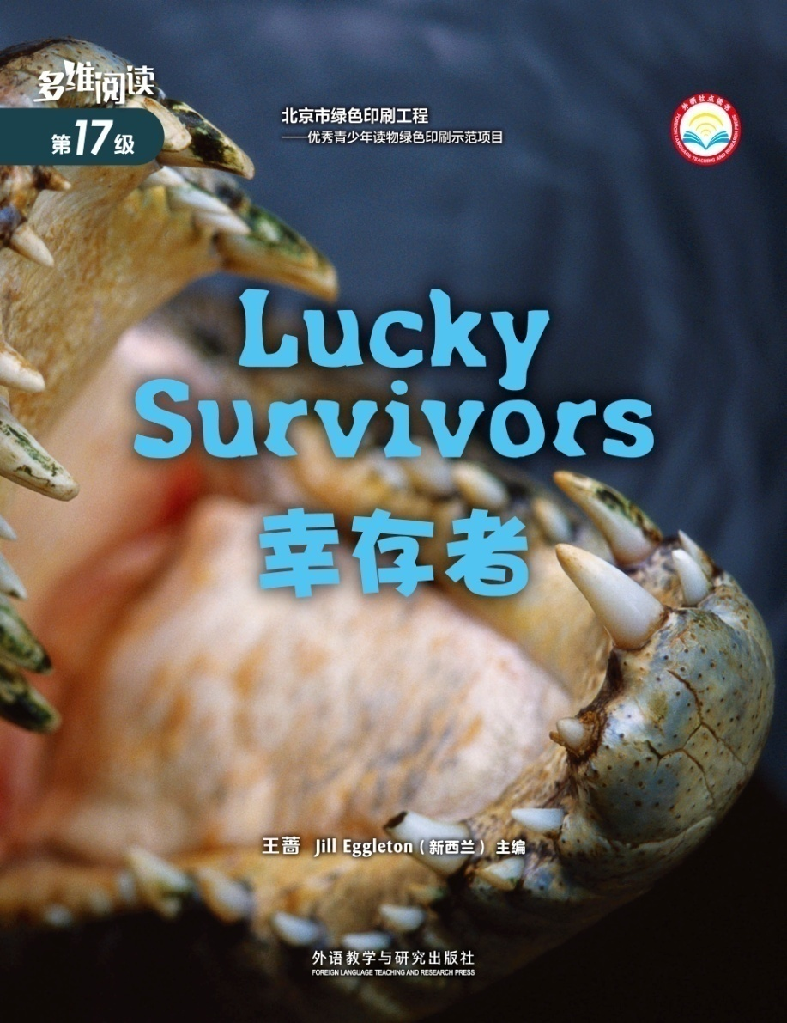
Observe the Cover
Notes:
What can you see from the front cover?
Do you want to know who are the lucky survivors and how did they survive?

Slide 5
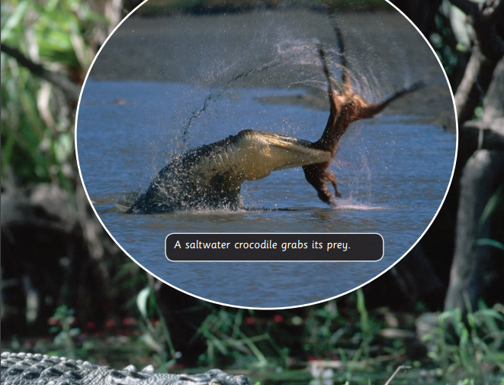
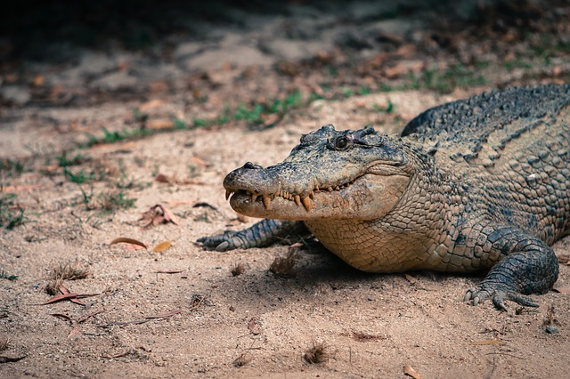
Dangerous Saltwater Crocs
Why are they dangerous animals?
the largest reptiles
powerful jaws
eat large prey
Notes:
Reptiles可以超链接到下一页，下一页有更多的爬行动物，用图片解释该词。

Slide 6
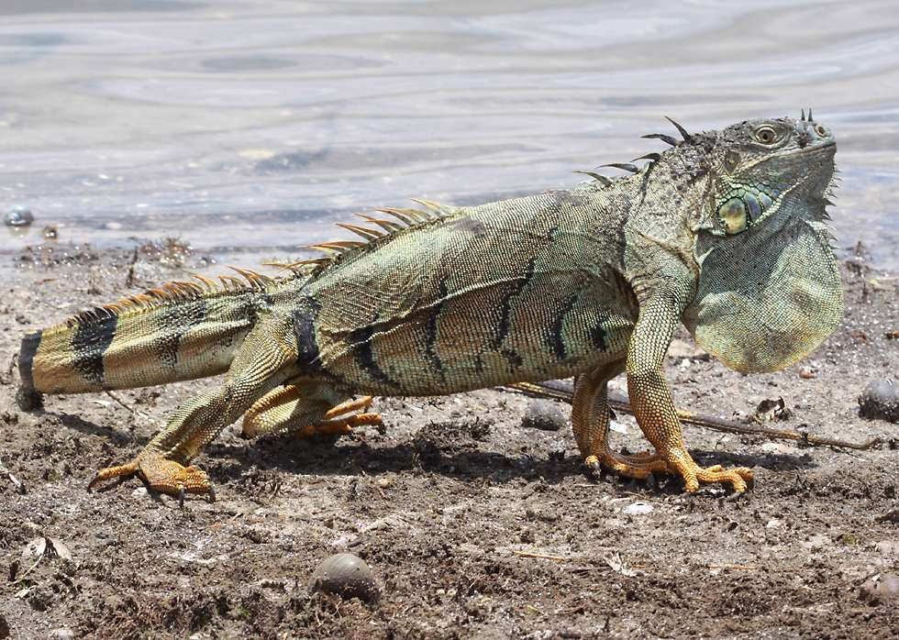
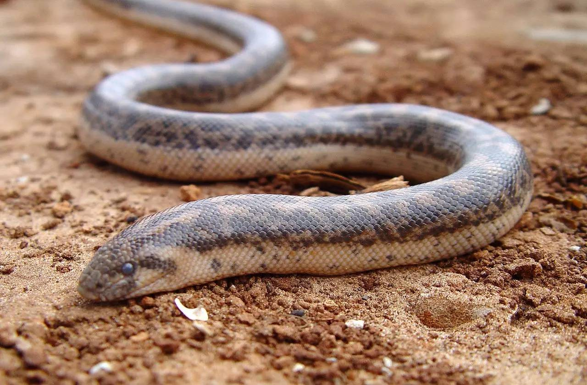
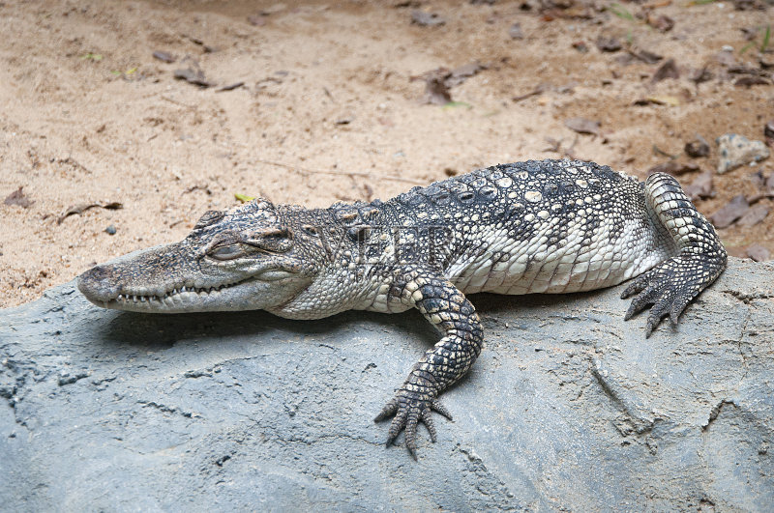
reptiles
Notes:
此处点击reptiles这个单词可以超链接回前一页

Slide 7
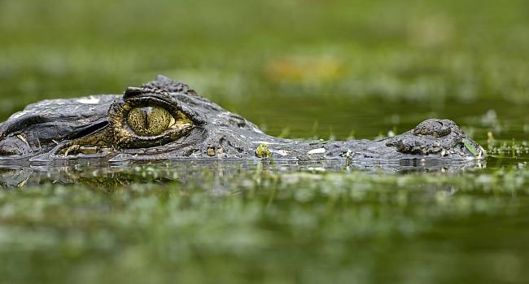
Dangerous Saltwater Crocs
Why do you think that saltwater crocodiles don’t often miss their target?
hide
wait
lunge
Notes:
Watch video to understand what is the meaning of “lunge”. (00:26-00:34)
视频网址：http://www.iqiyi.com/w_19ru2mjdq1.html

Slide 8
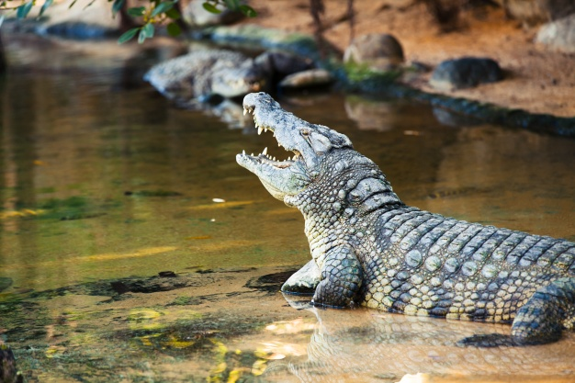
Dangerous Saltwater Crocs
What else do you know about crocs?
Notes:
Talk about more about crocodiles, for example:
Where do they live?
What do they eat?
How long can they live?

Slide 9
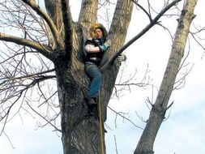
In Saltwater Croc Territory
Why do you think that David tied himself to the tree?
his only chance of survival
(survive/survivor)
Notes:
词汇拓展，survive, survival, survivor

Slide 10
A Long Wait
What did David do to survive?
He climbed a tree and tied himself to a branch.
He climbed higher in the tree and made a platform of sticks to lie on.
He hung toilet paper over the tree and waved his shirt like a flag.
He tried to make a flash of light by holding a tin box towards the sun.
Brave
Calm
Clever
Notes:
What other methods can you think of to help David?

Slide 11
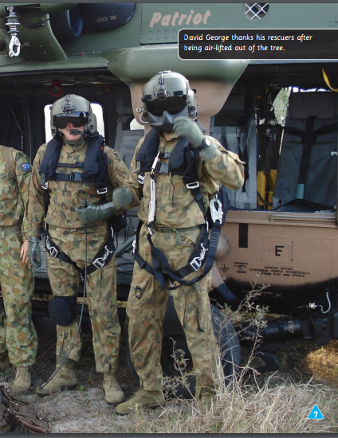
A Long Wait
Why do you think it was hard for the people in the helicopter to see David?

Slide 12
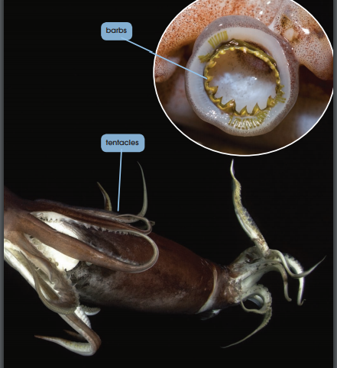
Dangerous Jumbo Squid
1. Why are they dangerous animals?
rows of sharp barbs
tentacles
2. Why do you think that squid might eat each other?
3. What else do you know about squid?

Slide 13
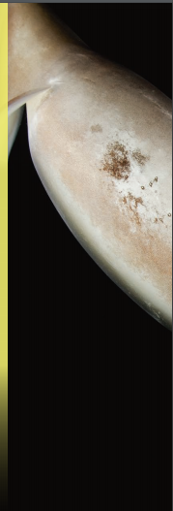
The Jumbo Squid Territory
1. Why do you think Shanda didn’t know which direction was up？
…jerked … around in the water
2. What did she do to survive?
kicked as hard as she could

Slide 14
Group work
Suppose you are a reporter who is reporting a case of animal attacking people.
Use information from the book.
Task 1
Make a poster to report the case.
Show the name of the animal
Show its territory, appearance, feature, hunting habit.
Discuss how people could survive from the attack.
Task 2
Interview the lucky survivors of the animal attack.
List the information on a table.
You should include:
Action of the animal;
Action of the lucky survivor;
The lucky survivor’s feelings.

Slide 15
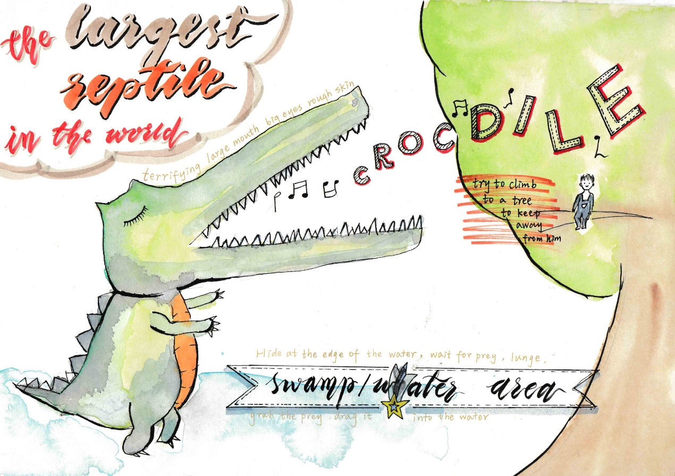
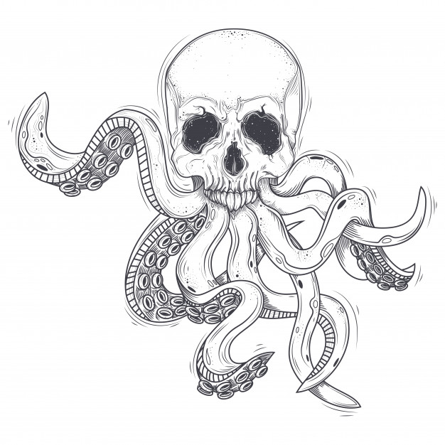
Show Time – in pairs
1. The Saltwater Crocodiles and Lucky Survivor David.
2. The Jumbo Squid and Lucky Survivor Shanda.
Eat everything!!!
Notes:
The two pictures are the example of the posters.
Students (in pairs) present their poster and retell the story according to their notes in task 1 and task 2.
Students are allowed to choose 1 or 2 to present.

Slide 16
Assessment – Who is the best reporter?
Notes:
Complete: The students could finish the assignments in the tasks. The report should include two parts, one part is about the animal, the other part is about the survivor.
Correct: The words and expressions related to this lesson is used correctly.
Pronunciation and tone: The students’ pronunciation is easy to understand and pronounced correctly.
Body language: The students use proper gestures in speech, such as eye contact with the audience.

Slide 17
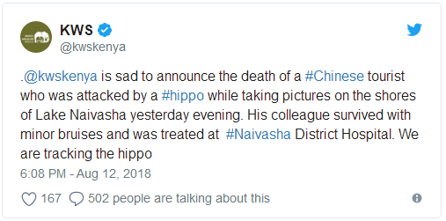
Understanding Animals
Notes:
Read the news again and think:
Why did the hippos attack the tourists?
What should we pay attention to when travelling in the wild?

Slide 18
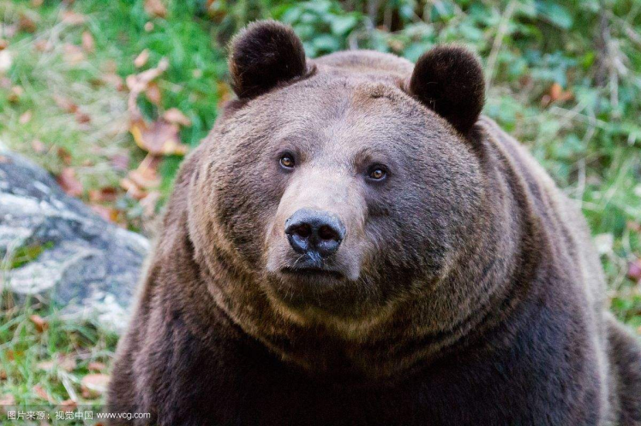
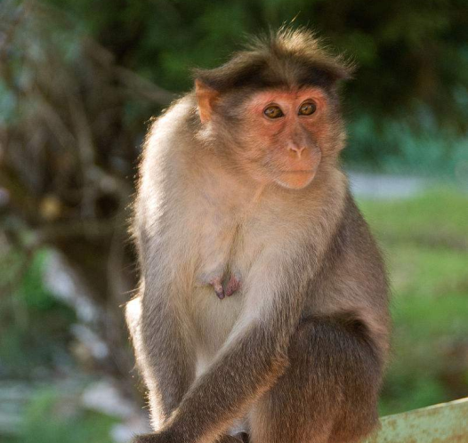
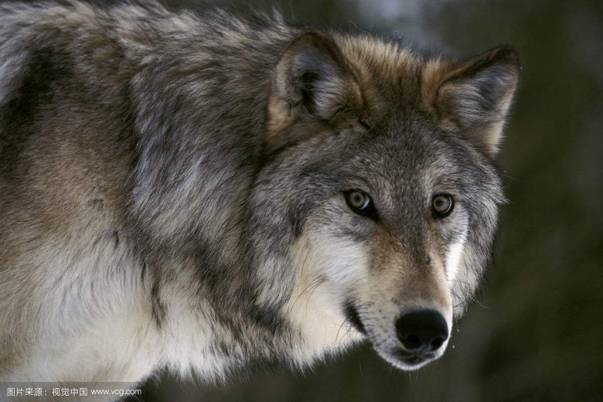
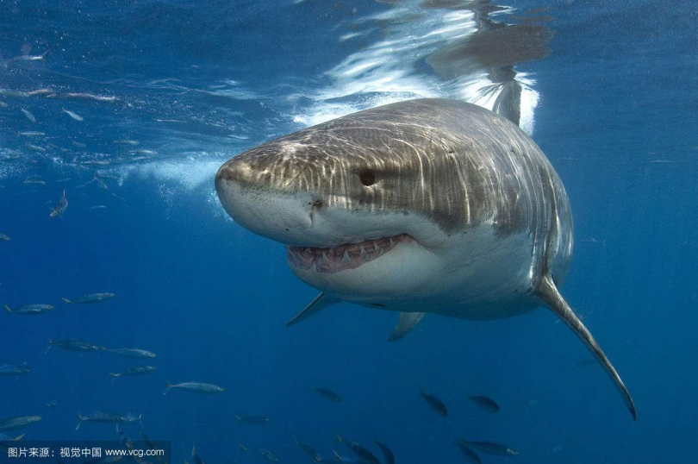
Group Work (in groups of four)
Make a booklet, helping tourist to Kenya to travel safely in the wild.
You should include:
What animals they may see and why animals attack human beings sometimes?
What should tourists pay attention to if they meet these animals in the wild?
Understanding Animals, Protect Ourselves
Notes:
Students are going to introduce their wildlife guide booklet to the class.

Slide 19
Assessment – Which is the best booklet?
Notes:
Complete: The students could finish the assignments in the tasks. The report should include two parts, one part is about the animal, the other part is about the survivor.
Correct: The words and expressions related to this lesson is used correctly.
Pronunciation and tone: The students’ pronunciation is easy to understand and pronounced correctly.
Body language: The students use proper gestures in speech, such as eye contact with the audience.

Slide 20
Homework
1. Write an introduction to your poster or your booklet.
or
2. Do you know other lucky survivor stories?
If yes, please write it down.

Slide 21
See you!
Notes:
If you want to know more about wildlife animals, please refer to the documentary of BBC. You can watch them on this website: http://www.iqiyi.com/jilupian/bbc.html

