Slide 1
极端气候
Too Wet-Too Dry
选自《多维阅读第17级》

Slide 2
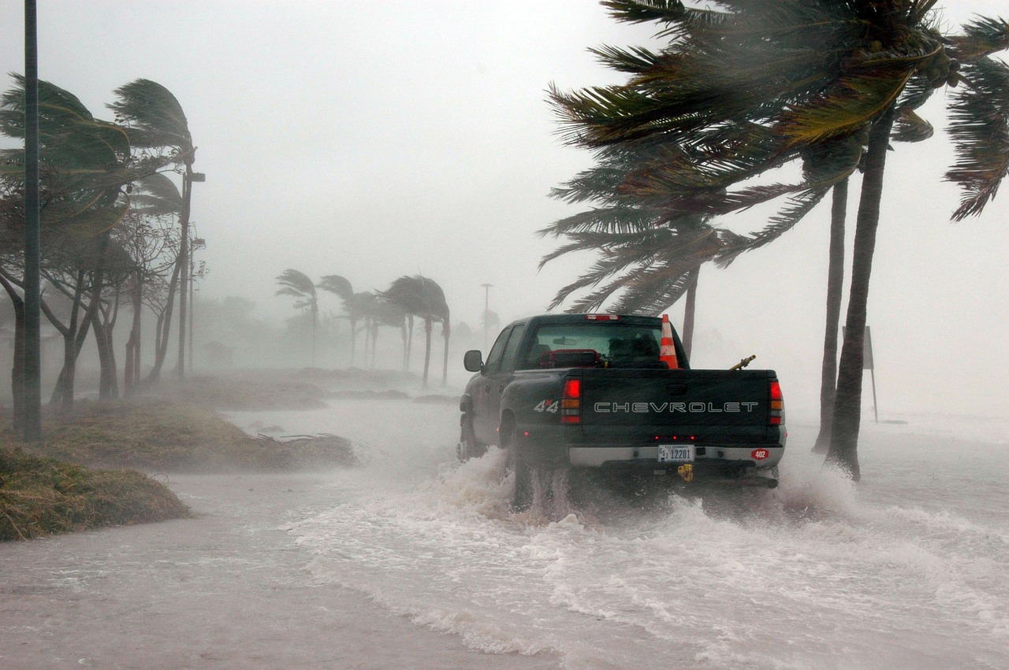
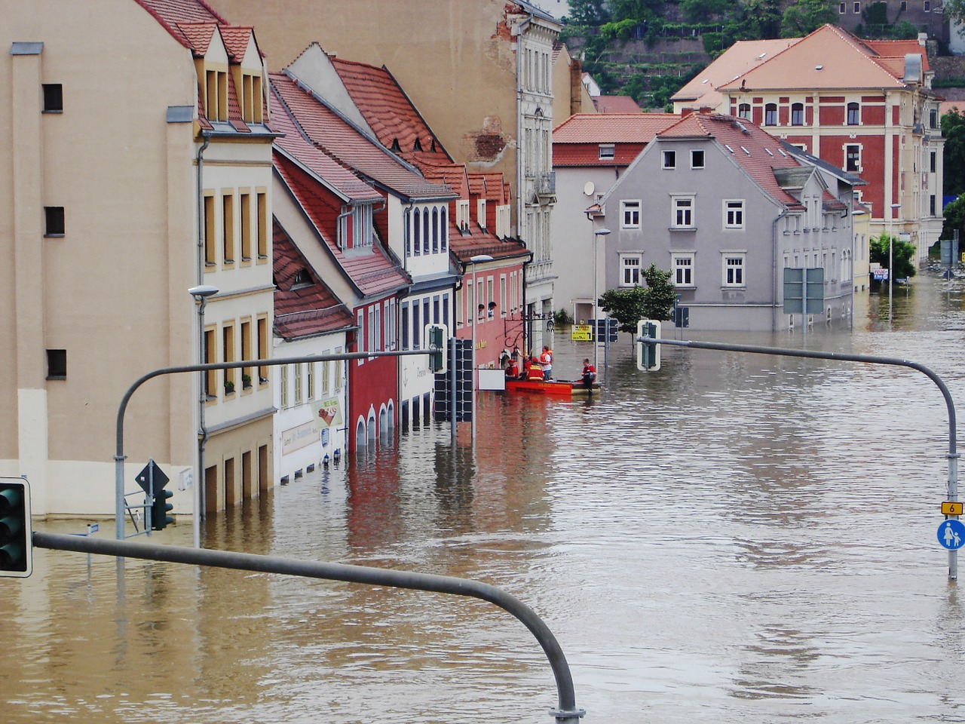

Slide 3
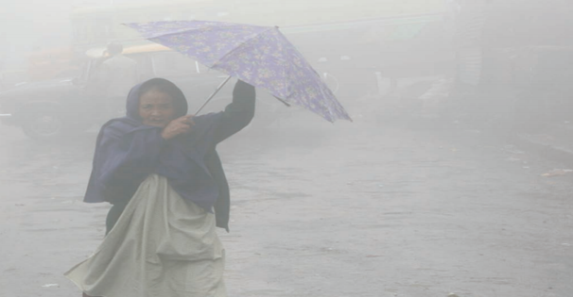
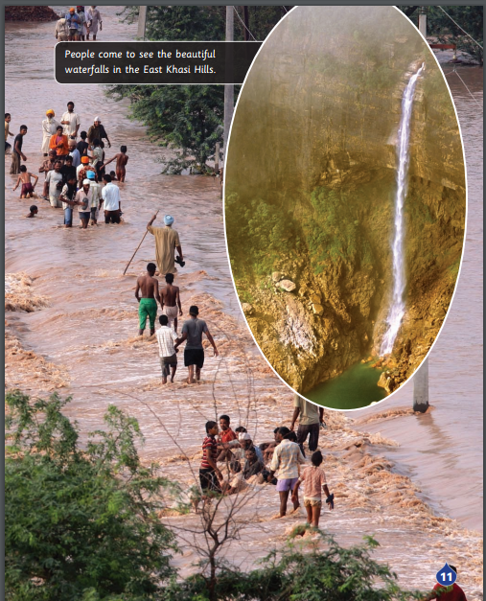
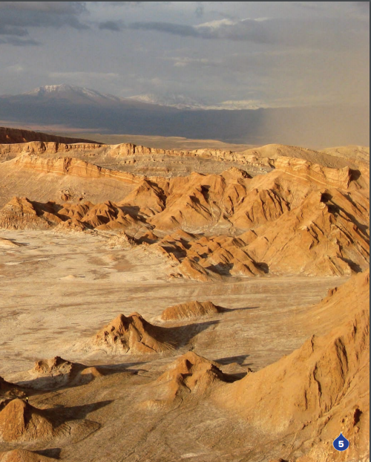
Too much rain
Too little rain

Slide 4
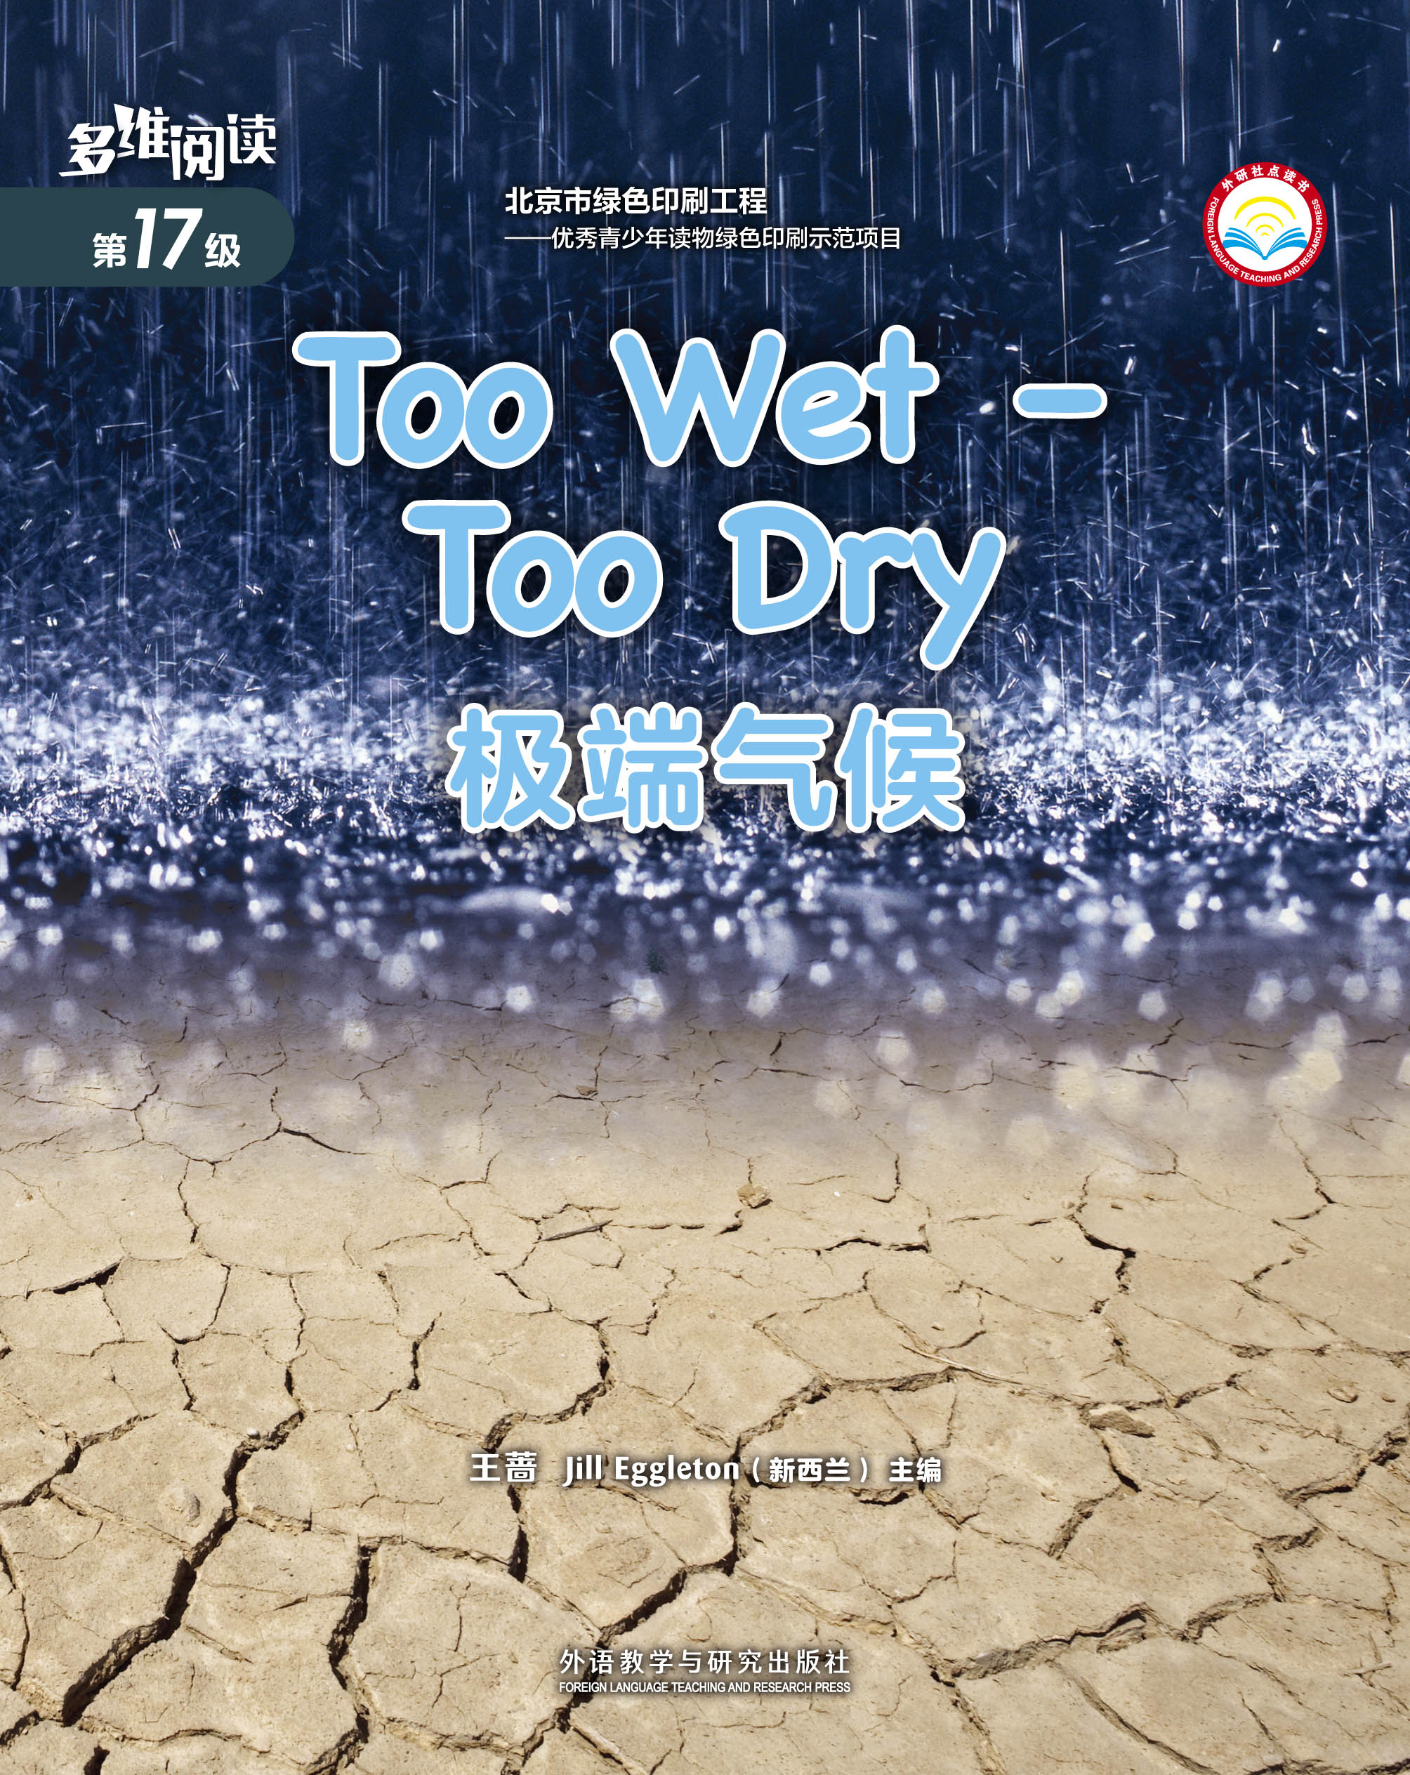
Observe the cover

Slide 5
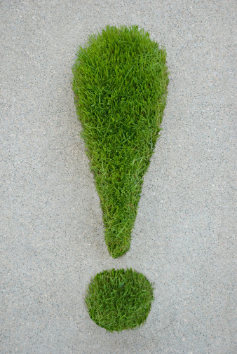
Know
Want to Know
Learnt

Slide 6
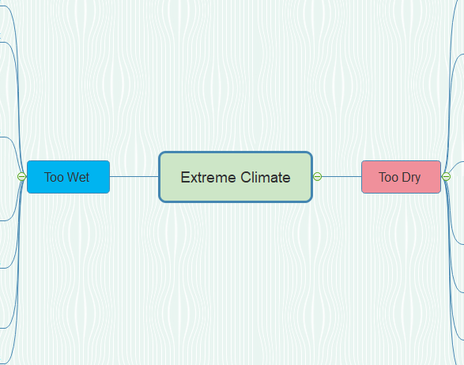
place
place
environment
environment
effects
effects
people’s living
people’s living
reasons
reasons
solutions
solutions
others
others

Slide 7
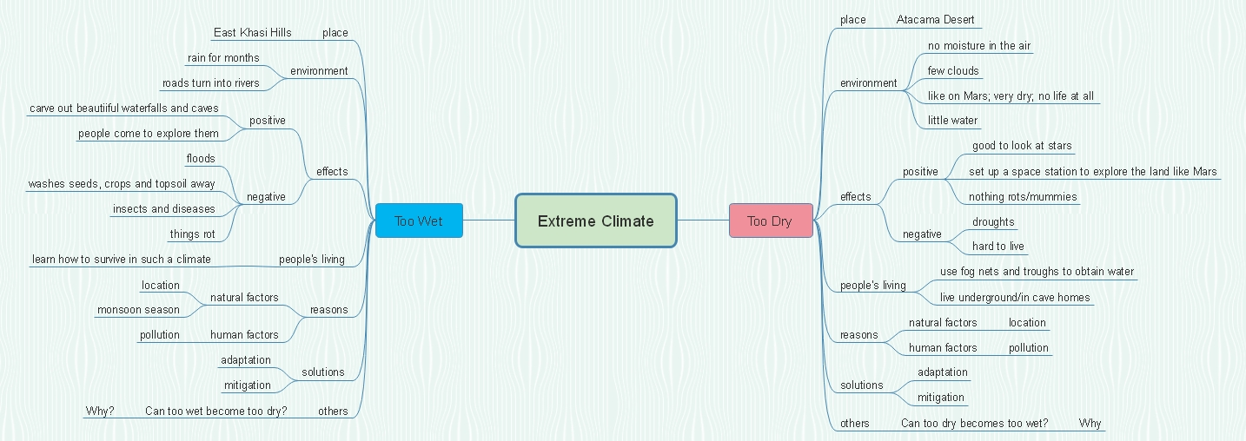
Retell the book.

Slide 8
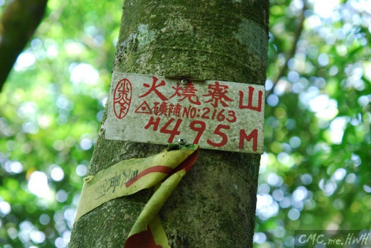
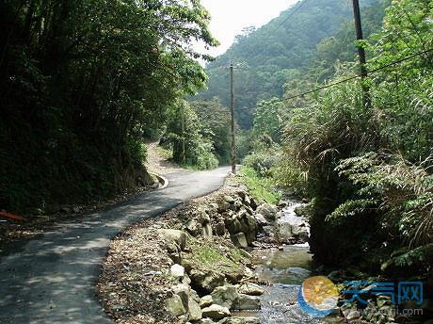
Show Time 1
In Groups of 4.
The wettest place in China
Huoshaoliao, Taiwan
Notes:
情景教学 1
You and your other three classmates visited Huoshaoliao in Taiwan as exchange students last year and this year another four students will go. This is the wettest place in China, and there is a lot of rain.
You are asked to:
1. introduce what the environment looks like;
2. introduce the positive and negative effects of such an extreme climate and how people deal with it;
3. introduce reasons for the wet climate;
4. give some suggestions to help the exchange students live better.
告诉学生注意台湾火烧寮和印度东卡西山相似，属于极端降雨气候。台湾火烧寮是中国最湿润的地方，被称为“雨极”。

Slide 9
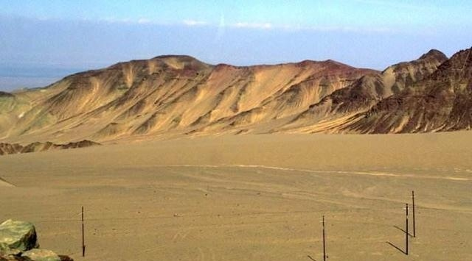
Show Time 2
In Groups of 4.
The driest place in China
Tuokexun County, Xinjiang
Notes:
情景教学 2
You and your other 3 classmates visited in Tuokexun County of Xinjiang last year and this year another four students will go. This is the driest place in China, and there is little rain.
You are asked to simply:
1. introduce what the environment looks like;
2. introduce the positive and negative effects of such an extreme climate and how people deal with it;
3. introduce reasons for the dry climate;
4. give some suggestions to help the four students live better.
告诉学生注意新疆托克逊和阿塔卡马沙漠相似，属于极端干旱气候，新疆托克逊是中国最干旱的地方，被称为“旱极”。

Slide 10
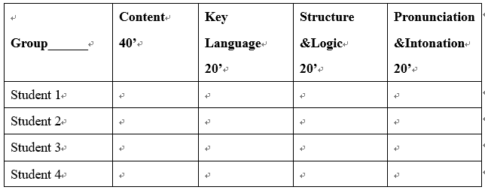
Assessment
Notes:
Please select the best group in your mind based on the criteria below.
Content: The presentation provides at least 2 points.
Key language: The presentation covers 10 key language points learnt in this book.
Structure & Logic: The presentation is clear to understand and reasonable.
Pronunciation & Intonation: The presentation is easy to understand and pleasant to listen to.

Slide 11
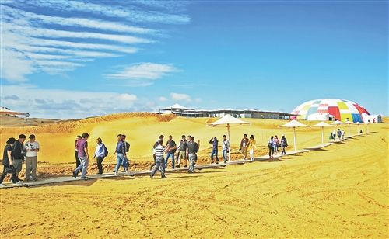
Man should learn to live in harmony with Nature.

Slide 12
Homework: choose 1 from the 4 tasks below
Complete the “Learnt” part in the KWL chart;
2. Write a paper to elaborate the mind map for the Atacama Desert or the East Khasi Hills;
3. Write a paper to provide practical ways in our daily life to protect the environment.

Slide 13
Thank You!

