Slide 1
Strong Teams
动物军团
选自《多维阅读第17级》

Slide 2
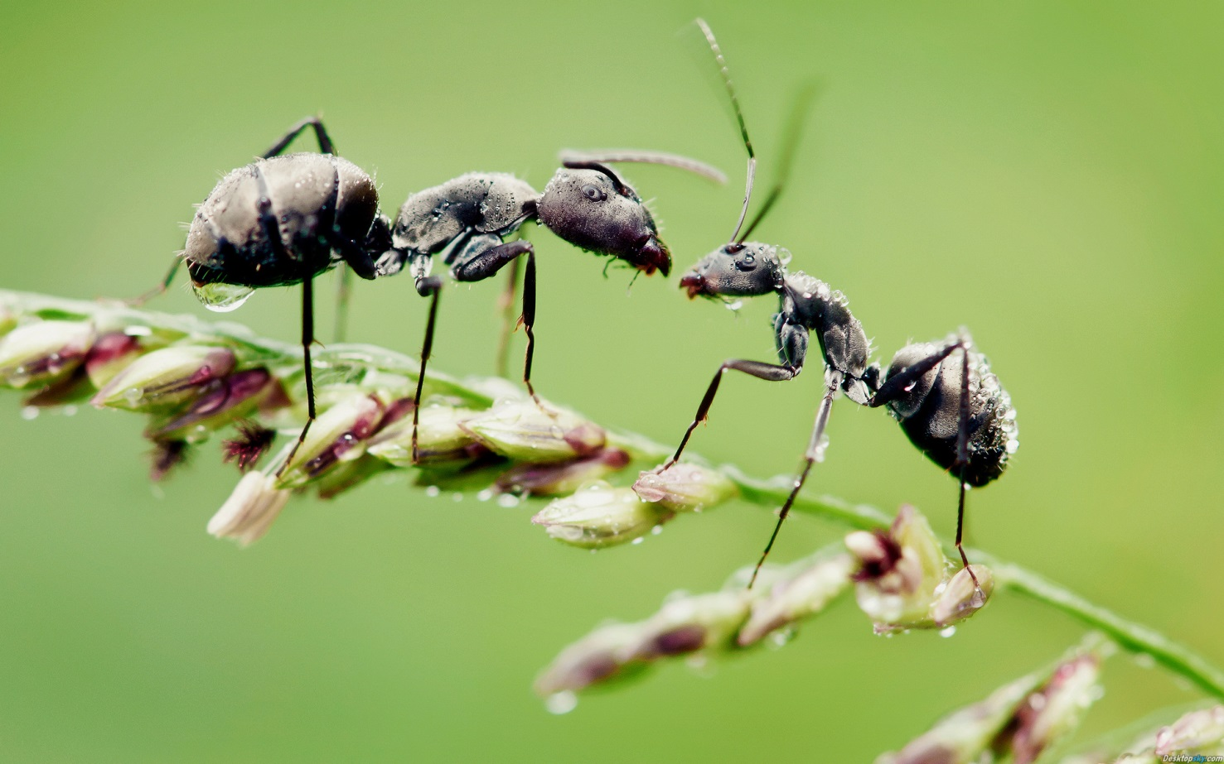
Notes:
老师通过蚂蚁导入（可借助实物蚂蚁，蚂蚁图片或者黑板绘制蚂蚁卡通形象），引起学生兴趣，并提问以下问题：
1. What is this?
2. Do you think it is weak or strong? Why?
3. When do you think the ant can be strong?

Slide 3
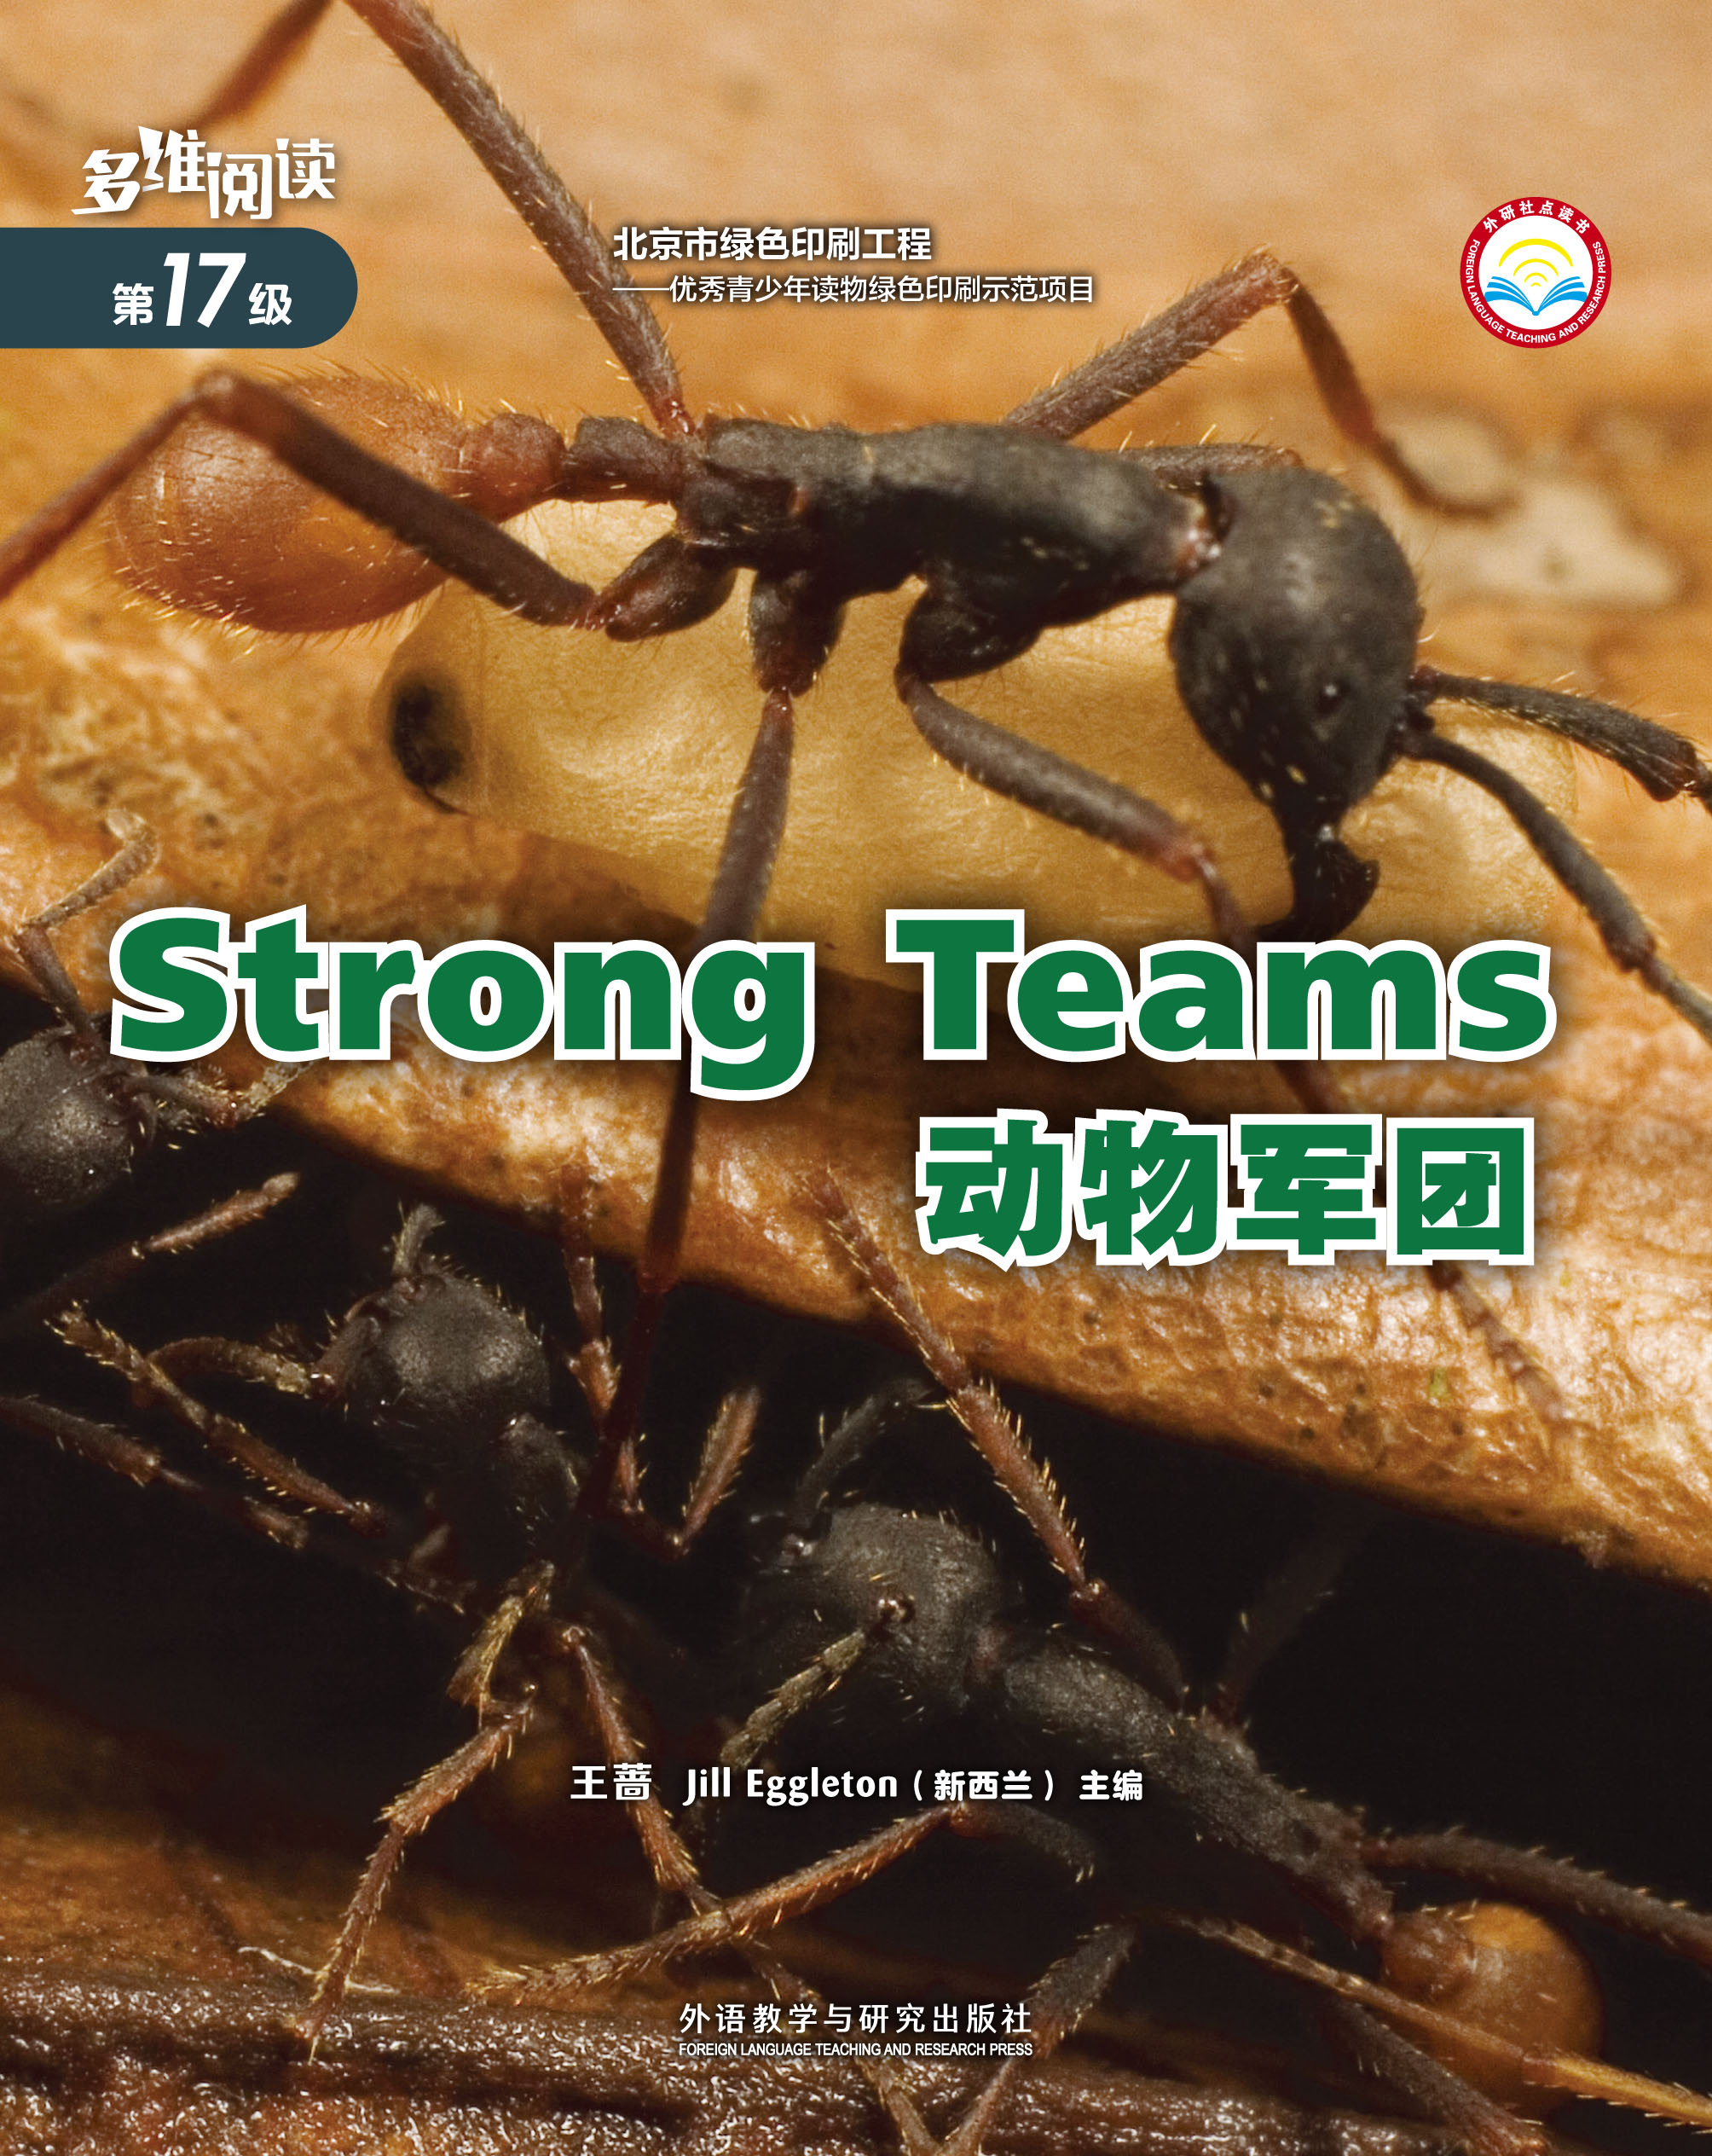
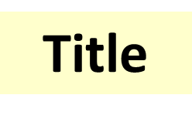
Observe the cover

Slide 4
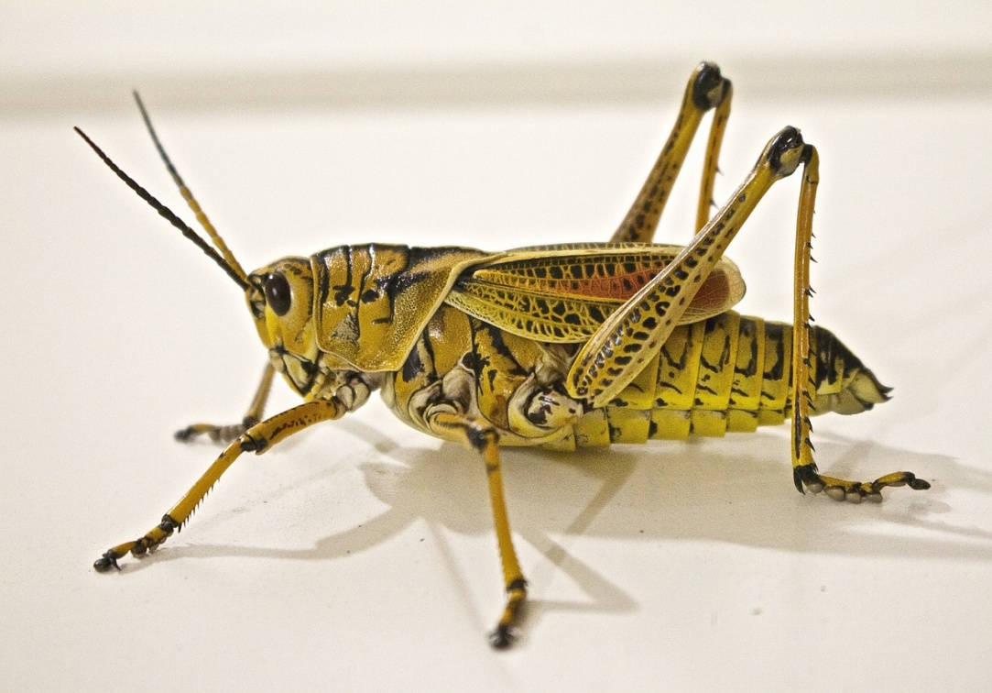
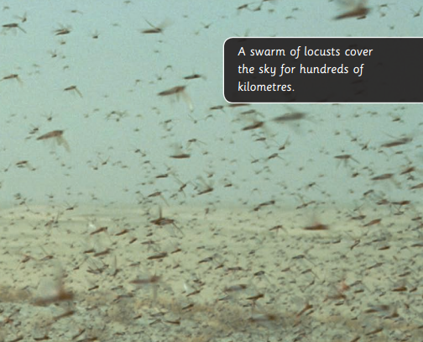
Why Animals Swarm
A locust
A swarm of locust

Slide 5
Discuss: Why Animals Swarm Then read page 2

Slide 6
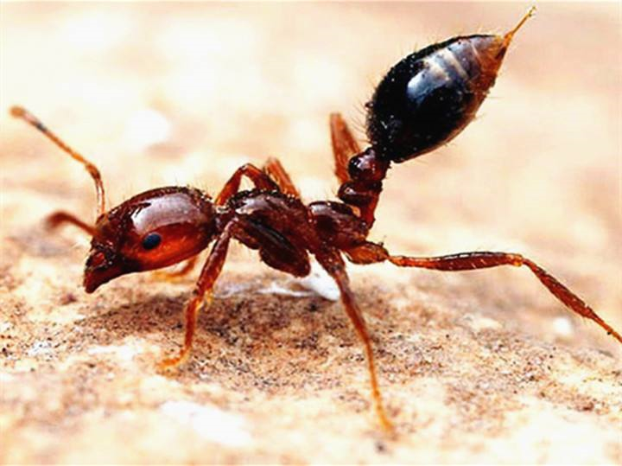
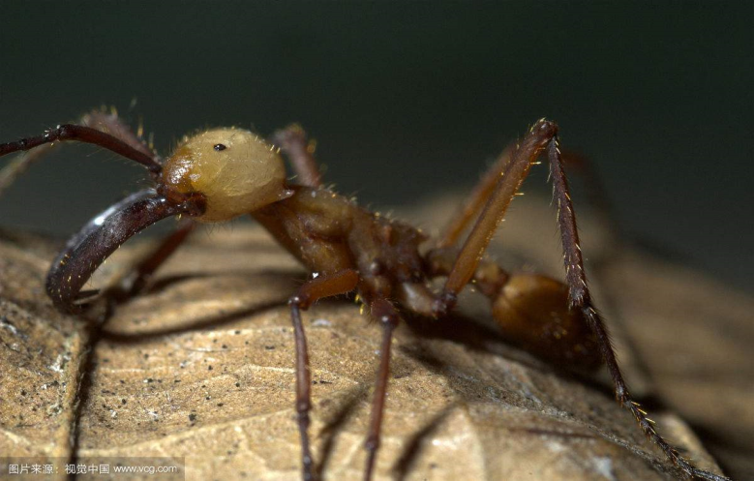
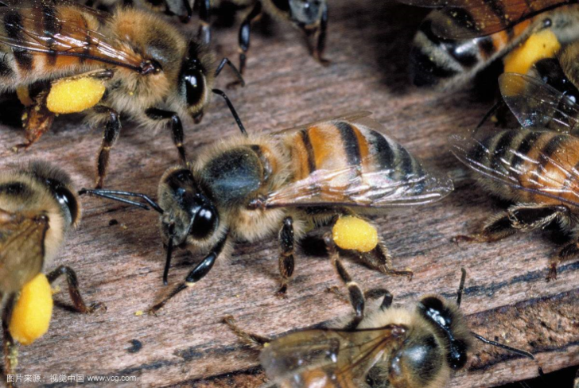
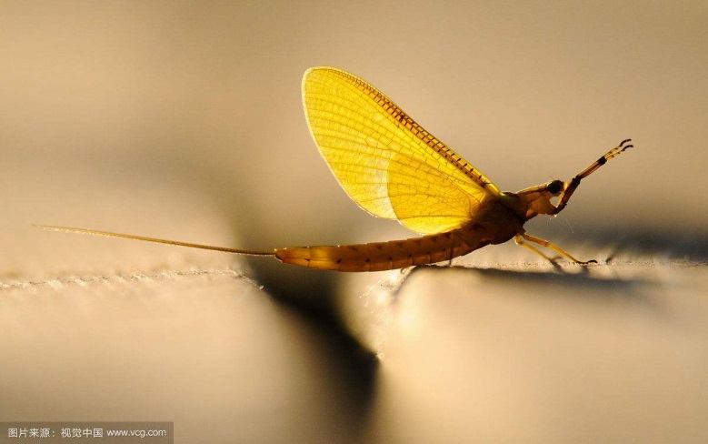
Read together in 4 groups
Pages 4-5 Fire Ant
Pages 6-7 Army Ant
Pages 8-9 Killer Bee
Pages 10-11 Mayfly
Notes:
学生选择阅读火蚁、军蚁、杀人蜂和蜉蝣四个种群的内容，完成思维导图。

Slide 7
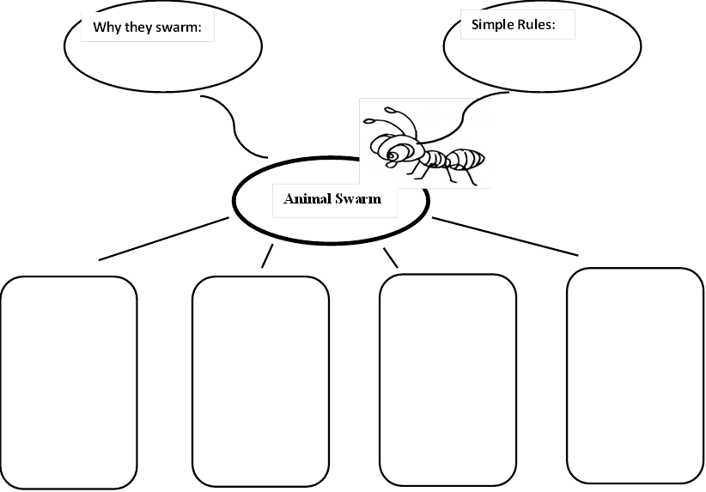
Notes:
学生通过自主与合作相结合的方式，建构四种昆虫群集的结构化知识图。

Slide 8
Present them in class!
1. Fire Ant
2. Army Ant
3. Killer Bee
4. Mayfly
Notes:
依据已有结构化知识图，运用所学习的词汇和表达方式，学生自选昆虫角色进行介绍，介绍自己种群在遇到问题时是怎样解决的。
学生按照火蚁、军蚁、杀人蜂和蜉蝣四个种群展示四种昆虫的特点，老师可借助带有四种昆虫图片的胸牌或者头箍，分发给不同角色，帮助学生进入情景。
学生展示结束后追问问题，进一步探讨个体和集体的力量。

Slide 9
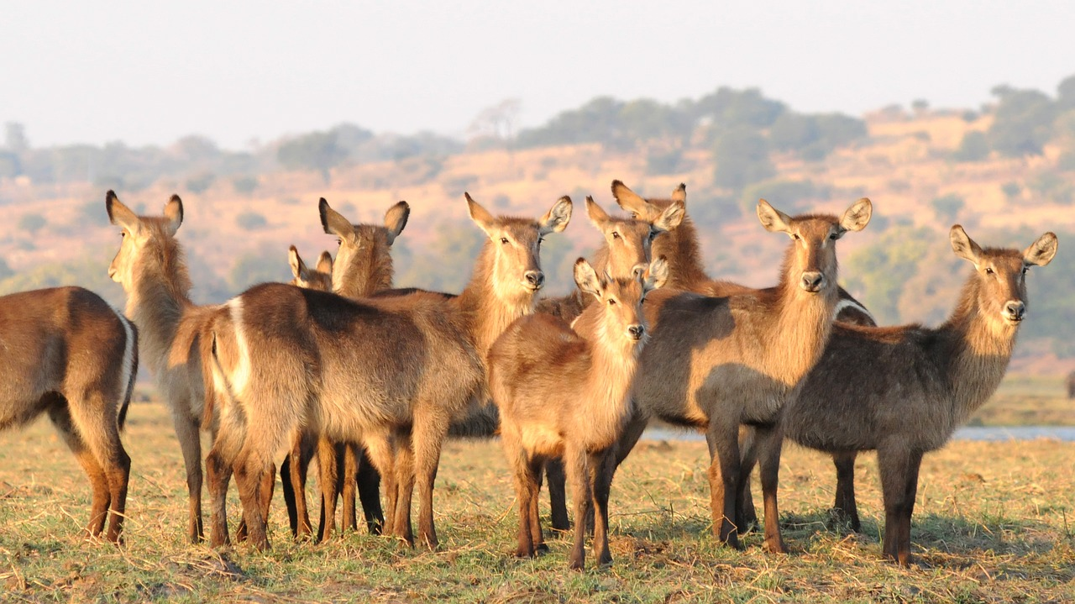
What other animals move in a swarm?

Slide 10
Connect with your own life
1. Do you like to study alone or as a team?
2. What are the pros and cons of studying alone?
3. What are the pros and cons of studying as a team?
Notes:
使用学案活动二，学生小组活动，运用T型图形组织图，联系个人生活论证当解决问题时运用个人或集体力量的利弊。

Slide 11
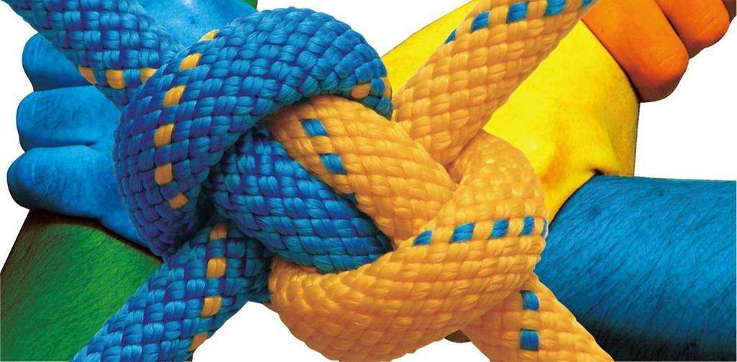
One can be weak,
yet together we can be strong teams.

Slide 12
Homework
Choose 1 from the 2 tasks below.
Work as a team, find another strong animal team and make a poster introducing them.
Choose 1 from the 4 types of insects in this book, find more information about it.
Write a diary “My One Ordinary Day”, introducing how the insect spend a day.

Slide 13
Thank you!

