Slide 1
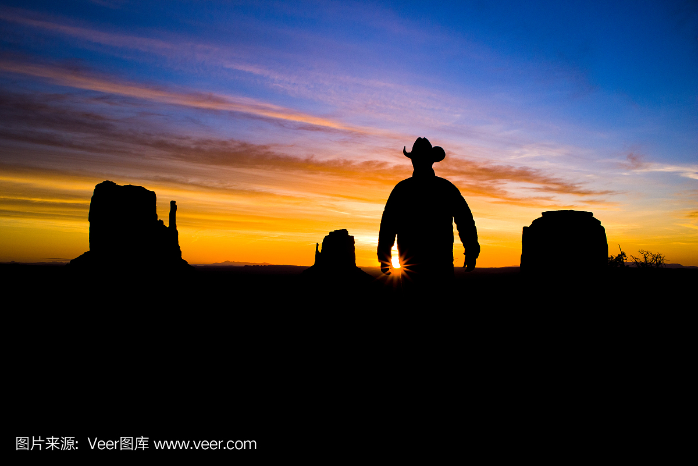
Mountain Cowboys
山地牛仔
选自《多维阅读第17级》

Slide 2
What does he do?

Slide 3
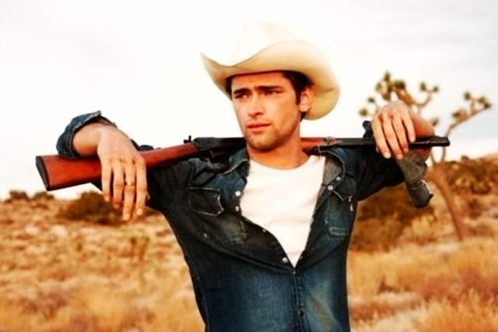
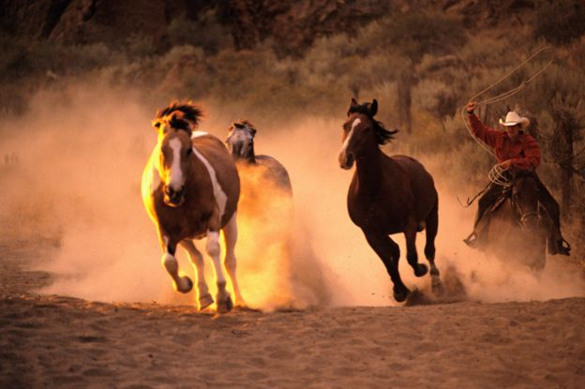
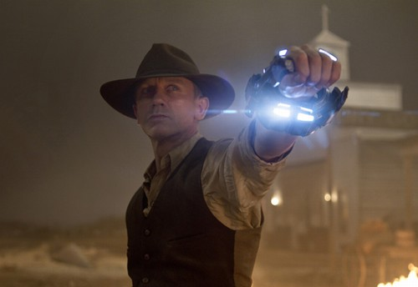
Cowboy
Mountain Cowboy

Slide 4
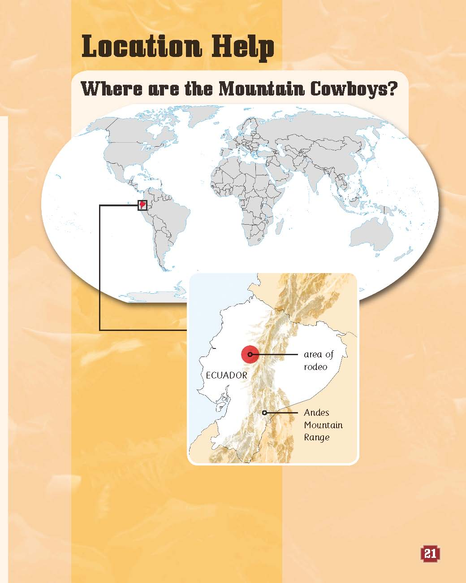
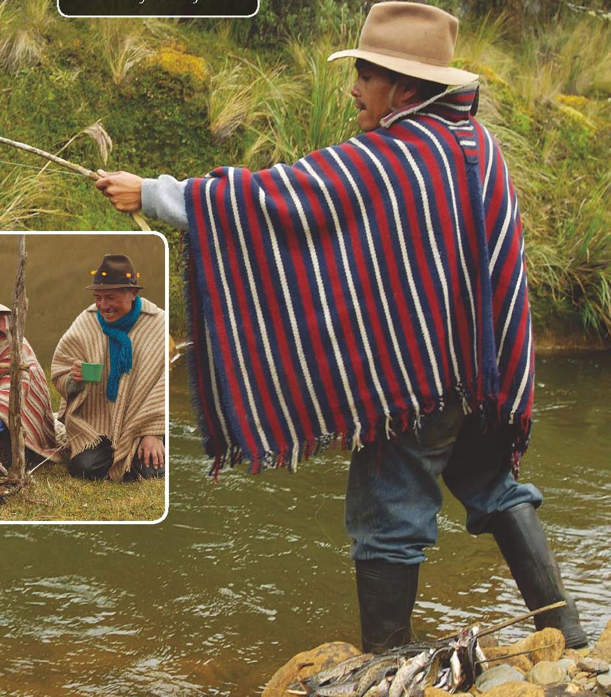
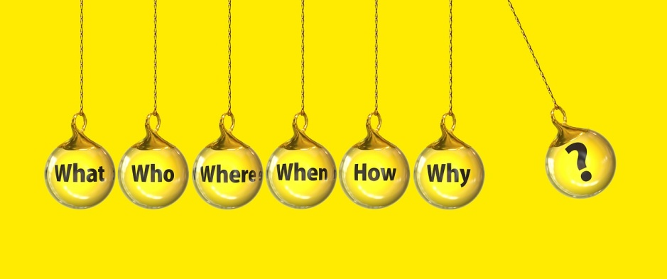
Background Information
In the Andes Mountain Areas of Ecuador
hat
poncho
boots

Slide 5
Read the book in groups

Slide 6
Find out the main idea of each part and reorganize the order
A cowboy’s job
A message in the hills
Teamwork
rodeo
team
smoke signal
More hard work
Running cattle
A celebration
celebrate
still hard work
stampede

Slide 7
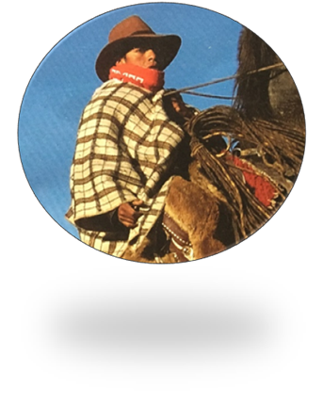
Complete the word web below
ways of communication
tools they use
celebration
what to do
danger

Slide 8
Mountain cowboy
tools
danger
what to do
celebration
communication
horses, lasso, camp
stampede, the attack from … horns
ride to …, set up camp, chase … down，take … back to
put … into …, count, brand, give … medicine, sort out
share …, tell …, sing …, light …，
send … into the sky
smoke signal

Slide 9
Homework
Please draw a mind map of a job and introduce it to your classmates. You can go to the library or surf the Internet to get more information.
Interpreter
Medical Researcher
Engineer
IT

Slide 10
Thank you!

