Slide 1
Superkid Heroes
少年英雄
选自《多维阅读第17级》

Slide 2
Observe the cover
What is a hero?

Slide 3
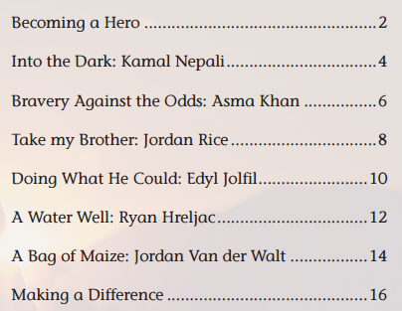
Challenging situations
Caring for others
Courage
Bravery
Leadership

Slide 4
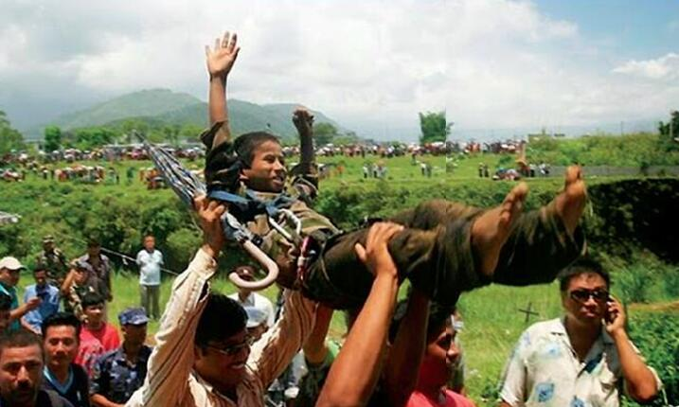
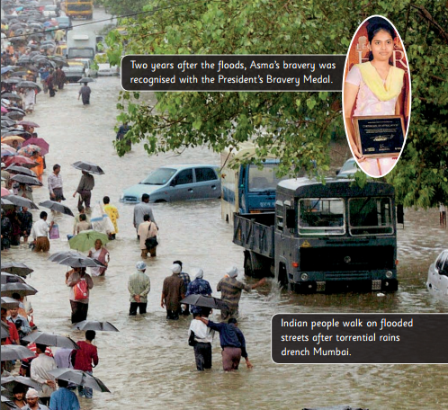
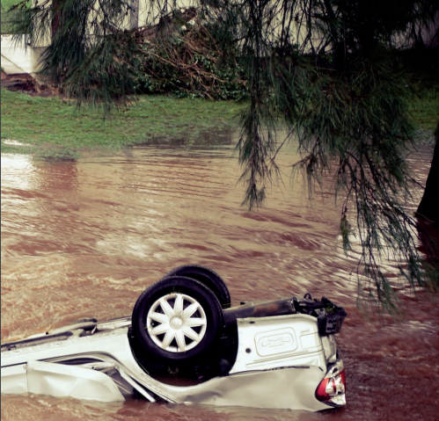
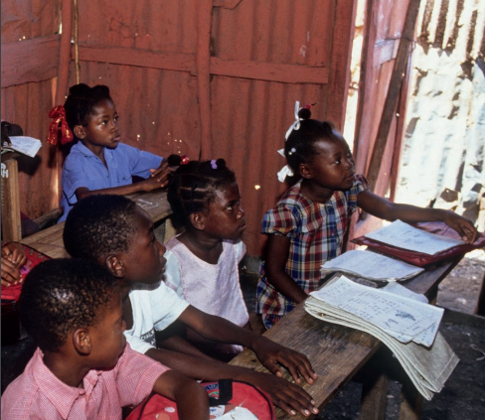
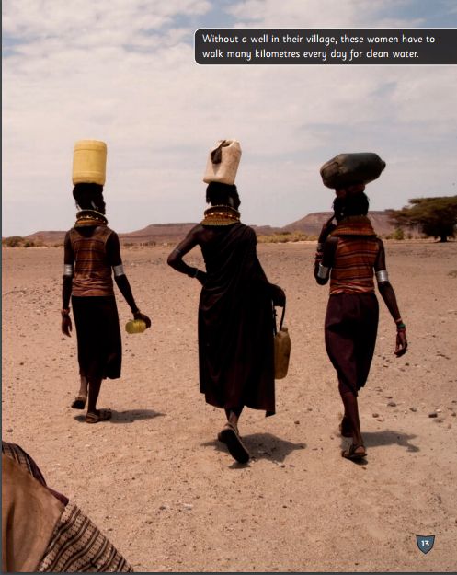
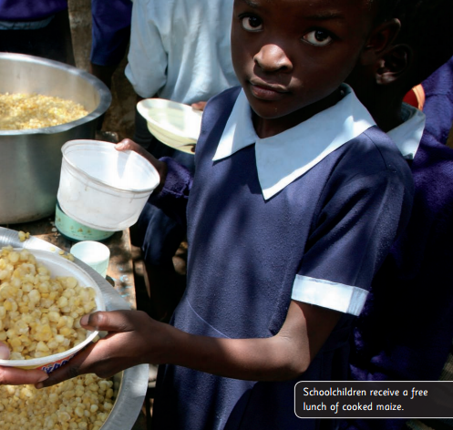
1

Slide 5
Locate the places

Slide 6
Into the Dark:
Kamal Nepali (Nepal)
Helper (Hero): | Receiver:
volunteer to enter; tie a rope; be given a walkie-talkie; be lowered into; emerge; be greeted | fall down

Slide 7
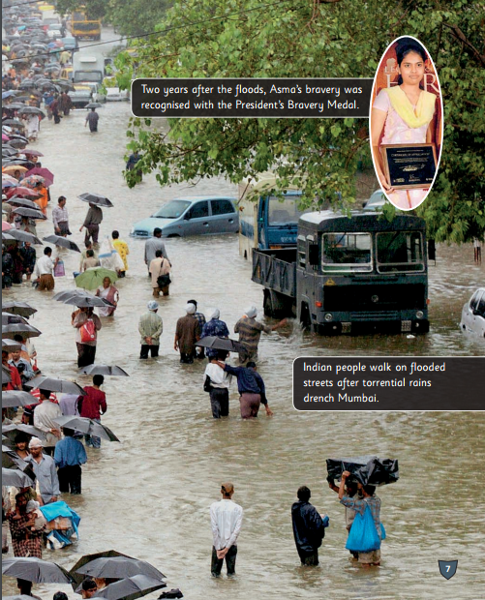
Bravery Against the Odds:
Asma Khan (India)
Helper (Hero): | Receiver:
make trip after trip; carry … to safety; keep her head high; can’t swim; be recognized with | cry in terror

Slide 8
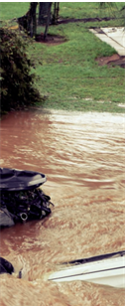
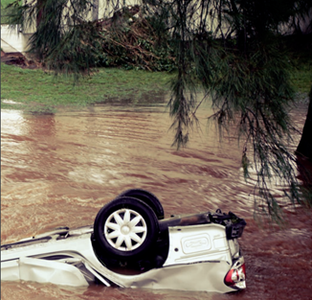
Take My Brother:
Jordan Rice (Australia)
Helper (Hero): | Receiver:
sacrifice his own life; push; saying “Take my brother first.”; climb; be swept away

Slide 9
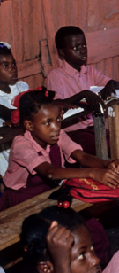
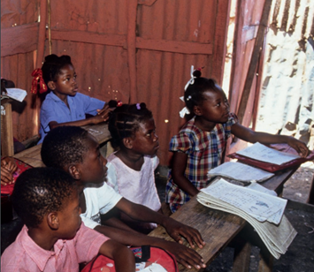
Doing What He Could:
Edyl Jolfil (Haiti)
Helper (Hero): | Receiver:
work to help; keep on trying and believing; “You don’t have to rely on other people”; “We must hold on strong”; “So many people go hungry here; I want to help them.”

Slide 10
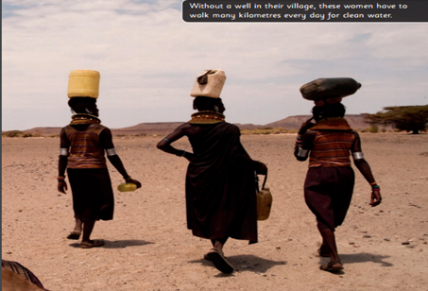
A Water Well:
Ryan Hreljac (Uganda)
Helper (Hero): | Receiver:
do extra chores; Give talks to people; Raise money; drill a well; help; inspire; give people access to clean water | walk many kilo-metres for clean water

Slide 11
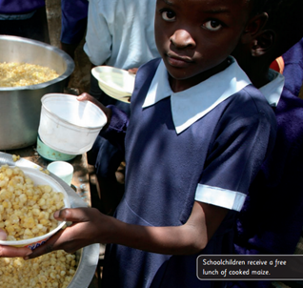
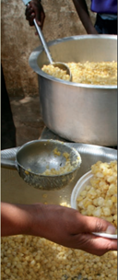
A Bag of Maize:
Jordan Van der Walt (South Africa)
Helper (Hero): | Receiver:
want to help; begin a campaign; encourage; collect; “No matter how big or small your idea is, you can help.” | go to school hungry; receive a free lunch

Slide 12
1

Slide 13
Choose one story and retell it
My name is …
My story happened in … I …

Slide 14
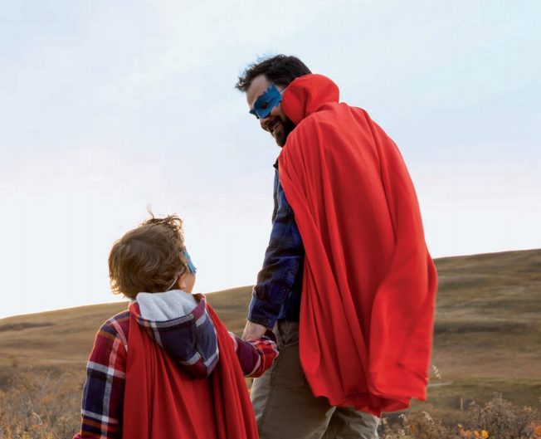
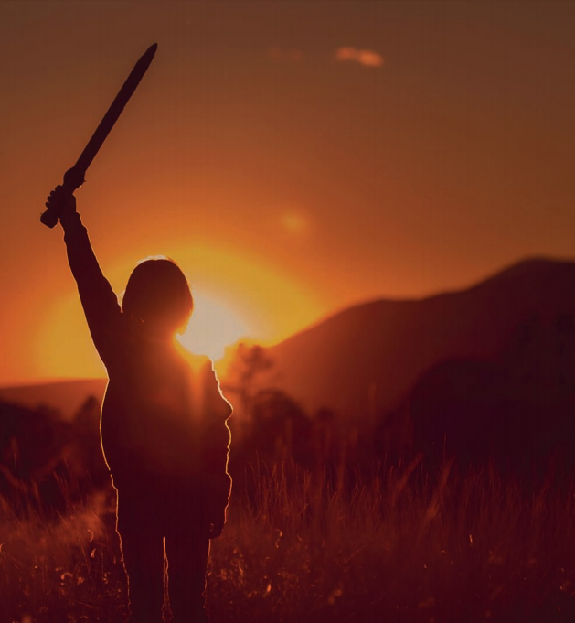
Discuss in groups
Which hero do you like best
among the six heroes? Why?
2. What makes a real hero?
Who is your hero in life? Why?
3. Do you want to be a hero?
Why and how?

Slide 15
Homework
Write a paper to summarize the six stories;
Write down several tiny things that a hero may do to help make the world a better place;
Write a hero story like one of the six stories in the book.

Slide 16
Thank You!

