Slide 1
DARING
勇气可嘉？
选自《多维阅读第17级》

Slide 2
Observe the cover
setting
characters
events

Slide 3
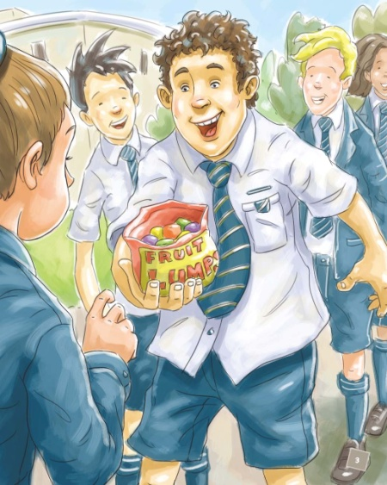
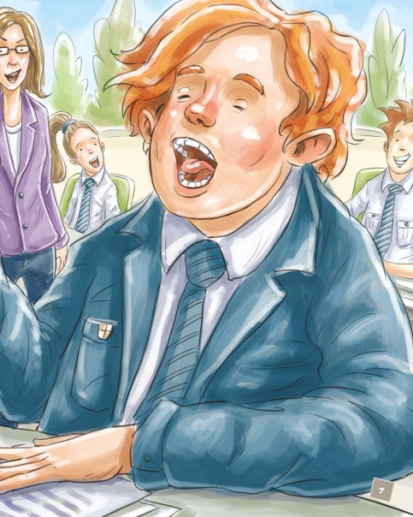
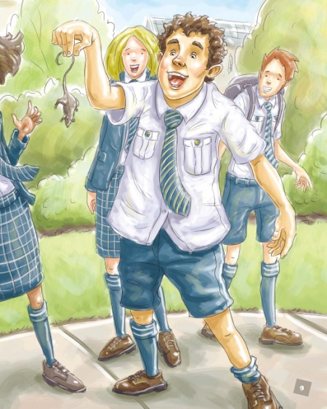
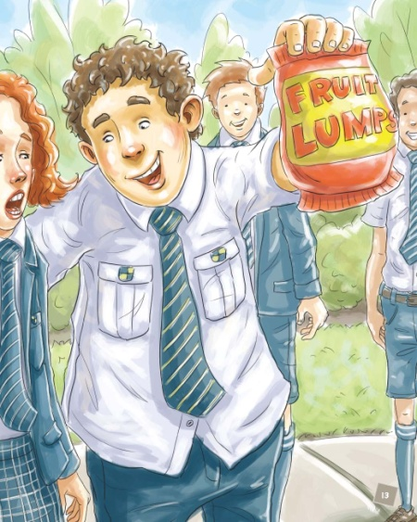
Read and clarify
How many times did Drew dare his classmates?

Slide 4
Read and clarify
DARING | what to do | how much to pay | who dares | how Miss Kelly reacts
1st dare
2nd dare
3rd dare
4th dare
to wear two different shoes and uniform back to front
peered over her glasses
two fruit lumps
Tilly Baker
to sing “Baa Baa Black Sheep” in a loud voice in the class
four fruit lumps
hardly stopped for a second
Jack
to put a fake mouse in Miss Kelly’s lunch box
ten fruit lumps if Miss Kelly screeches; eight if she doesn’t
picked it out gently and threw it into the bushes
Matt
reacted fast: called an ambulance; peered over her glasses, gave Drew a lesson
to wear raisins on the teeth, smile constantly
a whole bag of fruit lumps
Annie

Slide 5
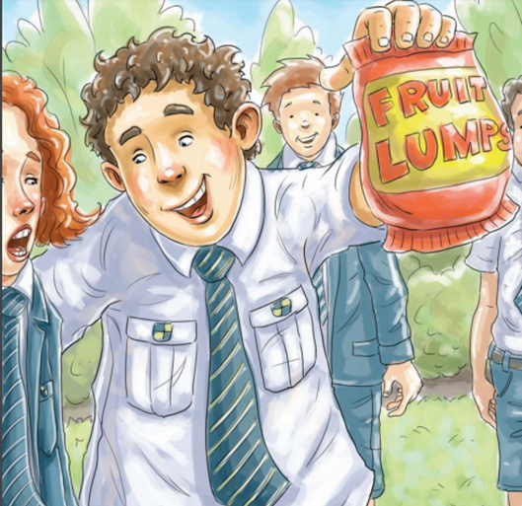
Think and share
What do you think of each dare?
Are there any differences between each dare?
Why did the students do the silly things on a dare?

Slide 6
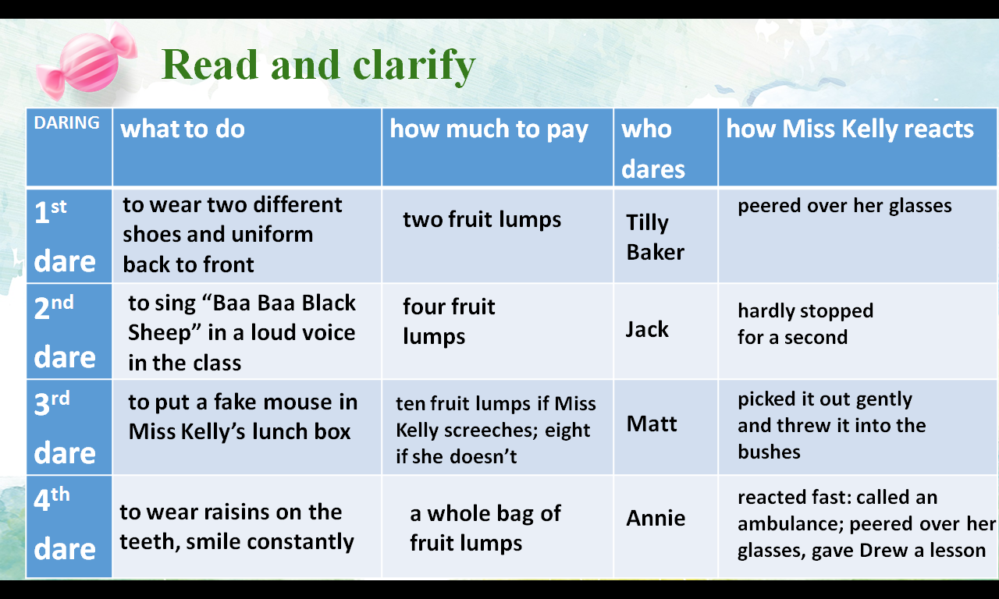
Think and share
Retell the story with the help of the key words
Introduction: ridiculous, crazy dares

Slide 7
Reading circle
Twenty years later, the students have a reunion. They talk about what happened in school days.
Miss Kelly (Character Captain)
Drew ( Creative Connector)
Tilly/Jack/Matt/Annie (Moral Master)
Another student from the class (Cultural Collector)

Slide 8
Reading circle
Miss Kelly (Character Captain)
Drew ( Creative Connector)
Tilly/Jack/Matt/Annie (Moral Master)
Another student from the class (Cultural Collector)

Slide 9
Voice your opinion
1. What do you learn from the story Daring ?
2. What would you do if you were dared to do something, rewarded or unrewarded?
3. If you do not want to do the things on a dare, how would you refuse it?

Slide 10
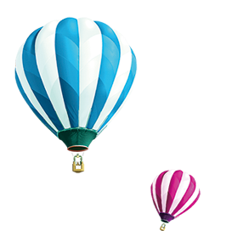
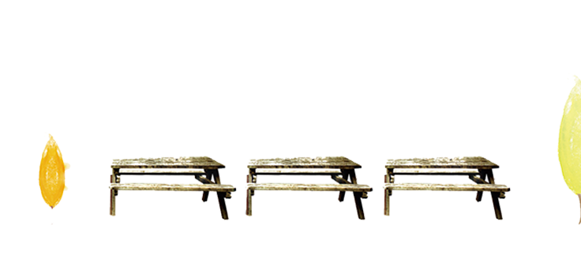
Thank you!

