Slide 1
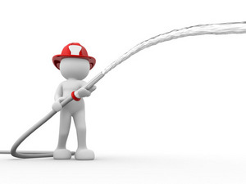
Strange Call Outs
奇特的救援任务
选自《多维阅读第17级》

Slide 2
Observe the cover

Slide 3
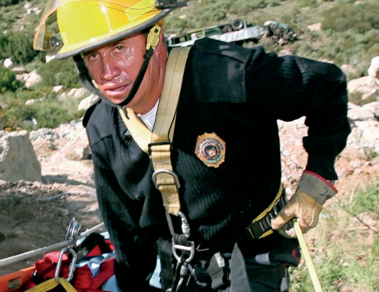
What is the role of the firefighter?
fight fire
Rescue people or animals
decide quickly
how serious the situation is
what equipment might be needed

Slide 4
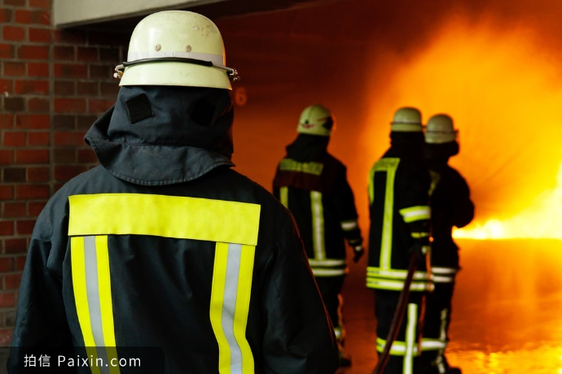
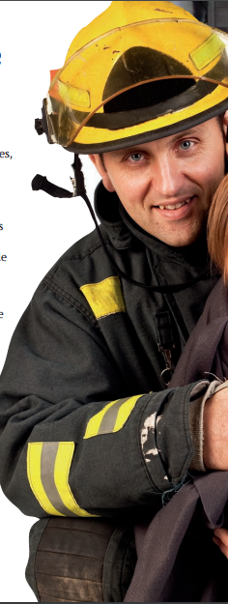
Which
Who
Strange Call Outs
Why
Human Beings
Why
Animals
Cost
Cost

Slide 5
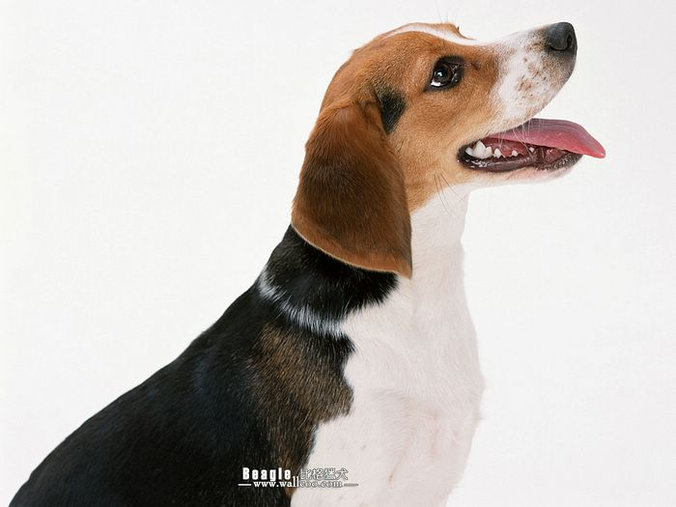
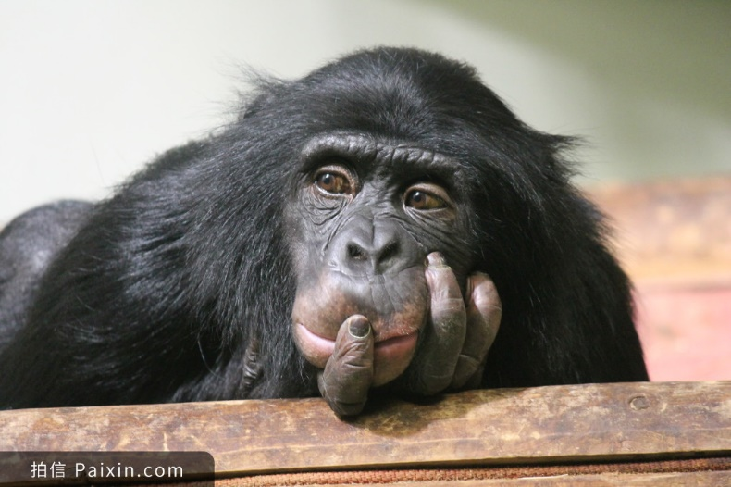
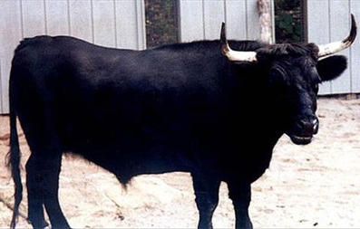
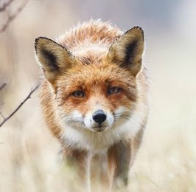
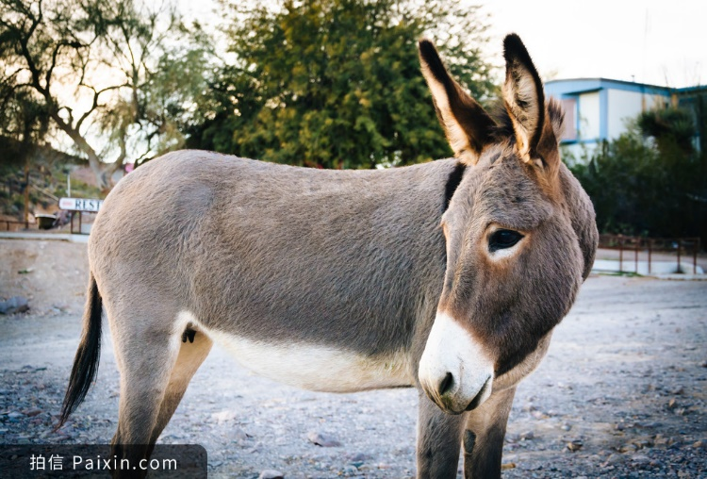
Animals
be trapped in
be stuck in
up a chimney
It takes many firefighters several hours
be stuck in
fall into

Slide 6
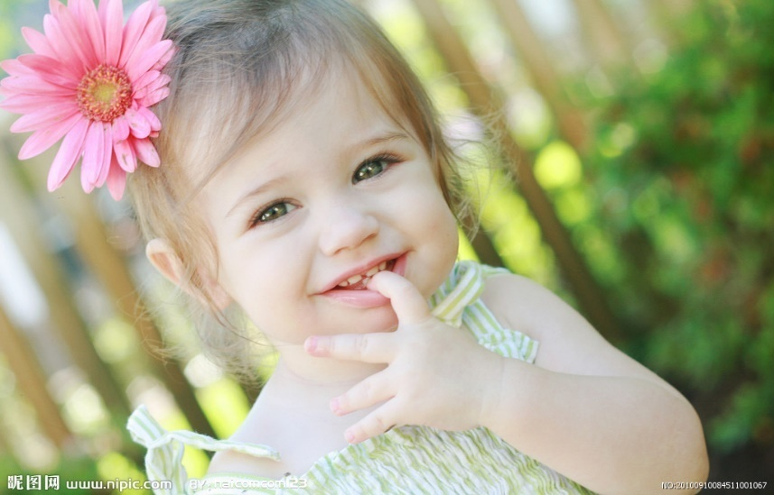
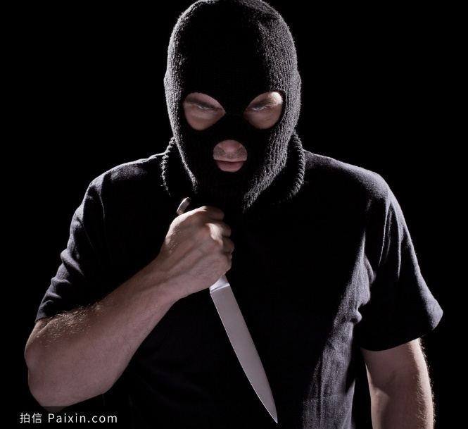
Human Beings
The firefighters had to remove part of the ceiling and cut open the vent.
It not only takes time but cost a lot to make these rescues.
crawl into
head (be) stuck...
leg wedged under...
finger stuck in...
arm in...
climb inside
become wedged
become trapped

Slide 7
I’m a firefighter. I’m often called to fight fires when we receive the emergency call. But sometimes I also need to rescue people or animals that are trapped.
Once I saved...
It/He/She was trapped...
I spent...
firefighter

Slide 8
Evaluation Worksheet(10’)
Correct(3’) | Coherent(3’) | Consistent(4’)

Slide 9
Do you think it’s firefighters’ job to rescue people or animals?

Slide 10
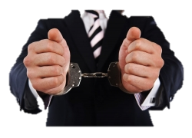
Debate
Is it proper for the firefighter to save the wrongdoer?
Save?
Agree or disagree?
Please explain with at least one argument(论据） from the passage.

Slide 11
Rename the firefighters
?
firefighter

Slide 12
Homework
“Have you ever made a hoax call? What do you think of it?
Please write a short passage in no less than 50 words. At least two pieces of arguments/examples should be given in it.

Slide 13
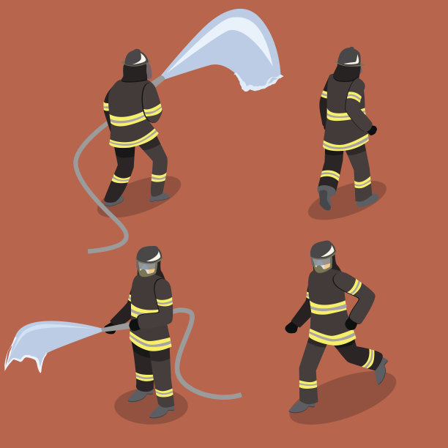
Thank
you!

