Slide 1
Living in Two Worlds
贝拉的生日派对
选自《多维阅读第17级》

Slide 2
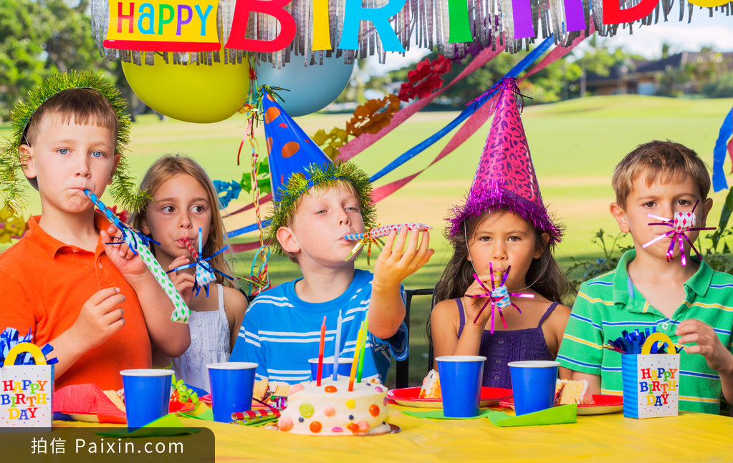
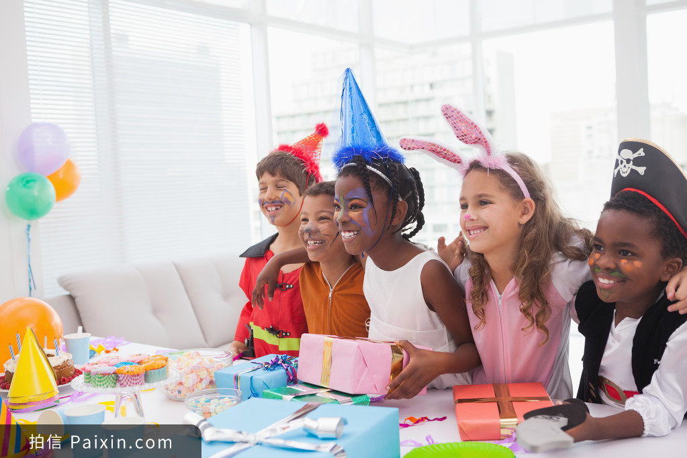
Notes:
老师通过家庭生活，生日派对导入，引起学生兴趣。
提问建议：
1.What are they doing in the picture?
2.Who ever had a birthday party?
3.Do you want to have one?
4.What if your parents or grandparents say no?

Slide 3
Observe the cover

Slide 4
Read and think
1. What did Bella want for her birthday?
2. Did her grandmother agree? Why?
3. Why did Bella’s grandmother decide to change at last?

Slide 5
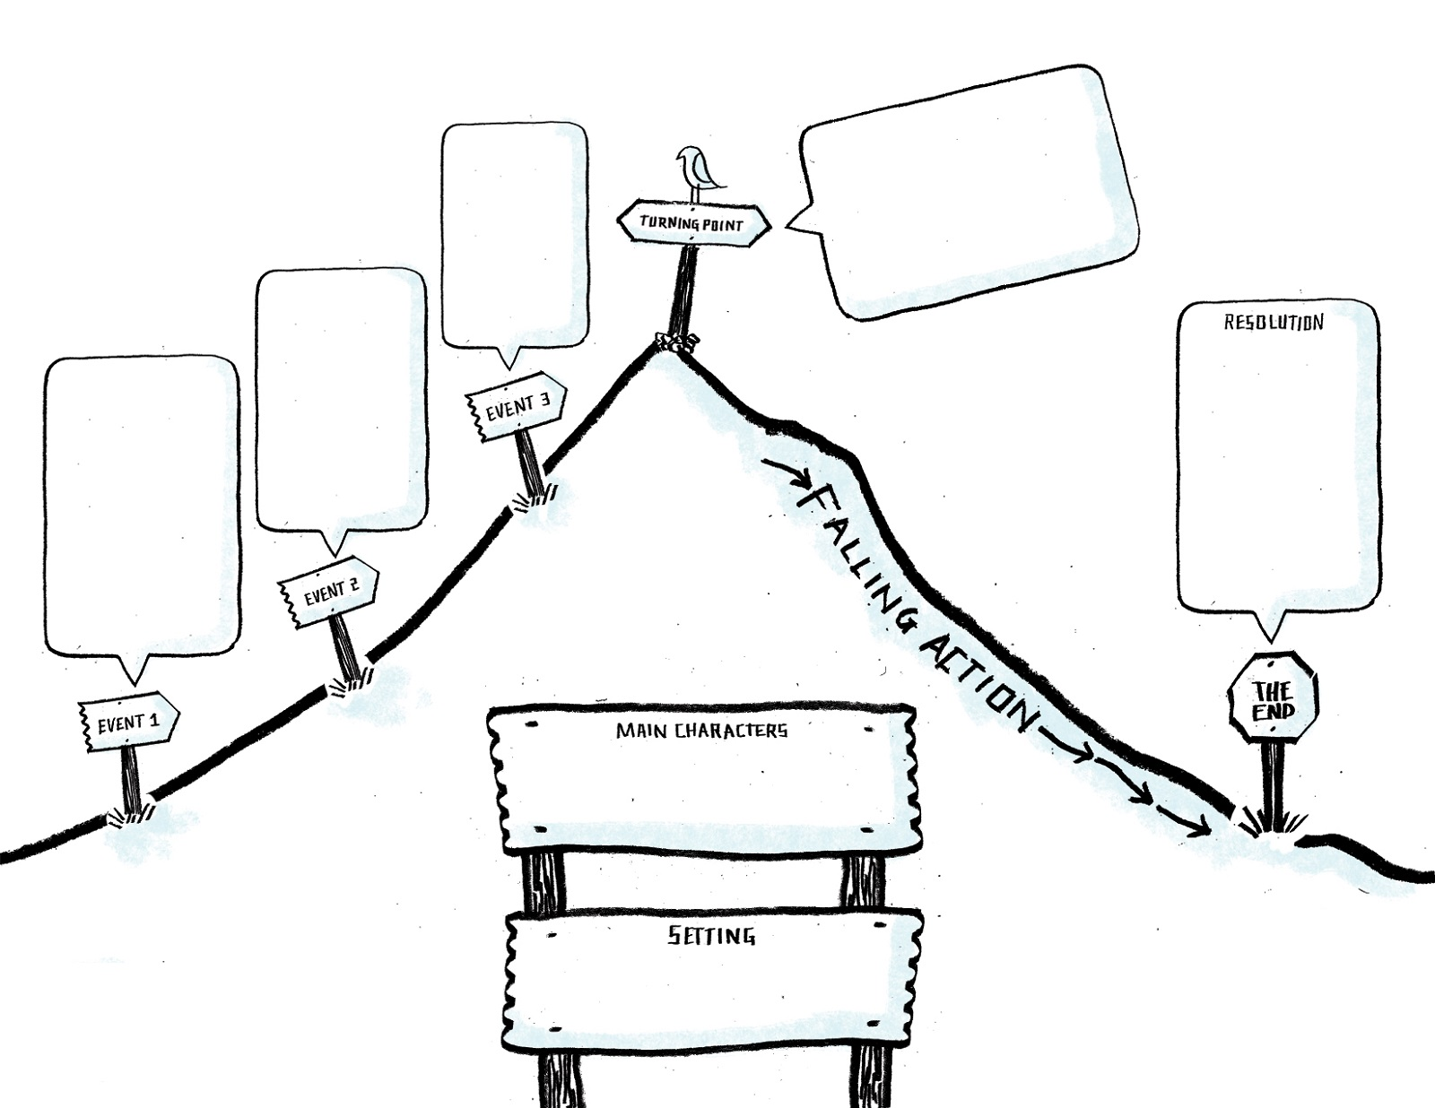
Turning point: a time at which an important change happens
Living in Two Worlds

Slide 6
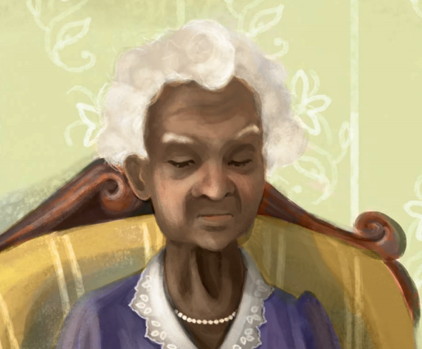
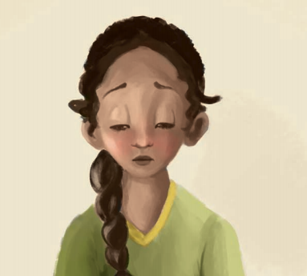
Compare and Contrast
Which character do you like? Give your reasons.

Slide 7
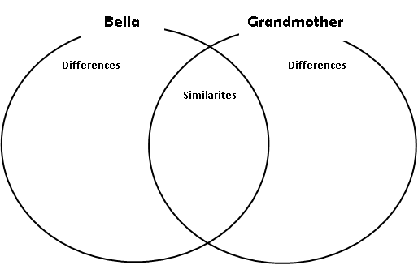
Do Bella and grandmother have any similarities?

Slide 8
Connect with your own life
1. Do you have any disagreements with your parents or your grandparents? How do you solve them?
2. Do you share any similar experiences with Bella? Is there something that you really want but your parents don’t agree on? How do you deal with it?
3. What do you think is the most important thing in getting along with your families?

Slide 9
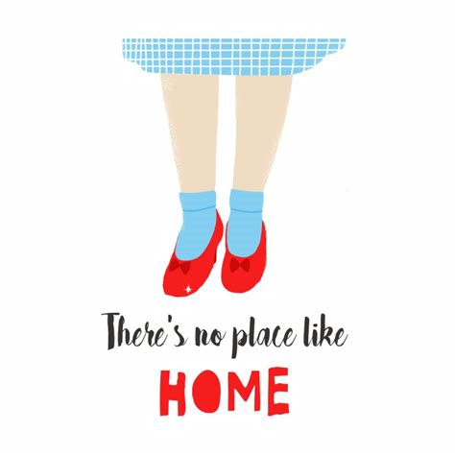

Slide 10
Homework
Choose 1 from the 2 tasks below
Write a diary entry about Bella’s birthday using first person perspective.
In the story, Mr. Barlow’s call to grandmother has changed her idea about throwing Bella a birthday party. Imagine what they say over the phone and write a call log recording their conversation.

Slide 11
Thank you!

