Slide 1
Facing the future
冰冷的未来
多维阅读第16级

Slide 2
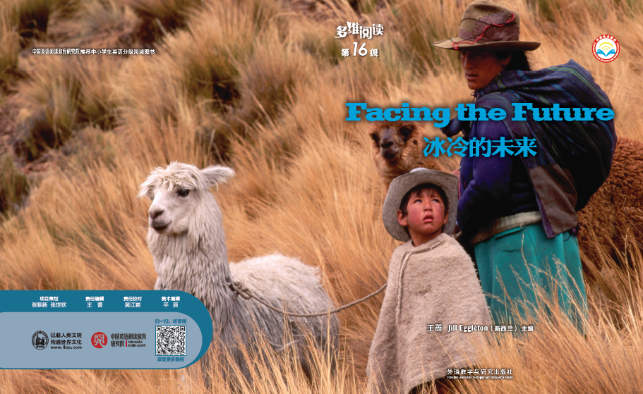
Facing the Future

Slide 3
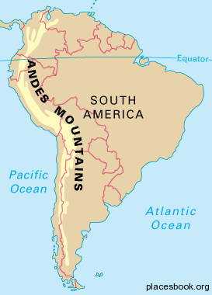
Pre-reading
What’s the climate in the Andes Mountains? Please share what you found out before the class.
Which part of the mountain might it be located in?

Slide 4
Who can you see from the picture? What do they look like?
Can you guess what happened to them? What future are they facing?
alpaca
/æl'pækə/

Slide 5
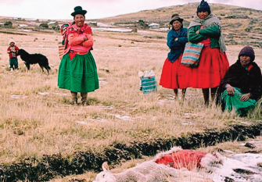
While-reading
Who lives in this place in the Andes Mountains?

Slide 6

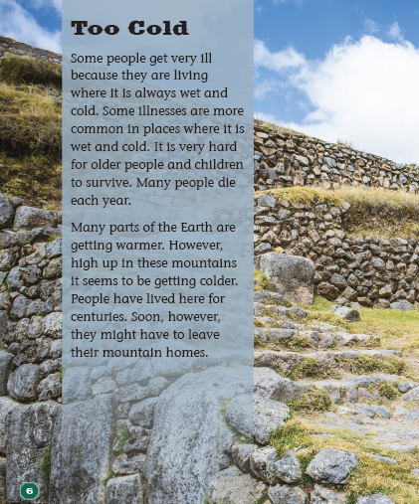
Facing the _________ Future

Slide 7
Facing the _____ Future
they might have to leave their mountain homes
they might have to make changes

Slide 8
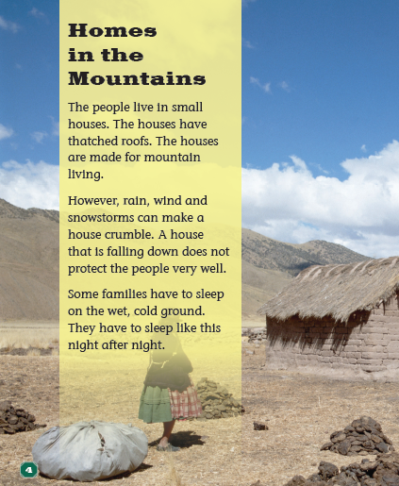
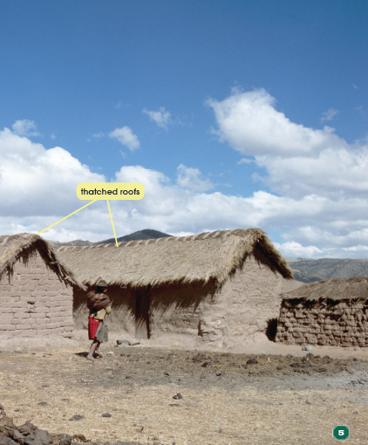
1. Why would they “have to leave their mountain homes”? What problems do they face?

Slide 9
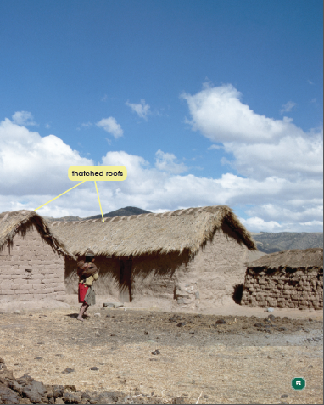
vocabulary
thatched roofs
/θætʃt/
/'krʌmbl/
However, rain, wind and snowstorms can make a house crumble. A house that is falling down does not protect people very well.

Slide 10
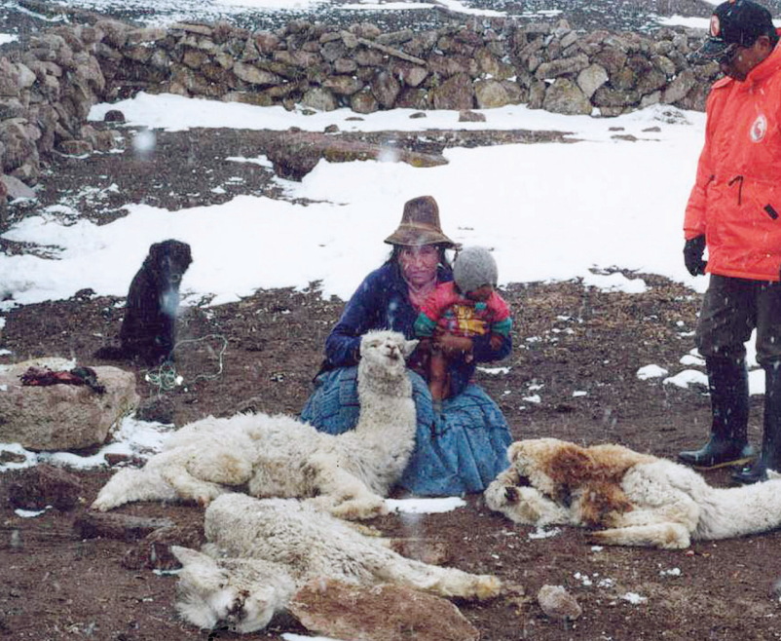
2. Why would they “have to make changes” if they want to keep living in the mountains? How does the author explain this point?

Slide 11
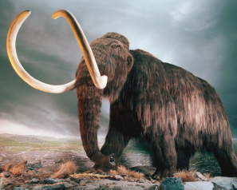
vocabulary
In the Ice Age there were many animals that don’t live today… As the Earth began to get warmer again, many of these animals became extinct. Some scientists think the animals were used to living in the cold and they couldn’t change.
/ɪk'stɪŋkt/
Some ancient animals like the woolly mammoth could survive when it was very cold.
/sɚ'vaɪv/

Slide 12
3. What methods does the author use to explain why these people have to “leave” or “make changes” in the future? Is the explanation clear and logical? What do you think?
Some families have to sleep on the wet, cold ground. They have to sleep like this night after night.
Some people get very ill because they are living where it is always wet and cold.
Many people die each year.
list facts

Slide 13
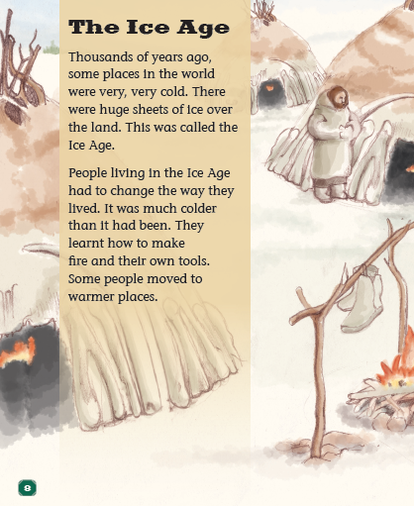
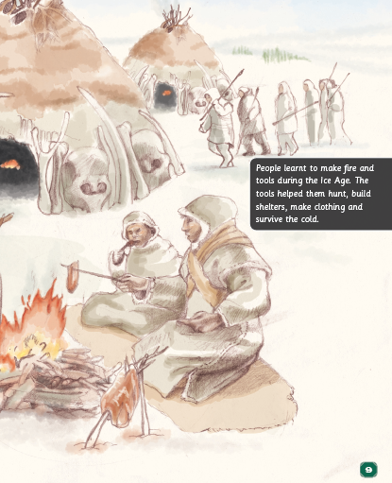
3. What methods does the author use to explain why these people have to “leave” or “make changes” in the future? Is the explanation clear and logical? What do you think?
make an example

Slide 14
3. What methods does the author use to explain why these people have to “leave” or “make changes” in the future? Is the explanation clear and logical? What do you think?
People living in the Ice Age had to change the way they lived. It was much colder than it had been. They learnt how to make fire and their own tools.
make contrast
As the Earth began to get warmer again, many of these animals became extinct. Some scientists think the animals were used to living in the cold and they couldn’t change.

Slide 15
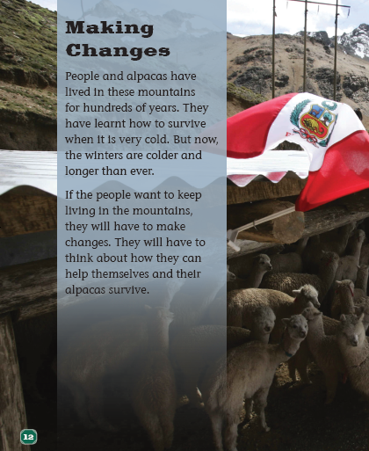
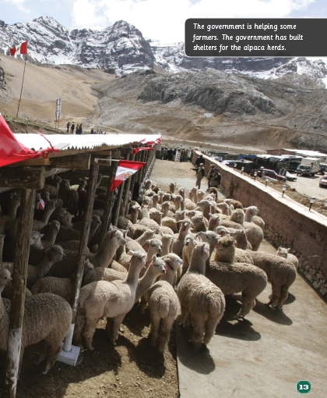
4. What changes do people make to face the future?

Slide 16
Facing the _____ Future
Please add more details and complete the mind map for the whole book.
they might have to leave their mountain homes
they might have to make changes
…
…
…
…

Slide 17
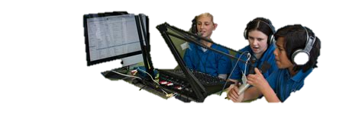
School Radio
Post-reading
Make an English program for the school radio station to introduce what you learned in this book.
One student plays the role of the host and the other students are the guests.
The host needs to ask the guests at least 7 questions. One of them should be an open question.

Slide 18
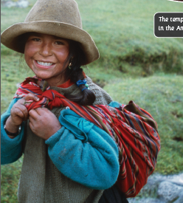
Discussion
Why do you think people live in such a cold place? Do you think they want to leave their mountain homes? Why do you think so?
What changes do you think the people might have to make if they don’t want to leave their mountain homes? Do you have some good advice for them?
Why does the author write the book?
Climate change is a global issue these days. How should we face it? What can we do?

Slide 19
Homework
Make a presentation about the climate change in one place, including the environment, the changes people have to face and how to deal with them.
Do you still have some questions after reading this book? Please find out the answers by asking teachers or searching on the Internet.

