Slide 1
The Gigantoraptor 巨盗龙
多维阅读第16级

Slide 2
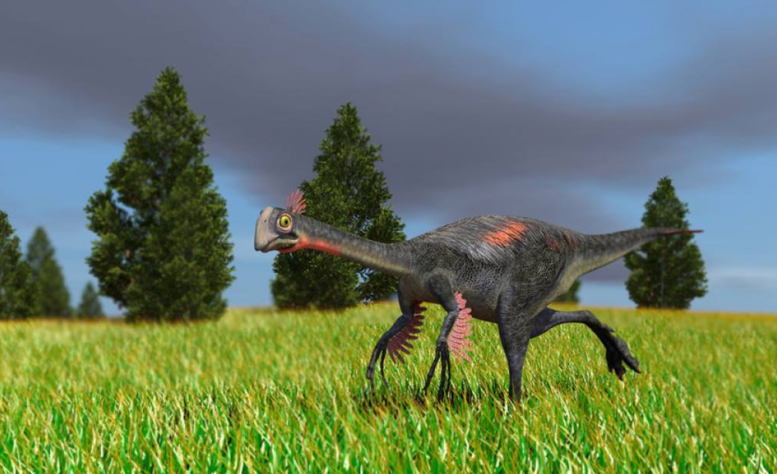
The Gigantoraptor

Slide 3
Preview
Jurassic Period(侏罗纪)
Cretaceous Period(白垩纪)

Slide 4
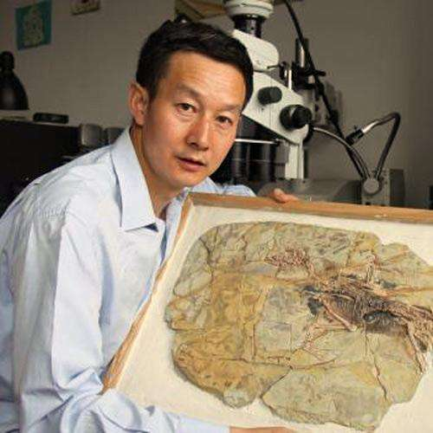
The scientist Xu Xing

Slide 5
1. Read and answer
An Amazing Find
1. What did Xu Xing find one day?
2. When did the Gigantoraptor live? What did it look like?
3. What strength did the Gigantoraptor probably have compared with other dinosaurs?

Slide 6
Other Huge Birds
1. What kinds of huge birds have been found? What did they look like?
2. What was the use of their huge beaks?
Big — Good or Not So Good?
What are the scientists’ opinions about being big?
What next?
How did the scientist feel about the discovery of the Gigantoraptor? Why?

Slide 7
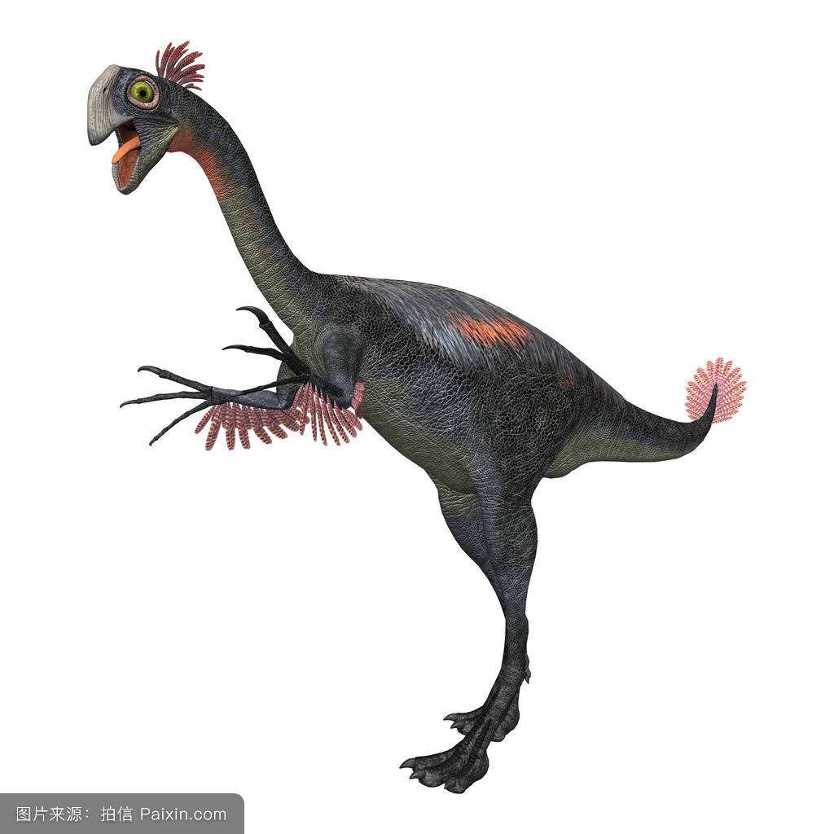
The Gigantoraptor and its skeleton

Slide 8
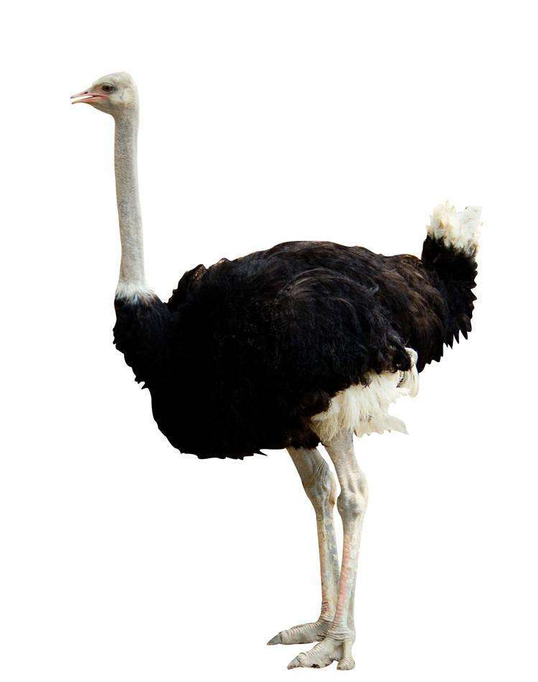
Gigantoraptor vs Ostrich

Slide 9
model

Slide 10
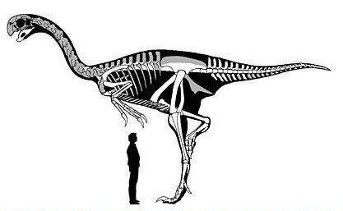
A Huge Animal

Slide 11
feathered

Slide 12
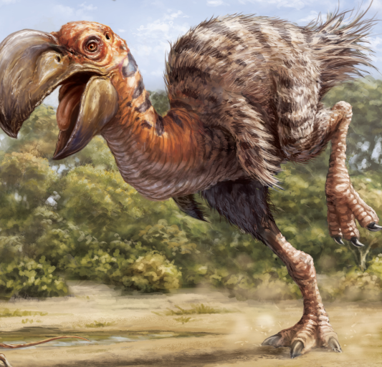
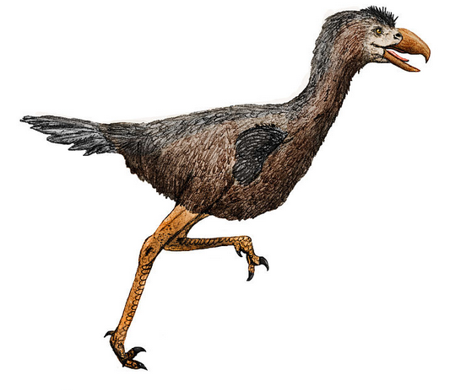
Stirton’s Thunderbird
Terror Bird

Slide 13
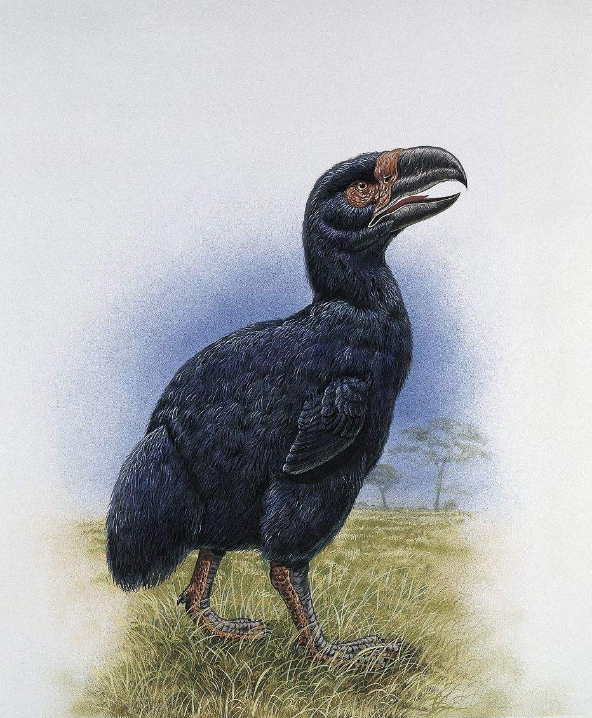
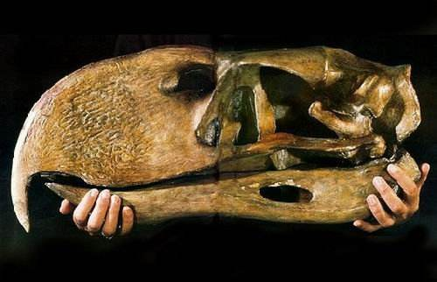
Terror bird and its skull

Slide 14
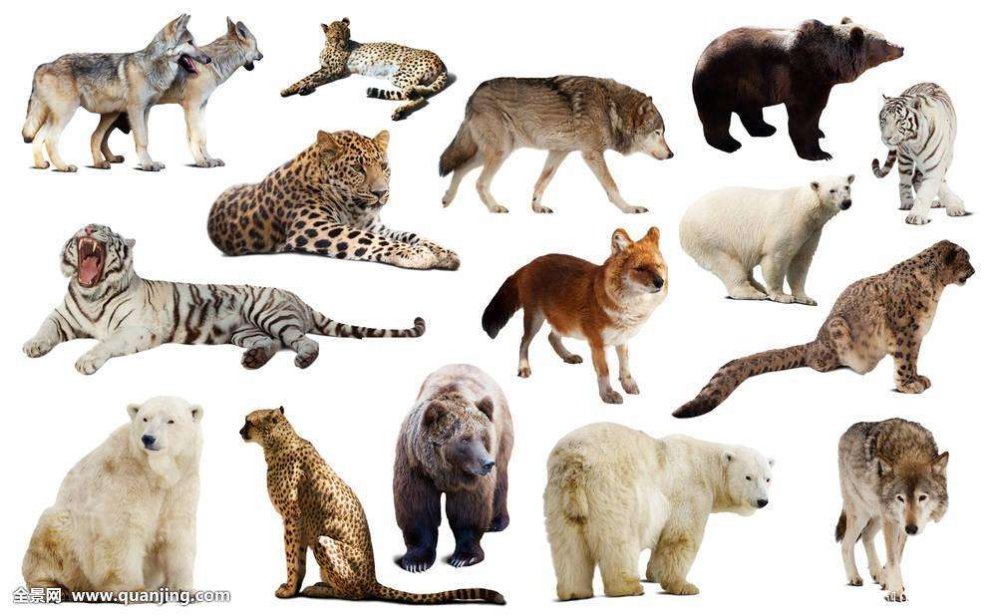
predator: an animal that hunts, kills or eats other animals to survive

Slide 15
examine: study something carefully

Slide 16
2. Mind map (1)

Slide 17
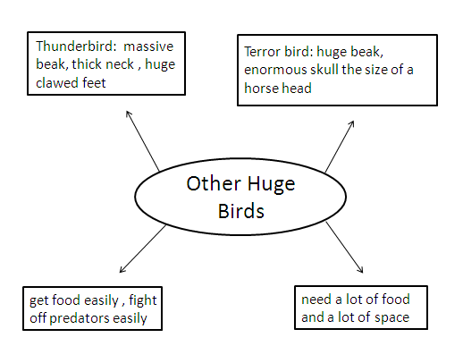
2. Mind map (2)

Slide 18
3. Debate
Affirmative:
The Gigantoraptor was very big. That was very good.
Negative:
The Gigantoraptor was very big. That was not so good.

Slide 19
4. Discussion
1. Why do scientists keep looking for animals that have never been seen before?
2. Can you imagine a new bird-like dinosaur? What may it look like?
3. How important is it to study ancient animals? Do you want to become a scientist in this field? Why or why not?
4. Why does the author write the book?

Slide 20
5. Homework
1. Design a poster to introduce the bird-like dinosaurs by referring to the handout.
2. Work in groups to know more about the bird-like dinosaurs by searching the Internet, and think about the relations between the bird-like dinosaurs and birds today.

