Slide 1
Giant Holes 各种各样的巨坑
多维阅读第16级

Slide 2
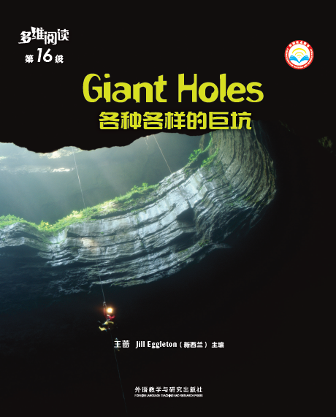
Giant Holes
Activity 1
1. What can you see from the cover?
2. What’s the title and what do you think the meaning of the title is?

Slide 3
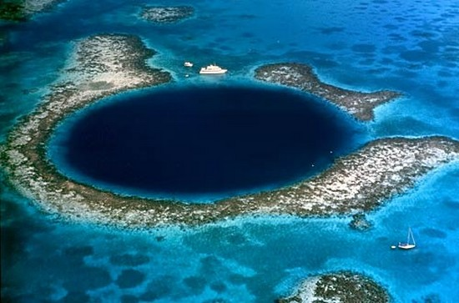
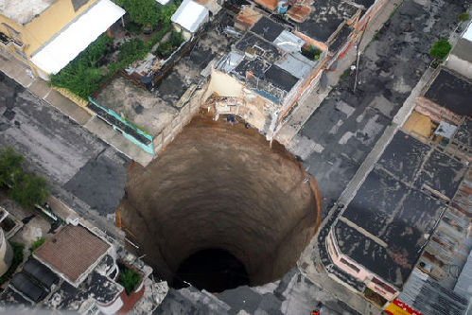
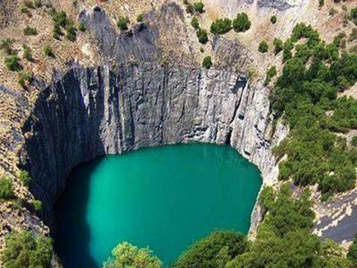
3. What have you known about giant holes?

Slide 4
Activity 2
Finish the following diagram about sinkholes according to the information you collect from the book.
Basic information about sinkholes:
Effects:
Causes:

Slide 5
Basic information about sinkholes
1. What are sinkholes?
2. Where can sinkholes be found?
3. What are sinkholes like?

Slide 6
Basic information about sinkholes

Slide 7
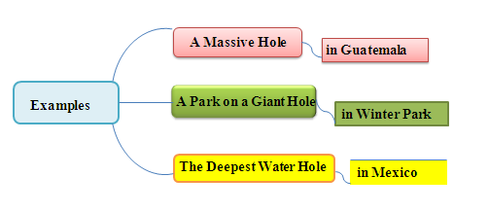
Notable (著名的) examples
What notable examples of sinkholes can be found in the book?

Slide 8
Causes of sinkholes
What causes sinkholes to form?

Slide 9
Effects caused by sinkholes
What effects are often caused by sinkholes?

Slide 10
Activity 3 Group Discussion
1. What human activities can cause sinkholes?
2. What effects have human activities had on sinkholes?
3. If sinkholes happen in places where many people live, what will happen?
4. How can people use sinkholes?
5. What do you think of the saying “sinkholes mean bad things are coming”?

Slide 11
Reflection
1. What do you think of sinkholes?
2. What should we do to avoid sinkholes?
3. If a sinkhole happened in your area, what would you do?

Slide 12
Assignments
1. Group work: Make a poster about sinkholes, including its characteristics, causes and effects.
2. Group work: Surf the Internet for sinkholes in China and write down their causes and effects.

