Slide 1
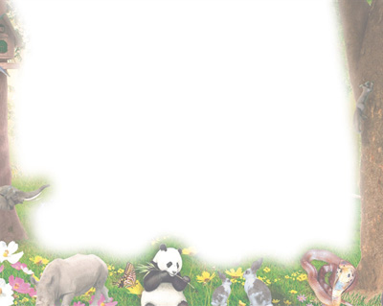
多维阅读第16级
Melting Ice
消融的冰川

Slide 2
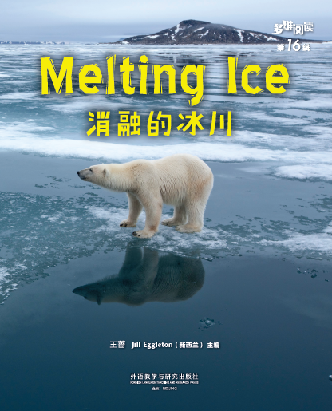
What’s the animal in the picture?

Slide 3
What does a polar bear look like?
Where does it live? What does it eat?
What else do you know about the animal?

Slide 4
What does the title mean?
Why does sea ice melt?
Can you guess what might happen to the polar bear when ice melts?

Slide 5
Reading Time
What can you learn about the polar bear?

Slide 6
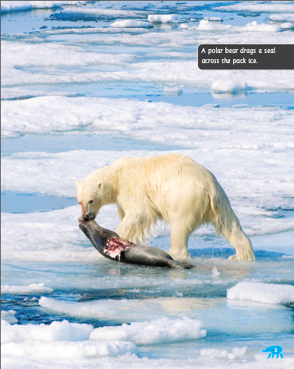
What does a polar bear hunt for food?
How does the fat in a polar bear’s body help it?

Slide 7
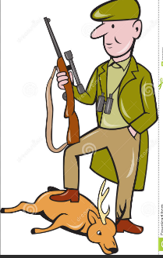
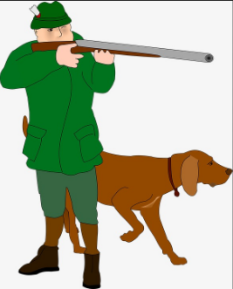
hunt

Slide 8
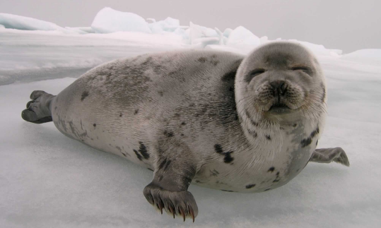
seal

Slide 9
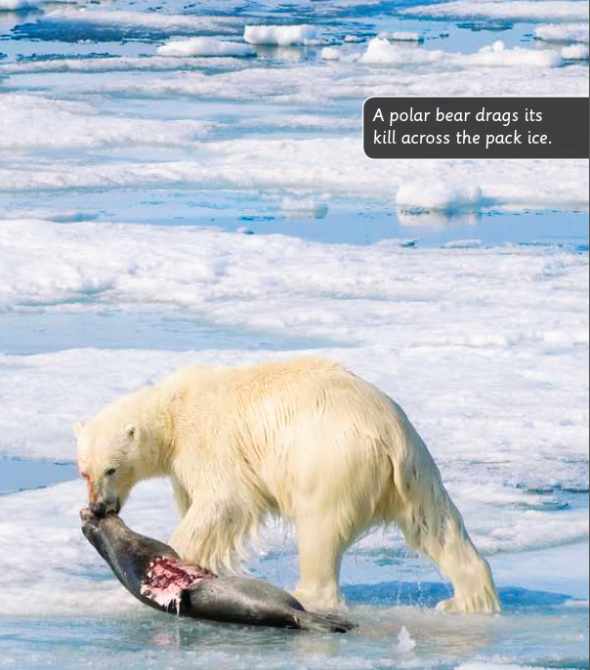
Why are polar bears starving?
What might happen to the cubs of a hungry mother bear?
Why is the sea ice melting earlier than before now?

Slide 10
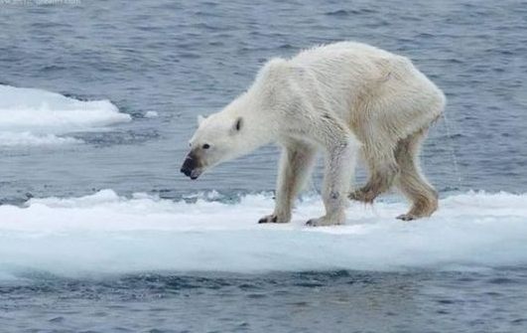
starving

Slide 11
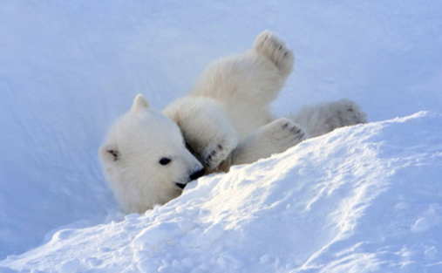
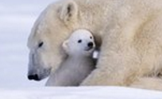
cub

Slide 12
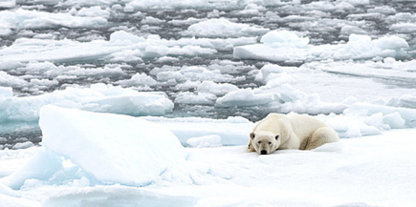
survive
to stay alive

Slide 13
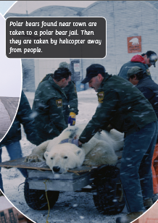
What do polar bears do in towns?
How does it affect human life?
How do humans deal with visiting polar bears?

Slide 14
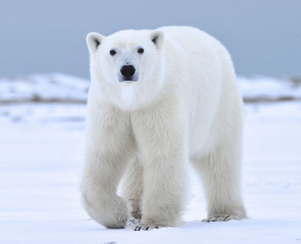
wander
to stray from one place to another

Slide 15
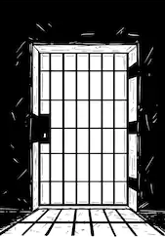
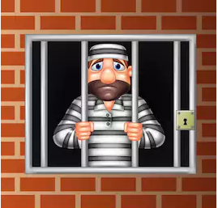
jail

Slide 16
Do you think a jail for polar bears is a good idea?
Why or why not?

Slide 17
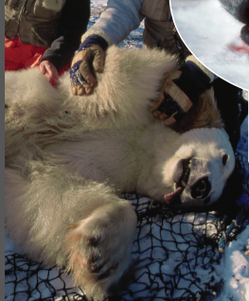
How do scientists get close to polar bears and do tests on them?
What tests do scientists do on polar bears?
Why do scientists do these tests?

Slide 18
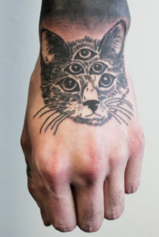
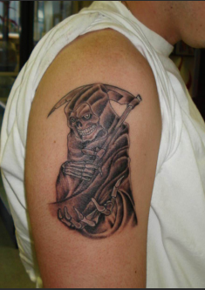
tattoo

Slide 19
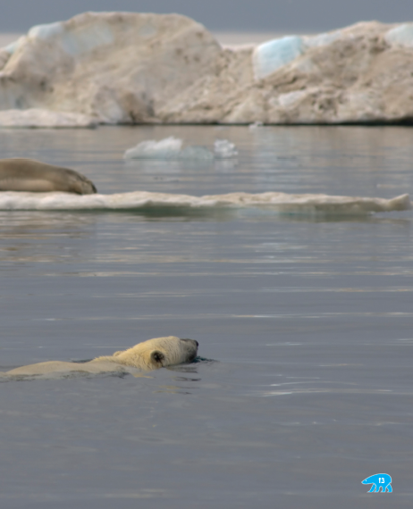
What might happen if the sea ice keeps melting?
Why do polar bears have an important place in the world?
What might cause the sea ice to melt faster? What can we do to stop it?

Slide 20
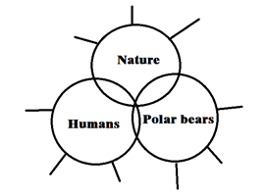
List the important facts you have learned so far. Share with your partner.

Slide 21
Reading Time
Causes or effects?

Slide 22
Pairwork
What are the relationships between
these events?
Learning tips:
Draw a mind map to show the relationships of the important events.

Slide 23
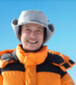
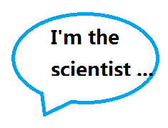
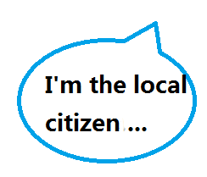
Role Play — Talk about polar bears’ situation, human behaviors and the relationship between them.

Slide 24
Discussion
1. Why does the author write the book?
2. How do you think of the relationships between humans, nature and animals?
3. Why is it important to protect nature and animals?

Slide 25
Further Study
Option One: Work in groups of four to make a poster introducing an endangered animal.
Option Two: Search for the reasons for ice melting and think about possible solutions.
Learning tips:
Choose one task. Finish it with the help of what you have learnt from the book and the information you can get from the Internet or the library.

