Slide 1
As Good as New — Almost 完好如初
多维阅读第16级

Slide 2
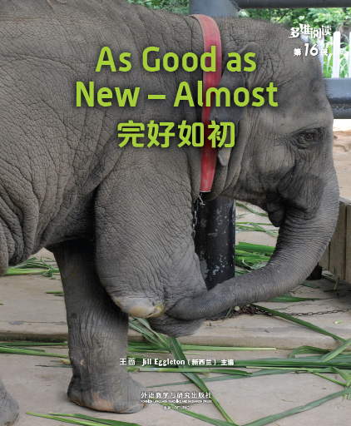
1. What’s the animal in the picture?
As Good as New — Almost
2. Is it the same as the elephant you have seen? Why?
3. What can people do to help it?
4. What idea does the title of the book make you think of?

Slide 3
What do you think the book is about?
封面和封底图片
Read and check your predictions.

Slide 4
Read PP 2-5 and answer the questions.
1. What was wrong with Nadya?
2. How did Nadya come out with the idea of
making a mermaid’s tail?
3. How was the mermaid’s tail made?

Slide 5
Read PP 2-5 and answer the questions.
1. What was wrong with Nadya?
Her legs were amputated.
(of a limb) taken off

Slide 6
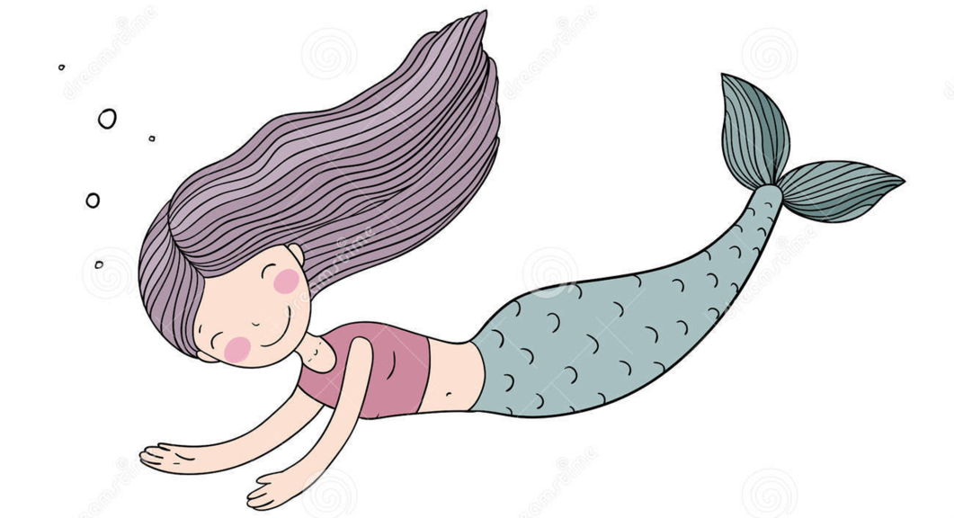
Read PP 2-5 and answer the questions.
2. How did Nadya come out with the idea of
making a mermaid’s tail?
A small boy asked her why she didn’t have any legs.
Nadya told him that she was a mermaid.
The answer gave her the idea.

Slide 7
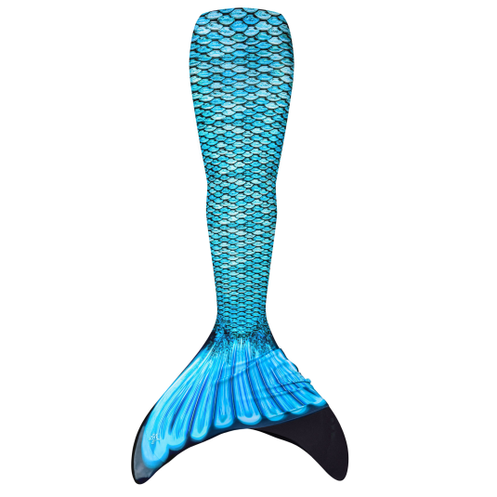
Read PP 2-5 and answer the questions.
3. How was the mermaid’s tail made?
Weta Workshop makes creatures for movies.
It made a spine and tail fin.
It made the skin of the tail from wetsuit material and printed scales on the outside.
a long bone down the centre of the back

Slide 8
Read PP 2-9 and complete the form.
 | Nadya | Fuji | Beauty
What was made?
How was it made?
How was the life changed?

Slide 9
Read PP 2-9 and complete the form.
 | Nadya | Fuji | Beauty
What was made?
How was it made?
How was the life changed?
A mermaid’s tail.
A tail fin.
A beak.
Weta Workshop made a spine and tail fin. The skin of the tail was made from wetsuit material and then scales were printed.
A rubber tail fin was made at first, but it didn’t work. A strong and fast one worked at last.
First, a model of her beak was made. Then, the model was fitted onto Beauty’s beak. The model had to be sanded many times.
She can swim like a mermaid now.
Fuji can swim
and leap again.
She has the chance to live a long life.

Slide 10
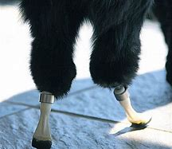
Read PP 10-13 and answer the questions.
1. How did the doctor attach the artificial paws to Oscar’s legs? Was the operation successful?
(What does “attach” mean?)
made by human beings rather than nature
2. Why do you think this operation is good for people who have lost body parts?

Slide 11
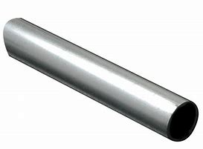
Read PP 10-13 and answer the questions.
1. How did the doctor attach the artificial paws to Oscar’s legs? Was the operation successful?
drilled holes into Oscar’s legs
put metal rods into the bones
Oscar’s operation was a success.
(What does “bone” mean?)
metal rod

Slide 12
The new idea helps make a seal. And it helps to stop infection from getting in. People and animals now can have artificial body parts that are almost as good as new.
Read PP 10-13 and answer the questions.
2. Why do you think this operation is good for people who have lost body parts?
a disease that is caused by
bacteria
something that keeps air, water, dirt etc out of something

Slide 13
Complete the mind map with the information about artificial body parts.
Artificial body parts

Slide 14
Give a short speech on artificial body parts with the title As Good as New — Almost. You can choose one role:
A scientist who works on artificial body parts.
A person or an animal that has artificial body parts, like Nadya, Fuji, Beauty or Oscar.

Slide 15
an artificial body part that is designed to replace a real body part
Discuss and share your ideas.
1. Why is the book titled As Good as New —Almost?
2. What else do you want to know about the bionic technology?
3. What do you think the artificial body parts will be like in the future?

Slide 16
Homework
1. Find answers to the questions about the bionic technology that your classmates raised in class. Add information to your mind map of the artificial body parts.
2. Search for more stories about the use of bionic technology and share with your classmates.

